Slide 1
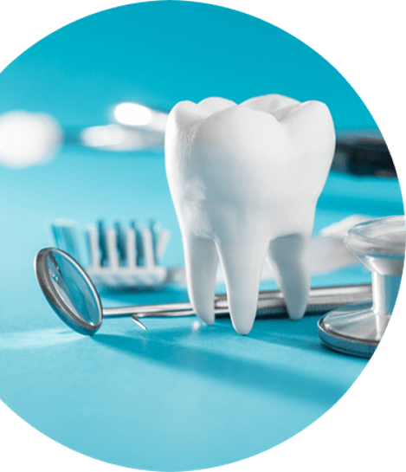
Virtual Patient Simulator for Skill Training in Dentistry
Group 16 :
E/16/086 Virajani Dharmathilaka
E/16/156 Tharushini Jayathilaka
E/16/223 Chanika Madushanki
Supervisors:
Prof. Roshan G. Ragel
Dr. Upul Jayasinghe
Dr. D Leuke Bandara

Slide 2

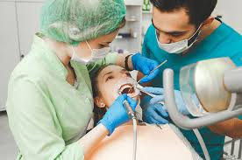
Background
DENTAL STUDENTS
VIRTUAL PATIENTS (VP)
Appropriate patient assessment for clinical disciplines.
Including proper
History taking
Examination
Decision on required investigations
Used for
Repetitive and deliberate practice
Record keeping & reproducibility, assessment

Slide 3

Problem
Need for,
Appropriate patient assessment
Proper clinical reasoning methods
Adequate training in problem based decision making
Lack of fair Assessment process
Less chances for a real time tutoring system
Less human resources

Slide 4

Solution
Virtual Patient Simulator
Assist the students using a virtual environment.
develop clinical reasoning and decision making skills
Virtual interface to practice patient assessment
following the main phases as in a real patient assessment.

Slide 5
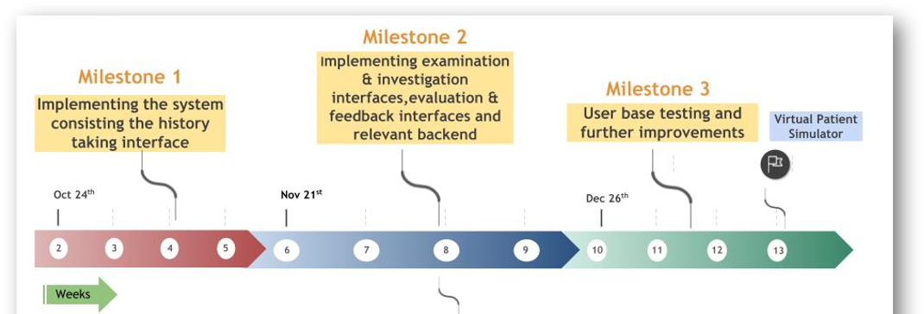

Milestones

Slide 6
Challenges
 | Challenge | Solution
Data Set | Multiple defects in a single x-ray | Multiple diagnosis selection choice for a student
 | Inability to provide single x-rays for each tooth | Provide x-ray for the specific tooth
Evaluation 1.History Taking phase | Categorize the questions as relevant/ irrelevant | feedback for question selecting order
 | No particular order in a section. | Consider Critical/Fatal Questions Not applicable (N/A) groups and questions

Slide 7
System Implementation

Slide 8
Study Design for Feedback Evaluation
Participants-Dental Undergraduates
Pre assessment questionnaire
Control Group
Intervention group
Clinical case in powerpoint questionnaire
Clinical case in VP
Post assessment questionnaire

Slide 9
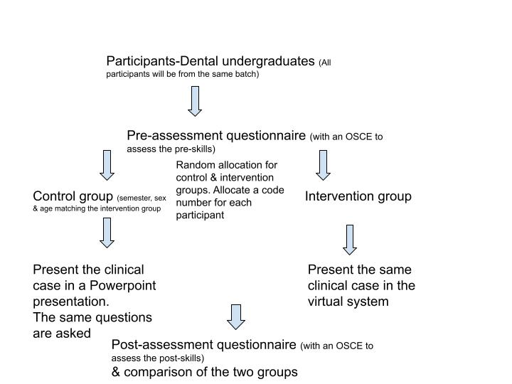

Slide 10
Results of the Feedback Evaluation
 |  | Mean | Standard Deviation
Pre questionnaire | Control | 44.64 | 9.896441807
 | VP | 44.21 | 13.77025356
Post questionnaire | Control | 58.93 | 9.64336588
 | VP | 58.95 | 11.85314625
 | P-value
Pre questionnaire | 0.818235
Post questionnaire | 0.666375

Slide 11
Results of the System Evaluation
System Evaluation
Concept | Mean
Authenticity of patient encounter and the consultation | 3.3125
Professional approach in the consultation | 3.50
Coaching during consultation | 3.857143
Overall judgment of case workup | 3.125

Slide 12
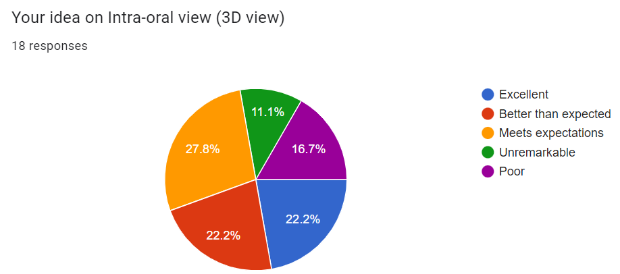
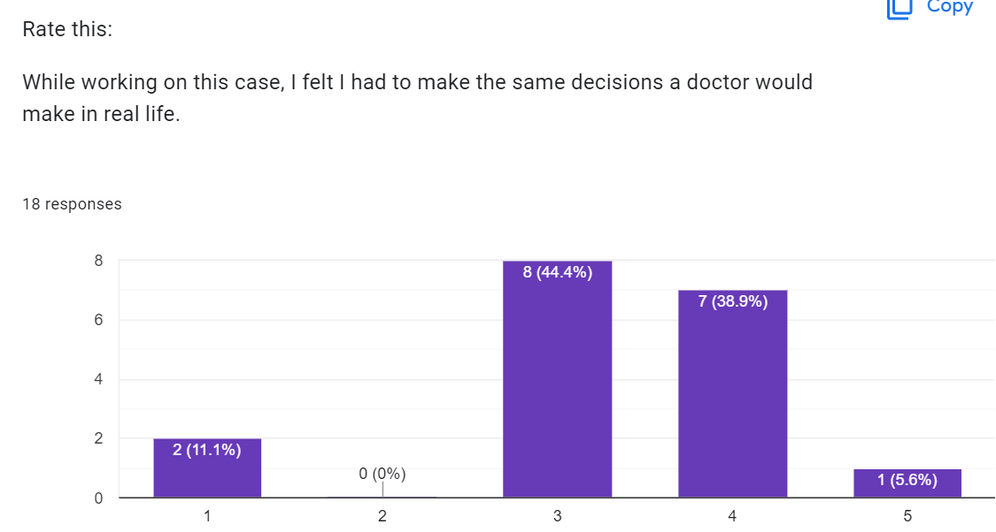
Results

Slide 13
Thank You!!

