Slide 1
Weather works
An application that calculates the average temperature and show detailed information of each days

Slide 2
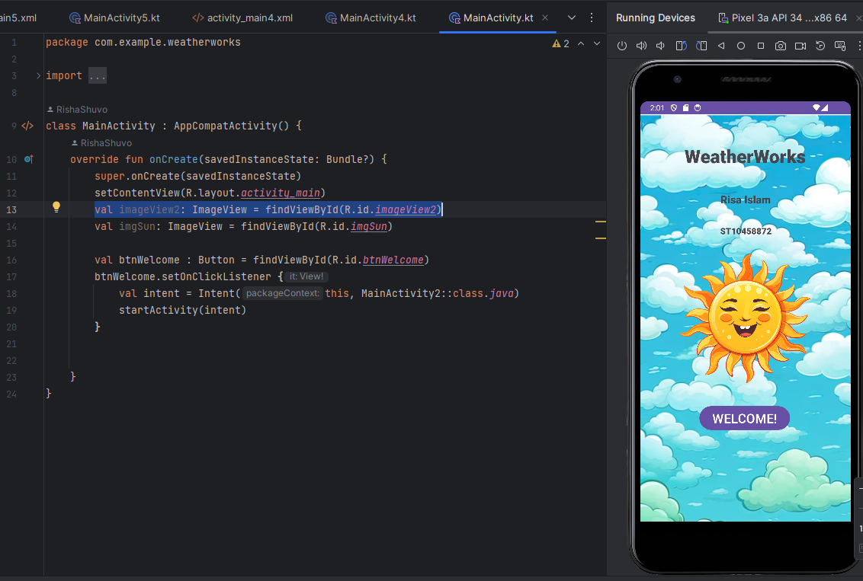
Splash screen

Slide 3
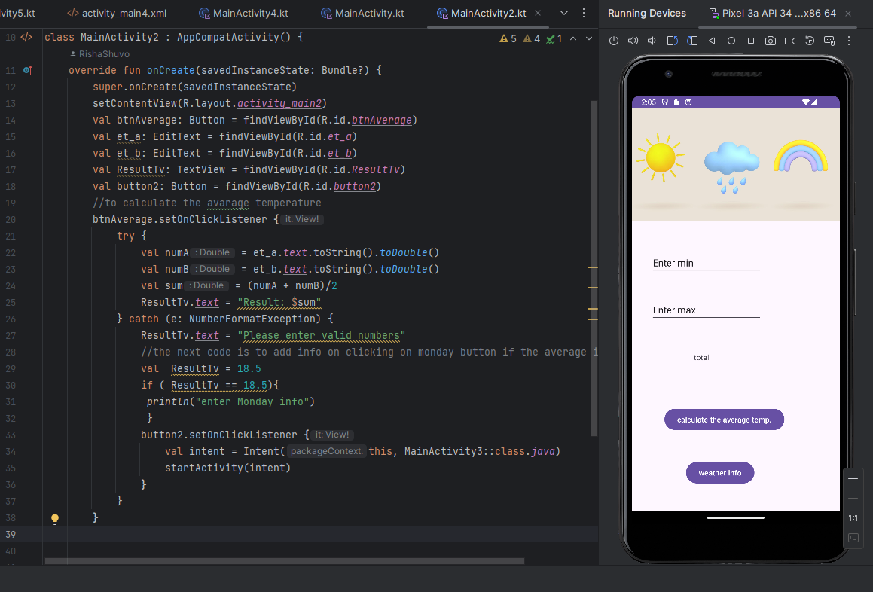
Main screen

Slide 4
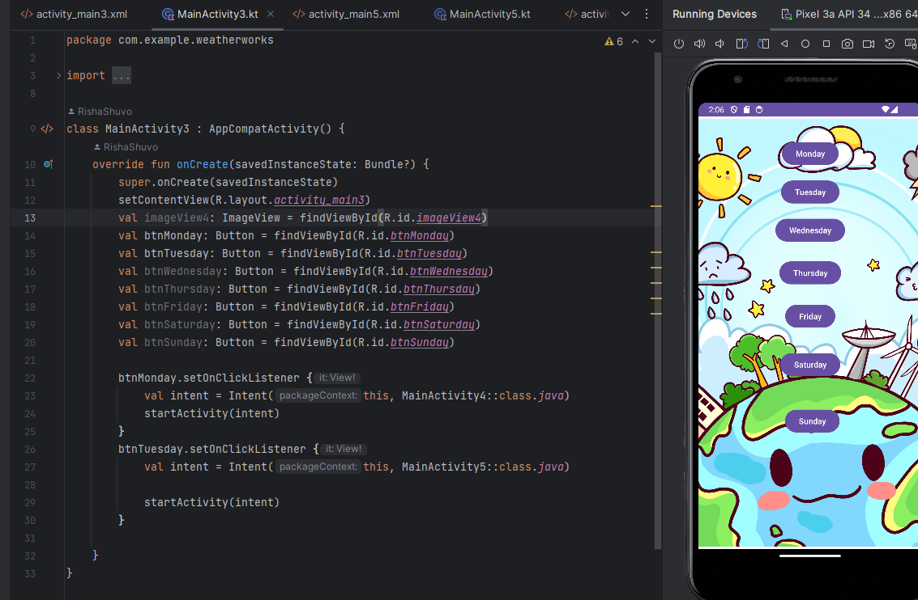
Third screen

Slide 5
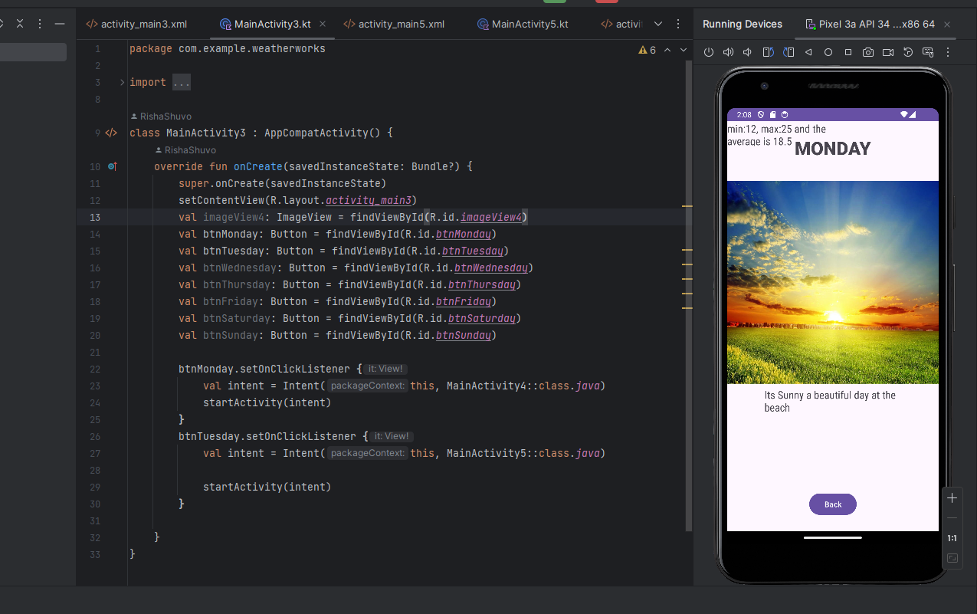
Final detailed screen

