Slide 1
Title: Applicant Screening System Using NLP
Group - 40 Section: 2, CSE431
Submitted by:
Md Rishat Sheakh ID:20301305
ST_RA: Farah Binta Haque Md Sabbir Hossain

Slide 2
Table of Contents
Introduction
Datasets and Results
1
5
2
Motivation
6
Limitations
3
Contribution
Future Work
7
4
Methodology & Experiment
8
Conclusion

Slide 3
Introduction
1

Slide 4
Introduction
"Applicant Screening System Using NLP" addresses modern recruitment challenges.
Leverages Natural Language Processing (NLP) for streamlined candidate selection.
Key features include resume-to-job-description comparison using cosine similarity.
Significantly departs from complex algorithms, opting for the simplicity and accuracy of NLP tools.

Slide 5
Motivation
2

Slide 6
Motivation
Dynamic Technological Landscape
Need for Efficient Human Resource Management
Struggles of Traditional Hiring
Exploration of Innovative Solutions

Slide 7
Contribution
3

Slide 8
Contribution
This paper proposes and develops an Applicant Screening System using Natural Language Processing (NLP).
Represents a transformative departure from traditional, time-consuming hiring methods.
Aims to automate the comparison of job descriptions and applicant resumes, ensuring efficiency.
Focuses on overcoming drawbacks of existing methodologies.
Utilizes NLP tools like NLTK and Spacy to enhance system capabilities.
Positions the proposed system as a significant advancement in applicant screening, promising increased efficiency, accuracy, and adaptability.

Slide 9
Methodology and Experiment
4

Slide 10
Methodology
Existing Method: Manual candidate eligibility assessment is time-consuming and impractical as the number of applications increases.
Proposed Method: Introduces Natural Language Processing (NLP) for automated resume-job description matching.
Working Model: User-friendly process involves uploading files, Spacy procedure, and cosine similarity calculation for efficient screening.
NLP Tools: Utilizes NLTK and Spacy to enhance capabilities, offering advanced tools like tokenization and part-of-speech tagging.

Slide 11
Dataset and Results
5

Slide 12
Dataset and Results
User details are stored in the "sql yog enterprise" database upon registration, enabling secure and efficient logins by fetching the necessary information during subsequent login attempts.
Experimental Results: New applicants register, upload documents, and receive a similarity percentage calculated by cosine similarity, setting a threshold above 70% for job suitability.

Slide 13
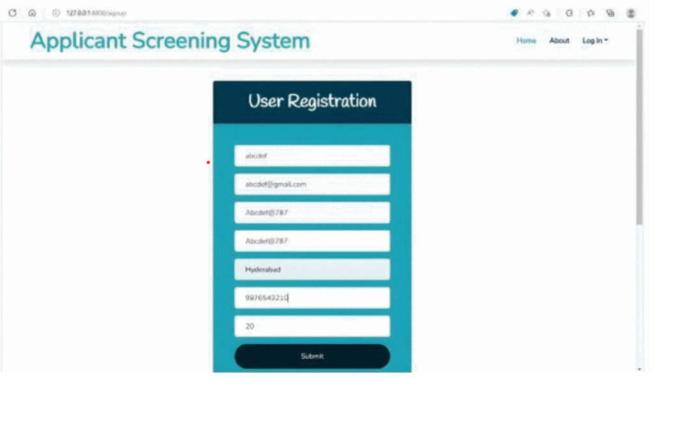
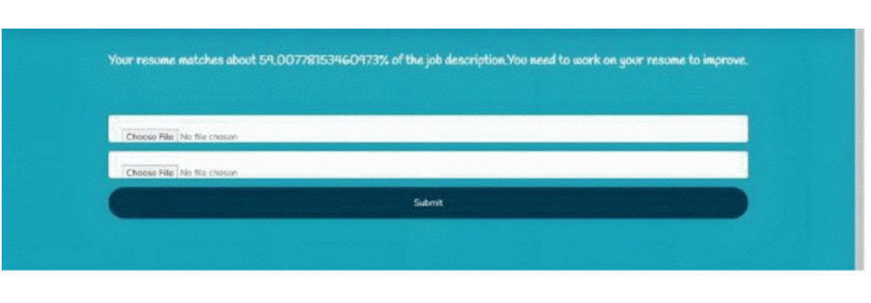
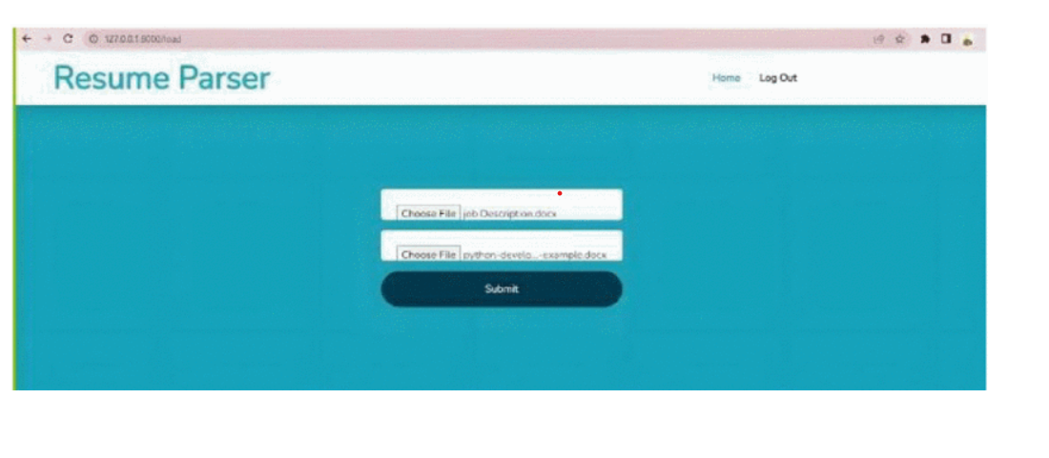
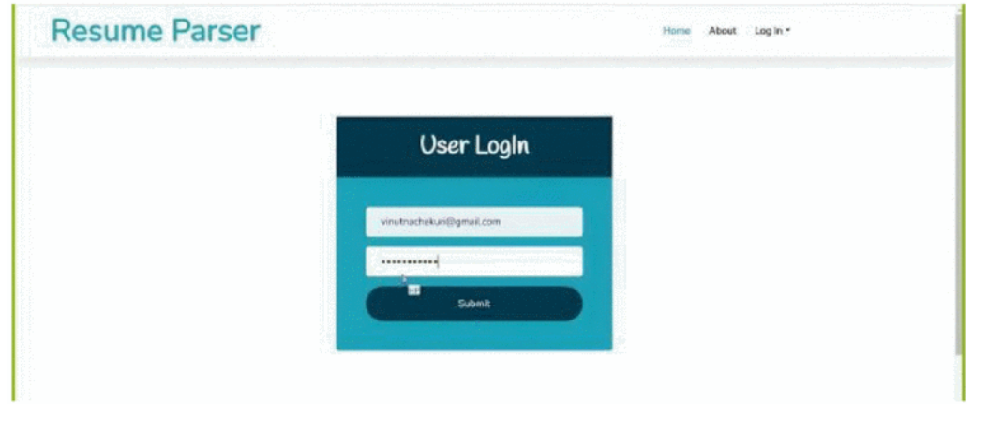
Experimental Result
Home Page
Upload Page
Registration Page
Login Page

Slide 14
Limitations
6

Slide 15
Limitation
Limited Data Variability
Dependency on Data Quality
Language Sensitivity
Inherent Biases

Slide 16
Future Work
7

Slide 17
Future Works
Upgrade the application to enable precise matching of resumes and job descriptions to specific categories, such as years of experience and candidate skills.
Implement a feature allowing the application to guide job seekers directly to the category that aligns with their requirements.

Slide 18
Conclusion
8

Slide 19
Conclusion
The NLP-based Applicant Screening System revolutionizes traditional hiring processes, ensuring efficiency and accuracy. Designed for user benefit, it streamlines job searches for applicants and enhances the selection process for hiring agencies. Acknowledging limitations, future work prioritizes continuous improvement through user feedback, dataset diversification, multilingual support exploration, algorithm refinement, and scalability considerations. In summary, it stands as a promising and impactful solution for the dynamic recruitment landscape.

Slide 20
Thanks for Watching

