Slide 1
Title: Enhancing Recommender Systems with NLP-based Biased Singular Value Decomposition
Group - 40 Section: 2, CSE431
Submitted by:
Md Rishat Sheakh ID:20301305
ST_RA: Farah Binta Haque Md Sabbir Hossain

Slide 2
Table of Contents
Introduction
Datasets and Results
1
5
2
Motivation
6
Limitations
3
Contribution
Future Work
7
4
Methodology & Experiment
8
Conclusion

Slide 3
Introduction
1

Slide 4
Introduction
Introduces a pioneering NLP-based Biased Singular Value Decomposition (SVD) model.
Addresses inherent limitations of existing recommendation methods and offers a unique viewpoint to ensure high-quality recommendations.
Championing Fairness and Transparency: Advocates for fairness and transparency in user-item interactions.

Slide 5
Motivation
2

Slide 6
Motivation
Exponential Growth of Digital Content
Demand for Personalization
Limitations in Existing Methods
Incorporation of Advanced NLP Techniques
Addressing Challenges of Bias and Fairness
Setting a Benchmark for Efficiency

Slide 7
Contribution
3

Slide 8
Contribution
Innovative Recommender System: NLP-based Biased SVD approach
Controlled Bias Implementation: Considers user and item biases for enhanced performance
Advanced NLP Techniques: Leverages NLP for meaningful data analysis
Sequential Models Integration: Incorporates neural network-driven sequential models
Advancing Recommender System Development: Contributes to efficient, fair, and transparent recommender systems

Slide 9
Methodology and Experiment
4

Slide 10
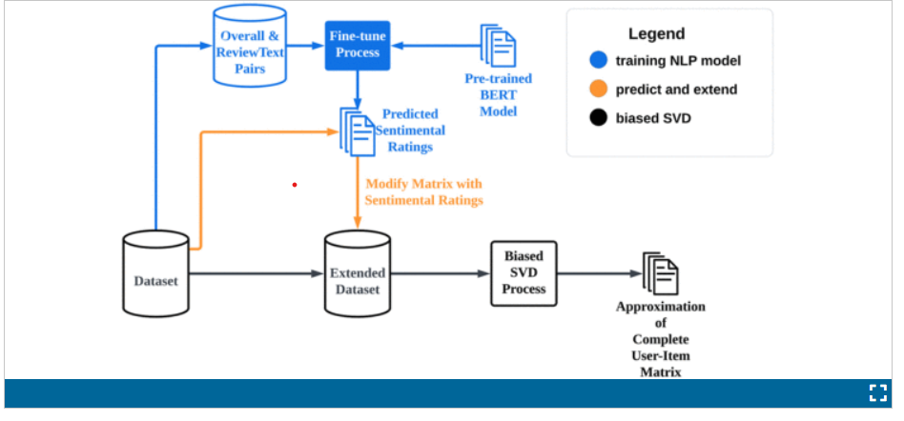
Methodology
Approach: Combined Biased SVD with NLP techniques
Bias-SVD Models
SVD (ratings only)
Biased SVD (ratings + sentiment)
Sequential Model

Slide 11
Dataset and Results
5

Slide 12
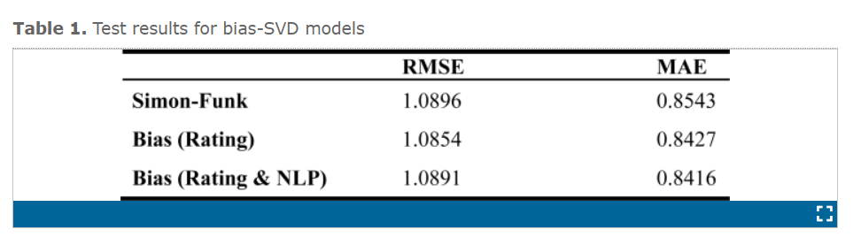
Dataset and Results
Datasets: Amazon 5-core Movies and TV dataset from 2018 comprising 3,410,019 reviews
Results:
Bias-SVD Models
Simon Funk SVD model exhibited the poorest performance, with the longest convergence time

Slide 13
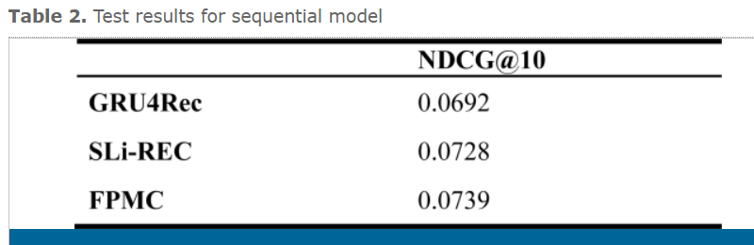
Dataset and Results
Sequential Model
FPMC outperforms GRU4Rec and SLi-REC on Amazon 5-core Movies and TV dataset
.

Slide 14
Limitations
6

Slide 15
Limitation
Base Simon Funk SVD model exhibited longer convergence time; potential for further exploration.
Trade-off observed between sentiment analysis and ratings in the proposed models.

Slide 16
Future Work
7

Slide 17
Future Works
Optimizing Sentiment Analysis Integration: Explore configurations for improved integration of sentiment analysis and ratings, balancing recommendation accuracy and computational efficiency.
Enhancing Baseline Model: Investigate strategies to reduce convergence times and enhance efficiency in the baseline Simon Funk SVD model.
Advanced Algorithmic Exploration: Consider integrating additional advanced algorithms/models for further performance improvement.
Real-world Implementation

Slide 18
Conclusion
8

Slide 19
Conclusion
The paper concludes by demonstrating the effectiveness of the proposed NLP-based Biased SVD Recommender System in addressing existing limitations and providing robust, fair, and personalized recommendations. Additionally, FPMC is identified as a promising algorithm for sequential models on the Amazon 5-core Movies and TV dataset.

Slide 20
Thanks for Watching

