Slide 1
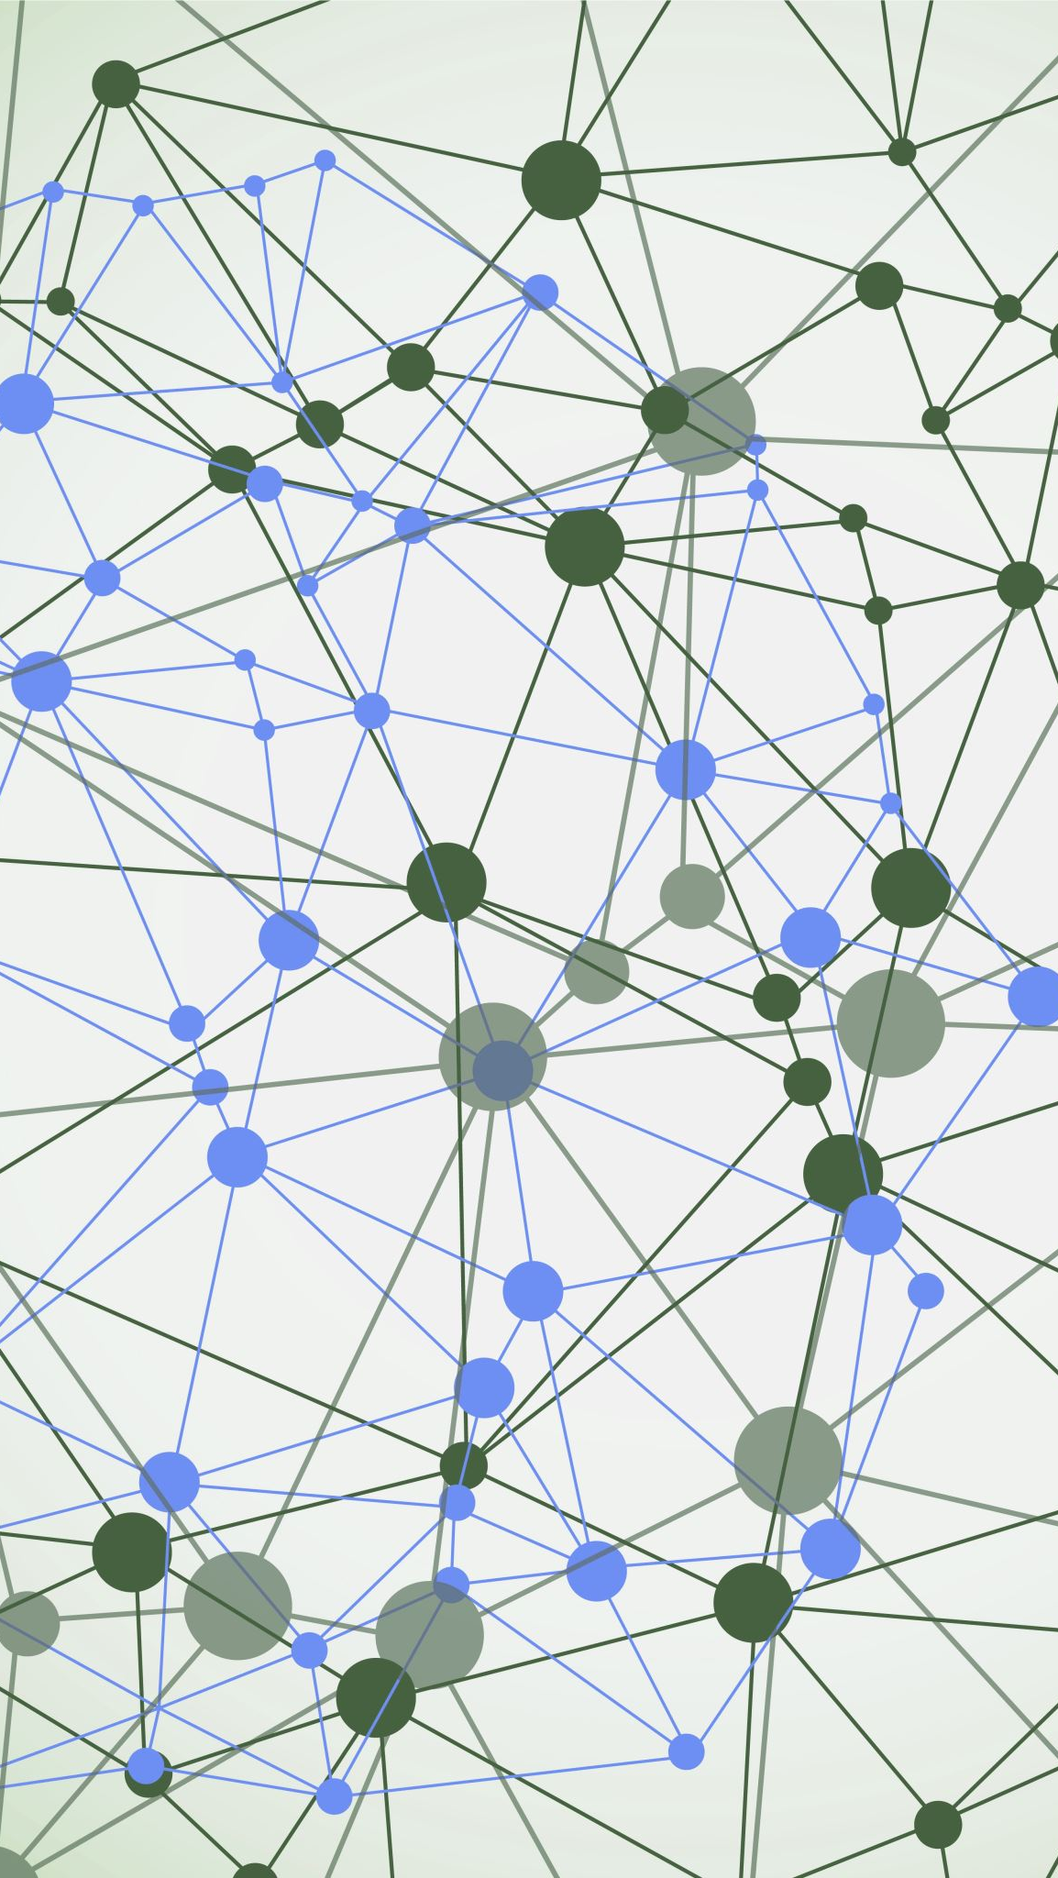
Relationship between crime and the type of businesses in the San Francisco area.
By: Rishav Datta

Slide 2
Who should be interested?
Local authorities to gain an understanding on the effect a business has on the area.
Local law makers to make informed decisions on which new businesses they should allow to start in an area.
New business owners looking to find safest area to start up in.

Slide 3

The data
Foursquare API: Used to fetch information on the different venues in a neighborhood.
San Francisco crime data: recording incidents of crime in each neighborhood.

Slide 4
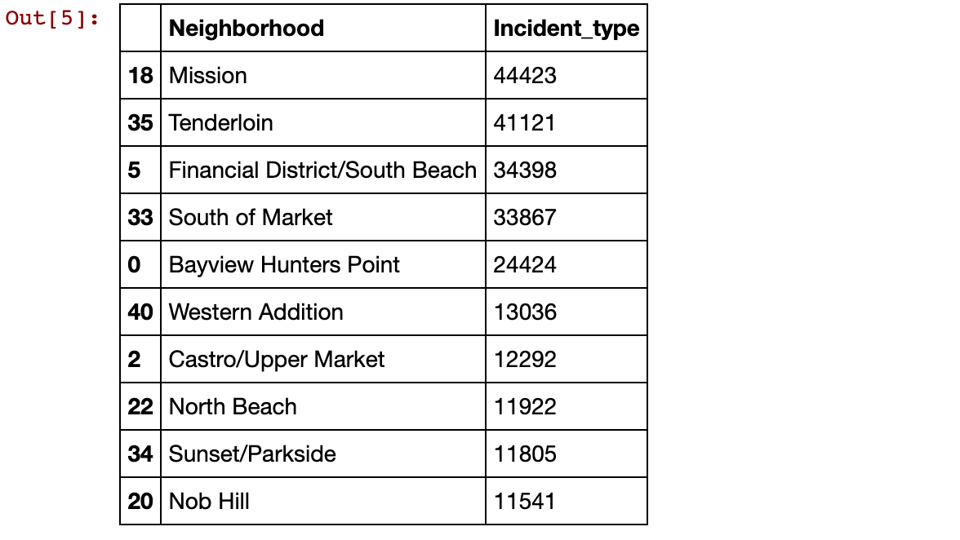

Slide 5
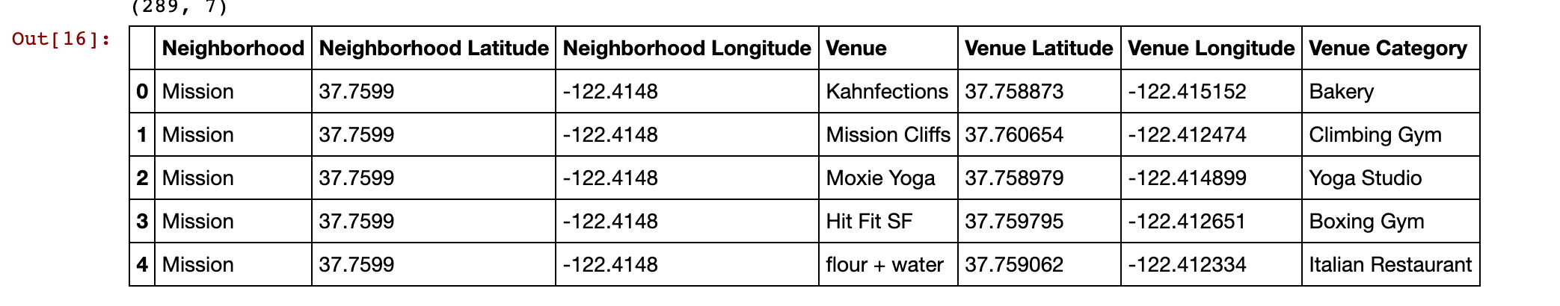

Slide 6
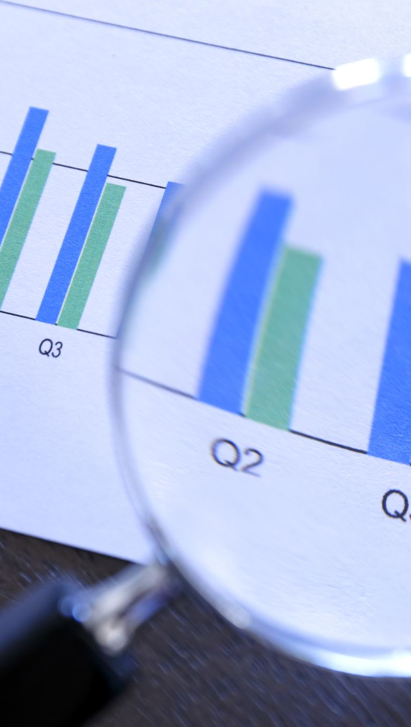
Exploratory Analysis
The data was then analyzed to gain more insights on the most crime ridden neighborhoods in San Francisco

Slide 7
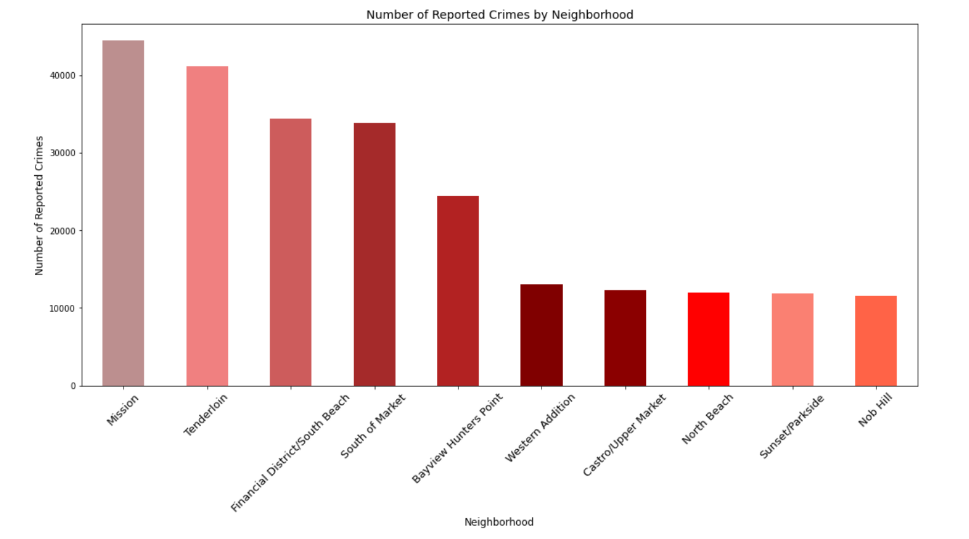

Slide 8
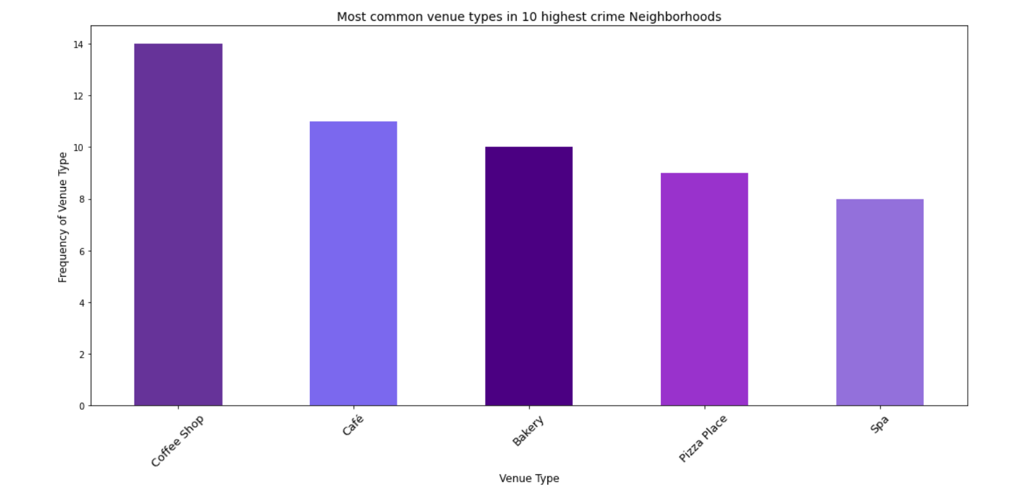

Slide 9

Results
4 of the top 5 venues in San Francisco are from the food and beverage industry.
Mission and Tenderloin are by far the neighborhoods with the most crime
Cluster analysis was relatively insightful, placing 6 of the top 7 in one cluster and 2 of the bottom 3 in one cluster.

Slide 10
