Slide 1
Copy-Move Forgery Detection using SIFT and RANSAC
Classical image forensics evaluated on the CoMoFoD dataset, with an interactive Streamlit web interface
Final Project Presentation | October 2026
Rishav Ranjan
Manu Singhal
Rishabh Jain
Nakul Tiwari
Reg. No. 20233345
Reg. No. 20233533
Reg. No. 20233232
Reg. No. 20233194
Dataset preparation, preprocessing, Frontend Design and Integration
SIFT feature matching and RANSAC
Evaluation, experiments, and visualizations
Testing, report, and presentation
Notes:
Introduce the project title and the four team members. Each member's contribution is listed on the cards; we cover it again on the last slide. Estimated talk time for the whole deck: about 20 minutes plus questions.

Slide 2






Outline
01
02
03
Introduction
Dataset and Design
Methodology
Abstract, copy-move forgery, objectives
CoMoFoD, preprocessing, architecture
SIFT, self-matching, ratio test, RANSAC
04
05
06
Implementation
Results and Discussion
Impact
Evaluation metrics and the Streamlit app
Demo, observations, testing
Limitations, use cases, conclusion
Notes:
Six parts: introduction, dataset and design, methodology, implementation, results and discussion, and finally impact (limitations, real-world use cases, conclusion).

Slide 3
Abstract
Problem: in a copy-move forgery, a region is copied and pasted elsewhere in the same image.
Method: SIFT keypoints are matched against the image itself, filtered by the ratio test, then verified by RANSAC.
Output: a verdict, red-highlighted regions, a binary mask and the copy transform (scale, rotation, shift).
Delivered: detect.py, evaluate.py for CoMoFoD, and a Streamlit web app.
Scope: an educational baseline. It highlights suspects and cannot prove forgery.
257
feature matches agree on one transform in the demo image
7
stages in the detection pipeline
6
tunable detector settings, all live in the web app
Notes:
Summarise in 30 seconds: what the attack is, what our detector does, and what we delivered. Stress that this is a baseline and that its output is a lead for a human examiner, not proof.

Slide 4
Introduction: Copy-Move Forgery
Why it matters: photos are trusted as evidence in news, law, insurance and science.
The attack: copy a patch and paste it in the same image to hide an object or duplicate one.
Why it is hard: the pasted patch has the same lighting, noise and camera traits as the rest of the image.
The clue: two different places look almost identical, even after resizing, rotation or JPEG.
Same image
Source
copy + paste
Pasted copy
Detection idea: find near-identical regions in two different places
Notes:
Explain the attack with the diagram: a source region is copied and pasted elsewhere in the same image. Typical uses are object removal and object duplication. Because source and paste come from the same photo, camera-based statistics are not helpful, but the two regions are near-identical, and that is what we detect.

Slide 5


Problem Statement and Objectives
Problem: given one image, decide whether a region was duplicated inside it, and mark the suspected source and destination.
Build the detector
Evaluate on CoMoFoD
Create a web interface
Review and improve
SIFT plus RANSAC with geometric verification of every match.
Image-level and pixel-level metrics on forged, original and mask files.
Upload or paste an image and see input and output side by side.
Record limitations and propose measurable improvements.
Notes:
State the problem in one sentence, then the four objectives: build the detector, evaluate it on CoMoFoD, create the web interface, and review the baseline critically.

Slide 6
Dataset and Preprocessing
260
200
60
Preprocessing steps
1
Select files
forged image sets
small, 512 x 512 px
large images
Regex on names keeps base F, O, B files only
2
Pick IDs
File | Meaning | Our use
001_F.png | Forged image | Positive sample
001_O.png | Original image | Negative sample
001_B.png | Binary mask | Pixel metrics
..._F_JC4.jpg | Post-processed (JPEG) | Manual tests only
Only IDs with F and O; evenly spaced via linspace
3
Read images
BGR colour in, grayscale for SIFT
4
Clean masks
Binarise at 127; resize with nearest neighbour
Variants include JPEG, blur, noise and brightness changes for robustness tests.
5
Limit size
Longest side capped at 1600 px in the app
Notes:
CoMoFoD is a benchmark built for copy-move detection. Each set has the forged image (F), the original (O) and a binary mask (B). Our evaluation script ignores the post-processed variants on purpose and uses them for manual tests in the web app. Preprocessing: file selection by regex, evenly spaced IDs for a reproducible subset, BGR reading, mask binarisation and nearest-neighbour resizing, and a size cap in the app.

Slide 7
System Architecture
User image (upload or paste)
CoMoFoD files (F, O, B)
One shared detector
app.py
evaluate.py
Experiment numbers and user results come from the same code
Change the detector once and both tools update
Easy to test, tune and compare parameter settings
Streamlit interface: verdict, overlay, mask, downloads
Batch run: CSV, JSON summary, masks, overlays
detect.py
SIFT, masked self-matching, RANSAC, mask, metrics
OpenCV | NumPy
Notes:
Both entry points, the Streamlit app and the batch evaluation script, call the same detect_copy_move function in detect.py, which in turn uses OpenCV and NumPy. This guarantees that what we report in experiments is exactly what a user sees in the app.

Slide 8
Methodology: Detection Pipeline
1
2
3
4
5
6
7
Grayscale
SIFT keypoints
Self-matching
Ratio test
RANSAC
Decision
Mask + overlay
Convert BGR to intensity for SIFT
Up to 2000 points with 128-value descriptors
Match the image to itself; skip points under 50 px apart
Keep a match if d1 < 0.75 x d2
Fit scale, rotation, shift; count inliers
Flag the image if inliers are 8 or more
Hulls of inliers, dilate, red tint
Input any image (BGR), uploaded, pasted or from CoMoFoD
Output verdict, reason, mask, overlay and the copy transform
Notes:
Walk through the seven stages left to right. The next two slides zoom into steps 2 to 4 (features and matching) and steps 5 to 7 (RANSAC, decision and mask). Early exits with explicit reasons exist for too few keypoints, too few candidate matches, no consistent transform, and inliers below the threshold.

Slide 9



SIFT Features and Self-Matching
SIFT keypoints
Distance-masked matching
Lowe ratio test
Scale- and rotation-invariant points
nfeatures = 2000, contrastThreshold = 0.02 to reach low-contrast areas
Under 8 keypoints: stop with a reason
Image matched against itself
n x n mask: 0 if two points are under 50 px apart, diagonal always 0
BFMatcher kNN (k = 2) with this mask
Keep a match if best is clearly better than second best
Self-matches dropped as a safeguard
Under 3 survivors: stop with a reason
Keep match if d1 < 0.75 x d2 | forbidden pair if distance < 50 px
Notes:
SIFT gives distinctive descriptors that survive rotation and scaling. The key adaptation is the spatial mask: matching an image with itself would match every point to itself or a neighbour, so pairs closer than 50 pixels are forbidden before the ratio test. Because forbidden pairs are removed first, the second-best neighbour is also a valid distant point, which keeps the ratio test meaningful. d1 and d2 are the distances to the best and second-best neighbours.

Slide 10

RANSAC, Decision and Mask
RANSAC similarity transform
Decision rule
inliers ≥ 8
q = s · R(θ) · p + t
Suspected forgery. The inlier count acts as confidence.
4 parameters: scale, rotation, shift x, shift y.
Inlier: transformed point lands within 5 px of its match.
Search: 3000 iterations, confidence 0.99, 10 refinements.
Result: the app shows scale, angle and shift.
Mask and overlay
1
Fill convex hulls of source and destination inliers
2
Dilate with a 17 px ellipse
3
Tint red (42%) and draw boxes
Notes:
The model is a similarity transform: a uniform scale s, a rotation by theta and a shift t. That is exactly what a forger can do with copy, resize, rotate and paste. RANSAC fits it from random minimal samples and keeps the model with the most inliers. Random false matches rarely agree on one transform, so a large inlier count is strong evidence. If at least 8 inliers agree, the image is flagged. The mask is built from the convex hulls of the inlier points on both sides, dilated and overlaid in red.

Slide 11

Detector Parameters
Parameter | Default | Controls | Raising it usually
nfeatures | 2000 | Maximum SIFT keypoints | Finds clones in weak texture; slower, more memory
min_distance | 50 px | Minimum separation of matched points | Ignores near look-alikes; may miss close clones
ratio | 0.75 | Ratio-test threshold | Keeps more matches, so more noise
ransac_threshold | 5 px | Allowed distance from the transform | Tolerates rotation and scale; admits false inliers
min_inliers | 8 | Inliers needed to flag an image | Fewer false alarms; may miss small clones
dilation_size | 17 px | Padding around the hull mask | Higher recall, lower precision
All six settings can be changed live in the web app sidebar to see their effect.
Notes:
These six settings define the detector. The most influential pair for false alarms versus misses is ratio and min_inliers; our tuning plan sweeps those two on a development set. In the web app each one is a slider, so the effect can be shown live.

Slide 12


Implementation and Evaluation Metrics
detect.py
Image level
SIFT, masked matching, RANSAC, hull mask, overlay, metrics and a command-line interface
Flagged forged = TP, missed = FN
Flagged original = FP, clean = TN
Accuracy, precision, recall, F1
evaluate.py
Runs F and O images of chosen IDs; writes CSV, JSON summary, masks and overlays
Pixel level (vs. B mask)
Precision, recall, F1 and IoU
IoU = TP / (TP + FP + FN)
Summed over all images; flags on originals count as FP
app.py
Streamlit interface that calls the same detector function
Notes:
detect.py holds the algorithm and a command-line interface. evaluate.py runs the detector on forged and original images and reports both image-level metrics (was the image flagged?) and pixel-level metrics (does the mask overlap the ground truth?). Flagged pixels on original images are counted as false positives, so false alarms also lower pixel precision.

Slide 13
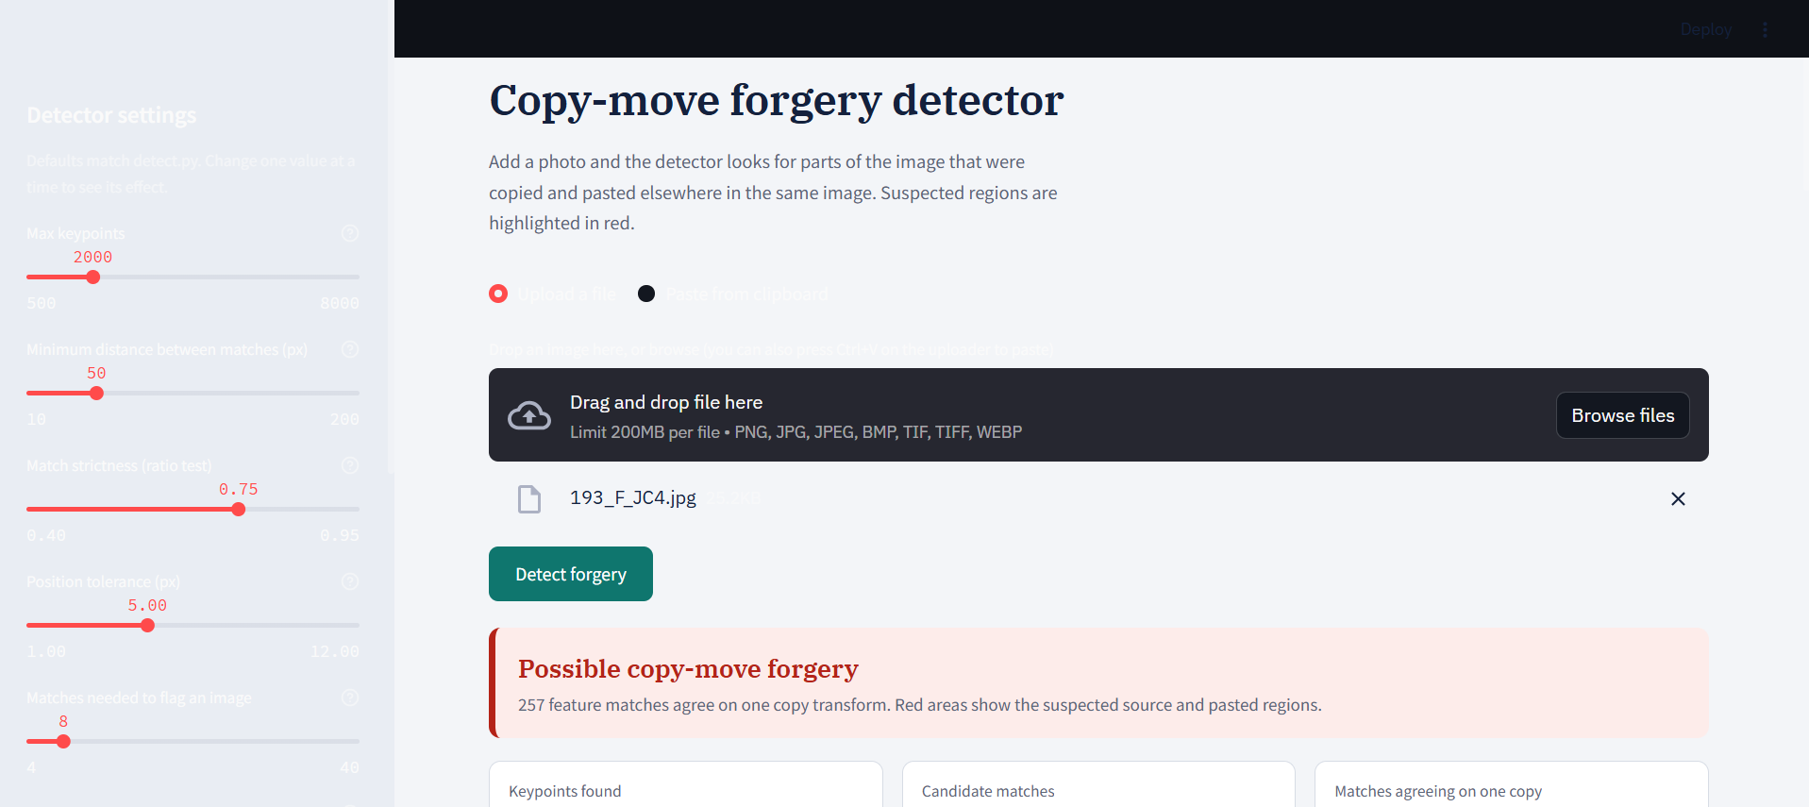

Frontend: Streamlit Web Interface
1
Add image
Upload a file or paste from the clipboard
2
Tune (optional)
Sidebar sliders for every detector setting
3
Detect
One click; errors shown as clear messages
Early build in Streamlit dark mode
4
Compare
Input left, red-tinted output right, downloads
Bug found in testing: dark mode drew light text on our light page. Fixed with a light theme file plus explicit dark-text CSS on every widget.
5
Explore
Tabs: mask, matched features, transform, score
Notes:
The interface is built so a non-programmer can add an image, press one button and compare input and output at once. It also shows the matched features, the transform values and can score the result against a ground-truth mask. The screenshot is an early build: during testing we found that Streamlit's dark mode drew light text on our light page, which made labels hard to read. We fixed it with a theme file and explicit CSS.

Slide 14
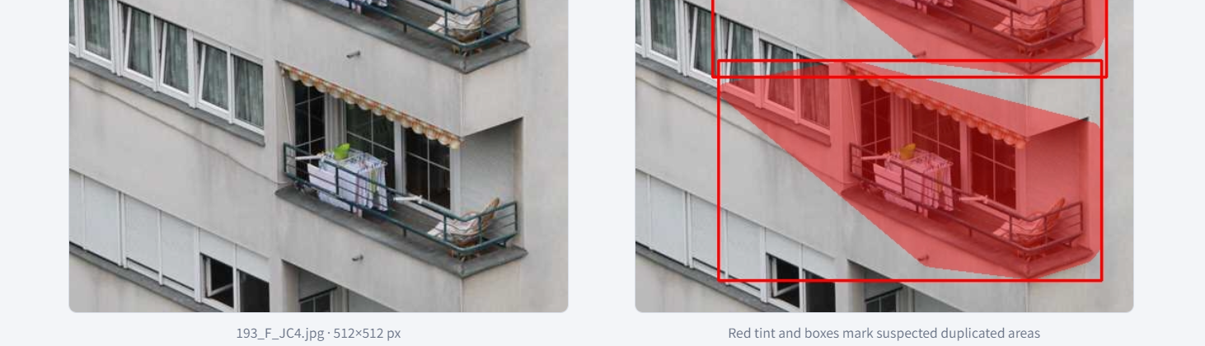
Results: Demonstration
257
feature matches agree on one copy transform (threshold: 8)
Possible copy-move forgery
193_F_JC4.jpg | 512 x 512 px | default parameters
Left: the input image as uploaded
Right: red tint and boxes mark duplicated areas
JPEG-compressed variant (JC4) still detected
One manual test. It shows the pipeline works end to end; it is not scored against the ground-truth mask.
Notes:
This is the CoMoFoD image 193, forged, JPEG-compressed variant. With default parameters the detector flagged it with 257 matches agreeing on a single transform, far above the threshold of 8. The red regions mark two similar balcony structures. Be honest that this is a single manual test and was not scored against the ground-truth mask.

Slide 15
Discussion
What worked
What to watch
Detection survives JPEG recompression
Copy transform recovered: scale, rotation, shift
Every outcome returns a clear reason
Fast on 512 x 512 images
Mask is generous: hull plus 17 px padding
Repeating windows or tiles can cause false alarms
Mask covers source and paste: precision is capped near 50% if B marks only the paste
Smooth-area clones give few keypoints
Evaluation scores
—
—
—
—
Image accuracy
Image F1
Pixel F1
Pixel IoU
Notes:
Strengths on the left, cautions on the right. IMPORTANT: the four score boxes at the bottom are placeholders. Before presenting, run evaluate.py on your held-out test IDs and type the values from summary.json into these boxes (image accuracy, image F1, aggregate pixel F1, aggregate pixel IoU). Do not present blank boxes.

Slide 16


Testing and Proposed Improvements
Testing
Proposed improvements
Passed
1
Symmetric inliers: count matches fitting the transform or its inverse
Upload forged image: verdict and side-by-side output
2
Iterative RANSAC: catch several cloned regions
Fixed
Dark-mode readability defect found and corrected
3
g2NN matching: handle regions copied more than once
4
Transform-guided mask: better pixel IoU than hulls
Planned
Originals, JPEG, blur and noise variants, corrupt file, textureless and very large images
5
RootSIFT, more keypoints: help smooth areas
Notes:
Testing so far: the end-to-end upload test passed, and the dark-mode readability defect was found and fixed. The remaining planned tests cover originals, JPEG, blur and noise variants, a corrupt file, a textureless image and a very large image. Right: the five highest-impact improvements from our code review. They are proposals and are not yet part of the submitted code.

Slide 17
Limitations and Future Work
Limitations
Future work
1
Integrate the accuracy fixes from the review
Smooth-region clones (sky, walls) are often missed
Mask is approximate: hulls of sparse keypoints
Natural repetition can trigger false alarms
One similarity transform only
Heavy blur, noise or compression removes detail
Output is a lead, not proof
2
Add a dense block-based or PatchMatch detector for smooth areas
3
Full evaluation: dev/test split, macro metrics, robustness table
4
Batch mode in the web app
5
Compare with deep-learning detectors
Notes:
Be upfront about limitations: clones in smooth areas, an approximate mask, false alarms on naturally repeated objects, a single transform, and weakness under heavy post-processing. Future work follows directly from the review: integrate the accuracy fixes, add a dense detector, run the full evaluation with a dev/test split, add a batch mode, and compare with deep-learning methods.

Slide 18






Real-World Use Cases
Digital forensics and courts
Journalism and fact-checking
Insurance claims
Screen photo evidence for duplicated regions before expert review.
Flag doctored news photos, such as duplicated crowds or objects.
Spot damage photos with cloned objects or hidden areas.
Research integrity
Social media moderation
Education and training
Check scientific figures and microscopy images for duplicated panels.
Triage viral images that may spread misinformation.
Teach image forensics with a transparent, tunable baseline.
In every case the detector is a screening aid for a human examiner, not a verdict.
Notes:
These are application areas where image authenticity matters. In all of them the detector should be used to screen and to point a human examiner at suspicious regions, never as a final verdict. Research integrity is a real-world example: duplicated panels in published figures are a known problem.

Slide 19




Conclusion
End-to-end detector: SIFT, masked self-matching, ratio test, RANSAC
A transparent baseline that highlights suspects, with a clear path to improve it.
CoMoFoD evaluation with image-level and pixel-level metrics
Streamlit app shows input and detected output side by side
Demo: 257 matches on one transform in a JPEG-compressed image
Notes:
Close with the four takeaways and the one-line message: a transparent baseline that highlights suspects, with a clear path to improve it.

Slide 20
Team and Contributions
Rishav Ranjan
Manu Singhal
Reg. No. 20233345
Reg. No. 20233533
Dataset preparation, preprocessing, Frontend Design and Integration
SIFT feature matching and RANSAC
Rishabh Jain
Nakul Tiwari
Reg. No. 20233232
Reg. No. 20233194
Evaluation, experiments, and visualizations
Testing, report, and presentation
Thank you. Questions?
Notes:
Name each member and their contribution, then invite questions. Likely questions: why SIFT instead of block-based methods, why the spatial mask is needed, how the 8-inlier threshold was chosen, what the false-alarm rate is, and how the mask could be improved.

