Slide 1
PROJECT TITLE
CAPSTONE PROJECT
Presented By:
Student Name- Rishav Kumar
College Name- Graphic Era University
Department- Btech CSE

Slide 2
OUTLINE
Problem Statement (Should not include solution)
Proposed System/Solution
System Development Approach (Technology Used)
Algorithm & Deployment
Result (Output Image)
Conclusion
Future Scope
References

Slide 3
Problem Statement
Fitness Buddy The challenge In today’s fast-paced world, many individuals struggle to maintain a healthy lifestyle due to lack of personalized guidance, time constraints, and inconsistent motivation. Traditional fitness solutions often require expensive subscriptions, in-person consultations, or rigid schedules that don't adapt to personal preferences or daily routines. There is a growing need for an accessible, friendly, and intelligent virtual assistant that can provide on demand fitness advice, healthy lifestyle suggestions, and basic nutrition guidance—all tailored to individual needs and available at any time.

Slide 4
Proposed Solution
We propose FitnessBuddyBot, a chatbot built on IBM Watsonx Assistant, hosted on IBM Cloud (Lite Plan).
It provides:
Home workout suggestions
Healthy eating tips
Motivation messages
Night fitness routines
Key features:
No code or API needed
Drag-and-drop action-based design
Simple interface for easy fitness Q&A
Available 24/7 with instant answers

Slide 5
System Approach
Tools & Platform:
IBM Cloud → Watsonx Assistant (Lite Plan)
Actions-based Q&A steps (no coding)
Simple condition-response logic
Web preview chat interface
Steps Taken:
Created Watsonx Assistant project
Added fitness Q&A as “Actions”
Previewed and tested all chat responses
Collected screenshots for results

Slide 6
Algorithm & Deployment
Algorithm: No ML model used. This is an Action-based chatbot logic:
"If user says X" → give predefined Y response
Designed using “User says something like…” condition
Examples:
Intent Condition Response
HomeWorkout suggest a home workout "Try 10 pushups, 20 squats...“
HealthyBreakfast what to eat for breakfast "Try oats, eggs, banana.“
MotivationTips motivate me "You’re stronger than you think!“
NightRoutine night workout routine "Try stretching and deep breathing."
Deployment: Previewed within IBM Cloud. Optional: Deploy to webchat or other apps.

Slide 7
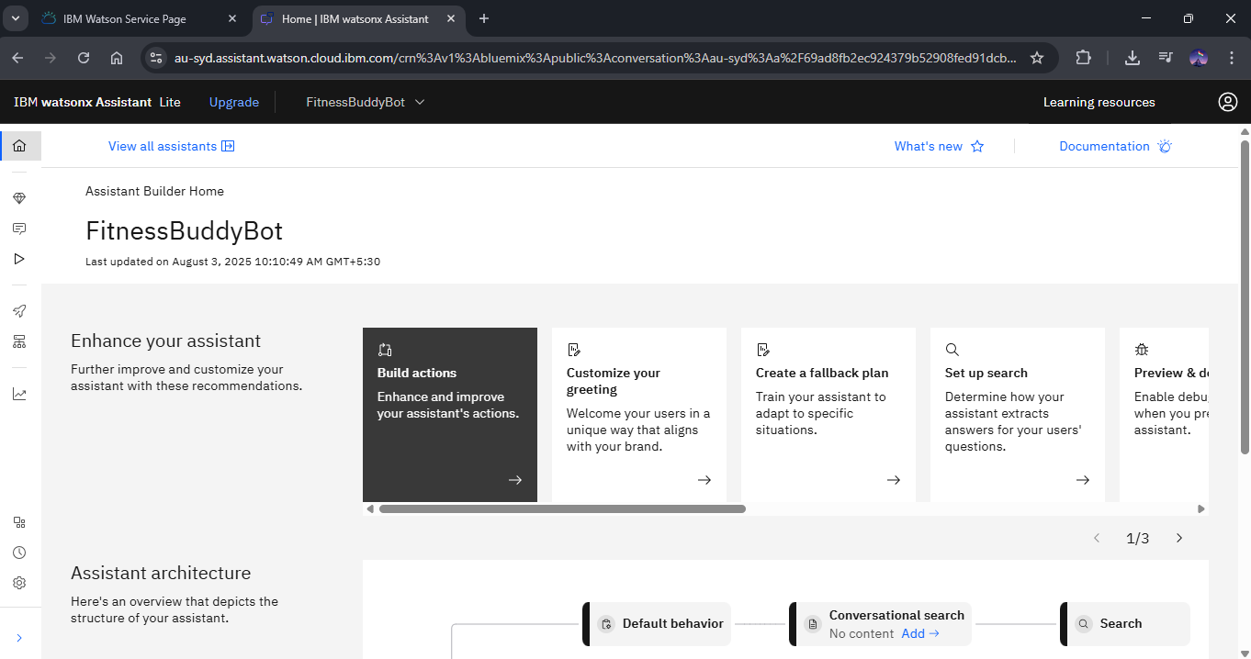
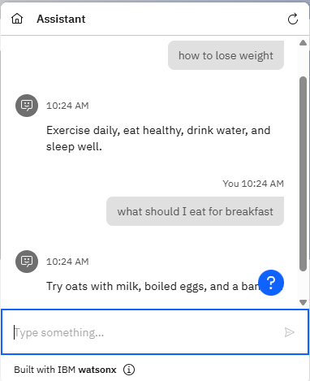
Result
Chat works as expected with all user inputs tested successfully.

Slide 8
Conclusion
FitnessBuddyBot successfully demonstrates a simple and effective way to create a personal fitness assistant using IBM Cloud. With no coding or AI training required, students and beginners can build helpful chatbots to promote healthy living. It is quick to build, lightweight, and easy to expand.

Slide 9
Future scope
Deploy to WhatsApp, Telegram, or a website
Add more actions (mental health, diet tracker, etc.)
Voice-based interface
Connect to APIs for weather-aware workouts
Expand to multilingual support

Slide 10
References
IBM Watsonx Assistant Docs: https://cloud.ibm.com/docs/watsonx-assistant
IBM SkillsBuild Platform
IBM Cloud Docs
Personal experimentation and testing
Github repository link - Rishav387/IBMcloudProject: Fitness Buddy

Slide 11
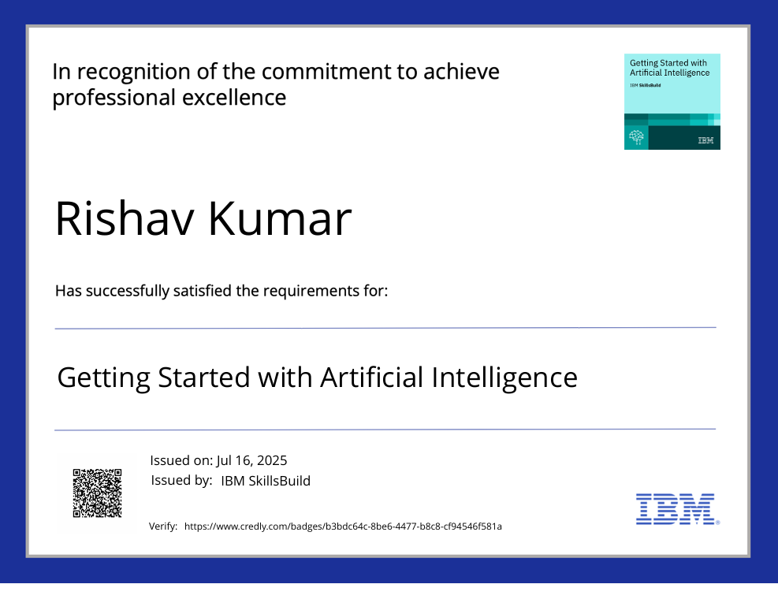
IBM Certifications

Slide 12
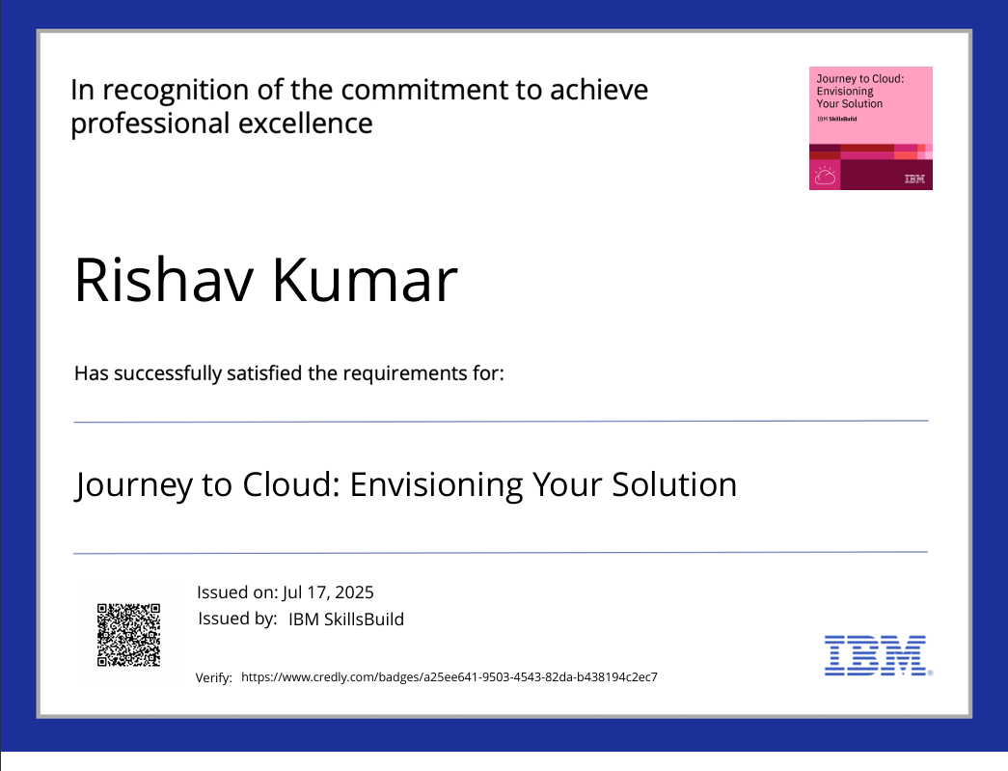
IBM Certifications

Slide 13
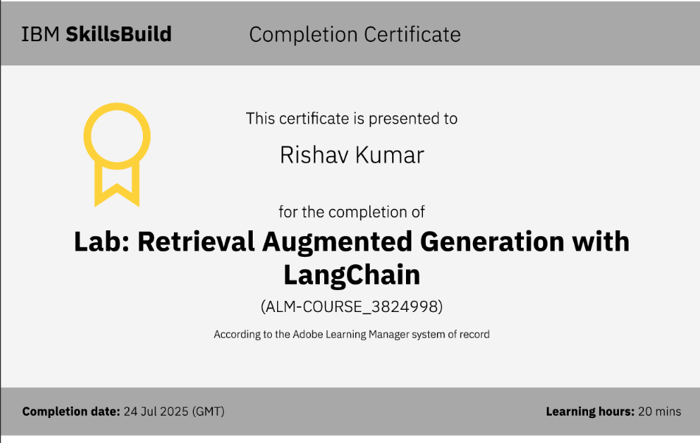
IBM Certifications

Slide 14
THANK YOU

