Slide 1
SOFTWARE ENGINEERING PROJECT
UrbanHive
Housing Society Management System
MIT World Peace University, Pune · 2025–2026 · SE & Modelling
Sr. No. | Student Name | PRN No. | Roll No.
1 | Kunal Tailor | 1032233258 | 38
2 | Rishav Singh | 1032233012 | 34
3 | Prakash | 1032233277 | 40
4 | Anuj Kudu | 1032233203 | 36
Project Guide
Dr. Yogesh Kulkarni

Slide 2
PROBLEM STATEMENT
Why UrbanHive Exists
📋
💬
🔒
Manual Registers
Fragmented Comms
No Accountability
Complaint books, payment ledgers, and attendance sheets are error-prone and impossible to audit at scale.
WhatsApp groups and verbal notices leave residents without a structured, role-filtered announcement channel.
No complaint ownership, no status trail, no payment transparency — residents are left in the dark.
Technical Gaps in Existing Approaches
No centralized authentication — shared logins undermine accountability
Role mixing — general apps like Google Sheets don't enforce access boundaries
No workflow state machine — complaints don't move through defined lifecycle states
No API contract — frontend & backend can't be developed or tested independently

Slide 3
SYSTEM ARCHITECTURE
Three-Tier, Role-Aware Architecture
Frontend
REST API
Database
Static HTML / CSS / JS
Node.js / Express.js
MongoDB Atlas
Role-based routing
JWT guards
10+ dashboard pages
⇄
RBAC middleware
JWT verification
Controller pattern
⇄
15 collections
Mongoose ODM
Soft-delete pattern
🔐 RBAC enforced at two levels — Frontend hides UI elements based on JWT role · Backend independently rejects unauthorized requests on every endpoint

Slide 4
MULTI-ROLE SYSTEM
Three Roles. One Platform.
Resident
Manager
Worker
🏠
🗂️
🔧
Raise & track complaints
Assign complaints to workers
View assigned tasks
Submit maintenance payments
Verify payment submissions
Mark attendance in/out
Request visitor approvals
Approve visitor requests
Report task completion
View notices & events
Publish notices
Receive staff-tagged notices
Book society amenities
Monitor worker attendance
Update availability

Slide 5
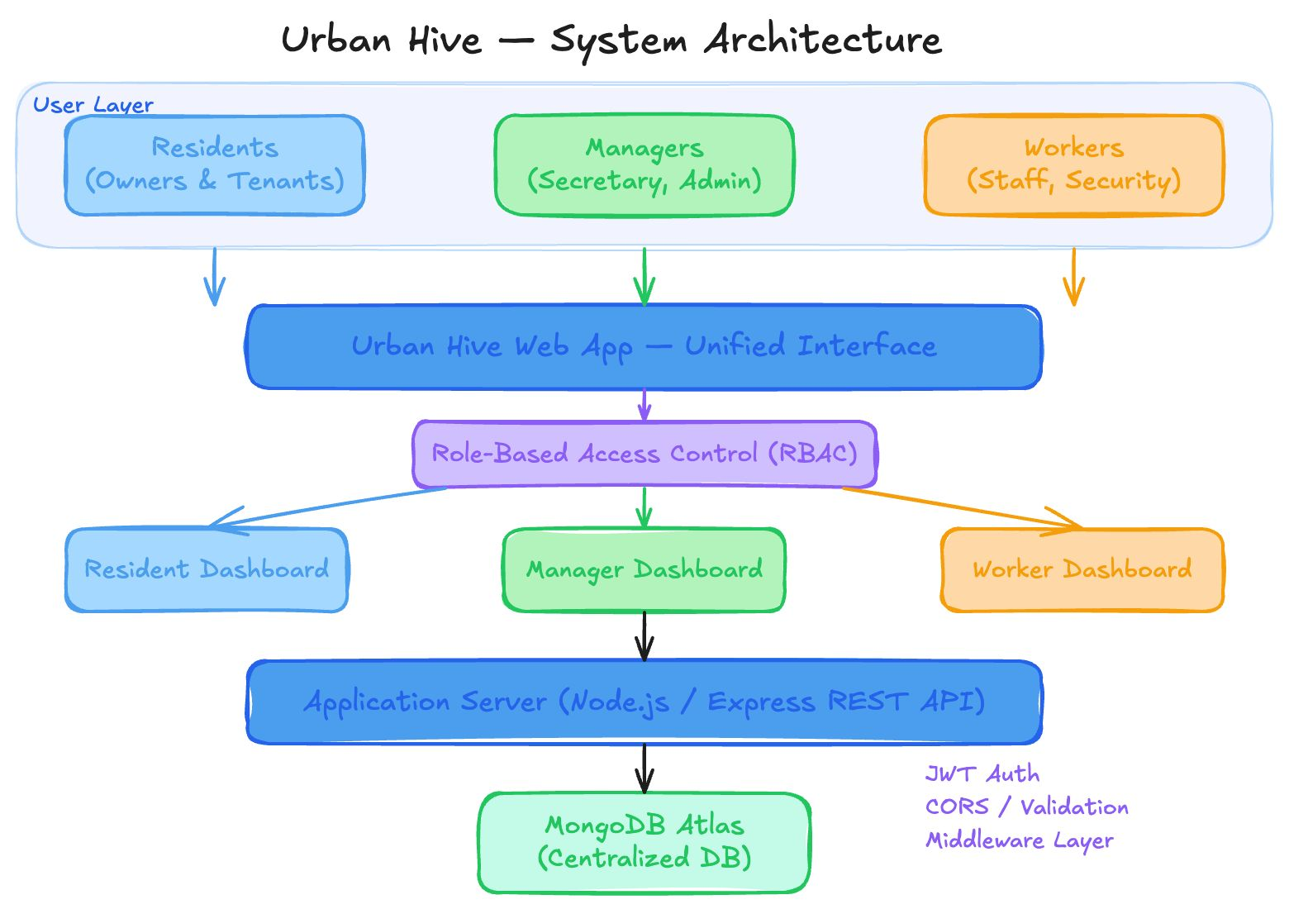
System Architecture

Slide 6
PROJECT MODULES
Five Core Modules
01
02
03
Auth & RBAC
Core Workflows
Secondary Modules
Phase 2 ✓
Phase 3 →
Phase 4
JWT login, bcrypt hashing, role guards on every protected endpoint. Server-side RBAC independent of frontend.
Complaints lifecycle (Open→Resolved), payment verification, visitor management, and notice board.
Event management, amenity booking (with availability checks), profile management, and notification fanout.
04
05
UI Integration
Security & Deploy
Phase 5
Phase 6–7
Static frontend connected to live API. Centralized API client with JWT injection, error handling, and loading states.
Input validation (express-validator), CORS hardening, rate limiting, Render deployment with MongoDB Atlas.

Slide 7
SOFTWARE PROCESS MODEL
Incremental Delivery Model
P0
P1
P2
P3
P4
P5
P6
P7
P8
Product
Definition
Data Model
& API Map
Auth &
Role Routing
Core
Workflows
Secondary
Modules
UI
Integration
Security &
Validation
Deploy
Polish
Why Incremental over Waterfall?
Early Working Software
✓ After each phase
✗ Only at the end
Handles Evolving Requirements
✓ Later phases absorb changes
✗ Scope freeze required
User Feedback
✓ Per increment
✗ Only post-delivery
Risk Management
✓ High-risk first
✗ Risks surface late

Slide 8
TECHNOLOGY STACK
Tools & Technologies
Frontend
Backend
Database
— HTML / CSS / JavaScript (Vanilla)
— Node.js 20+ · Express.js
— MongoDB Atlas (Cloud)
— Role-aware page routing with JS guards
— JWT (jsonwebtoken) · bcrypt
— Mongoose ODM — 15 collections
— JWT decode for conditional rendering
— express-validator · dotenv · nodemon
— Connection pooling · IP allowlisting
Auth & Security
DevOps
— JWT stateless token auth
— Render cloud hosting
— RBAC middleware (server-side)
— Environment variables (never in source)
— CORS config · Rate limiting
— GET /health endpoint · GitHub

Slide 9
DATABASE DESIGN
15 MongoDB Collections — 5 Logical Groups
Core / Auth
Resident
Operations
Worker
Comms
Users
Residents
Complaints
Workers
Notifications
Roles
Flats
Payments
Tasks
Managers
Permissions
Visitor_Logs
Attendance
Role_Permissions
Notices
Key Design Decisions
Single Users table for all roles — role-specific data in separate linked collections
Complaint status as ENUM (Open → Assigned → InProgress → Resolved) for state machine integrity
Soft-delete pattern — records are never hard-deleted, preserving a complete audit trail

Slide 10
RESULTS
What We've Built
3
15
9
10+
User Roles
RBAC Enforced
MongoDB
Collections
Development
Phases
Static Frontend
Pages
✓
Phase-0: Product definition, role matrix, feature lock
✓
Phase-1: Full MongoDB schema + API endpoint specification
✓
Phase-2: JWT auth, bcrypt, RBAC middleware, 3 demo accounts
→
Phase-3: Core workflows — complaints, payments, visitors, notices
✓
GET /health — server + DB connectivity confirmed
✓
10+ frontend pages with role-based conditional rendering

Slide 11
CHALLENGES
Challenges & How We Solved Them
RBAC on Static Frontend
JWT Expiry UX
⚠ Users could modify localStorage to bypass JS guards.
⚠ Silent token expiry caused confusing mid-session 401 errors.
✓ Server-side RBAC on every endpoint makes frontend bypass irrelevant.
✓ Token expiry checked before each API call with auto-redirect to login.
CORS Dev vs Production
Static Frontend Routing
⚠ localhost and Render URLs require different CORS origins.
⚠ Direct URL navigation bypasses login guards on HTML pages.
✓ CORS origin read from environment variables with localhost fallback.
✓ Guard check at top of every protected page script — redirects if no token.
Phase-3 Scope Size
Mongoose Schema Sync
⚠ Four major workflows in one increment was too large.
⚠ Schema changes during Phase-1 conflicted with Phase-2 test data.
✓ Subdivided into Sprint 3A (complaints + payments) and 3B (visitors + notices).
✓ Schema version policy: all Phase-1 schema changes finalized before Phase-2 begins.

Slide 12
ROADMAP
Future Scope
💳
🤖
📱
🔐
Real Payment Gateway
AI Complaint Triage
Mobile App (React Native)
QR Visitor Entry
Razorpay / Stripe for online maintenance collection with auto-reconciliation.
LLM classifier to auto-tag Emergency complaints and suggest assignment.
Native iOS/Android wrapping the same REST API with FCM push notifications.
QR code generation for pre-approved guests, scanned at gate by security.
🗳️
🌐
🔧
📡
Online Voting
Multi-Society SaaS
Predictive Maintenance
IoT Sensor Integration
Digital elections for committee roles with tamper-evident vote records.
Multiple societies as isolated tenants under one platform.
AMC schedule tracking for lifts, generators — alert managers before due dates.
Water tank levels and generator health on Manager Dashboard in real time.

Slide 13
TEAM
Project Team
Kunal Tailor
Rishav Singh
Lead Engineer & System Architect
Backend Developer
PRN: 1032233258 Roll: 38
PRN: 1032233012 Roll: 34
Overall architecture, Phase-2 JWT/RBAC, Phase-3 complaint & payment APIs, MongoDB schema, documentation.
Phase-1 API map, Mongoose models, Phase-3 visitor & notice APIs, Phase-6 validation, Render deployment.
Prakash
Anuj Kudu
Frontend Developer
Testing & Documentation
PRN: 1032233277 Roll: 40
PRN: 1032233203 Roll: 36
All role dashboards, login/register UI, complaint & payment components, responsive layout, routing guards.
Phase-5 integration testing, bug log, regression tracking, user docs, system design, final presentation.
Guide: Yogesh Kulkarni · MIT World Peace University, Pune

Slide 14
CONCLUSION
UrbanHive
Housing Society Management, Digitised.
A clean three-tier, role-aware architecture proving that open-source technologies — Node.js, Express, MongoDB, and vanilla JavaScript — are sufficient to build a production-grade, privacy-conscious society management platform.
MIT World Peace University, Pune · 2025–2026

