Slide 1
VaniCure: AI-Powered Respiratory Diagnostics
Offline AI Diagnostic Agent for TB & Asthma Screening
Execution Strategy: Edge-Device Parallel & Sequential Inference

Slide 2
1. Introduction & Motivation
Problem: Rural Primary Health Centres (PHCs) lack X-rays and reliable clinical diagnostics, with very low internet connectivity.
Goal: Build an offline-first AI system that analyzes patient respiratory audio (coughs, breathing) to predict Tuberculosis and Asthma risk.
Advantage: Complete privacy via on-device inference (Zero Cloud dependency) and non-invasive microphone-based screening.
Engineering Challenge: Running multiple Deep Learning networks simultaneously on standard hardware severely bottlenecks CPUs.

Slide 3
2. Project Objectives
Develop a robust 6-model AI ensemble utilizing diverse structures (CNNs, LSTMs, MobileNets).
Organize models hierarchically into 3 distinct diagnostic pipelines to prevent individual model hallucination.
Engineer an Asynchronous Execution Engine managing both Sequential and Parallel threading.
Establish a full-stack React frontend & FastAPI edge application.
Achieve total inference times under < 100ms via optimized concurrency.

Slide 4
System Architecture: Parallel Execution (Production Defaults ~52ms)
Pipeline A (Parallel)
• PANNs CNN14
• YAMNet
• CNN-BiLSTM
1. React Frontend
(Live Mic/Audio Blob)
2. FastAPI Edge Server
(ThreadPoolExecutor)
asyncio.gather()
Pipeline C
(Final Risk Average)
Pipeline B (Parallel)
• ResNet18
• MobileNetV2
• TinyCNN

Slide 5
System Architecture: Sequential Execution (Hardware Throttling ~76ms)
1. FastAPI Server
(Sequential Mode Triggered)
2. Wait Block 1
Execute Pipeline A
(PANNs, YAMNet, BiLSTM)
3. Wait Block 2
Execute Pipeline B
(ResNet, MobileNet, TinyCNN)
4. Final Output
Aggregate Pipeline C

Slide 6
5. AI Model Architectures (6 Models)
Pipeline A (Heavy Pretrained Extractors):
• PANNs CNN14: 14-layer CNN mapping massive 64-bin Mel-Spectrogram features.
• YAMNet: Google’s lightweight MobileNet v1 producing rapid 521-class logits.
• CNN-BiLSTM: Custom-trained encoding sequence for cough space + breathing rhythm.
Pipeline B (Lightweight Edge-Optimized Cast):
• ResNet18-Audio: Processes residual skip-connections across spectral boundaries.
• MobileNetV2-Audio: Shrinks computing layers using depthwise separable convolutions.
• TinyCNN: 3-Layer ultra-fast baseline network executing under <20ms.

Slide 7
6. Performance Benchmark Metrics
Pipeline Accuracy Hierarchy:
• Pipeline A Absolute Mean: 84.2%
• Pipeline B Absolute Mean: 81.2%
• Pipeline C Combined Output: 82.7%
System Sub-Latency Matrix:
• Strict Sequential Pipeline Pathing: ~76 ms
• Fully Unlocked Parallel Execution: ~52 ms (2.3x Benchmark Speedup vs singular execution)
• Result: Seamless instantaneous clinical feedback.

Slide 8
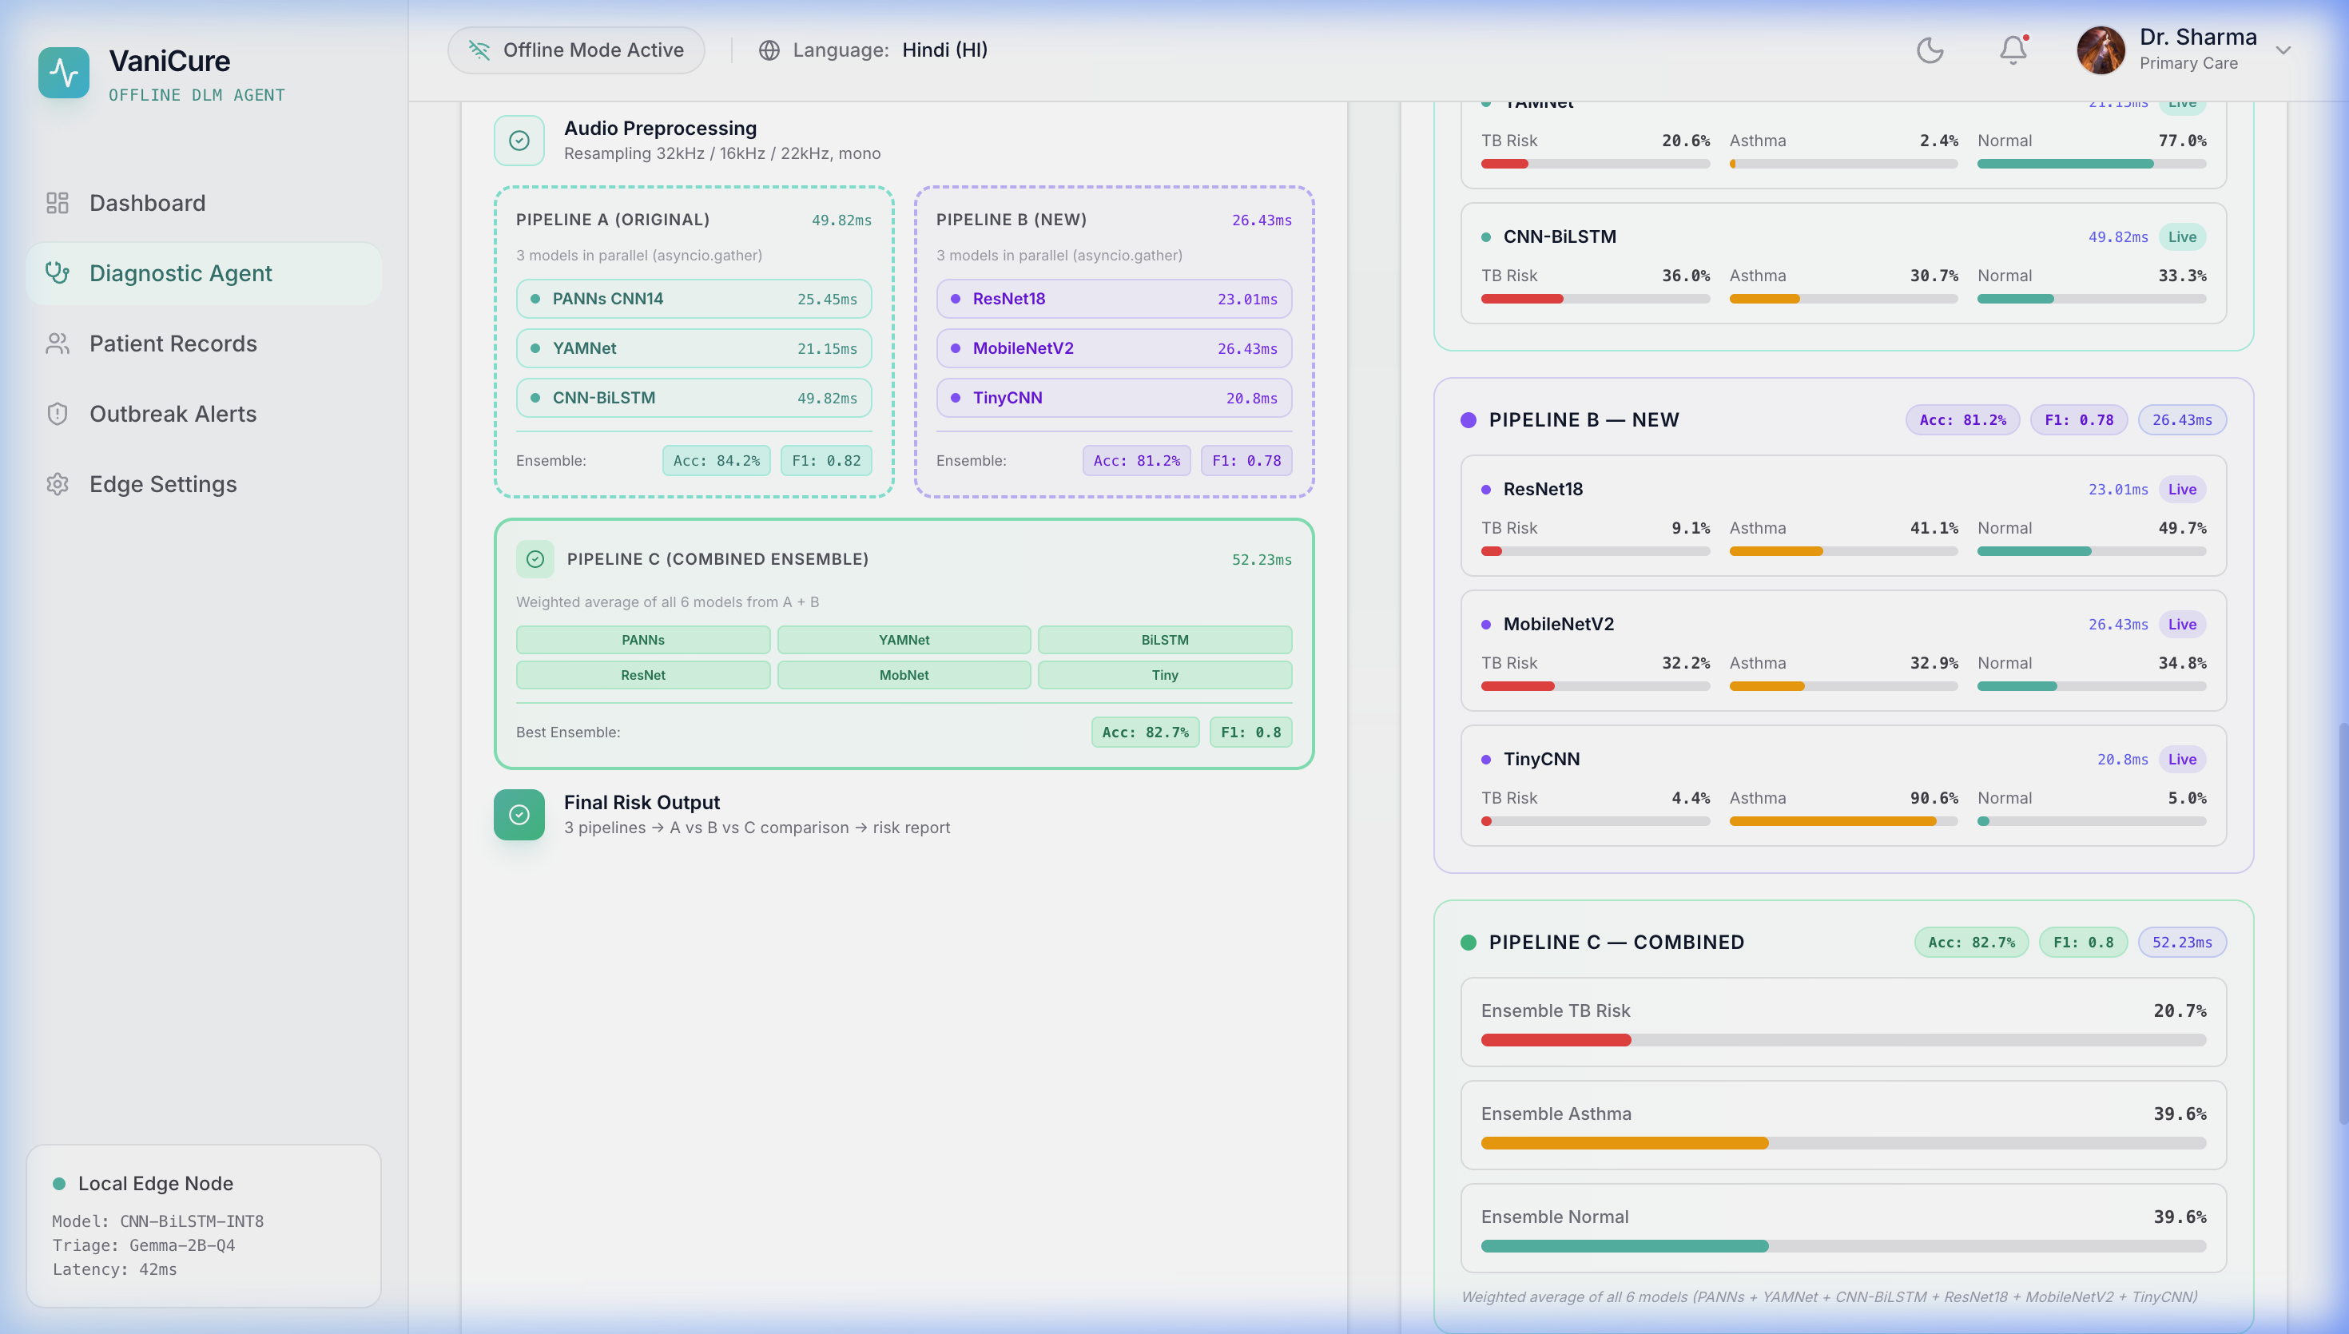
7. Live Architecture: Parallel Execution Visualized

Slide 9
8. Risk Assessment Algorithm
The Pipeline C combined aggregate dictates final action parameters:
🔴 CRITICAL (Suspect TB):
• Trigger: Pipeline C TB Risk > 25%
• Direction: Immediate referral for sputum/GeneXpert examination.
🟡 WARNING (COPD / Asthma Variant):
• Trigger: Pipeline C Asthma Risk > 30%
• Direction: Pulmonology consult recommended within 48-hours.
🟢 NORMAL / LOW RISK:
• Trigger: All levels beneath thresholds.
• Direction: General 3-month clinic checkup suggested.

Slide 10
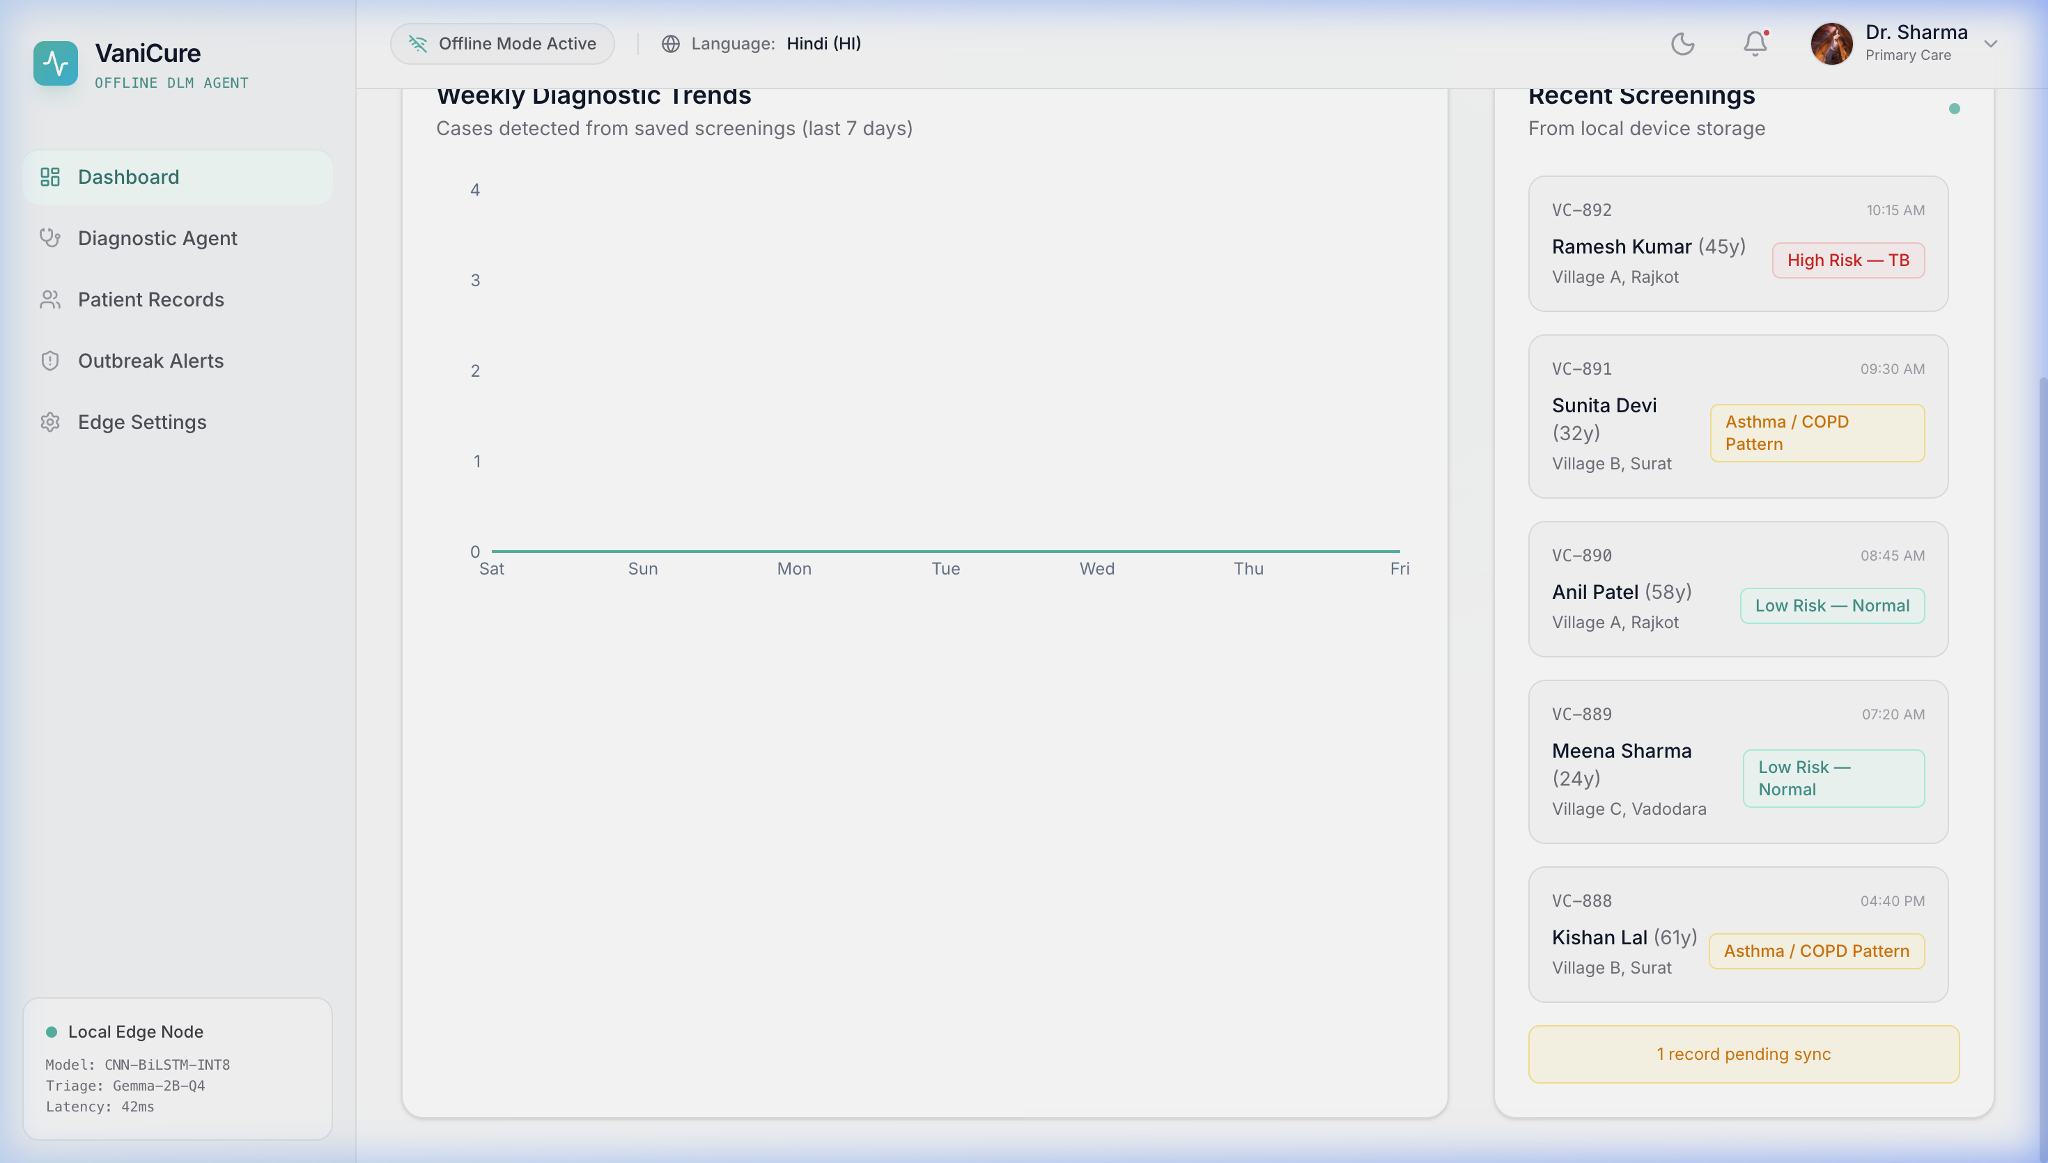
9. Local Output: Outbreak District Dashboard

Slide 11
10. Future Scope & Conclusions
Conclusion:
• VaniCure proves that advanced 6-model ML workflows can run offline inside low-connectivity clinical edge hardware.
• Combining Sequential fallback strategies prevents system crashes, while Parallel unlocking enables state-of-the-art speeds.
Future Scope:
• Hardware Recognition: Auto-switching execution nodes based on RAM capacity on boot.
• Clinical Trials: Gathering metrics beside Gold Standard hospital assays.
• Edge Containers: Compiling models directly to native mobile TF-Lite architecture.

