Slide 1

Organized by Bhagwan Mahaveer College, Balotra
Website: https://safarchaska.com/
Contact: +91 8171379469

Slide 2

Day – 01
RAJASTHAN TO JAMMU
• Depart from Rajasthan at night.
• Overnight Journey.

Slide 3
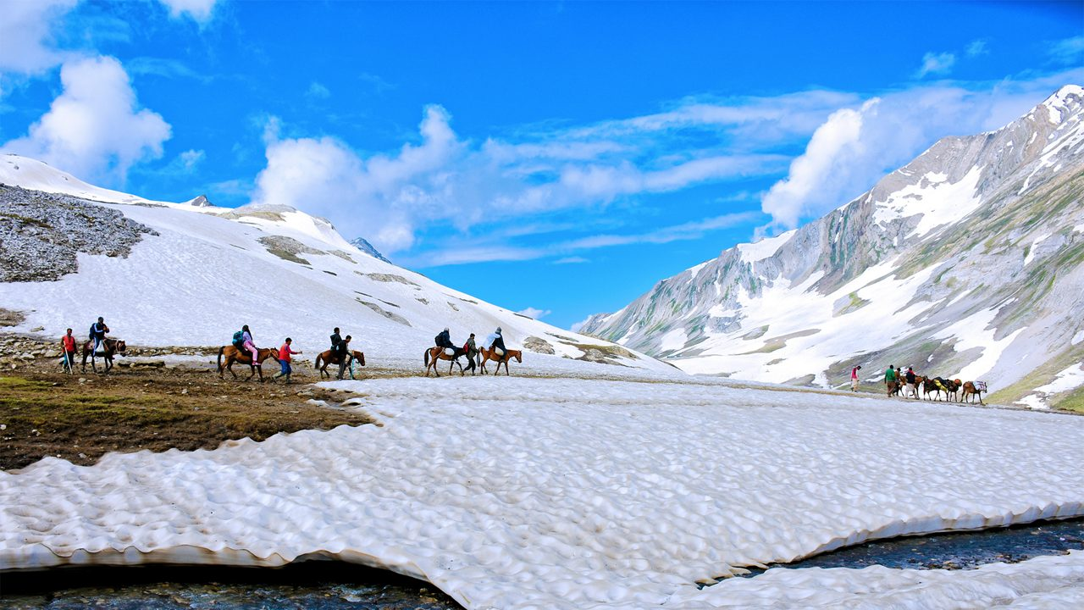
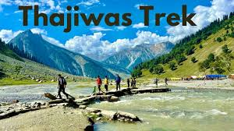
Day – 02
JAMMU TO SRINAGAR
• Arrive Jammu & proceed to Srinagar, 6 Hours journey Jammu to Srinagar (depending on Traffic).
• Later check in at Hotel.
• Day free for rest.
Day – 03
SONMARG DAY TRIP
• After breakfast, a full-day excursion to Sonmarg which is the most beautiful drive from Srinagar.
• On the way, stop at many beautiful spots.
• Continue drive to Sonmarg 2690 Mtrs (Meadow of Gold).
• One can ride on Horse to visit Thajiwas Glacier where snow remains around the year & Sonmarg is known as the Gateway of Ladakh.
• Overnight stay at Srinagar Hotel.

Slide 4
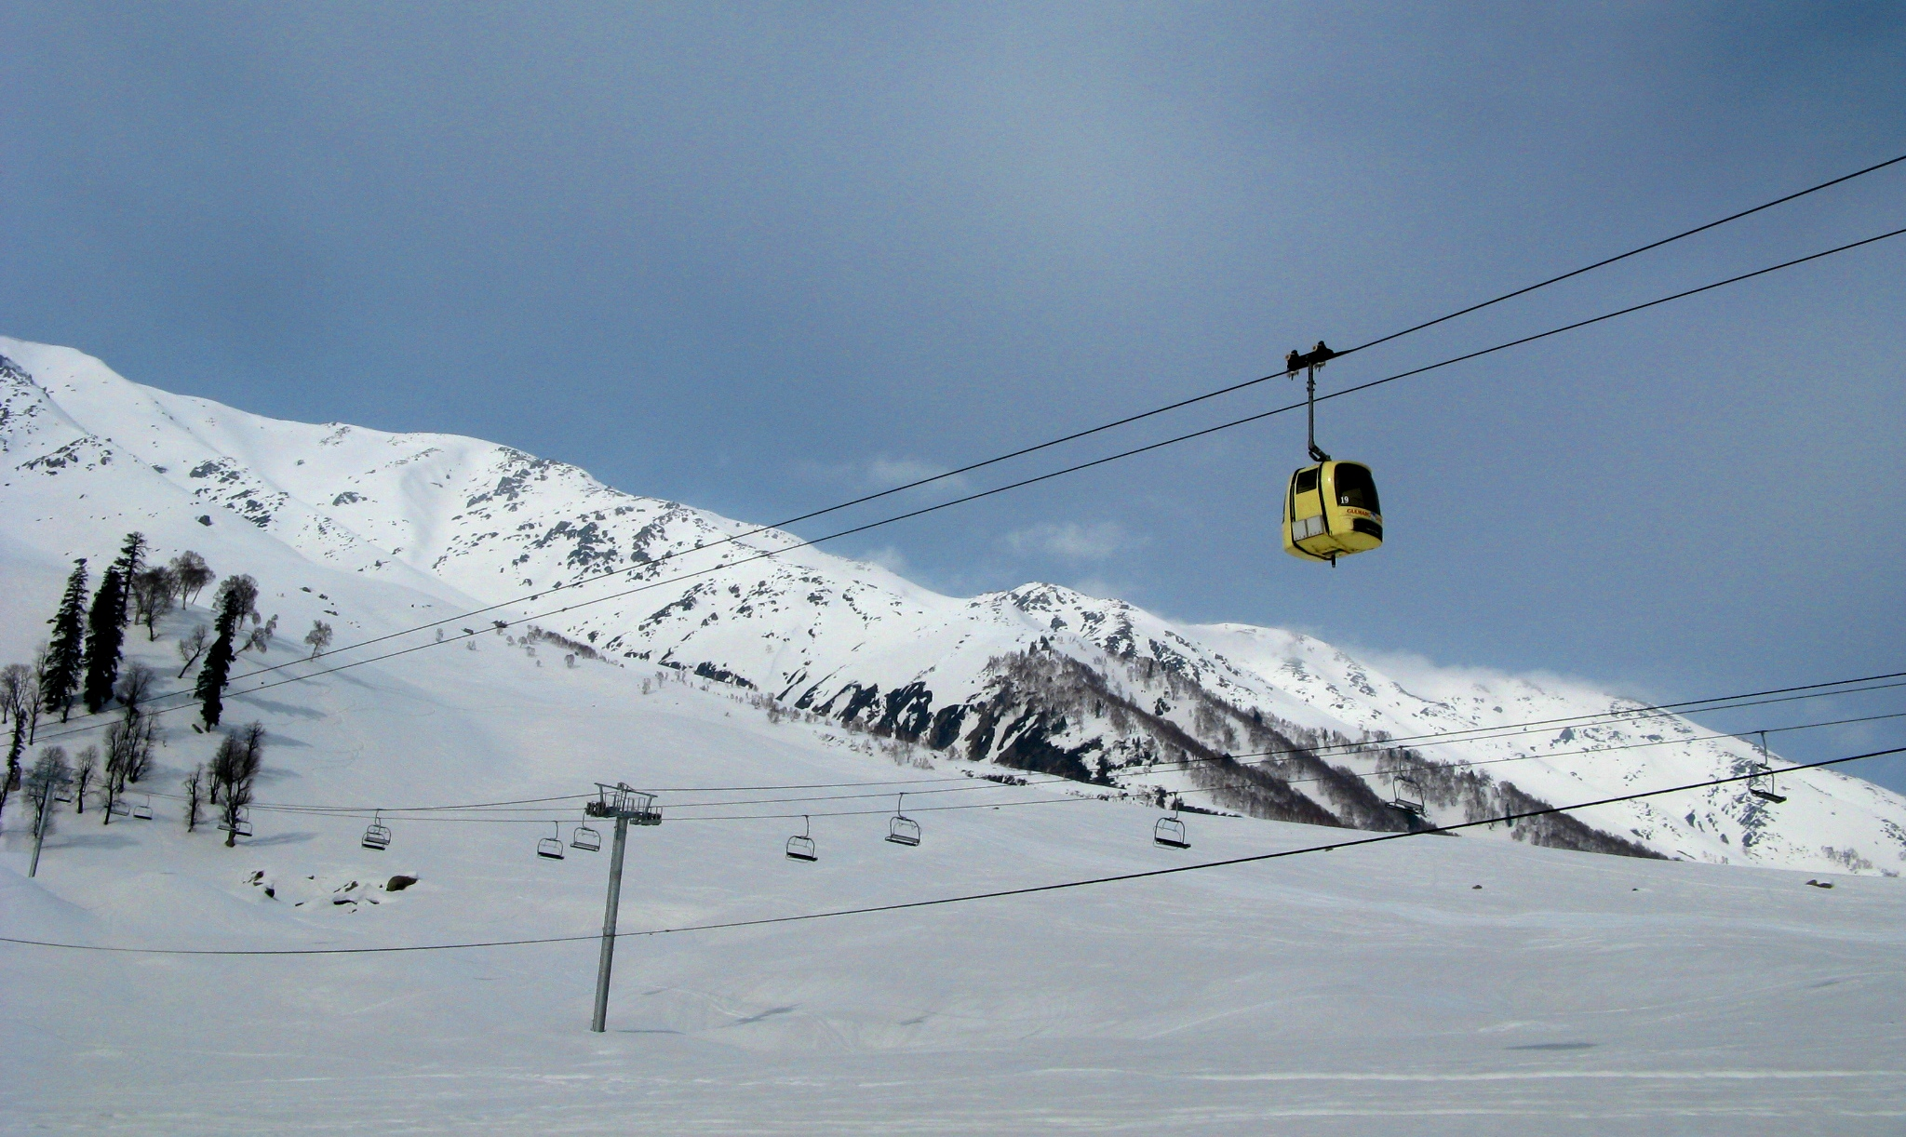
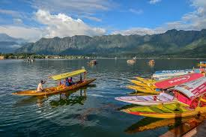
Day – 04
GULMARG DAY TRIP
• After breakfast a full day excursion to Gulmarg (8700 ft i.e. 2652 mts), known as “Meadow of Flowers”.
• Go for the famous Gondola Ride, Asia’s highest & longest cable car (two-stage ropeway).
• First stage from Gulmarg to Kungdoor Station.
• Second stage takes skiers to a height of 3,747 m (12,293 ft).
• Gondola timing: 10 AM to 5 PM.
• In evening return to Srinagar.
• Overnight stay at Srinagar.
Day – 05
HOUSEBOAT STAY
• Check out from hotel & proceed for sightseeing.
• Local Srinagar tour of Mughal Gardens visiting Cheshmashahi, Shankaracharya Temple.
• Check in at Houseboat.
• Enjoy Shikara ride in the evening.
• Dinner & Overnight stay at Houseboat.

Slide 5
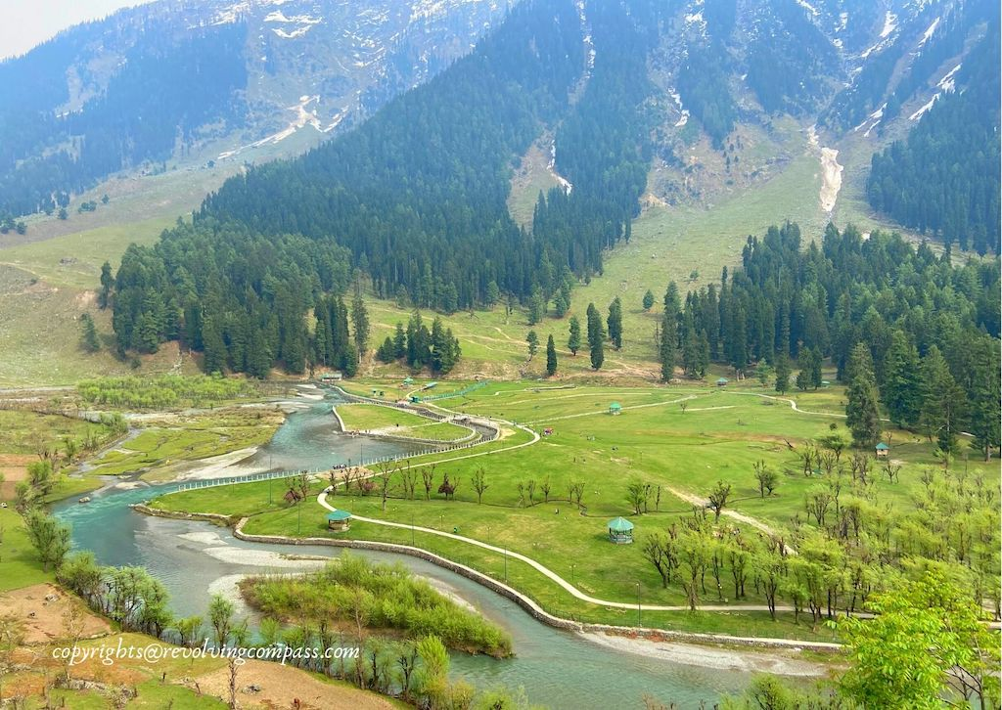
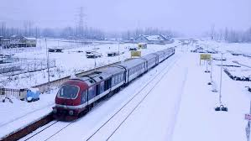
Day – 06
SRINAGAR TO PAHALGAM
• On the way visit Awantipura ruins & Saffron fields.
• Pahalgam offers breathtaking views.
• Trekking options to Lidderwat, Kolahoi Glacier or Sonmarg.
• Pahalgam is the entry point for the holy Amarnath Cave.
• Dinner & Overnight stay at hotel in Pahalgam.
Day – 07
PAHALGAM TO JAMMU
• After breakfast check out from the hotel and proceed to Jammu railway station with lots of memories.
Day – 08
REACH BACK RAJASTHAN

Slide 7


Tour Inclusions
DJ Night (Group Entertainment)
Lunch & Dinner Included

Slide 8
FEEL FREE TO REACH OUT TO ME
🌐WEBSITE: SAFARCHASKA.COM
📞PHONE: +91 8171379469
📧EMAIL: INFO@SAFARCHASKA.COM
📘FACEBOOK: SAFAR CHASKA
📸INSTAGRAM: @SAFAR__CHASK

