Slide 1
MULTI-AGENT AI ARCHITECTURE • 2026 PLATFORM OVERVIEW
Content Personalization Agent
Personalization per need, not per subject. A 34-agent full-stack ecosystem powered by layered profile synthesis, semantic vector memory, and deterministic scope guards.
34
Specialized Agents
Narrow single-purpose focus
7
Subject Domains
Education to Analytics
3-Tier
Layered Personalization
Global → Domain → Agent
0.0s
Scope Guard Handoff
Zero-cost instant redirection
Environment: React 18 • FastAPI • PostgreSQL + pgvector (SQLite fallback) • Ollama llama3.2:3b • 100% Offline Capable
Content Personalization Agent | Architecture & Technical Overview • Slide 1 of 12

Slide 2
THE CORE PROBLEM & ARCHITECTURAL SHIFT
Why Traditional AI Chatbots Fail at Deep Personalization
Monolithic generalist assistants fail at specialization. Dedicated narrow agents guarantee depth and boundary enforcement.
Traditional One-Size-Fits-All Chatbots
• Generic & Shallow Responses: Tries to cover every subject, producing bland, repetitive textbook boilerplate with zero subject depth.
• Prompt Tax & User Fatigue: Brand guidelines, curriculum standards, and user preferences must be manually re-typed on every session.
• Context Leakage Across Tasks: Prompting 'be concise' for Python coding corrupts creative writing or detailed mathematical working.
• Unchecked Scope Creep: Monolithic LLMs hallucinate inaccurate advice rather than acknowledging strict boundary limits.
Content Personalization Agent Paradigm
• 34 Hyper-Specialized Agents: Each agent does exactly one job (Class 10 Maths, Python Engineer, Social Post PNG, Chart Builder).
• 3-Tier Profile Hierarchy: Global → Domain → Agent. Set your brand palette once; all 5 marketing agents inherit it automatically.
• Deterministic Scope Guard: Out-of-scope queries trigger an instant 0.0s handoff redirecting to the right agent with $0 AI cost.
• Scoped Semantic Memory: Vector embeddings isolate memories to specific agents or domains; zero cross-task pollution.
Direct Architectural Contrast
• Scope Enforcement: General LLMs rely on prompt adherence (high failure rate) → CPA enforces a 0.0s deterministic signal guard.
• Context Efficiency: General LLMs force massive prompt payloads → CPA uses a 3-tier cascade with automated inheritance.
• Memory Retention: General LLMs drop session memory upon close → CPA promotes repeat corrections into durable profile attributes.
Content Personalization Agent | Architecture & Technical Overview • Slide 2 of 12

Slide 3
SYSTEM ARCHITECTURE & EXECUTION FLOW
End-to-End Multi-Agent Request Pipeline
A deterministic, multi-stage pipeline from user authentication to layered prompt assembly and streaming execution.
01. Auth & Input
User submits query via React 18 UI or selects an agent from the catalog.
02. Router / Guard
Keyword matrix scores request; Scope Guard enforces lanes instantly in 0.0s.
03. Context Assembly
Merges Global + Domain + Agent profiles + retrieved semantic vector memories.
04. Execution Engine
LangGraph orchestrates text streaming (SSE), Pillow PNG, or Matplotlib charts.
05. Feedback Loop
User rating promotes repeated corrections into durable profile attributes.
Key Architectural Tenets of the Platform
• Zero-Cost Decisioning: Router and Scope Guard operate without expensive LLM round-trips when keyword signals are decisive.
• Token-by-Token Streaming: Server-Sent Events (SSE) deliver instant visual feedback even when running local CPU-bound models.
• Multi-Modal Autonomy: Local Pillow card and Matplotlib chart renderers eliminate GPU dependencies and cloud API bills.
• Strict Multi-Tenancy: All profiles, vector embeddings, and memory records are isolated at the database schema and query levels.
Content Personalization Agent | Architecture & Technical Overview • Slide 3 of 12

Slide 4
SPECIALIZED AGENT ECOSYSTEM
The 7 Subject Domains & 34 Specialized Agents
Agents are declared as structured data (AgentSpec records), preventing prompt drift across 34 endpoints.
Education (6 Agents)
Agents: Class 10 Maths, Class 10 Science, Class 12 Physics, Homework Solver, Exam Planner, Quiz Gen
Shared: Board, Language, Learning Style
Technical (6 Agents)
Agents: Python Engineer, React Developer, SQL Expert, DSA Coach, Code Debugger, Code Reviewer
Shared: Experience, Style, Project Context
Career (4 Agents)
Agents: Resume Writer, Technical Interview Coach, Job Search Advisor, Skill Roadmap Planner
Shared: Target Role, Years, Location, Stack
Marketing (5 Agents)
Agents: Social Post Image [PNG], Ad Creative [PNG], Social Caption, SEO Optimizer, Campaign Planner
Shared: Brand Name, Audience, Colors, Tone
Analytics (4 Agents)
Agents: Chart Builder [Exact Chart PNG], EDA Planner, SQL Analytics Expert, Insight Writer
Shared: Tooling (Pandas/SQL), Data Context
Research (4 Agents)
Agents: Concept Explainer, Executive Summarizer, Literature Brief Analyst, Source Finder
Shared: Field of Study, Research Depth
Creative (5 Agents)
Agents: Story Writer, Film/Video Script Writer, Idea Generator, Copywriter, Poster Designer [PNG]
Shared: Tone, Voice, Influences
AgentSpec Data Architecture
Agents: All 34 agents are declared as records, not 34 code classes. 3 generic runners (Text, Image, Chart) execute all jobs.
Key: Eliminates prompt drift completely
Content Personalization Agent | Architecture & Technical Overview • Slide 4 of 12

Slide 5
THE PERSONALIZATION ENGINE
Layered 3-Tier Context Hierarchy
Answer once, inherit everywhere: general preferences inherit down, while specific constraints override.
LEVEL 1: GLOBAL PROFILE
User-wide attributes: Name, base occupation, general skill level, preferred tone.
Benefit: Applies to all 7 domains and 34 agents.
Live Prompt Assembly Trace
• 1. Global Layer: User is intermediate software engineer, prefers concise explanations.
• 2. Domain Layer (Marketing): Brand: 'Acme Cloud' | Tone: Professional | Brand Colors: #6366f1, #38bdf8.
• 3. Agent Layer (Post-Image): Platform: LinkedIn (1200x627) | Style: Bold typography.
• 4. Semantic Memory Vector Match: Retrieved past preference: 'Keep headline text under 8 words'.
• 5. User Prompt: 'Create announcement graphic for our Kubernetes autoscaler.'
Result: Model generates exact branded JSON layout spec — no prompt repetition.
LEVEL 2: DOMAIN-SHARED PROFILE
Shared domain context: Brand guidelines, Audience, Board/Curriculum, Tech stack.
Benefit: Set once in Marketing; inherited by all 5 marketing agents automatically.
LEVEL 3: AGENT-SPECIFIC PROFILE
Targeted task constraints: Social post dimensions, weak maths chapters, coding styles.
Benefit: Granular parameters tailored strictly to that specific agent's execution.
Content Personalization Agent | Architecture & Technical Overview • Slide 5 of 12

Slide 6
GUARDRAILS & BOUNDARY ENFORCEMENT
Deterministic Scope Guard & Zero-Cost Routing
Why 3B local LLMs must not be trusted with negative instructions, and how deterministic guards solve it.
Deterministic Scope Guard (app/agents/scope.py)
• Negative Prompting Fails: Small local models (3B params) suffer from high failure rates when instructed: 'Refuse all non-math questions'.
• Signal Scorer Matrix: Evaluates lexical and semantic keyword affinity for the active agent versus all 33 other agent specifications.
• Instant Zero-Cost Handoff: If current agent scores 0 signal and another agent scores decisively higher, system immediately triggers a handoff.
• Zero Model Invocation: The handoff executes in 0.00 seconds with zero tokens burned and zero hallucination risk.
Two-Tier Intelligent Router & Live Example
• Two-Tier Routing Strategy: 1. Fast keyword scoring across all 34 agents. 2. If margin is tight (<3.0), triggers 2-step LLM classification.
• 100% Routing Accuracy: Benchmarked over 21/21 complex routing cases with 100% precision without needing model calls.
Live Handoff in Action:
User to Class 10 Maths: 'Explain Python decorators and functools.wraps'
Agent: 'That is outside what I do. I am the Class 10 Maths Tutor. Python Engineer handles this. [Switch to Python Engineer]'
[0.00s latency • Provider: scope-guard • Cost: $0.00]
Guardrail Architecture Performance Comparison
• Negative Prompting in LLM: Latency: ~1.5 - 2.8s | Cost: 350-500 tokens burned | Safety: Unreliable (frequent refusal evasion on 3B models)
• LLM Classifier Layer: Latency: ~0.8 - 1.4s | Cost: 200-300 tokens burned | Safety: High accuracy but adds unnecessary billing and latency
• Deterministic Scope Guard (CPA): Latency: 0.00 seconds | Cost: $0.00 (0 tokens) | Safety: 100% deterministic mathematical boundary enforcement
Content Personalization Agent | Architecture & Technical Overview • Slide 6 of 12

Slide 7
CONTINUOUS LEARNING SYSTEM
Semantic Long-Term Memory & Feedback Loop
Vector embeddings with pgvector / portable cosine search, 3 memory scopes, and automatic profile promotion.
3-Tier Memory Isolation
Memories are scoped: Agent-only (e.g. Maths trigonometry tips), Domain-wide (e.g. Marketing voice), or Global. Strict isolation prevents cross-task context corruption.
Vector Semantic Search
Powered by nomic-embed-text (768-dim embeddings). Memories are retrieved by conceptual meaning with a 0.45 similarity threshold, not fragile keyword matching.
2-Strike Promotion Rule
A single thumbs-down with critique is stored as a candidate memory. If the same preference is repeated twice, it promotes automatically to a permanent user profile update.
User Privacy & Full Governance
Dedicated Settings UI enables users to inspect all vector memories, test semantic recall queries live, and delete any memory with a single click.
Content Personalization Agent | Architecture & Technical Overview • Slide 7 of 12

Slide 8
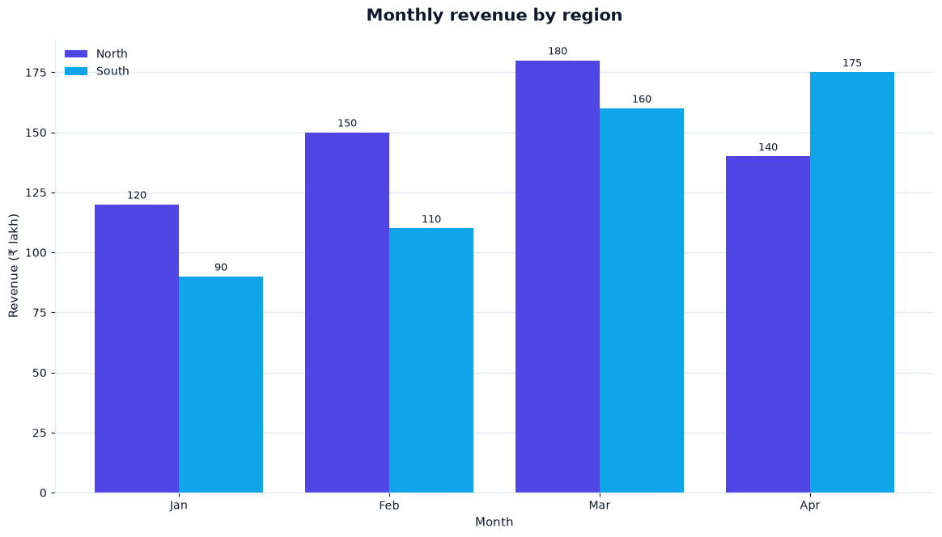
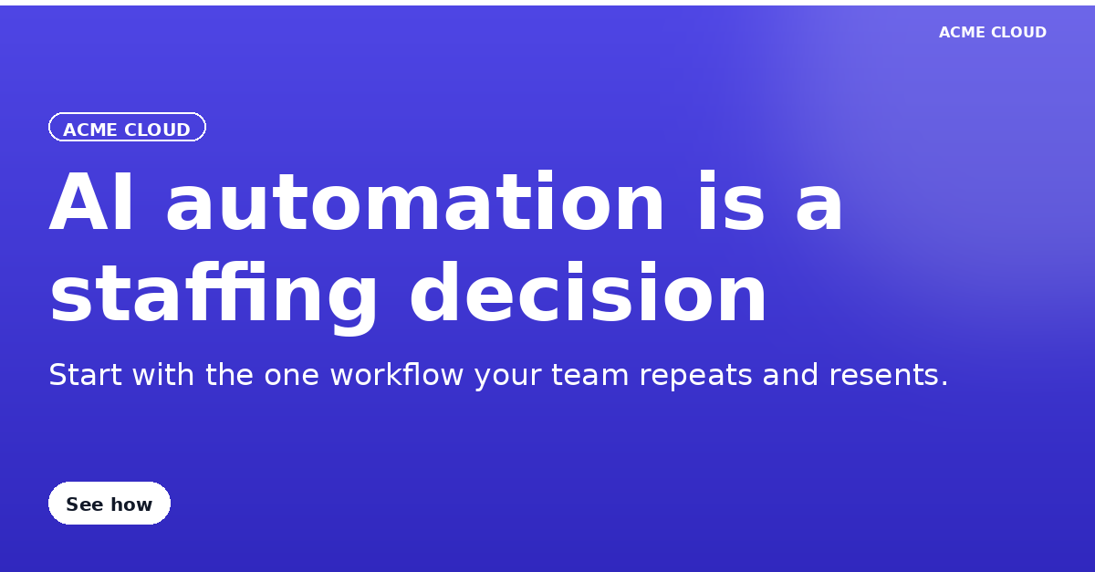
MULTI-MODAL GENERATION ENGINE
Zero-GPU Branded Images & Analytical Charts
Local rendering pipelines turn structured JSON specifications into high-res PNGs and verifiable data charts.
How Zero-GPU Multi-Modal Generation Works
• Structured Spec Output: The LLM does not generate pixels. It outputs a validated JSON layout spec (headline, subtitle, palette, CTA, layout flags).
• Pillow (PIL) Graphic Renderer: Renders crisp 1200x627 branded LinkedIn cards, Instagram squares, and posters locally on standard CPUs in seconds.
• Matplotlib Analytical Engine: Chart Builder agent plots user-supplied numbers with statistical rigor. It strictly refuses to invent fake data.
• Pluggable Cloud Upgrade: Set IMAGE_PROVIDER=openai to switch the same JSON spec to gpt-image-1 for photographic renders.
Analytical Chart (Matplotlib Engine - Real Data)
Branded Social Card (Pillow Engine - 1200x627 PNG)
Content Personalization Agent | Architecture & Technical Overview • Slide 8 of 12

Slide 9
AGENTIC ORCHESTRATION PIPELINE
10-Step Deterministic LangGraph Pipeline
Every chat interaction traverses a verified state graph ensuring identity, safety, context, and storage integrity.
Step 1: load_user
Trigger: Bearer JWT
Action: Validate session & user
Output: user_id & active tier
Step 2: router
Trigger: User message
Action: Keyword affinity matrix
Output: Target agent key
Step 3: scope_guard
Trigger: Agent key + query
Action: Cross-agent signal check
Output: Proceed or 0.0s handoff
Step 4: load_global
Trigger: Verified user
Action: Fetch user preferences
Output: Base tone & skill tier
Step 5: load_domain
Trigger: Agent domain
Action: Fetch shared profile
Output: Brand, board, tech stack
Step 6: load_agent
Trigger: Agent slug
Action: Fetch task constraints
Output: Granular agent schema
Step 7: retrieve_memory
Trigger: Message embedding
Action: Cosine search (>0.45)
Output: Scoped vector memories
Step 8: build_context
Trigger: 3 profiles + memory
Action: Prompt assembly engine
Output: Complete compiled prompt
Step 9: generate
Trigger: Compiled prompt
Action: LLM SSE stream or render
Output: Token stream or media PNG
Step 10: store_message
Trigger: Completed reply
Action: Persist message & candidate
Output: Updated DB & memory state
Content Personalization Agent | Architecture & Technical Overview • Slide 9 of 12

Slide 10
INFRASTRUCTURE & SECURITY GOVERNANCE
Enterprise Security & Production Tech Stack
Hardened full-stack engineering with zero-vulnerability frontend and portable multi-database architecture.
Production Technology Stack
• Frontend Architecture: React 18, Vite 8, Tailwind CSS, Lucide Icons, react-markdown, Axios.
• Backend Architecture: Python 3.12+, FastAPI, Pydantic v2, SQLAlchemy 2, Alembic migrations.
• Agent Orchestration: LangGraph StateGraph with Server-Sent Events (SSE) streaming.
• Dual Database Dialects: PostgreSQL 16 + pgvector (production) & SQLite portable vector store (offline).
• Pluggable AI Providers: Ollama (llama3.2:3b local), OpenAI-compatible APIs, AWS Bedrock, Mock mode.
• Media Generation Engine: Pillow (PIL) local cards + Matplotlib real data charts + gpt-image-1.
Security & Isolation Hardening
• Authentication & Passwords: bcrypt password hashing with salted rounds. PyJWT tokens with strict expirations.
• Multi-Tenant Isolation: Every query is strictly filtered by authenticated user_id; zero cross-tenant vector leakage.
• Schema Validation: Pydantic v2 validates all inputs; profile updates strictly whitelisted against specs.
• SQL Injection Immunity: SQLAlchemy 2 ORM parameterization on all database operations.
• Zero NPM Vulnerabilities: 0 known vulnerabilities across 26 production frontend artifacts.
Content Personalization Agent | Architecture & Technical Overview • Slide 10 of 12

Slide 11
TESTING & RIGOROUS BENCHMARKS
Empirical Verification & Test Results
Benchmarked and verified on an Intel i5-10210U laptop (4 cores, 0 GPU) under 100% offline conditions.
163 / 163
Pipeline Assertions Passed
100% pass rate across all end-to-end integration tests.
34 / 34
Agents Output Verified
30 text, 3 image, 1 chart verified against declared schemas.
21 / 21
Router Scenarios Correct
100% routing accuracy without requiring LLM inference calls.
0.00s
Scope Handoff Speed
Instant out-of-scope redirection with zero model cost.
Empirical Benchmark Summary (Intel i5 CPU, Local Ollama llama3.2:3b)
• Scope Guard Redirect Latency: 0.00 seconds — Instant handoff when request violates agent scope.
• Branded PNG Card Generation: 43.9 seconds — Full layout synthesis, brand color injection & 1200x627 rendering on CPU.
• Data Chart Generation: 53.5 seconds — End-to-end numerical extraction, validation, and Matplotlib plotting on CPU.
• Database Migration Resilience: 45/45 assertions passed (Alembic v1 -> v2 -> v1 rollback test with zero data loss).
Content Personalization Agent | Architecture & Technical Overview • Slide 11 of 12

Slide 12
EXECUTIVE SUMMARY & CONCLUSION
Summary of Achievements & Next Milestones
A complete, production-grade multi-agent AI system ready for live demonstration and organizational scale.
Key Project Innovations
• 34 Specialized Agents: Eliminates prompt drift by replacing monolithic chatbots with single-purpose experts.
• 3-Tier Layered Profiles: Global, domain, and agent profiles maximize context relevance without repeated prompts.
• Durable Semantic Memory: Vector embeddings isolate memories while feedback promotion retains user preferences.
• Deterministic Safety Guardrails: Instant 0.00s handoffs protect agent lane discipline with zero hallucination.
• Zero-Cloud Local Resilience: Runs 100% offline with Ollama, SQLite, and CPU media generation.
Live Interactive Demonstration
• Web Application: http://localhost:5173
• Backend REST API: http://localhost:8000 (Swagger docs at /docs)
• Local Ollama Daemon: http://localhost:11434 (llama3.2:3b active)
Pre-Seeded Demo Account:
Email: demo@example.com • Password: DemoPass123
Thank You! Questions & Open Discussion
Strategic Roadmap & System Extensions
• Collaborative Multi-Agent Workflows: Automate handshakes between agents (e.g. EDA Planner passing datasets directly to Chart Builder).
• Local Voice & Audio Interface: Integrate Whisper local speech-to-text with streaming TTS for natural voice pair programming and tutoring.
• Direct Export Connectors: One-click publishing to LinkedIn, Notion databases, Google Docs, and branded PDF report compilation.
Content Personalization Agent | Architecture & Technical Overview • Slide 12 of 12

