Slide 1


Tiffany & Co. -- -LVMH Acquisition Proposal
PRESENTED BY – Group 3
Rishav jhaveri
Yash Mahavir Khanter
Nitin Narayanaswamy

Slide 2
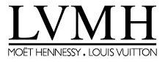
The Situation
LVMH Expected to Make an Offer
Current Position:
Stock Price: $91.58 (down 35% from $140 peak in October 2018)
Market Capitalization: $11.2 billion
Enterprise Value: $11.4 billion
Shares Outstanding: 122 million

Slide 3
The Situation
Founded 1837 - 182 years of American luxury heritage
World's most iconic jewelry brand
Market Position:
#1 in United States (14.4% market share)
#2 globally (11.0% market share)
$4.4B revenue, 321 stores, 14,200 employees
World's largest luxury conglomerate
75 brands across 5 segments
CEO: Bernard Arnault (3rd richest person globally)
Scale:
Revenue: €46.8B ($53B)
Market cap: $211B
#1 in fashion, wine, perfumes, retail

Slide 4
The Situation
Current Challenges: Stock down 35% ($140 → $91.58)
Temporary headwinds: Hong Kong protests, trade war, strong USD
Turnaround plan underway (CEO Bogliolo, 2017)
China momentum strong (6 quarters double-digit growth)
Current Challenges: #2 in jewelry (only 7.8% share vs Richemont 18.2%)
Jewelry only 9% of revenue (smallest segment)
Need scale to compete with Richemont (Cartier)
No alternative targets available

Slide 5
The LVMH Problem – Why LVMH Needs Us
#1 in Everything... Except Jewelry
-
Luxury Segment | LVMH Rank | 2018 Revenue
Fashion & Leather Goods | #1 | €18.5B
Wine & Spirits | #1 | €5.1B
Perfumes & Cosmetics | #1 | €6.1B
Selective Retail | #1 | €13.6B
Watches & Jewelry | #2* | $4.1B
*Among conglomerates; #3 overall in market share (7.8% vs Richemont 18.2%, Tiffany 11.0%)
THE PROBLEM: Jewelry is the only segment where LVMH does NOT lead. With only 7.8% market share vs Richemont's 18.2%, this is their biggest competitive gap and smallest business segment (9% of revenue).

Slide 6
The Jewelry Market Gap
#1 Richemont (Cartier, Van Cleef) ████████████████████ 18.2%
#2 Tiffany & Co. █████████████ 11.0%
#3 LVMH (Bulgari, TAG Heuer) ████████ 7.8%
Post Acquisition:
#1 LVMH + Tiffany ████████████████████ 18.8%
#2 Richemont ████████████████████ 18.2%
*This acquisition instantly makes LVMH the jewelry market leader. It closes the competitive gap that has existed for over a decade.

Slide 7
Tiffany - The Only Option
LVMH has no alternative path to jewelry leadership. This creates l significant negotiating leverage for us.
Brand | Availability | Reason
Cartier | ❌ | Richemont owns Cartier (won't sell to rival)
Hermès | ❌ | Family-controlled - LVMH tried in 2010-14, failed
Chanel | ❌ | Wertheimer family - Private, not for sale
TIFFANY | ✅ | Public, available
Others | ❌ | Too small

Slide 8
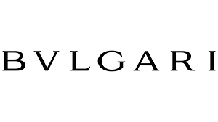
The Bulgari Precedent (2011)
LVMH's Last Jewelry Acquisition
Deal Metric | Bulgari | Why this is relevant to Tiffany
Premium paid | 60% | Same strategic imperative
EV/EBIT | 29x | Far above market (18x avg)
Rationale | Fill jewelry gap, no alternatives | Identical situation
Deal Value | $5.2B
:

Slide 9
Bulgari Success Under LVMH
Post-Acquisition Results (2011-2018):
Metric | 2011 | 2018 | Change
Revenue | $1.5B | $2.5B | +67%
EBIT Margin | 12% | 20% | +800 bps
Stores | 300 | 600 | Doubled
What This Proves:
LVMH will pay premium multiples for strategic jewelry
LVMH successfully integrates and grows jewelry brands
Bulgari sets benchmark for Tiffany – High prices are justified by post-deal value creation

Slide 10
What we bring to LVMH
Geographic Fit
The Gap: Tiffany’s Europe share only 11% vs. LVMH’s 29%
Key Takeaway: Tiffany’s heavy reliance on the Americas contrasts with LVMH’s balanced global footprint. This highlights a clear strategic opportunity for LVMH to expand its presence.
Tiffany’s Strength: Americas – 45% of revenue ($2.0B in 2018)
LVMH’s Strength: Europe – 29% of revenue

Slide 11
What we bring to LVMH
 | Metric/Scale | Strategic Value to LVMH
US Market Leadership | 14.4% US market share (#1 position) | Instant Americas dominance in jewelry
Established Infrastructure | 321 company-operated stores worldwide | Immediate global footprint, prime locations
American Heritage Brand | 182-year iconic status, cultural relevance | Only major US luxury jeweler (authentic positioning)
China Growth Momentum | 6 consecutive quarters double-digit growth | Platform to build on in critical market
Underdeveloped Platforms | Europe 11%, Watches 8% of revenue | Easy expansion opportunities for LVMH expertise

Slide 12
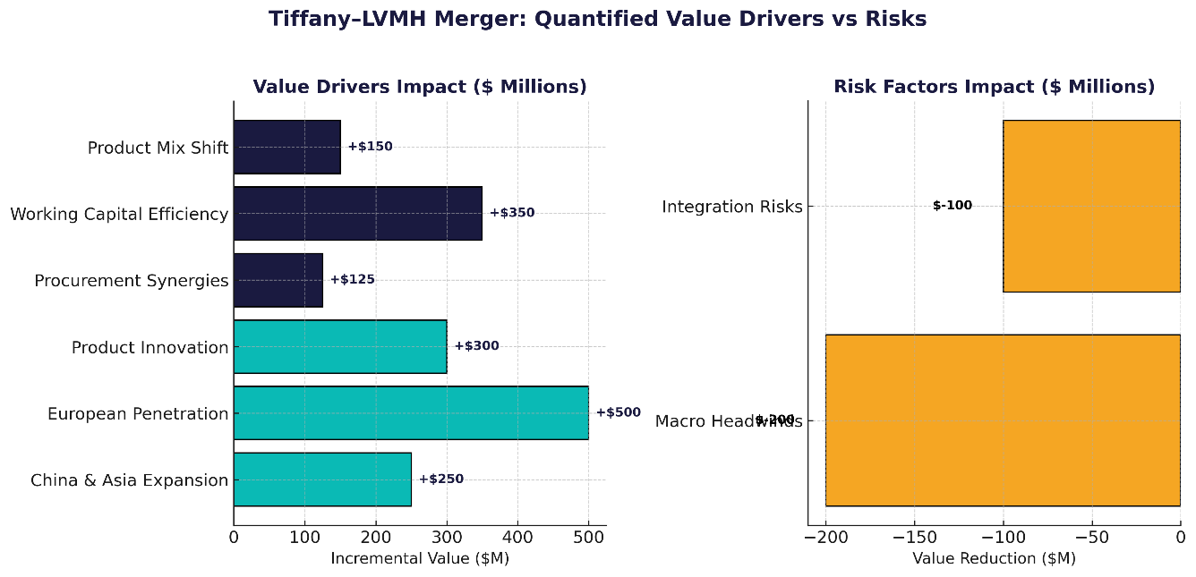
What we bring to LVMH

Slide 13
What we bring to LVMH
Growth Platform | Tiffany's Current Position | What LVMH Can Do with It | Value LVMH Creates
China/Asia Market | $1.2B revenue, 7% growth, strong momentum | Leverage 140+ LVMH stores, WeChat platform → 17% growth | $200-300M/year
Europe Market | $504M revenue (11% of total), 3% growth, 47 stores | Leverage 320+ LVMH stores, prime locations → 12-15% growth | $500M+/year
Watch Category | $350M revenue (8% of total), fashion positioning | Leverage TAG Heuer Swiss expertise → premium watches | $400M+/year
TOTAL REVENUE SYNERGIES |  |  | $1.1B/year

Slide 14
Valuation Summary
Method | Low | Implied | High | Weight
DCF | $71.86 | $105.23 | $216.66 | 20%
EV/Revenue | $34.52 | $108.42 | $293.77 | 20%
EV/EBITDA | $47.49 | $94.62 | $233.51 | 20%
EV/EBIT | $62.88 | $135.00 | $515.40 | 20%
P/E | $36.55 | $91.48 | $134.69 | 20%
Weighted Avg |  | $106.95 |  | 100%

Slide 15
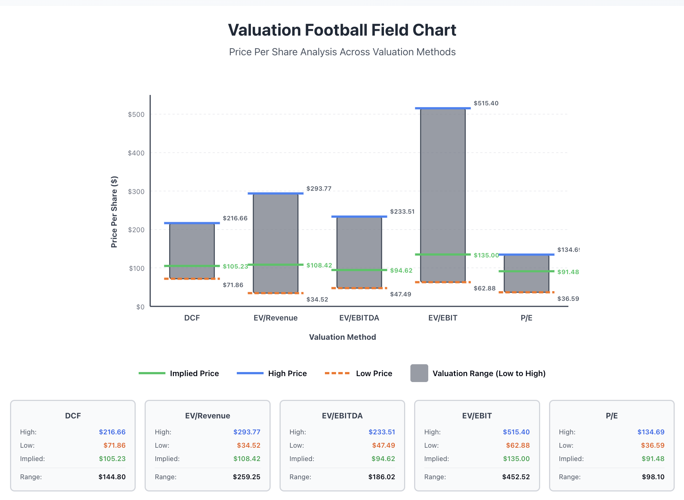
Football Field Valuation

Slide 16
Our Price Position
ANALYSIS:
Standalone: $105-107
With Synergies: 125-132 per share
Bulgari precedent: $147-175 per share
Opening position: $145 per share

Slide 17
Our Leverage
Why we're strong:
LVMH desperate - No alternative, must close jewelry gap
Bulgari precedent - 60% premium, 29x EBIT benchmark
Competing bidders - Richemont, Kering, Berkshire possible
Standalone works - Turnaround on track, stock recovers to $120-130+
Time favors us - Temporary headwinds normalizing

Slide 18
THANK YOU

