Slide 1
PROJECT REPORT | IoT, EMBEDDED SYSTEMS & WATER CONSERVATION
IoT-Based Smart Water Tank Monitoring and Management System
ESP32 • Ultrasonic level • Flow • TDS • Automatic pump control
Prince Mandal (24BCE1606)
Vineet Verma (24BCE1611)
Harshika Tripathi (24BCE1627)
SCOPE, Vellore Institute of Technology
Submitted to: Mr. M Manigandan
Academic Year 2026–2027
Notes:
Introduce the team, guide and project title.

Slide 2
01 PROBLEM
Problem Statement
Manual operation
Goal
1
Conventional tanks need manual monitoring and pump control, causing overflow, shortages and wasted electricity.
Reduce manual intervention, improve water management and support efficient use of water resources.
No real-time data
2
Users cannot see water level, flow through the pipeline, or dissolved solids (TDS) in the water.
Our solution
Tank overflow • Dry tank • Wasted power
3
An ESP32-based system that senses level, flow and TDS, switches the pump automatically, and shows readings on an LCD with buzzer alerts.
Smart Water Tank Monitoring and Management System
2
Notes:
Explain why manual tank handling wastes water and electricity.

Slide 3
02 OBJECTIVES
Objectives
1
Water-level monitoring
2
Automatic pump control
Ultrasonic distance → level estimate
ON at ≤30%, OFF at ≥90%
3
Water-flow measurement
4
Water-quality monitoring
YF-402 flow rate and total volume
TDS sensor estimates dissolved solids
5
Real-time display
6
Alert system
Level, distance, flow, total use, TDS on 16×2 LCD
Buzzer on level or TDS thresholds
7
Water conservation
8
Embedded integration
Minimise overflow and wastage
Sensors, actuators and MCU as one system
Smart Water Tank Monitoring and Management System
3

Slide 4
03 REQUIREMENTS
Hardware Requirements
# | Component | Qty | Purpose
1 | ESP32 DevKit V1 | 1 | Main microcontroller: processes sensors, drives outputs
2 | Ultrasonic sensor (HC-SR04) | 1 | Measures distance to the water surface
3 | YF-402 flow sensor | 1 | Measures water flow using electrical pulses
4 | TDS sensor module with probe | 1 | Estimates total dissolved solids
5 | 16×2 LCD with I²C module | 1 | Shows readings and pump status
6 | JQC3F-05VDC relay module | 1 | Switches the water pump ON/OFF
7 | Water pump | 1 | Transfers water into or out of the tank
8 | Buzzer | 1 | Audible alerts
9 | Regulated power supply | As req. | Powers the ESP32 and peripherals
10 | Connecting wires | As req. | Electrical connections
11 | Breadboard | 1 | Prototype wiring, if used
12 | Water tank and pipe | As req. | Test environment for level and flow
Smart Water Tank Monitoring and Management System
4

Slide 5
03 REQUIREMENTS
Software Requirements
Arduino IDE
Embedded + IoT prototype
Write, compile and upload the ESP32 program
ESP32 reads sensors and controls the pump locally; Wi-Fi connects telemetry to HiveMQ Cloud.
ESP32 Arduino board package
ESP32 board support in the IDE
LiquidCrystal_I2C library
Controls the I²C LCD
Cloud-connected stack
Serial Monitor (115200 baud)
HiveMQ Cloud (MQTT) → Node.js/Express API → PostgreSQL history → live dashboard/app.
Readings and debugging output
Embedded C++
Sensor processing and control logic
Smart Water Tank Monitoring and Management System
5

Slide 6
04 ARCHITECTURE
System Architecture: Four Layers
1
2
3
4
Sensing Layer
›
Processing Layer
›
Control Layer
›
Cloud + Display Layer
Collects water level, flow and TDS data
ESP32 reads sensors, computes level %, flow rate, checks thresholds
ESP32 drives the relay (pump) and buzzer per programmed conditions
LCD / Serial + backend dashboard present readings and status
Telemetry: Sensors → ESP32 → HiveMQ Cloud → Node.js backend → PostgreSQL → dashboard/app | Commands return via MQTT
Smart Water Tank Monitoring and Management System
6

Slide 7
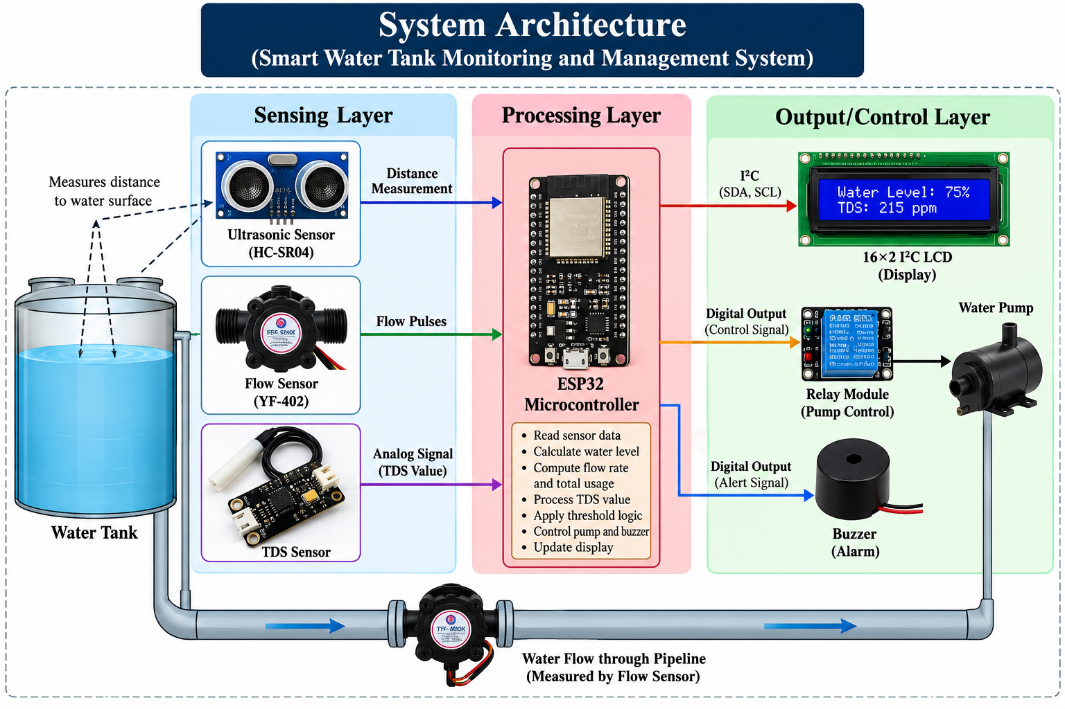
04 ARCHITECTURE
System Architecture Diagram
Level
Ultrasonic echo time gives distance; ESP32 converts it to a percentage.
Flow
YF-402 pulses are counted to get flow rate and total volume.
TDS
Analog signal on an ADC pin is converted to ppm.
IoT outputs
LCD + buzzer provide local feedback; MQTT sends telemetry to the backend and relays remote commands to the ESP32.
Smart Water Tank Monitoring and Management System
7
Notes:
Figure 1: Water Tank Monitoring and Management System.

Slide 8
05 HARDWARE
ESP32 Pin Connections
Ultrasonic HC-SR04
YF-402 flow sensor
TDS module
TRIG → GPIO 5
ECHO → GPIO 18 (via divider / level shifter)
VCC, GND
Signal → GPIO 27 (3.3 V-safe)
VCC per sensor spec
GND common
Analog out → GPIO 34
VCC (+) supported supply
GND (−) common
I²C LCD 16×2
Relay module
Buzzer
SDA → GPIO 21
SCL → GPIO 22
VCC per module, GND common
IN → GPIO 26
VCC per module
GND common
(+) → GPIO 25, if current-compatible
(−) → GND
Verify actual component labels and 3.3 V compatibility before powering the circuit.
Smart Water Tank Monitoring and Management System
8

Slide 9
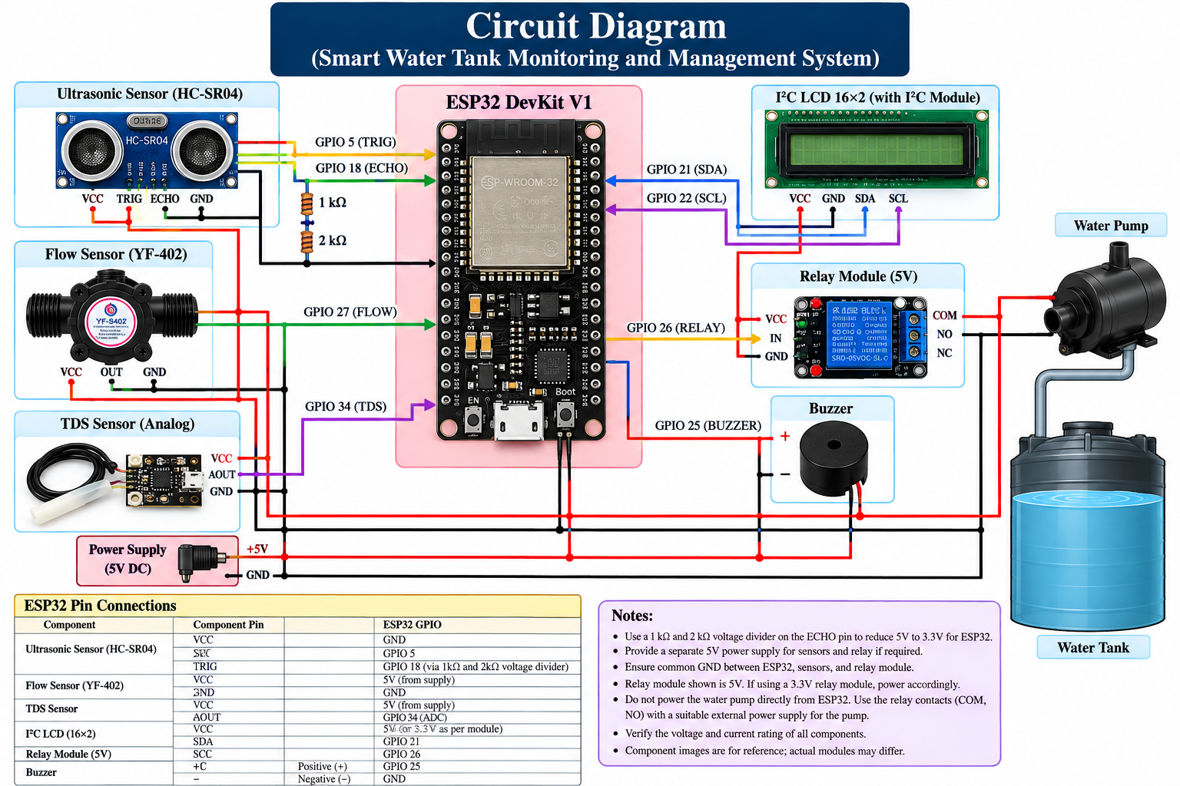
05 HARDWARE
Circuit Diagram and Relay–Pump Wiring
Relay and pump
Relay acts as an electrically controlled switch
Control input on GPIO 26
Pump wired through relay COM and NO contacts
ESP32 drives only the relay input; pump has its own rated supply
Test relay behaviour before connecting the pump
Smart Water Tank Monitoring and Management System
9
Notes:
Figure 2: Circuit diagram. Includes ESP32, HC-SR04, YF-402, TDS, I2C LCD, relay + pump, buzzer, common ground.

Slide 10
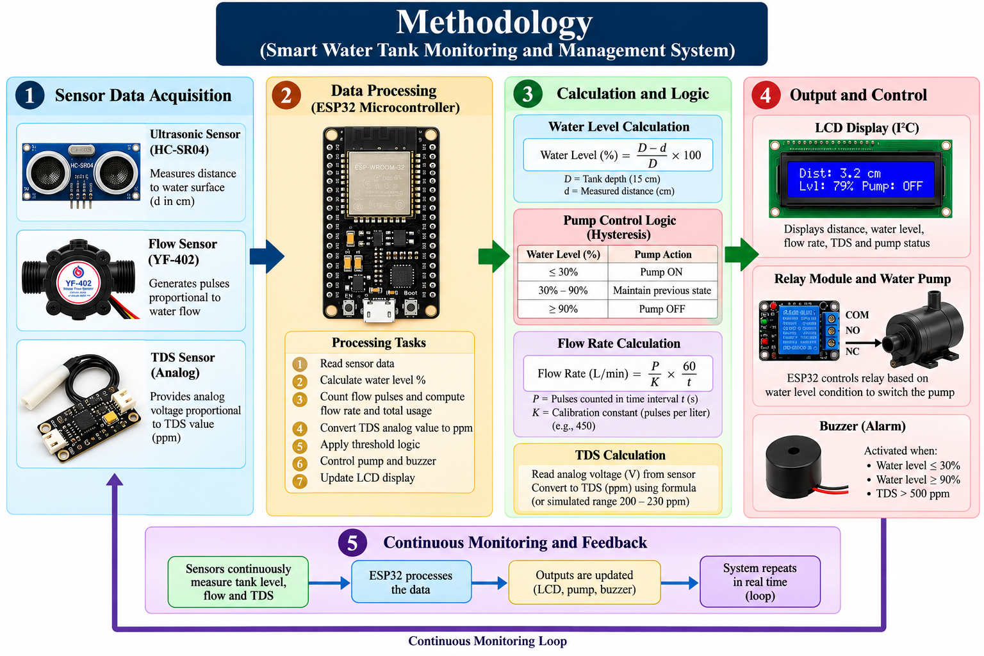
06 METHODOLOGY
Methodology Overview
1
Initialise
GPIOs, LCD, ADC, flow interrupt; relay and buzzer OFF
2
Acquire
Level, flow and TDS
3
Process
Compute values, compare thresholds
4
Control
Pump, buzzer, LCD; loop repeats
Smart Water Tank Monitoring and Management System
10

Slide 11
06 METHODOLOGY
Water Level and Automatic Pump Control
Level (%) = (D − d) / D × 100
Water-level condition | Pump action
Level ≤ 30% | Pump ON
30% to 90% | Maintain previous state
Level ≥ 90% | Pump OFF
Invalid ultrasonic reading | Pump OFF (auto mode)
D = reference distance (tank depth, 15 cm in prototype)
d = measured distance to the water surface
Example: d = 3 cm → (15 − 3)/15 × 100 = 80%
Why hysteresis?
Holding the previous state between 30% and 90% prevents unnecessary relay chatter and wear.
Design caution
90% of a 15 cm depth is about 1.5 cm from the sensor, below the reliable range of many HC-SR04 units. Sensor placement or the upper threshold may need adjusting.
Smart Water Tank Monitoring and Management System
11

Slide 12
06 METHODOLOGY
Flow, TDS, Display and Alerts
Flow rate
TDS (ppm)
Q = (P / K) × (60 / t) L/min
Read analog voltage on GPIO 34
P = pulses in interval, K = pulses per litre (450, provisional; must be calibrated), t = interval (s). Volume is accumulated over intervals.
Converted to ppm by an approximate formula; needs calibration and temperature compensation.
LCD screens (alternate)
Buzzer alerts
Screen 1: distance, level %, pump status
Screen 2: flow L/min, TDS ppm
Level ≤ 30%
Level ≥ 90%
TDS > 500 ppm
16×2 I²C display; also mirrored on Serial Monitor.
Thresholds are adjustable for the application.
Smart Water Tank Monitoring and Management System
12

Slide 13
07 RESULTS
Functional Test Results
Test case | Expected result | Status
Ultrasonic sensor | Distance shown in cm on Serial Monitor | Pass
Water-level calculation | Correct percentage from distance | Pass
LCD screen 1 | Distance, level, pump status shown | Pass
LCD screen 2 | Flow rate and TDS shown | Pass
Flow sensor | Flow rate changes when water flows | Pass
TDS sensor | TDS responds to analog input | Pass
Low-level control | Pump ON command at ≤30% | Pass
Full-level control | Pump OFF command at ≥90% | Pass
Buzzer | Activates on programmed conditions | Pass
Relay | Contacts switch as commanded | Pass
10 / 10
test cases passed
Test sequence
Check sensors and display first, test the relay with the pump disconnected, then connect the pump after verifying electrical safety.
Smart Water Tank Monitoring and Management System
13
Notes:
Procedure: connect per circuit, upload via Arduino IDE, Serial Monitor at 115200, verify ultrasonic distances, compare level to tank, pass water through flow sensor, check TDS, test relay with pump disconnected, verify low/full logic, check LCD and buzzer, connect pump last.

Slide 14
07 RESULTS
Worked Examples and Discussion
Discussion
Contactless level sensing plus flow data in one compact unit
Local LCD reduces manual tank checks
Automatic control limits overflow and needless pump runs
Accuracy depends on calibration, wiring and measurement quality
Flow K-factor, TDS conversion and relay contacts need verification
Pump action: 12 cm and 10.5 cm → ON; 7.5 cm and 3 cm → maintain; 1.5 cm → OFF. Mathematical examples, not all physically tested; 1.5 cm may be outside sensor range.
Smart Water Tank Monitoring and Management System
14

Slide 15
08 APPLICATIONS
Applications
1
Residential tanks
2
Apartment buildings
Overhead and underground tanks with automated pumps
Multiple units tracking level and consumption
3
Educational institutions
4
Agriculture
Schools, colleges, labs and hostels
Small water distribution and storage systems
5
Industrial storage
6
Consumption monitoring
Level measurement and pump management
Estimate usage; spot unusual changes
7
Remote IoT monitoring
HiveMQ MQTT, Node.js API, PostgreSQL history, live dashboard and alerts
Smart Water Tank Monitoring and Management System
15

Slide 16
Conclusion and Future Scope
Conclusion
Next improvements
ESP32 integrates ultrasonic, flow and TDS sensing with relay control, LCD and buzzer
Pump ON at ≤30%, OFF at ≥90% reduces manual monitoring
Shows how embedded automation supports water conservation
Sensor calibration and better placement
Electrical safety verification
Cloud integration (Wi-Fi, MQTT)
Historical data storage
Mobile / web dashboard
References: Espressif ESP32 docs • MQTT/HiveMQ docs • Node.js/Express docs • PostgreSQL docs • HC-SR04, YF-402, TDS and relay module datasheets
Thank you

Slide 17
08 CLOUD CONNECTIVITY
HiveMQ Cloud and MQTT Messaging
The broker routes telemetry and control messages between the ESP32 and the backend.
publish
subscribe
insert
ESP32 device
Sensors • local control
HiveMQ Cloud
MQTT broker • TLS port 8883
Node.js / Express
MQTT subscriber + REST API
PostgreSQL
Historical telemetry
Telemetry topic
Command + acknowledgement
Device status + alerts
smartwater/ESP32_001/telemetry
Publishes distance, water level, flow rate, total litres, TDS estimate, pump state and auto/manual mode.
…/command → ESP32
…/ack ← ESP32
The backend publishes a command; the device applies it and can return its pump/mode state.
…/status reports online/offline state. …/alert carries threshold or possible-leak warnings when that logic is configured.
Important: topic names and DEVICE_ID must match across firmware, HiveMQ subscriptions and backend configuration. Use broker credentials securely and validate TLS certificates for production.
17

Slide 18
09 BACKEND & DATA
Node.js Backend and PostgreSQL
The backend bridges MQTT device messaging and the dashboard's HTTP API.
ESP32
MQTT telemetry / commands
HiveMQ Cloud
Topic routing
Express API
Validation • device state
PostgreSQL
Telemetry history
Backend responsibilities
API surface
Database purpose
• Subscribe to telemetry, status and alert topics
• Validate incoming JSON and timestamps
• Store readings and expose latest/history data
• Publish commands to the device topic
GET /api/health
GET /api/telemetry/latest
GET /api/telemetry/history?limit=100
GET /api/device/status
POST /api/device/command
Store time-series readings for trends and troubleshooting. Typical fields: deviceId, timestamp, distanceCm, waterLevel, flowRateLMin, totalLiters, tdsPPM, pumpStatus and autoMode.
Deployment note: the API must use environment variables for database and broker secrets. Protect command endpoints with authentication/authorization before public deployment.
18

Slide 19
10 LIVE MONITORING
Live Dashboard: What the User Sees
Dashboard values are refreshed from the backend; historical charts come from stored telemetry.
● ONLINE
SMART WATER / DEVICE ESP32_001
Pump control
AUTO / MANUAL mode
ON • OFF commands via backend → MQTT
Water level
65%
Flow rate
3.2 L/min
TDS estimate
215 ppm
Pump status
ON
Alerts & connection
Recent water-level trend (illustrative UI mock-up)
Low / high level • TDS threshold
Possible flow anomaly • device offline
History & usage
Flow and level charts from PostgreSQL history; total litres support consumption review.
Dashboard figures shown here are illustrative mock-up values, not a live feed or verified measurements.
19

Slide 20
11 ALERT LOGIC
Possible Leakage Detection from Flow History
A flow anomaly can raise a warning; it cannot confirm a leak on its own.
1. Build a baseline
2. Compare current flow
3. Avoid false alarms
Calculate typical flow for comparable conditions: same pump state, operating mode and usage window. Store historical samples in PostgreSQL.
Drop (%) = (baseline − current flow) / baseline × 100. Example: 4.0 → 2.8 L/min is a 30% decrease.
Require a sustained deviation across multiple readings; ignore invalid sensor samples and account for pump state and normal demand changes.
Flow anomaly?
Below calibrated baseline
Persisting?
Multiple consecutive samples
Raise warning
Possible leakage / check pipe
Important limit
Sensor position changes what a flow drop means. Validate with real tests.
The flow sensor only measures flow at its installation point. A leak upstream may reduce downstream flow, increase total pump flow, or change pressure depending on plumbing and pump characteristics.
20

