Slide 1

Electric Vehicle Adoption GROUP-A RISHAV MONDAL AASHIKASHRESTHA SANDHYA POUDEL JOSEPH DIRAVIAM LINDON RITHI VERONICA Professor: Yue Gao Date : 12/1/2023

Slide 2
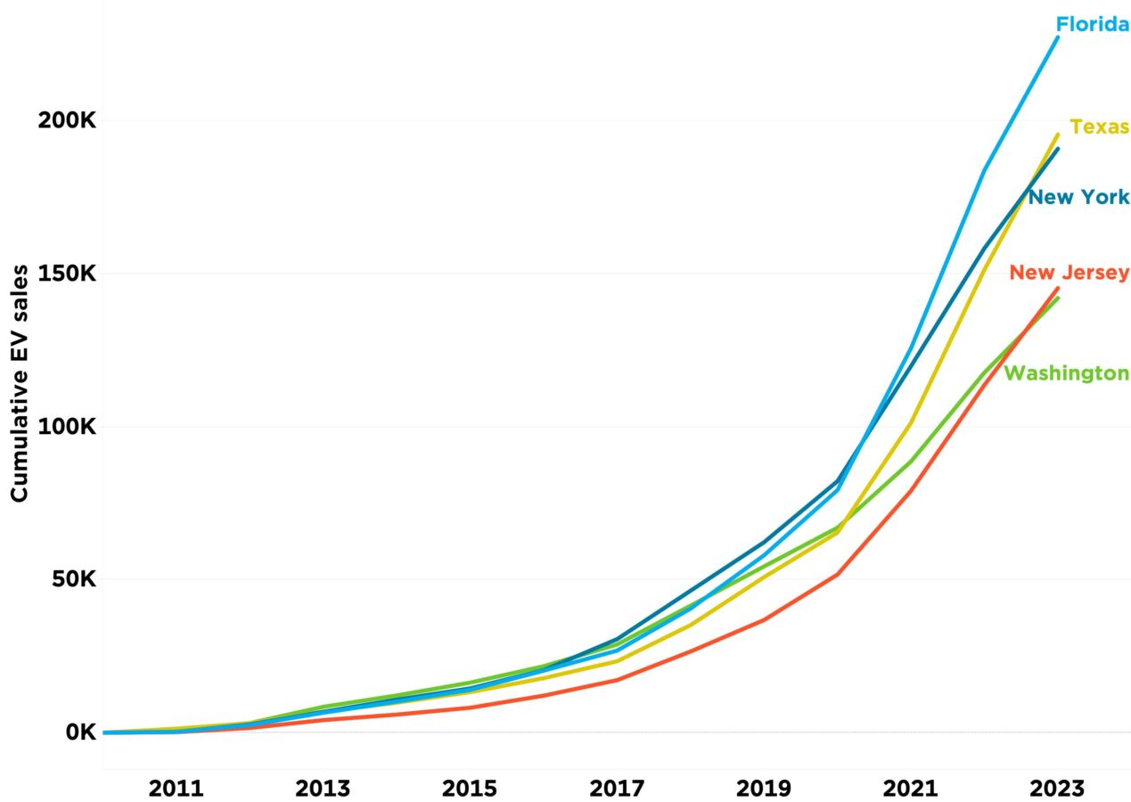
Introduction
Global EV market to grow 10.07%
Sales exceeded 10 million in 2022
US EV sales: 22,000 to over 2 million
Nearly 918,500 light EVs sold in 2022
EVs' share of car market: 4% to 14%
US EV sales: 0.2% to 4.6% of total sales

Slide 3
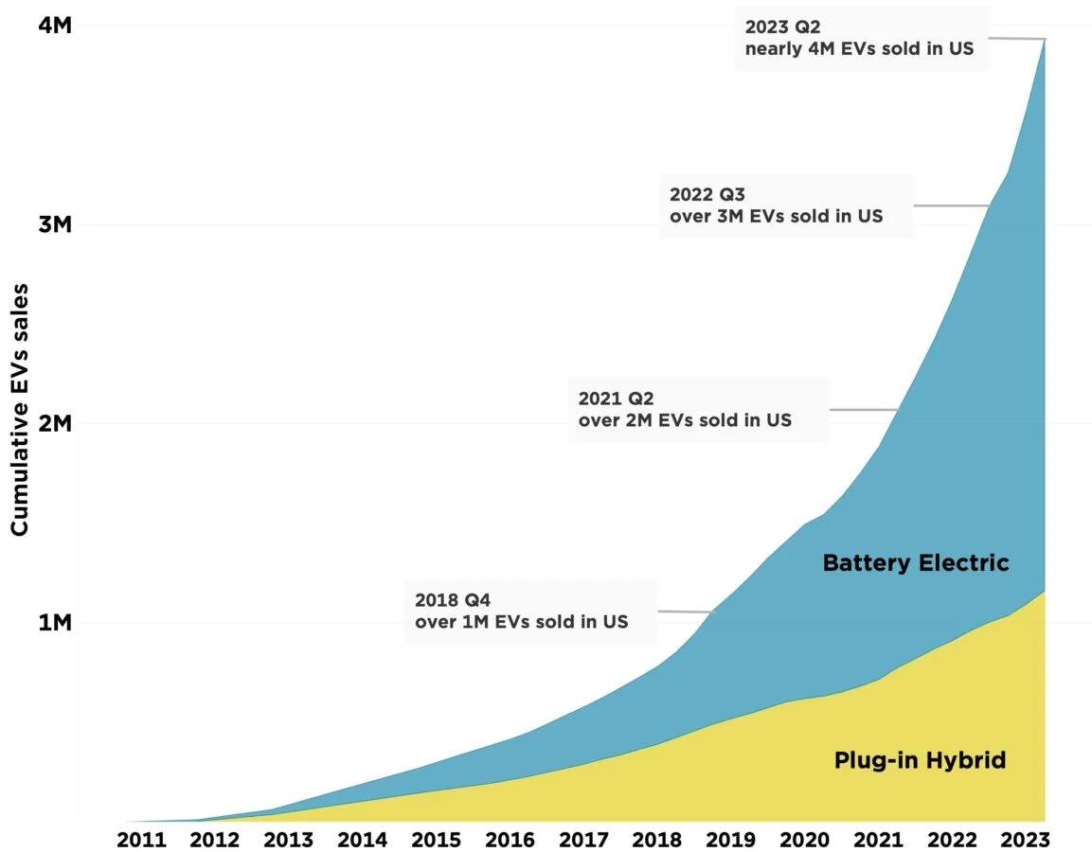
Introduction
Data Set used: Electric_Vehicle_Population_Data.csv.
Total no. of variable used: 150 thousand.
Dependent Variables: Electric range and eligibility of EVs.
Business problems:
Electric Vehicle Adoption Analysis:
Vehicle Characteristics and Eligibility:
Electric Range and Eligibility:
Research question: What are the intricate factors influencing the electric range and eligibility of electric vehicles?

Slide 4
Introduction
Field | Data Types | Description
County | Categorical | Represents the county where the vehicle is located
City | Categorical | Indicates the city where the vehicle is registered
Make | Categorical | Specifies the make or manufacturer of the vehicle
Model | Categorical | Identifies the specific model of the electric vehicle
Type | Categorical | Describes whether the vehicle is a BEV or a PHEV
CAFV Eligibility | Categorical | Indicates whether the vehicle is eligible for incentives
Electric Range | Numerical | Represents the electric range of the vehicle in miles

Slide 5

Methods
We used many methods in for this project.
The main methods were mainly the one used to handle large datasets and perform the regression.
Data Manipulation and Analysis:
- Pandas: For data manipulation, filtering, and analysis.
- NumPy: For numerical computations and array operations.
Data Visualization:
- Matplotlib: For creating static, interactive, and animated plots and visualizations.
- Seaborn: Built on top of Matplotlib, Seaborn provides a high-level interface for creating informative and attractive statistical graphics.

Slide 6


Methods
Statistical Analysis:
- SciPy: For scientific and statistical computations.
- Scikit-Learn: For machine learning tasks such as regression, classification, and clustering.
Data Cleaning and Preprocessing:
- Data cleaning can be done using Pandas and NumPy.
Time Series Analysis:
- StatsModels: for time series analysis and forecasting. s: For data manipulation, filtering, and analysis.

Slide 7
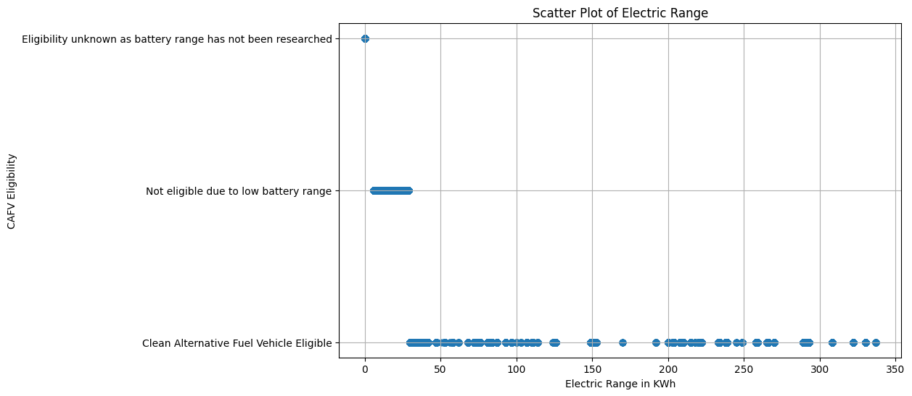
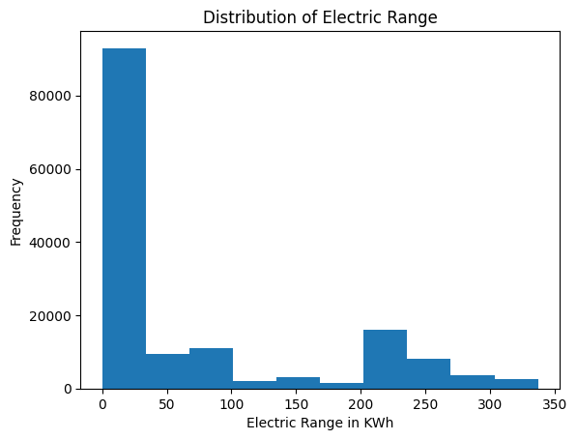
Data Description
The data used for the project was collected from Data.gov
It is a collection of Evs in the state of Washington, registered under Washington State Department of Licensing .
The distribution of the data is shown by the graph, where most of the entries has 0 KWh range which is the minimim, meaning they are not electric vehicles. The highest range being 337 KWh which is a EV.
Most of the vehicles do not fall under the CAFV eligibility criteria as they has very small Electric Range.

Slide 8
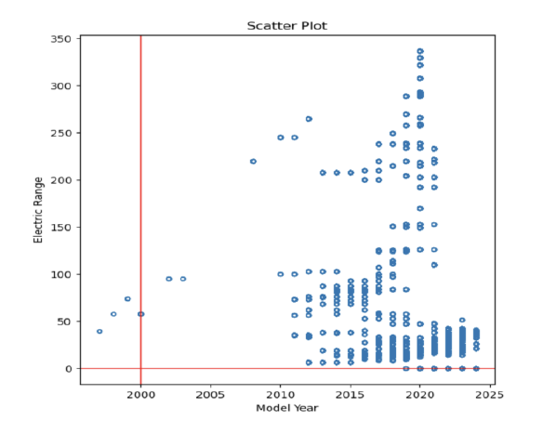
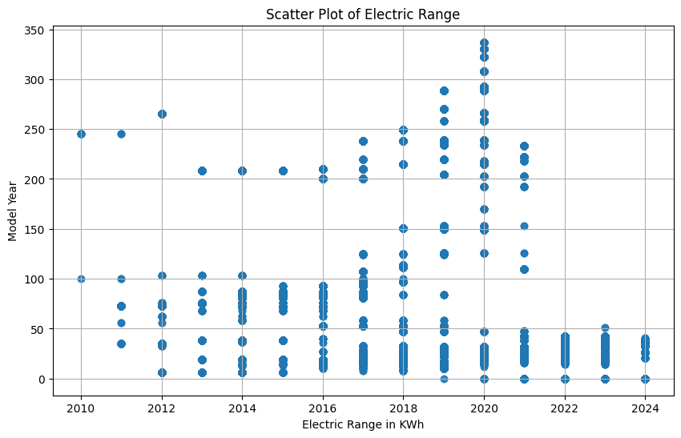
Data Description
We had to clean the dataset and remove any unnecessary columns not needed for the project.
The total number of data stood at 150482 entries with 15 columns.
We cleaned the dataset further by removing the all data prior 2010.
The new dataset size after removing outliers became 150446.
The graphs below show the before and after cleaning.

Slide 9
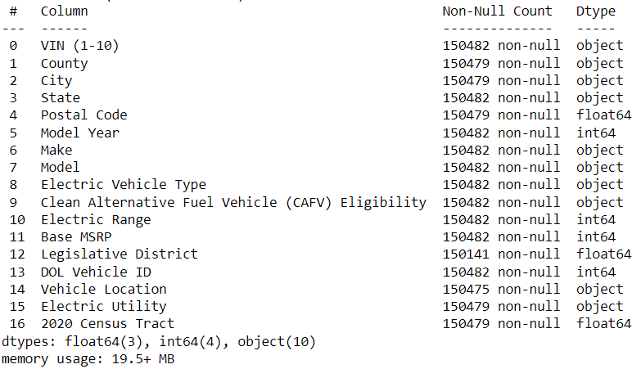
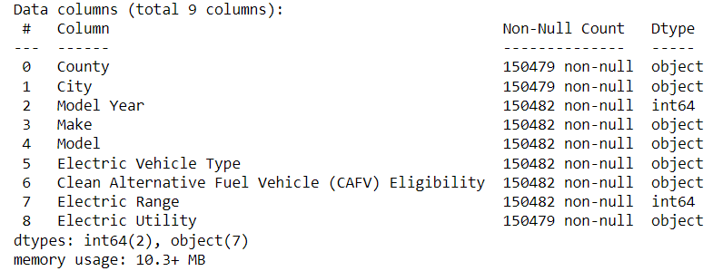
Data Description
We also removed many unnecessary columns which had no impact on the analysis we were performing.
After
Before

Slide 10
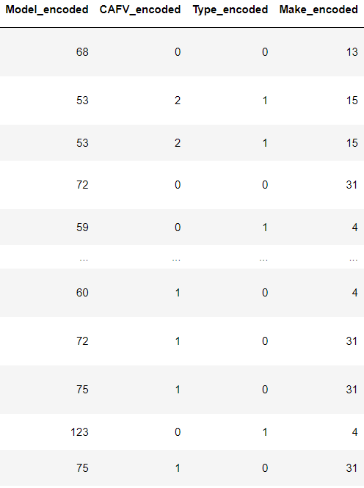
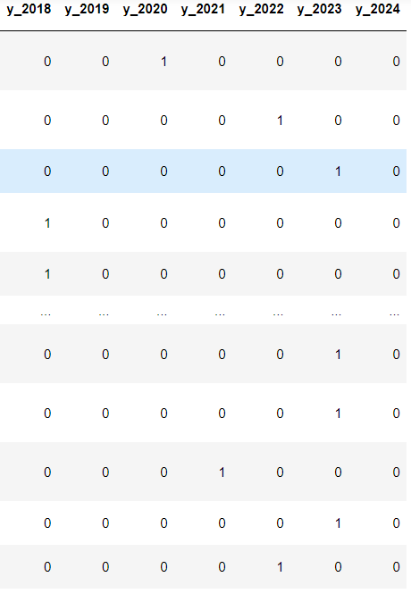
Data Description
We encoded the categorical variables so that they could be used for the regression.
We introduced dummy variables created on the Model Year, to facilitate the regression analysis, which turned out to be a great decision.
The number of columns after preprocessing became 37, with a total sample size of 150446.

Slide 11
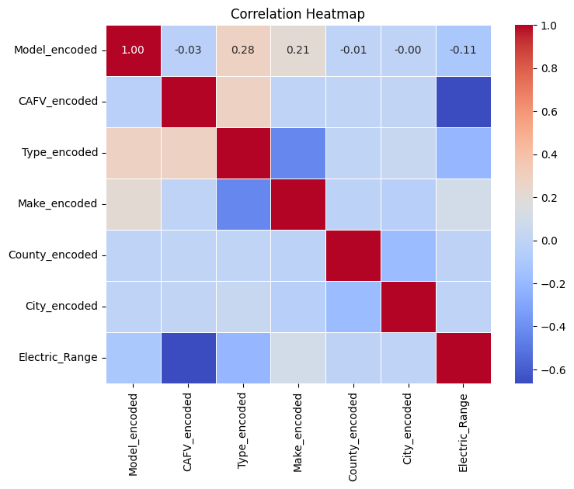
Data Description
Model is strongly correlated with CAFV (0.8) and Type (0.6). This suggests that the model is capturing the relationship between these variables well.
Make, City and County have weak correlations with Model and Electric Range. This suggests that these variables are not as strongly associated with the dependent variable.
The Electric Range has a strong negative correlation at -0.6 (0 being eligible , 1 being unsure and 2 being eligible in the CAFV column), hence catching the relationship between the Electric Range CAFV eligibility as it should be.

Slide 12
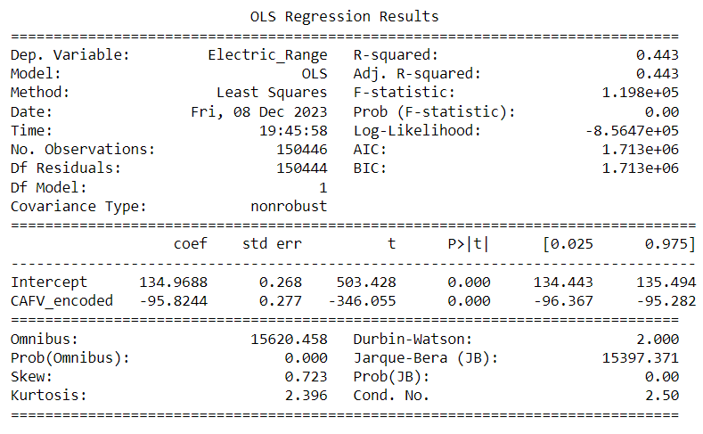
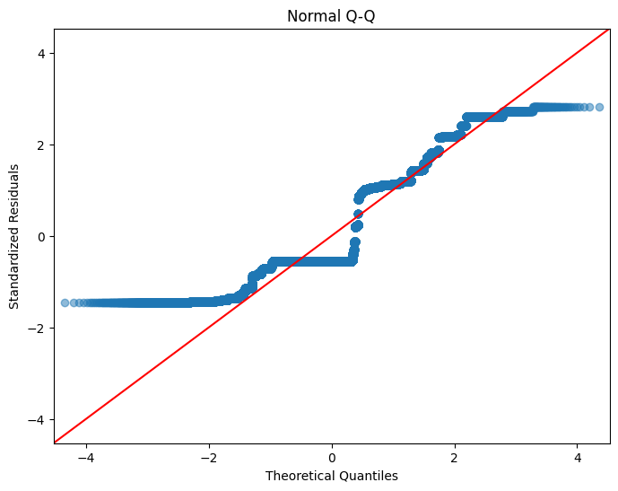
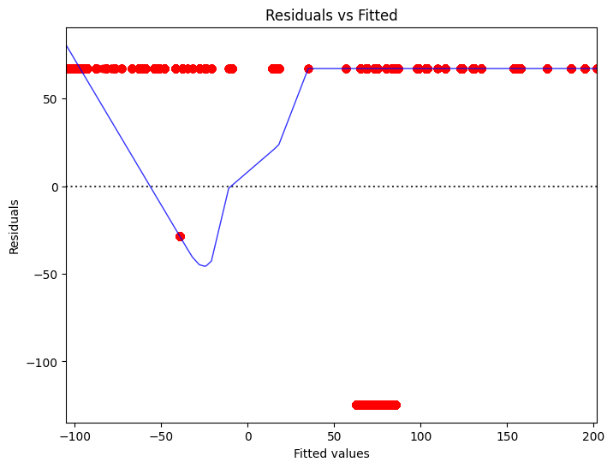
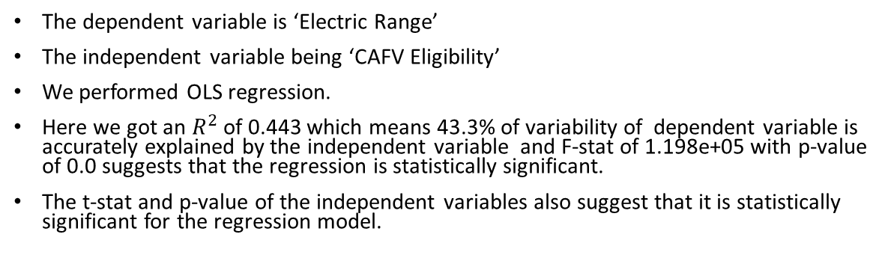
Results or Solutions-1
The dependent variable is ‘Electric Range’
The independent variable being ‘CAFV Eligibility’
We performed OLS regression.
Here we got an $R^{2}$ of 0.443 which means 43.3% of variability of dependent variable is accurately explained by the independent variable and F-stat of 1.198e+05 with p-value of 0.0 suggests that the regression is statistically significant.
The t-stat and p-value of the independent variables also suggest that it is statistically significant for the regression model.

Slide 13
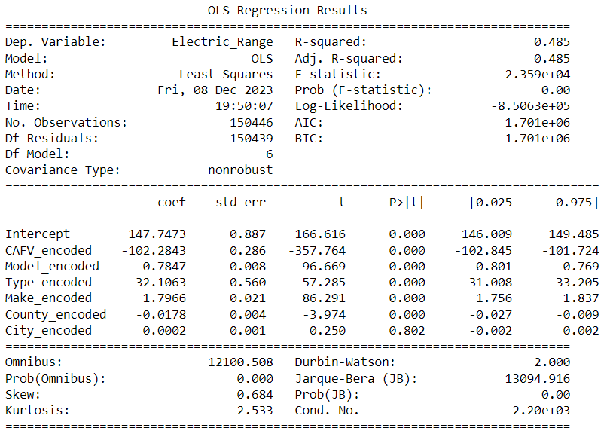
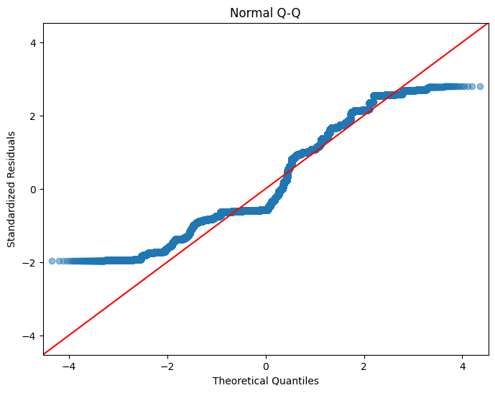
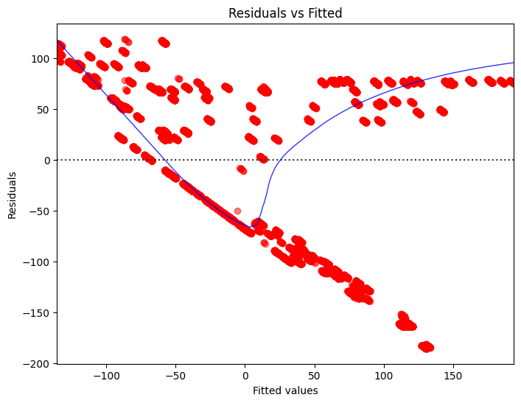
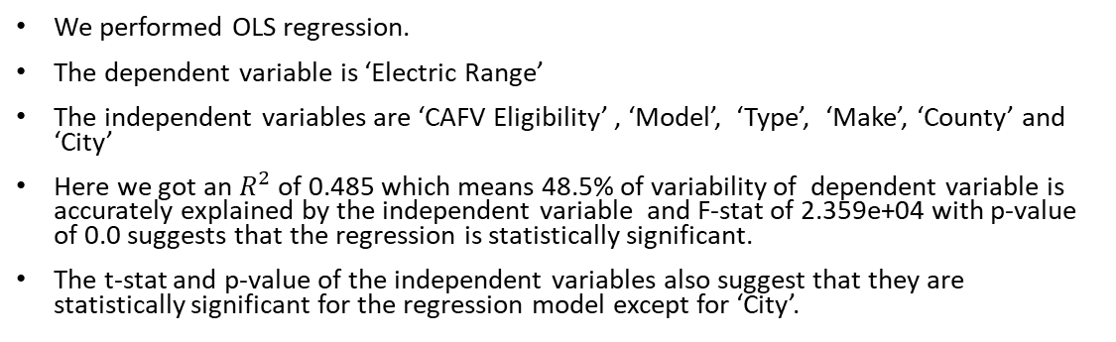
Results or Solutions-2
We performed OLS regression.
The dependent variable is ‘Electric Range’
The independent variables are ‘CAFV Eligibility’ , ‘Model’, ‘Type’, ‘Make’, ‘County’ and ‘City’
Here we got an $R^{2}$ of 0.485 which means 48.5% of variability of dependent variable is accurately explained by the independent variable and F-stat of 2.359e+04 with p-value of 0.0 suggests that the regression is statistically significant.
The t-stat and p-value of the independent variables also suggest that they are statistically significant for the regression model except for ‘City’.

Slide 14
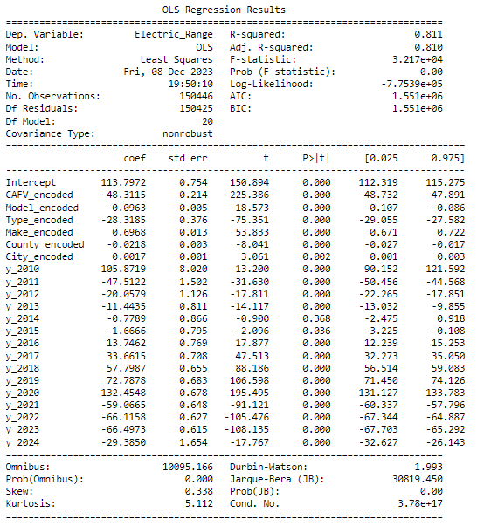
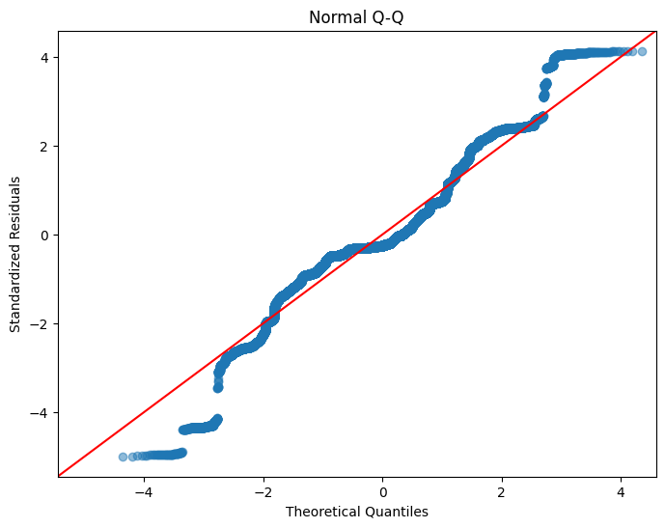
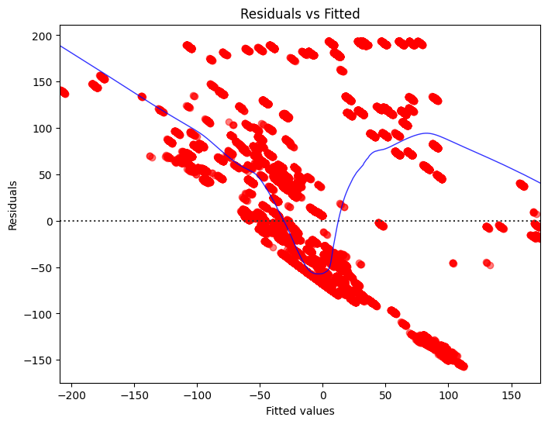
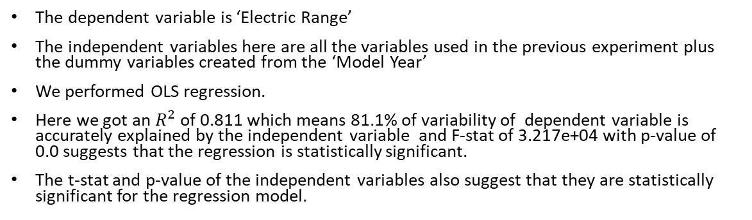
Results or Solutions-3
The dependent variable is ‘Electric Range’
The independent variables here are all the variables used in the previous experiment plus the dummy variables created from the ‘Model Year’
We performed OLS regression.
Here we got an $R^{2}$ of 0.811 which means 81.1% of variability of dependent variable is accurately explained by the independent variable and F-stat of 3.217e+04 with p-value of 0.0 suggests that the regression is statistically significant.
The t-stat and p-value of the independent variables also suggest that they are statistically significant for the regression model.

Slide 15
Results or Solutions-4
We ran Chi-Square hypothesis test on the independent variables against the dependent variable, an got results that agreed with the regression results as well.
The chi-stat for just ‘CAFV Eligibility’ is 300892.0 with a p-value of 0.0
And the chi-stat for all the independent variables combined is 13568546.835 with a p-value of 0.0

Slide 16
Results or Solutions-5
We also performed an One-Way ANOVA test on the most important independent variable the ‘CAFV Eligibility’
With an F-stat of 120675.095 and p-value of 0.0, we concluded the experiment.

Slide 17
Discussion
Insight:
Through this experiment we found that vehicles that have been named as a CAFV vehicle, generally has a higher electric range.
It was also found that electric range of a vehicle is surprisingly dependent on the model year as well.
The higher accuracy in the third experiment suggests that both CAFV and Model Year has a significant impact on the electric range of the vehicle, conversely, electric range of a vehicle can also be used to predict the CAFV and Model Year of a vehicle.
City and County had no impact on the electric range at all.

Slide 18
Discussion
Insight:
Make and Type of the vehicle had a very small impact
The ‘residual vs actual’ plot suggests that the data are fitting extremely.
The graph show that the predictions made from regression were pretty accurate.
After performing the chi-square test we got a high value for the chi-stat, so we were able to determine that there was significant relationship between the independent variables and the dependent ones.
The one way ANOVA test later performed gave an F-stat which showed that the regression model is statistically significant.

Slide 19
Discussion
Feature Importance:
We investigate the importance of each significant feature to understand its impact on Electric_Range.
Temporal Trends:
We explore the impact of year-related variables on Electric_Range. Consider seasonality or evolving trends in electric vehicle technology.
Further Analysis:
We also conduct residual analysis, check for model assumptions, and consider potential interactions between features.
The residual analysis showed that the data and the prediction made by the regression are pretty accurate.

Slide 20
Discussion
Model Development:
These models contribute to understanding the relationship between various features and Electric_Range.
Insights for Stakeholders:
They Provide stakeholders with insights into the factors influencing Electric_Range, enabling informed decision-making.
Research Contribution:
The study contributes to the understanding of the electric vehicle landscape, providing insights into factors affecting electric range.

Slide 21
Conclusion
In this project, we aimed to unravel the intricate factors influencing the electric range of vehicles, contributing to a comprehensive understanding of electric vehicle performance. Through extensive data analysis and regression modeling, we have gained valuable insights into the nuanced relationships between various features and the electric range.
The regression models performed very well to fulfil the desired business and research questions.
But the EV dataset here is more suitable for a Classification model .
Using regression we could only establish relationship between Electric Range and other independent variables.
To be able to properly predict if a vehicle is CAFV we need classification as well.

