Slide 1
National Banking Industry

Slide 2




Overview of Industry
Industry: National Commercial Banks
SIC: 6021
Description: Industry classified under SIC-6021 is National Commercial Banking Industry. This industry deals with providing banking services like extending loans, accepting deposits to public and different commercial banks.
Interested Companies:

Slide 3
Research questions
How does the recession probability indicator affect JPMorgan Chase's net income?
How is housing sales getting affected when there's a rise in recession or federal funds interest rate?
Is there a direct impact on profitability of banks when there’s a fluctuation in federal funds rate?

Slide 4
Economic Indicator: Federal Funds Rate
Federal Funds refers to the target interest rate set by Federal Open Market Committee (FOMC)
Banks are supposed to maintain their deposits in an account at Federal Reserve Bank in order to ensure they have enough money to cover depositor’s withdrawals.
Any money that goes beyond required level, is given out to other banks at federal funds interest rate
Sample Period: 1990-2023

Slide 5
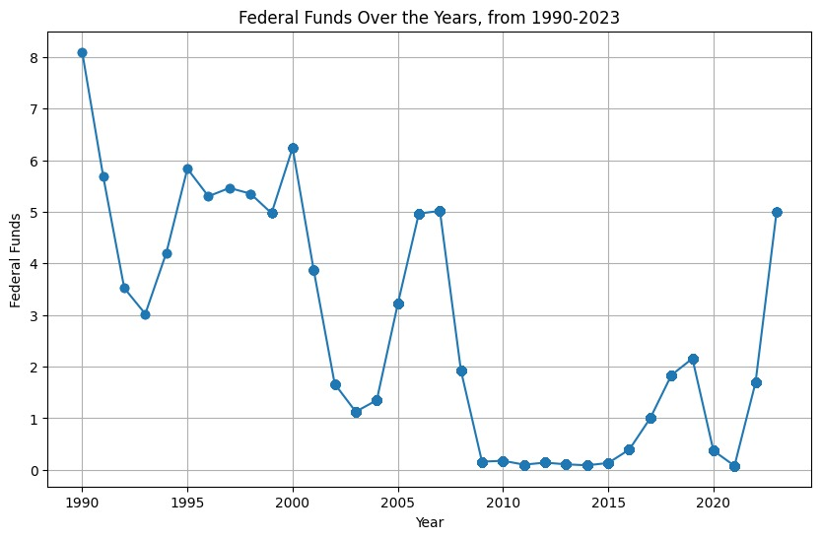
Federal Funds
In 1980-1990, federal funds rate was at it peak at around 8%, reflecting high inflation.
In response to great recession at around 2008, rates were lowered by FOMC at around 0%-0.25%.
In order to protect the economy from the impacts of covid-19, FOMC cut down its rate to 0%
Currently, rate is set at around 5%

Slide 6
Economic Indicator: Housing Units Sold
It is an essential tool for assessing the state of the housing market and general economic activity.
The strength of consumer borrowing and spending patterns is reflected in the Existing Home Sales report, which is regarded as a leading economic indicator.
Through the examination of the Existing Home Sales report, investors and economists can spot possible changes in the housing sector that could have wider effects on the whole economy.
Data: 10/2022 to 12/2023

Slide 7
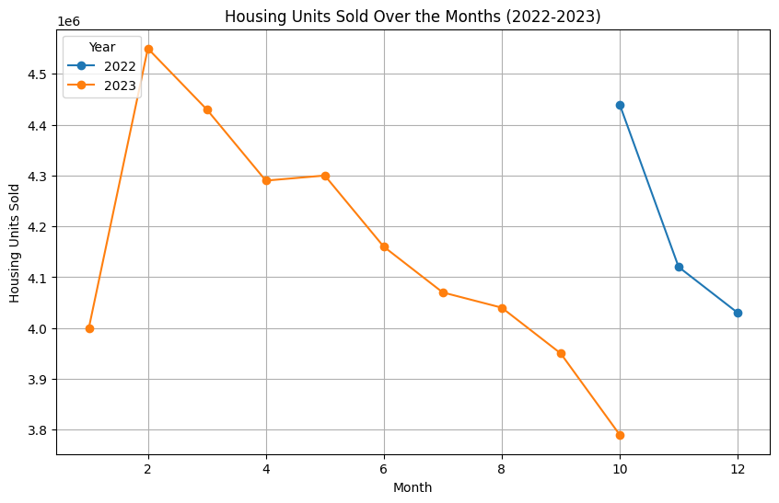
Housing Units Sold
The reason for the graph being not so detailed is due to the lack of the data for my economic indicator 'Housing Units Sold' , which start at October 2022 to 2023 present.
According to the graph we can clearly see that the housing units sold was at its peak when the data started collecting.
It came down to its minimum in 2023, most probably because of the current recession.

Slide 8
Economic Indicator: Recession Probability
The recession probability metric evaluates the chances of a recession using diverse methods.
It incorporates financial indicators like changes in the yield curve and the difference between various interest rates.
It also includes key economic indicators, such as consumer confidence and
critical macroeconomic factors like inflation and joblessness rates.
To predict the likelihood of a notable rise in unemployment in the near and distant future,
models, often logistic regression, are employed.
This comprehensive approach, which merges financial, economic, and market information,
highlights the complexities involved in forecasting economic downturns.
Sample Period: 1990-2023

Slide 9
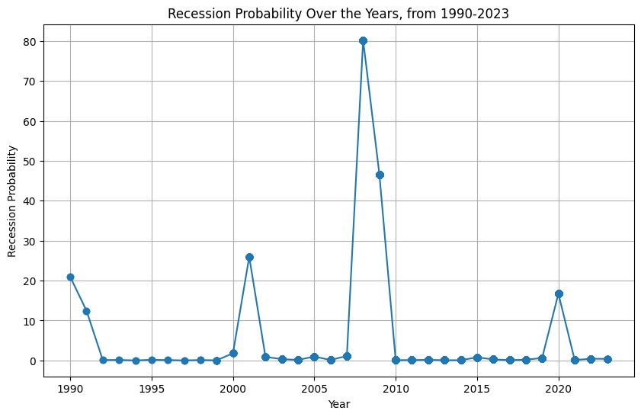
Recession Probability
1990: The peak around this time was influenced by a combination of factors including the end of the Cold War,
2008: The dramatic spike in 2008 corresponds to the global financial crisis,
2020: The peak in 2020 is due to the economic impact of the COVID-19 pandemic.
The lesser peaks in other periods likely indicate minor economic downturns or regional recessions, which were mitigated by swift monetary policies or were not as disruptive

Slide 10
Data description
Sample Size (Federal Funds + Recession Probability):
10224 rows x 10 columns
Sample Size (Federal Funds + Recession Probability + Housing Sales):
483 rows x 11 columns
Unique no. of companies under 6021 code:

Slide 11
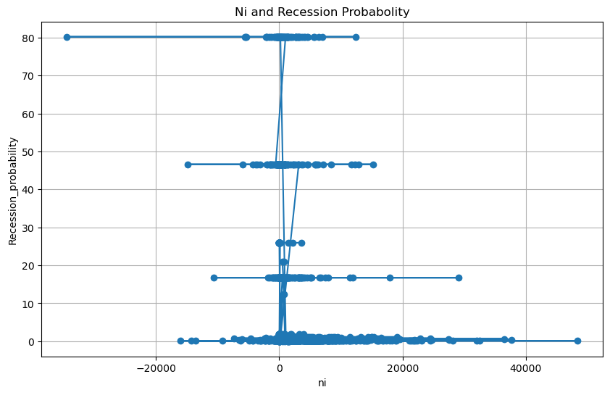
How does the recession probability indicator affect JPMorgan Chase's net income?
As you can see, the recession probability has a negative correlation with NI variables. This means that as the recession probability increases, the values of this variable tend to decrease. This is consistent with the idea that a recession is a period of economic decline that is characterized by lower levels of economic activity.
It is a well-known fact that a rise in the recession probability indicator is typically linked to a possible decline in economic activity, which can influence banks' financial health. Because of things like higher loan loss provisions, less demand for loans, and lower interest income, this can result in a decline in net income.

Slide 12
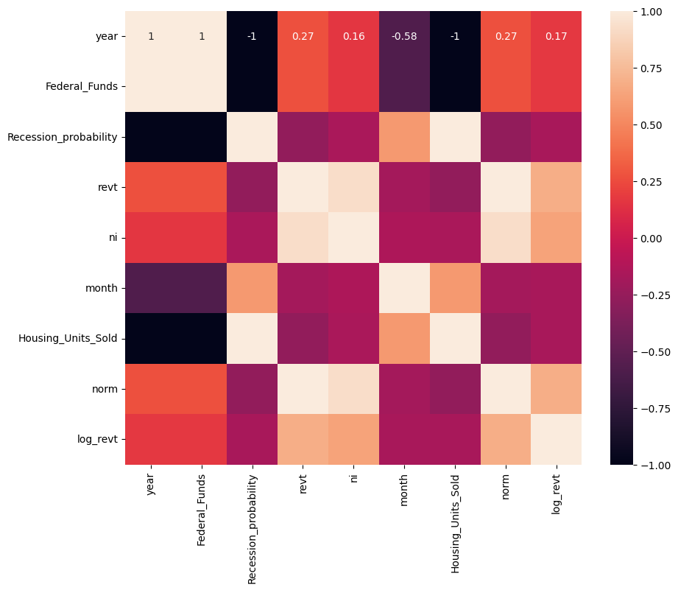
Correlation
year has a strong positive correlation with revenue (0.75). This suggests that as the year progresses, revenue tends to increase.
Federal Funds has a strong negative correlation with revenue (-0.58), net income (-0.44), and Housing Units Sold (-0.50). This indicates that as the Federal Funds rate increases, these variables tend to decrease.
Recession probability has a strong negative correlation with revenue (-0.50) and net income (-0.45). This suggests that as the probability of a recession increases, these variables tend to decrease.

Slide 13
Regression analysis
Model 1 : Comparing revenue with economic Indicators
Dependent Variable: Revenue (revt)
Independent Variables: Net Income, Federal Funds Rate, Recession Probability, Housing Units Sold
No. of observations: 485

Slide 14
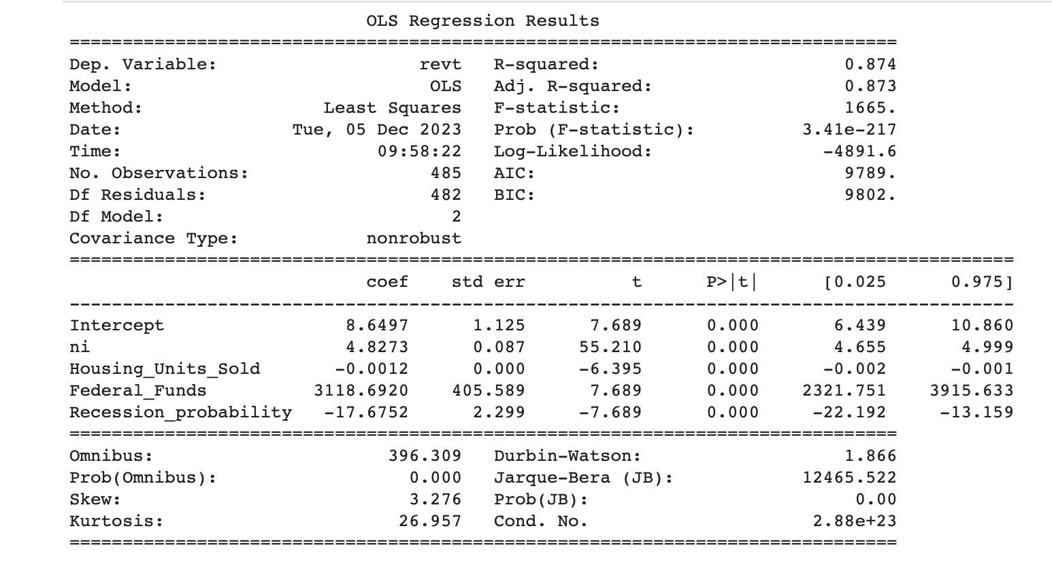
R-squared: 0.874
>> 87.4% of dependent variable can be explained by independent variables
P-Value(F-Statistic): 3.41e-217
>>In this case, the F-statistic is 1665. with a p-value of 3.41e-217, which indicates that the overall model is statistically significant.
Individual Variables:
All are statistically significant

Slide 15
Regression analysis
Model 2: Comparing revenue with economic Indicators during pandemic period.
Dependent Variable: Revenue (revt)
Independent Variables: Net Income, Federal Funds Rate, Recession Probability,
Sample Period: 2020-2022
No. of observations: 1457

Slide 16
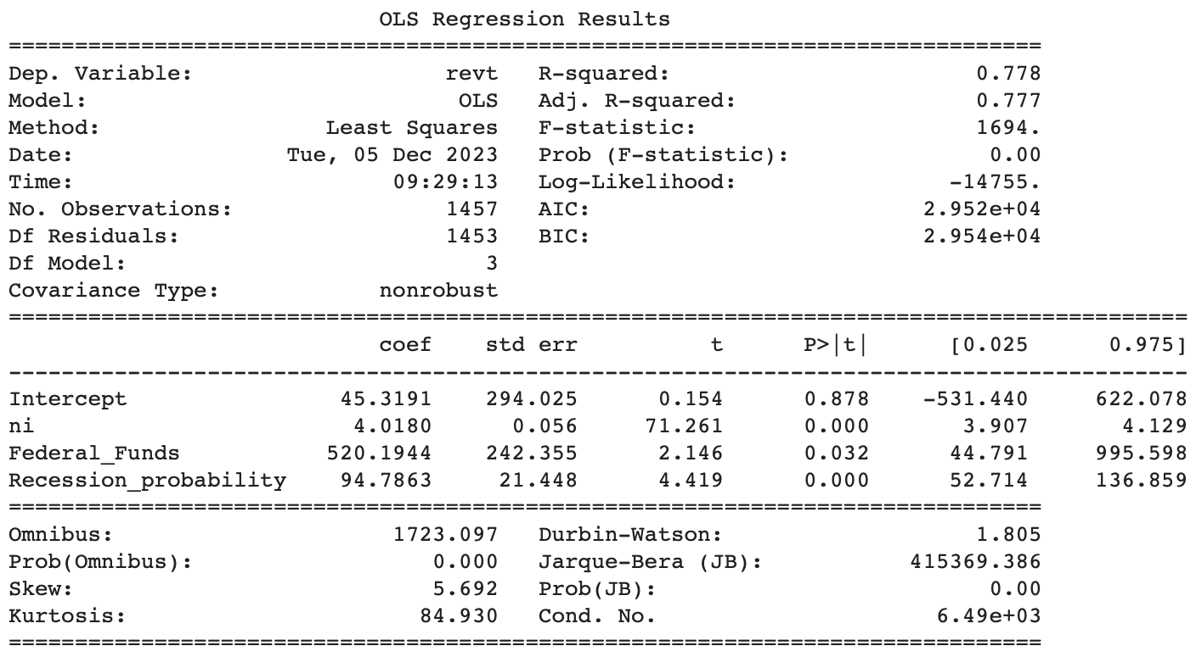
R-squared: 0.778
>> 77.8% of dependent variable can be explained by independent variables
P-Value(F-Statistic): 0.00
>>In this case, the F-statistic is 1694. with a p-value of 0.00, which indicates that the overall model is statistically significant.
Individual Variables:
All are statistically significant

Slide 17
Regression analysis
Model 3: Comparing revenue of JP Morgan Chase with economic Indicators.
Dependent Variable: Revenue (revt)
Independent Variables: Net Income, Federal Funds Rate, Recession Probability,
Sample Period: 1990-2023
No. of observations: 20

Slide 18
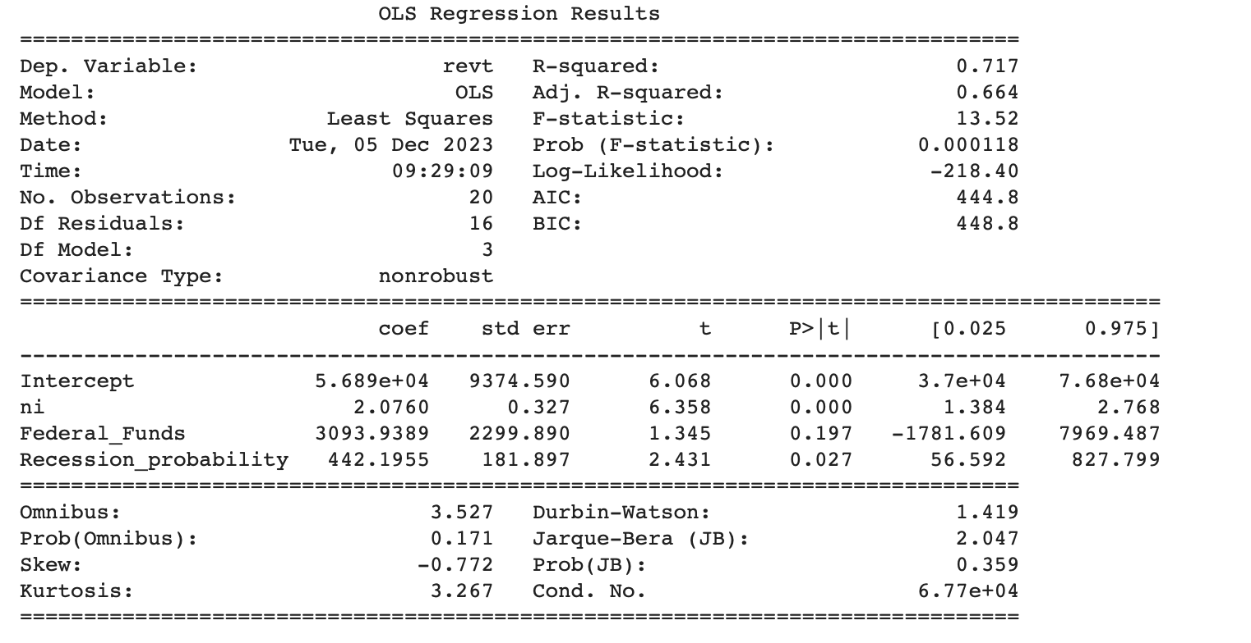
R-squared: 0.717
>> 71.7% of dependent variable can be explained by independent variables
P-Value(F-Statistic): 0.00
>>In this case, the F-statistic is 13.52 with a p-value of 0.00, which indicates that the overall model is statistically significant.
Individual Variables:
All are statistically significant except for federal funds whose p-value is too high.

Slide 19
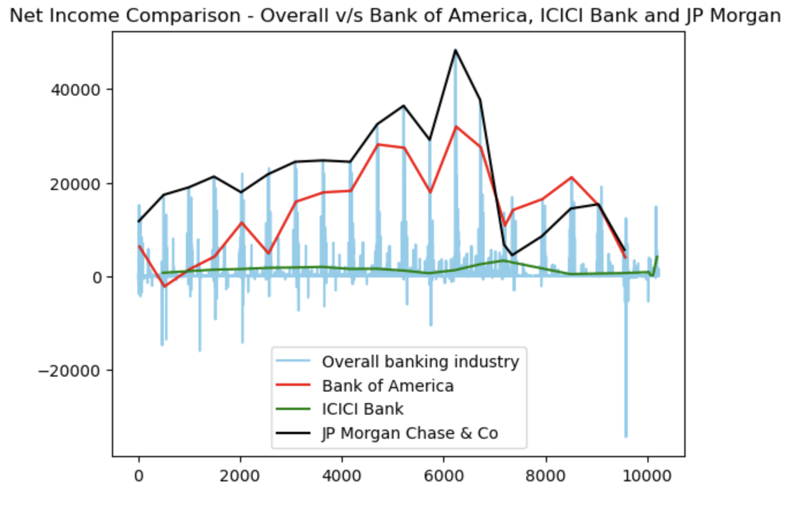
Net Income Comparison with Overall Banks
Bank of America has consistently performed highest in terms of net income among other two banks.
JP Morgan Chase showed great fluctuations in when it comes to net income comparison.
ICICI Bank has performed the lowest when it comes to comparing the other two banks.

Slide 20
Business implication
Market Opportunity: The expansive scope of the national commercial banking sector, with over 81,450 businesses and about 2.15 million employees, presents a substantial market for Clark & Co.'s consulting services. These banks could benefit from strategic advice, financial management, and operational efficiency improvements.
Specialized Expertise Demand: To effectively serve this sector, Clark & Co. may need to bolster its expertise in banking and finance. Understanding the intricacies of this industry, including regulatory compliance and financial technologies, would be crucial.
Relationship Building: For Clark & Co., forging strong connections within the banking industry could be a key growth strategy. Networking with industry leaders and staying abreast of sector-specific challenges and innovations would be beneficial.
Tailored Consulting Solutions: There's an opportunity for Clark & Co. to stand out by offering bespoke consulting solutions. This could include risk management strategies, compliance assistance, aid in digital transitions, and enhancing customer engagement for these banks.
Strategic Partnerships: Collaborating with entities in the banking sector could open new avenues for Clark & Co. Such partnerships might help the firm expand its clientele and refine its service offerings.

Slide 21
Limitation
Dataset Constraints: This limited size and scope might restrict the study's ability to broadly generalize its findings and detect subtle, yet significant, trends.
Data Aggregation Approach: Data was organized yearly, averaging values annually, it might overlook crucial short-term fluctuations
Bias and Incompleteness Risks: The method of selecting and integrating different datasets raises the possibility of biases or missing critical information.

Slide 22
Potential project
Extension of Data Analysis: To improve the precision and applicability of its forecasts and recommendations, the project could expand its analysis to incorporate more current data or other economic indicators.
Application in Other Sectors: To gain a more comprehensive understanding of these economic indicators' overall influence, future research may examine how they affect industries other than banking and housing.

Slide 23
Question 1
What were the Economic Indicators mentioned in the Project
A. Federal Funds Rate, Recession Probability, House Taxes
B. Interest Rates, Inflation Probability, House Taxes
C. Federal Funds Rate, Recession Probability, House Units Sold
D. Recession Probability, Inflation Probability, House Taxes

Slide 24
Question 2
What were the 3 Banks mentioned in the Project?
A. Laxmi Chit Fund Bank, HDFC Bank, ICICI Bank
B. ICICI BANK, Bank of America, JP Morgan Chase & Co.
C. HDFC Bank, Bank of America, ICICI Bank

