Slide 1
Tesla Social Media Analytics Project
~ By Rishav Vishnoi

Slide 2
Project Overview
  Objective: Analyze Tesla’s 2024–2025 social media activity across platforms
  Platforms: Twitter (X), Instagram, YouTube, Facebook
  Key Goals: Engagement, Campaign ROI, Follower Growth, and Content Strategy

Slide 3
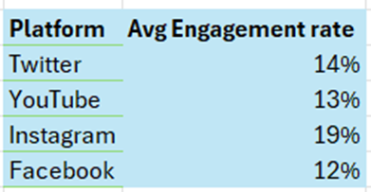
Platform
Analysis
Tesla should focus on Instagram for maximum engagement, use Twitter for updates, leverage YouTube for demos, and reconsider Facebook unless targeting less active audiences.

Slide 4
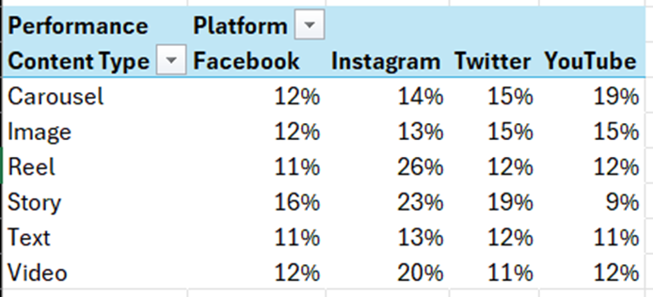
Content Type Analysis
  Instagram Reels, Videos and Stories deliver the highest engagement (26%,20% and 23%), while YouTube Carousels (19%) and Images (15%) perform best for product-focused content.
  Tesla should use platform-specific content—Reels, Stories & Videos for Instagram, Carousels and Images for YouTube—for maximum brand impact.

Slide 5
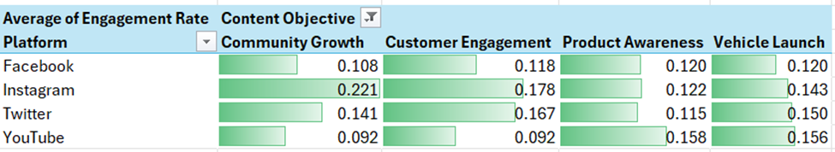
Content objective wise analysis for each Platform
  Instagram is best for community growth and engagement
  YouTube for product launches and awareness
  Twitter for real-time interaction
  Facebook should be deprioritized for branding efforts

Slide 6
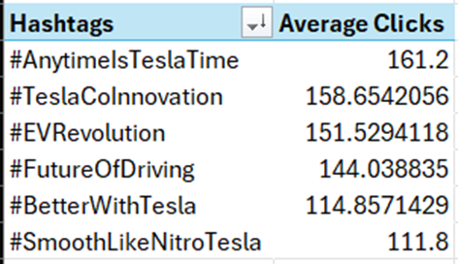
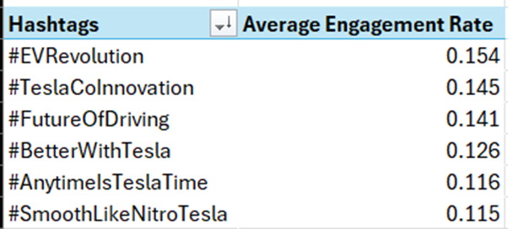
#ashtags Analysis
  Use #EVRevolution and #TeslaCoInnovation for highest engagement, and #AnytimeIsTeslaTime for driving clicks.
  Focus campaigns on these top-performing hashtags to maximize impact.

Slide 7
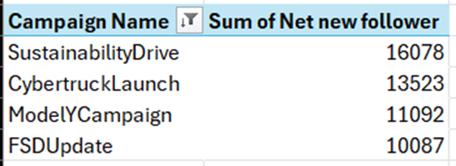
Campaign Analysis
  The SustainabilityDrive campaign brought in the most new followers, making it Tesla's most effective for audience growth.
  Prioritize similar awareness and sustainability-focused campaigns to boost brand reach and loyalty.

Slide 8
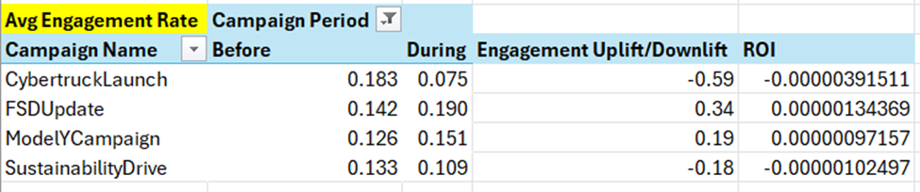
Before & After Campaign Performance
  FSDUpdate and ModelYCampaign delivered the strongest engagement uplift and positive ROI.
  Focus resources on campaigns that boost interaction, not just reach.
  Refine strategies for launches, as Cybertruck's high follower gain didn't translate to engagement during the campaign.

Slide 9
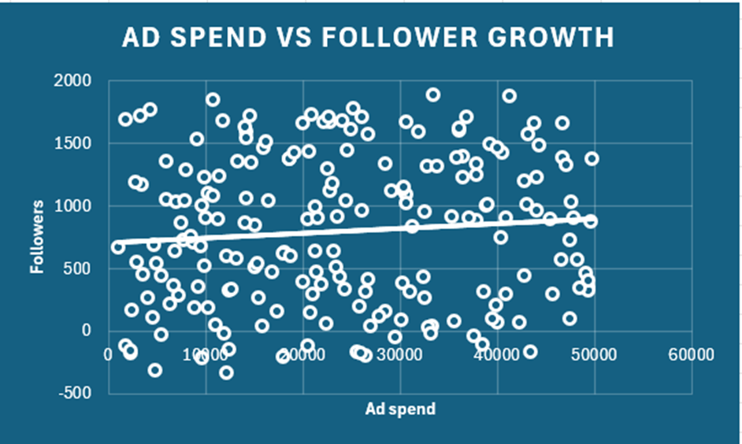
Ad Spend vs Follower growth Analysis
There is only a weak correlation between higher ad spend and follower growth, so Tesla should focus on engaging content and strategic timing, rather than simply increasing advertising budgets.

Slide 10
Thank You

