Slide 1
INTERNSHIP PROJECT | MACHINE LEARNING
Airline Ticket Price Prediction
✈
A full-stack ML application: regression models, FastAPI backend and React frontend
Submitted by: Rishav Rai
Internship project submitted to Naviotech Solution Pvt. Ltd
rairiahav961@gmail.com
Airline Ticket Price Prediction | Rishav Rai | 1

Slide 2
Problem Statement
Why ticket prices are hard to predict
Airline ticket prices depend on many interacting factors:
Goal
Airline and route
Number of stops
Journey date
Departure and arrival time
Flight duration and extra info
Learn patterns from historical flight data and estimate the expected price of a new flight.
Airline Ticket Price Prediction | Rishav Rai | 2

Slide 3
Project Objectives
1
Build end to end
2
Clean and engineer
3
Train and compare
Complete price prediction system
Data cleaning and feature engineering
Multiple regression models
4
Evaluate
5
Analyse
6
Deploy-ready
MAE, RMSE, R², cross-validation
Feature importance and error analysis
FastAPI + React UI, Joblib + Git LFS
Airline Ticket Price Prediction | Rishav Rai | 3

Slide 4
Machine Learning Pipeline
From raw dataset to prediction
1
2
3
4
›
›
›
Raw Data
Cleaning
Feature Eng.
Split
5
6
7
8
›
›
›
Preprocess
Train
Evaluate
Final Model
Final model is served through a FastAPI prediction API to the React frontend.
Airline Ticket Price Prediction | Rishav Rai | 4

Slide 5
Feature Engineering
Eight time-based features derived from raw columns
Journey Day
Journey Month
Journey Weekday
Departure Hour
Departure Minute
Arrival Hour
Arrival Minute
Duration (min)
Original inputs (airline, route, stops, additional info) are kept and encoded alongside these features.
Airline Ticket Price Prediction | Rishav Rai | 5

Slide 6
Preprocessing Pipeline
Numerical and categorical features are handled separately
1
2
Numerical features
Categorical features
Engineered date, time and duration values, prepared for the models.
Airline, route and other flight details, encoded into model-ready form.
Both branches are combined in one scikit-learn pipeline, so training and prediction use identical steps.
Airline Ticket Price Prediction | Rishav Rai | 6

Slide 7
Model Training
Two regression models trained and compared
Random Forest
XGBoost
Ensemble of decision trees
Averages many trees to reduce variance
Handles non-linear price patterns
Gradient boosted trees
Builds trees sequentially to correct errors
Strong on structured, tabular data
Airline Ticket Price Prediction | Rishav Rai | 7

Slide 8
Evaluation Methodology
How model quality is measured
MAE
RMSE
R²
CV
Average absolute price error
Error that penalises large misses
Share of price variance explained
Cross-validation for stability
Feature importance shows which inputs drive price. Error analysis shows where predictions miss.
Airline Ticket Price Prediction | Rishav Rai | 8

Slide 9
Model Results
Comparison of the trained models
Model | MAE | RMSE | R²
Random Forest | [add] | [add] | [add]
XGBoost | [add] | [add] | [add]
Key findings: Random Forest is the model served in the final application (v1.0, prices in INR); feature importance highlights the main price drivers; error analysis guides future improvements.
Airline Ticket Price Prediction | Rishav Rai | 9

Slide 10
System Architecture
Model served through an API to an interactive UI
ml
backend
frontend
Data, features, training, saved model (Joblib, Git LFS)
›
FastAPI REST API loads the model and returns a price
›
React interface where users enter flight details
Airline Ticket Price Prediction | Rishav Rai | 10

Slide 11
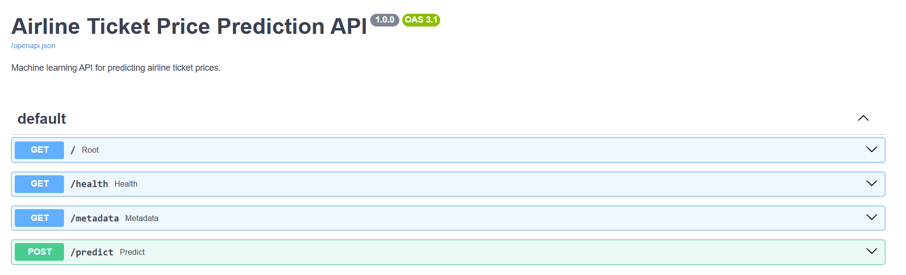
Backend: FastAPI Prediction API
Interactive Swagger docs served at /docs
GET /
Root
GET /health
Health check
GET /metadata
Model metadata
POST /predict
Returns predicted price
Airline Ticket Price Prediction | Rishav Rai | 11

Slide 12
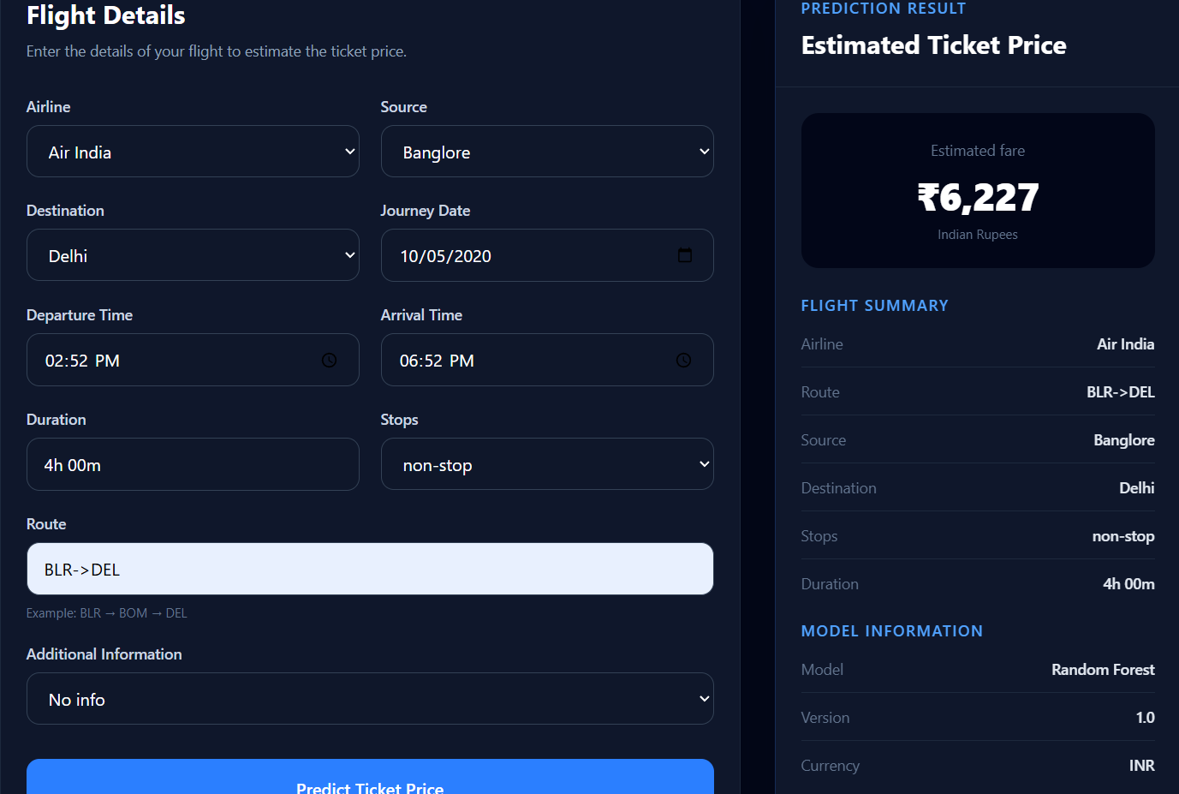
Frontend: Flight Form and Prediction
React interface calling the /predict endpoint
Sample prediction
₹6,227
Air India, BLR to DEL
Non-stop, 4h 00m
Journey date 10/05/2020
Model: Random Forest v1.0
Currency: INR
Airline Ticket Price Prediction | Rishav Rai | 12

Slide 13
Technology Stack
1
Data and ML
2
Visualisation
3
Backend
Python, pandas, NumPy, scikit-learn, XGBoost
Matplotlib, Seaborn, Jupyter Notebook
FastAPI, Uvicorn, Pydantic
4
Frontend
5
Packaging
6
Version control
React
Joblib, Git LFS, requirements.txt
Git and GitHub
Airline Ticket Price Prediction | Rishav Rai | 13

Slide 14
Repository and Deliverables
github.com/Rishavv75/Airline-Ticket-Prediction
Airline-Ticket-Prediction/
├── backend/
├── frontend/
├── ml/
├── .gitignore
├── .gitattributes
├── README.md
└── requirements.txt
Full source code on GitHub
README with problem, objectives and pipeline
requirements.txt for reproducible setup
Live deployment link to be added
Airline Ticket Price Prediction | Rishav Rai | 14

Slide 15
Future Scope
1
Deploy
2
Tune
Publish the app and add the live link
Hyperparameter tuning of both models
3
More models
4
More data
Try additional regressors and ensembles
Add fresh flight data to improve accuracy
Airline Ticket Price Prediction | Rishav Rai | 15

Slide 16
Thank You
Rishav Rai | Internship project for Naviotech Solution Pvt. Ltd
rairiahav961@gmail.com
github.com/Rishavv75/Airline-Ticket-Prediction
Airline Ticket Price Prediction | Rishav Rai | 16

