Slide 1

Team Details
ShipSure
a. Team name: One Neuron
b. Team leader name: Tanisha Jain
c. Problem Statement: Manufacturing: Intelligent Operations & Industrial Efficiency
Notes:
Team details reproduced from the user-provided PDF. Project name: ShipSure. Template instruction slide and unused blank slide omitted. All requested content sections retained.

Slide 2
Brief about the idea
ShipSure
An AI operations assistant for small manufacturers
Owners ask about overdue payments and late orders in plain language. ShipSure answers from their records, opens the relevant workspace and helps prepare the next action.
The same workspace checks export invoices and prepares draft shipping documents for review.
Notes:
Sources: repository implementation; README.md, VALIDATION.md and FIRESTORE.md in the local reviewed working tree. All business examples are synthetic demo data. No customer outcome study or production benchmark.
Template source: One Neuron _ AI Builder Cup.pdf, supplied by user. Original branding artwork retained. Editable body text uses Arial for portability because the PDF Google Sans Flex subset is not an installed complete font.

Slide 3
Opportunities
Problem
How ShipSure helps
Orders, collections and export paperwork sit in separate files. Owners spend time finding the record behind each decision.
A question opens the relevant ledger or order. Confirmed actions update the same business records.
Proposed USP
Expected benefit
A single conversation connects factory operations with export checks, with links back to the underlying records.
Fewer lookups and less repeated entry. A pilot will measure time saved and document corrections.
Notes:
Sources: repository implementation; README.md, VALIDATION.md and FIRESTORE.md in the local reviewed working tree. All business examples are synthetic demo data. No customer outcome study or production benchmark.
Differentiation describes our design, not an independently audited competitive comparison. Benefits are hypotheses pending user validation.
Template source: One Neuron _ AI Builder Cup.pdf, supplied by user. Original branding artwork retained. Editable body text uses Arial for portability because the PDF Google Sans Flex subset is not an installed complete font.

Slide 4
List of features offered by the solution
Business operations | Export workflow
Orders, partial dispatches and linked invoices | Invoice upload and editable extraction
Receivables, payment allocation and statements | FTA eligibility and SCOMET screening
English and Hinglish assistant with record links | Risk explanation with policy context
Confirmation before supported chat writes | Draft Shipping Bill and Certificate of Origin
Tasks, stock preview and GST preview | Shipment history and private PDF storage
Live prototype. Stock and GST remain previews. Filing stays with the exporter or broker.
Notes:
Sources: repository implementation; README.md, VALIDATION.md and FIRESTORE.md in the local reviewed working tree. All business examples are synthetic demo data. No customer outcome study or production benchmark.
Template source: One Neuron _ AI Builder Cup.pdf, supplied by user. Original branding artwork retained. Editable body text uses Arial for portability because the PDF Google Sans Flex subset is not an installed complete font.

Slide 5
Process flow diagram or Use-case diagram
Export invoice review
Upload invoice
PDF, image or sample JSON
Extract fields
Review and correct details
Check compliance
Rules plus retrieved context
Download draft documents
Human review before filing
Generate documents
Shipping Bill and CoO
Review risk and eligibility
Evidence and next steps
Notes:
Sources: repository implementation; README.md, VALIDATION.md and FIRESTORE.md in the local reviewed working tree. All business examples are synthetic demo data. No customer outcome study or production benchmark.
Template source: One Neuron _ AI Builder Cup.pdf, supplied by user. Original branding artwork retained. Editable body text uses Arial for portability because the PDF Google Sans Flex subset is not an installed complete font.

Slide 6
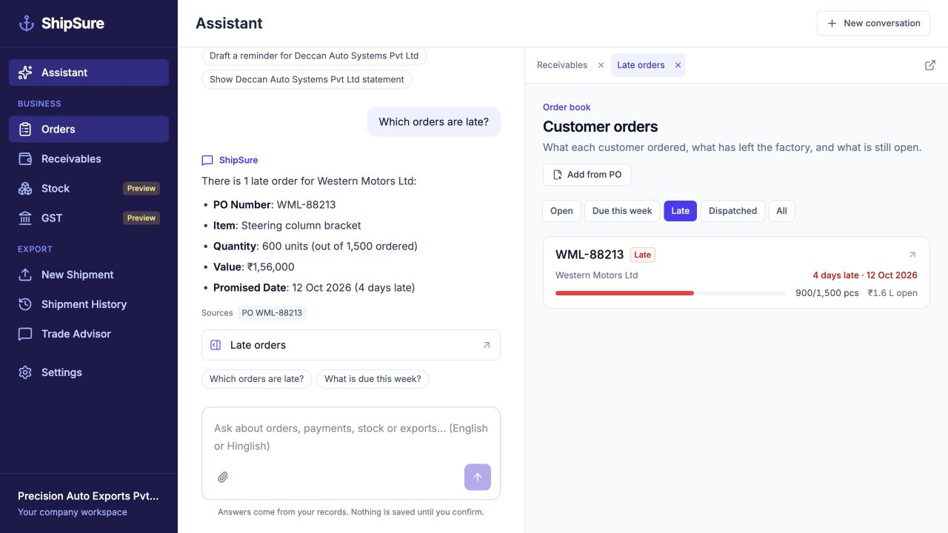
Wireframes/Mock diagrams of the proposed solution (optional)
Implemented workspace
Conversation on the left
Records open alongside the answer
Source links connect claims to evidence
Notes:
Sources: repository implementation; README.md, VALIDATION.md and FIRESTORE.md in the local reviewed working tree. All business examples are synthetic demo data. No customer outcome study or production benchmark.
Image is the implemented interface captured during the reviewed deployment, not a wireframe. Date-relative values reflect that capture.
Template source: One Neuron _ AI Builder Cup.pdf, supplied by user. Original branding artwork retained. Editable body text uses Arial for portability because the PDF Google Sans Flex subset is not an installed complete font.

Slide 7
Architecture diagram of the proposed solution
Next.js web app
Cloud Run
FastAPI service
Cloud Run
Gemini 2.5 Flash
Vertex AI
Durable state lives outside the Cloud Run filesystem
Business rules
SQLAlchemy projection
Firestore
Versioned demo records
Private Cloud Storage
Profile, uploads and PDFs
Document AI + Search
Extraction and policy context
Notes:
Sources: repository implementation; README.md, VALIDATION.md and FIRESTORE.md in the local reviewed working tree. All business examples are synthetic demo data. No customer outcome study or production benchmark.
Firestore stores bounded table snapshots with a versioned transaction. Each request uses a disposable in-memory SQLAlchemy projection. This is a single-demo design, not a general multi-tenant ERP.
Template source: One Neuron _ AI Builder Cup.pdf, supplied by user. Original branding artwork retained. Editable body text uses Arial for portability because the PDF Google Sans Flex subset is not an installed complete font.

Slide 8
Technologies to be used in the solution
Layer | Implemented technology | Purpose
Interface | Next.js 16, React, TypeScript | Responsive workspace and chat
API and business rules | FastAPI, Python, SQLAlchemy | Orders, payments and dispatch validation
AI and retrieval | Gemini on Vertex AI, Vertex AI Search | Grounded explanations and policy context
Document workflow | Document AI, ReportLab | Extraction and draft PDF generation
Hosting and storage | Cloud Run, Firestore, Cloud Storage | Public prototype with durable records
Verification | pytest, Playwright, ESLint | Business rules and browser workflows
Notes:
Sources: repository implementation; README.md, VALIDATION.md and FIRESTORE.md in the local reviewed working tree. All business examples are synthetic demo data. No customer outcome study or production benchmark.
Template source: One Neuron _ AI Builder Cup.pdf, supplied by user. Original branding artwork retained. Editable body text uses Arial for portability because the PDF Google Sans Flex subset is not an installed complete font.

Slide 9
Estimated implementation cost (optional)
Prototype target: near $0 for light usage
Component | Cost approach
Cloud Run frontend and API | Request billing, zero minimum instances, one-instance maximum
Firestore and Cloud Storage | Use eligible free allowances in us-central1
Gemini, Document AI and Search | Metered usage may incur charges
Builds, images and network | Additional usage charges may apply
Planning target, not a billing guarantee. No Cloud SQL instance. Developer time excluded.
Notes:
Sources: repository implementation; README.md, VALIDATION.md and FIRESTORE.md in the local reviewed working tree. All business examples are synthetic demo data. No customer outcome study or production benchmark.
Pricing checked 17 October 2026: https://cloud.google.com/run/pricing ; https://cloud.google.com/firestore/pricing ; https://cloud.google.com/storage/pricing . Free allowances depend on eligibility and aggregate usage. No invoice/billing export has been measured.
Template source: One Neuron _ AI Builder Cup.pdf, supplied by user. Original branding artwork retained. Editable body text uses Arial for portability because the PDF Google Sans Flex subset is not an installed complete font.

Slide 10
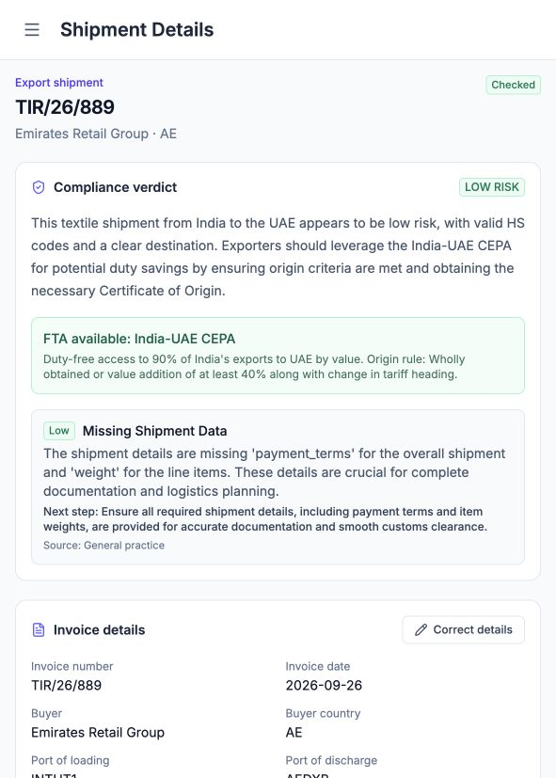
Snapshots of the prototype
Checked export invoice
The live application shows the extracted invoice and a compliance verdict. Generated documents remain available after a fresh revision and an overnight cold start.
Working evidence
Preserved company profile and 11 orders
Saved invoice and generated PDFs
Completed persistence verification task
Notes:
Sources: repository implementation; README.md, VALIDATION.md and FIRESTORE.md in the local reviewed working tree. All business examples are synthetic demo data. No customer outcome study or production benchmark.
Live screenshot captured after Firestore production activation on 17 October 2026. Synthetic invoice TIR/26/889.
Template source: One Neuron _ AI Builder Cup.pdf, supplied by user. Original branding artwork retained. Editable body text uses Arial for portability because the PDF Google Sans Flex subset is not an installed complete font.

Slide 11
Prototype Performance report/Benchmarking
Check | Observed evidence
Business and persistence tests | 61 backend tests passed
Browser workflows | 10 isolated browser workflows passed
Data preservation | 11 orders and six full customer statements matched
Restart persistence | Task, invoice and identical PDF survived a new revision
Concurrency protection | Real Firestore rejected a stale transaction
Live API | Health, profile, totals, PDF and disabled reset passed
No measured customer time savings, extraction accuracy score or load-test result yet.
Notes:
Sources: repository implementation; README.md, VALIDATION.md and FIRESTORE.md in the local reviewed working tree. All business examples are synthetic demo data. No customer outcome study or production benchmark.
61 backend tests passed on 17 October 2026. Ten isolated browser workflows, ESLint and a Webpack production build passed on 17 October 2026. Live public API and restart checks are recorded in VALIDATION.md. This is functional verification, not a load or accuracy benchmark.
Template source: One Neuron _ AI Builder Cup.pdf, supplied by user. Original branding artwork retained. Editable body text uses Arial for portability because the PDF Google Sans Flex subset is not an installed complete font.

Slide 12
Additional Details/Future Development (if any)
Before real customer use
Beyond the demo dataset
Add sign-in, tenant isolation and audit controls. Validate extraction with a labelled real-document dataset.
Replace bounded table snapshots with record-level persistence or a relational database as usage grows.
Deeper factory workflows
Pilot measurement
Add purchase and inventory movements. Validate GST and stock previews with domain specialists.
Track task completion time, correction rate and answer accuracy. Keep filing and compliance decisions under human review.
Notes:
Sources: repository implementation; README.md, VALIDATION.md and FIRESTORE.md in the local reviewed working tree. All business examples are synthetic demo data. No customer outcome study or production benchmark.
Template source: One Neuron _ AI Builder Cup.pdf, supplied by user. Original branding artwork retained. Editable body text uses Arial for portability because the PDF Google Sans Flex subset is not an installed complete font.

Slide 13
Provide links to your:
GitHub repository
https://github.com/RisheekNayak/AI-Builder-Cup-2026
Public access and latest branch push pending
Demo video (3 minutes)
Pending recording and upload
Final product
https://shipsure-web-117561127510.us-central1.run.app/
Notes:
Sources: repository implementation; README.md, VALIDATION.md and FIRESTORE.md in the local reviewed working tree. All business examples are synthetic demo data. No customer outcome study or production benchmark.
Repository URL comes from git remote origin and the user confirmed it as the intended submission repository. Unauthenticated GitHub API returned 404 on 17 October 2026, so public access remains unverified. Demo video has not been recorded yet.
Template source: One Neuron _ AI Builder Cup.pdf, supplied by user. Original branding artwork retained. Editable body text uses Arial for portability because the PDF Google Sans Flex subset is not an installed complete font.

Slide 14

Notes:
Closing artwork from the supplied template, preserved unchanged.

