Slide 1
OPERATING SYSTEMS PROJECT PRESENTATION (19AIE202)
TEAM - 13

Slide 2
MULTI-LEVEL QUEUE SCHEDULING

Slide 3

TEAM MEMBERS
Rishekesan S.V
Karthikeyan M
Nalin M R
Pragadishwaran K
Karthik Raja B

Slide 4
TABLE OF CONTENTS
01
INTRODUCTION
03
FCFS
02
Round Robin(RR)
04
PRIORITY SCHEDLING
CPU Scheduling
05
MULTI LEVEL QUEUE SCHEDULING

Slide 5
What is CPU Scheduling?
CPU Scheduling is a process of determining which process will own CPU for execution while another process is on hold.
The main task of CPU scheduling is to make sure that whenever the CPU remains idle, the OS at least select one of the processes available in the ready queue for execution.
The selection process will be carried out by the CPU scheduler. It selects one of the processes in memory that are ready for execution.

Slide 6
Why do we need CPU scheduling?
As we know, a process needs CPU time and I/O time both for its execution. In a multi-programming system, one process can use CPU while another process is waiting for I/O whereas, on the other hand in a uni programming system, all the time get wasted in waiting for I/O whereas CPU is free during that time.
Here are the reasons for using a scheduling algorithm:
The CPU uses scheduling to improve its efficiency.
It helps you to allocate resources among competing processes.
The maximum utilization of CPU can be obtained with multi-programming.
The processes which are to be executed are in ready queue

Slide 7
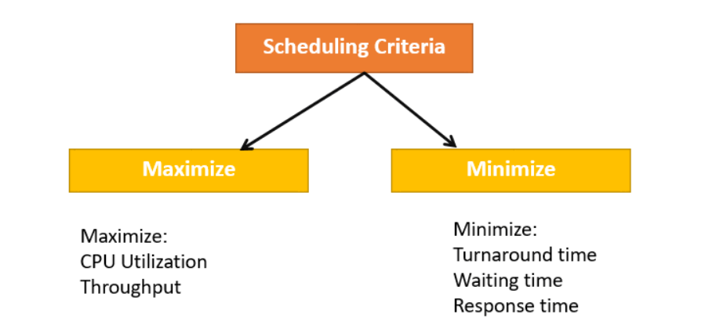
CPU utilization – keep the CPU as busy as possible
Throughput – of processes that complete their execution per time unit
Turnaround time – amount of time to execute a particular process
Waiting time – amount of time a process has been waiting in the ready queue
Response time – amount of time it takes from when a request was submitted until the first response is produced
A CPU scheduling algorithm tries to maximize and minimize the above conditions.

Slide 8
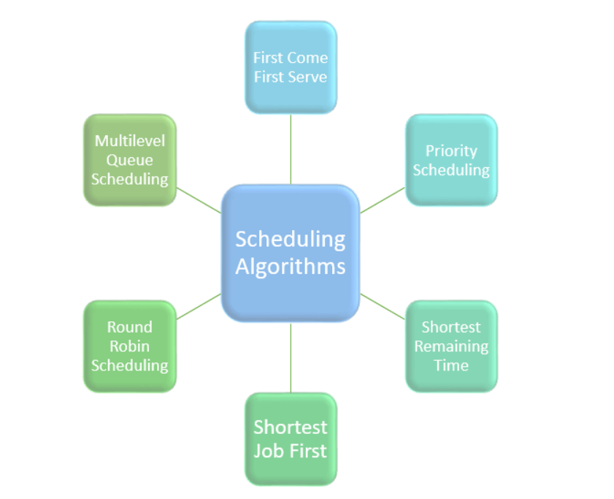
CPU Scheduling Algorithms
Types of CPU scheduling Algorithm
There are mainly six types of process scheduling algorithms
First Come First Serve (FCFS)
Shortest-Job-First (SJF) Scheduling
Shortest Remaining Time
Priority Scheduling
Round Robin Scheduling
Multilevel Queue Scheduling

Slide 9
Round-Robin (RR) Scheduling
Round-robin (RR) is one of the algorithms employed by process and network schedulers in computing. As the term is generally used, time slices (also known as time quanta) are assigned to each process in equal portions and in circular order, handling all processes without priority (also known as cyclic executive). Round-robin scheduling is simple, easy to implement, and starvation-free. Round-robin scheduling can be applied to other scheduling problems, such as data packet scheduling in computer networks. It is an operating system concept.
The algorithm's name is derived from the round-robin principle, which is used in various disciplines to ensure that everyone gets an equal share of something.

Slide 10
Working
To schedule processes fairly, a round-robin scheduler generally employs time -sharing, giving each job a time slot or quantum (its allowance of CPU time), and interrupting the job if it is not completed by then.
The job is resumed next time a time slot is assigned to that process. If the process terminates or changes its state to waiting during its attributed time quantum, the scheduler selects the first process in the ready queue to execute. In the absence of time-sharing, or if the quanta were large relative to the sizes of the jobs, a process that produced large jobs would be favoured over other processes.
Round-robin algorithm is a pre-emptive algorithm as the scheduler forces the process out of the CPU once the time quota expires.

Slide 11
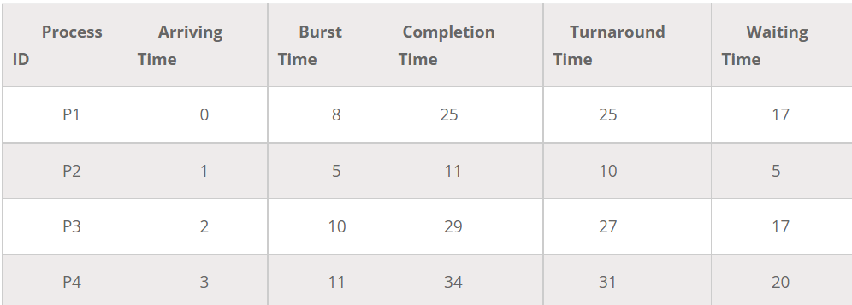
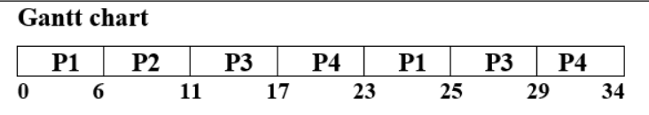
We will take an example to demonstrate how Round Robin CPU Scheduling works.
Based on the Gantt chart we calculate the following
Turnaround Time= Completion time – Arrival time
P1= 25-0 =0
P2= 11-1=10
P3= 29-2 = 27
P4= 34-3=31
Average Turnaround Time= 0+10+27+31/4
=17
Waiting Time = Turnaround time – Burst Time
P1= 25-8=17
P2=10-5=5
P3=27-10=17
P4=31-11=20
Average Waiting Time=17+5+17+20/4
=14.75
In the following explained example, we have 4 processes with process ID P1, P2, P3, and P4. The arrival time and burst time of the proceses are given table and quantum time is 6.

Slide 12
First- Come, First-Served (FCFS) Scheduling
First Come First Serve (FCFS) is an operating system scheduling algorithm that automatically executes queued requests and processes in order of their arrival. It is the easiest and simplest CPU scheduling algorithm. In this type of algorithm, processes which requests the CPU first get the CPU allocation first. This is managed with a FIFO queue. The full form of FCFS is First Come First Serve.
As the process enters the ready queue, its PCB (Process Control Block) is linked with the tail of the queue and, when the CPU becomes free, it should be assigned to the process at the beginning of the queue.
The job which comes first in the ready queue will get the CPU first. The lesser the arrival time of the job, the sooner will the job get the CPU. FCFS scheduling may cause the problem of starvation if the burst time of the first process is the longest among all the jobs.

Slide 13
Working
Step 1 : Input the number of processes required to be scheduled using FCFS, burst time for each process and its arrival time.
Step 2 : Using enhanced bubble sort technique, sort the all given processes in ascending order according to arrival time in a ready queue.
Step 3 : Calculate the Finish Time, Turn Around Time and Waiting Time for each process which in turn help to calculate Average Waiting Time and Average Turn Around Time required by CPU to schedule given set of process using FCFS.
Step 4 : Process with less arrival time comes first and gets scheduled first by the CPU.
Step 5 : Calculate the Average Waiting Time and Average Turn Around Time.
Turn Around Time = Completion Time - Arrival Time
Waiting Time = Turnaround time - Burst Time
It is easy to implement and use. However, this method is poor in performance, and the general wait time is quite high.

Slide 14
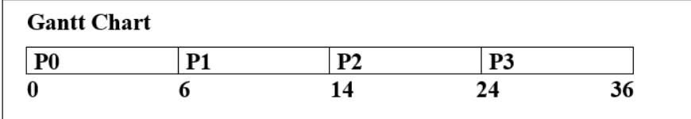
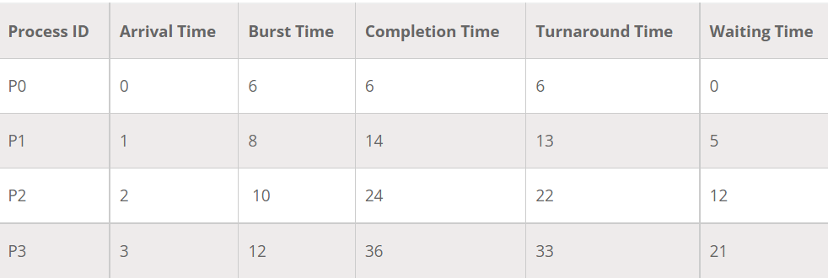
We will take an example to demonstrate how FCFS CPU Scheduling works.
Waiting Time = Turnaround time – Burst Time
Turnaround Time = Completion time – Arrival time
Based on the Gantt chart we calculate the following
Average Waiting Time = 0+5+12+21/4
= 38/4
= 9.5
Average Turnaround Time = 6+13+22+33/4
=74/4
= 18.5
In the following example, we have 4 processes with process ID P0, P1, P2, and P3. The arrival time of P0 is 0, P1 is 1, P2 is 2, and P3 is 3. The arrival time and burst time of the processes are given in the above table.

Slide 15
Priority Scheduling
A CPU algorithm that schedules processes based on priority.
It used in Operating systems for performing batch processes.
If two jobs having the same priority are READY, it works on a FIRST COME, FIRST SERVED basis.
In priority scheduling, a number is assigned to each process that indicates its priority level.
Lower the number, higher is the priority.
In this type of scheduling algorithm, if a newer process arrives, that is having a higher priority than the currently running process, then the currently running process is preempted.

Slide 16
Working
First input the processes with their arrival time, burst time and priority.
First process will schedule, which have the lowest arrival time, if two or more processes will have lowest arrival time, then whoever has higher priority will schedule first.
Now further processes will be schedule according to the arrival time and priority of the process. (Here we are assuming that lower the priority number having higher priority). If two process priority are same then sort according to process number. Note: In the question, They will clearly mention, which number will have higher priority and which number will have lower priority.
Once all the processes have been arrived, we can schedule them based on their priority.

Slide 17
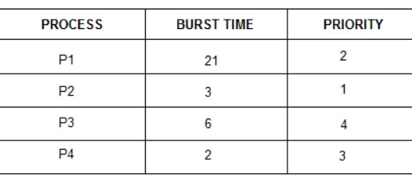

We will take an example to demonstrate how Priority CPU Scheduling works.
Consider the below table fo processes with their respective CPU burst times and the priorities. Based on the priority of the process CPU is schedulted, basically the process with the lowest priority is assigned first followed by the priority in ascending order for the process.
Gantt Chart
Average waiting time= (0+3+24+26)/4 = 13.25

Slide 18
INTRODUCTION TO MULTI LEVEL SCHEDULING
It's possible that processes in the ready queue will be separated into multiple classes, each with their own scheduling requirements. A frequent division is between a front (interactive) process and a background (batch) process, for example. Multilevel Queue Scheduling is employed in this case.
In this scheduling each process are easily classified into different groups. For example, a common division is made between foreground (interactive) process and background (batch) processes. These two types of processes have different response-time requirements and so may have different scheduling needs.

Slide 19
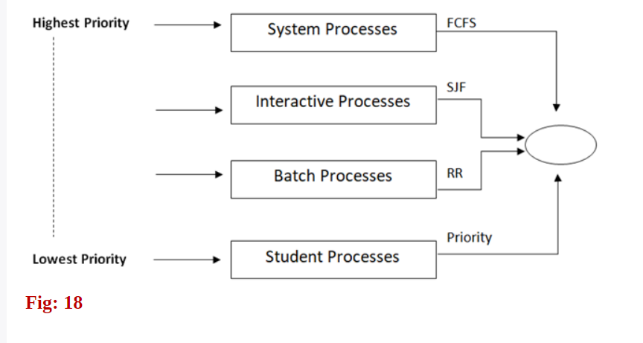
Multi-level queue scheduling
A multilevel queue scheduling algorithm partitions the ready queue into several separate queues .
Processes are permanently assigned to one queue as per group, based on some property.
Multilevel queue scheduling is used when processes in the ready queue can be divided into different classes where each class has its own scheduling needs.

Slide 20
Multi-level Queue Scheduling (MLQ)
Multilevel Queue Scheduling classifies the processes according to their types. For example, a multilevel queue scheduling algorithm makes a common division between the interactive processes (foreground) and batch processes (background). These two processes have different response times, so they have different scheduling requirements. Also, the interactive process has higher priority than the batch process.
In this scheduling, ready queue is divided into various queues that are called sub queues. A sub queue is a distinct operational queue.
The method separates the ready queue into various separate queues is Multilevel Queue.
The processes are permanently assigned to subqueues, generally based on some property of the process such as memory size, priority or process type.
Each sub queue has its own scheduling algorithm. For example, interactive processes at the foreground may use round robin scheduling while batch jobs at the background may use the FCFS method.

Slide 21
This scheduling partitions the ready queue in several separate queues and processes are permanently assigned to one queues. It is a common practice to associate some priority depending upon where the process may have or originated.
For instance, systems programs may have a higher priority over the user programs.
The processes are permanently assigned to one another, based on some property of the process, such as
Memory size
Process priority
Process type
Algorithm choose the process from the occupied queue that has the highest priority, and run that process either preemptive or non-preemptively Each queue has its own scheduling algorithm or policy.

Slide 22
OUTLINE OF MULTI LEVEL QUEUE SCHEDULING
Ready Queue partitioned into separate queues Example: system processes, foreground (interactive), background (batch), student processes.
Each queue has its own scheduling algorithm • Example: foreground (RR), background (FCFS)
Processes assigned to one queue permanently.
Scheduling must be done between the queues o Fixed priority - serve all from foreground, then from background. Possibility of starvation. o Time slice - Each queue gets some CPU time that it schedules - e.g. 80% foreground (RR), 20% background (FCFS)

Slide 23
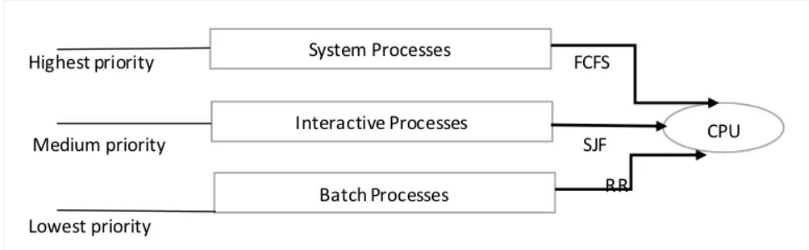
Here, we will take 3 different types of processes called system processes, interactive processes and Batch processes.
System process has the highest priority. If an interrupt is generated in the system, then the Operating system stops all the processes and handle the interrupt. According to different response time requirements, process needs different scheduling algorithm.
Interactive process has medium priority. If we are using VLC player, we directly interact with the application. So all these processes will come in an interactive process. These queues will use scheduling algorithm according to requirement.
Batch processes has the lowest priority. The processes which run automatically in the background comes under the batch processes. It is also known as background processes

Slide 24
According to process priority and type, the processes are scheduled with different scheduling algorithm.
Multilevel queue scheduling must be different in scheduling among the processes and generally are implemented as fixed preemptive priority scheduling.
Another case is if there are no processes in system and interactive queues. Suppose we are executing batch processes in the queue and all were empty initially. Assume that a new process enters either the system or interactive queue. Then, we have to preempt batch process queue scheduling wherein we have to give high priority to the queue which are above the batch queue.

Slide 25
IMPLEMENTATION IN C

Slide 26
THANK YOU

