Slide 1


Continuous Glucose Monitoring (CGM) – PCB design
AY 2021-25
GITAM UNIVERSITY
Major Project
Project ID: V8
A University should be a place of light, of liberty, and of learning.
Department of Electrical Electronics and Communication Engineering
Project Team:
B. Jashwanth Rishi-BU21EECE0100352
D. Sai Bhargavi – BU21EECE0100454
B. Dileep-BU21EECE0100141
Project Mentor:
Dr. Munmun Das
www.gitamedu.com

Slide 2




Project Group – Details
Photo
Track
Roll No
Name
EECE
BU21EECE0100352
B. Jashwanth rishi
EECE AI/ML
BU21EECE0100454
D. Sai Bhargavi
EECE
BU21EECE0100141
B. Dileep

Slide 3
CAPSTONE PROJECT
Review -2

Slide 4
CONTINUOUS GLUCOSE MONITORING (CGM)
PCB Design

Slide 5
Objective and Goals
Objective
The objective of the project is to design and develop a customized Printed Circuit Board (PCB) as the core component of a wearable Continuous Glucose Monitoring (CGM) device.
The PCB will integrate various subsystems, including an electrochemical glucose sensor interface, a microcontroller, a power management system, and a wireless communication module, into a compact and efficient platform.
The project aims to create a non-invasive CGM solution that minimizes user discomfort compared to traditional invasive methods.
It will facilitate continuous glucose level monitoring in wearable formats such as smartwatches.
The design will prioritize miniaturization, power efficiency, and robust data transmission capabilities to ensure reliable performance in diverse environments.
The project seeks to optimize the PCB for power consumption and user comfort through thorough testing and prototyping.
The optimized design will enable extended operation periods of the CGM device.
Goals
Main Goals
PCB design circuit for potentiostat
GUI Interface for Glucose Monitoring
Wearable Device Development
Additional Goals
Wireless Data Transmission
User-Friendly Interface

Slide 6
Abstract
Wearable Continuous Glucose Monitoring (CGM) systems are essential for the effective management of diabetes, offering real-time glucose level monitoring without pain associated with the glucose prick test. Our project is focused on designing and developing a customized Printed Circuit Board (PCB) that serves as the backbone for a wearable CGM device. This PCB serves as the centralized component that integrates various subsystems, including the glucose sensor interface (Electrochemical), microcontroller, power management system and wireless communication module, into a compact and efficient platform. The requirement for the customizable PCB arises from the unique requirements of the CGM systems. The need for miniaturization, with power efficient system which has robust and reliable data transmission subsystem using wireless mode in various environments. Many CGM available in the market are mostly work the technique of glucose prick (Invasive) which might cause the user to feel uncomfortable to tackle and reduce this problem this project will help in reducing this problem.
The primary objective of the project is to design a reliable and cost-effective PCB for a CGM device that can be used in wearable formats such as smart-watches and many more forms using non-invasive techniques for continuous glucose data transmission. Which helps user in monitoring the glucose levels using an interface. By system design outlining the circuit design for placement of appropriate sensors, microcontrollers and communication modules. PCB design layout using design software to create the board layout including components which are prone to noise and interference for completing the task without any errors. This PCB will be tested, prototyped for optimal results with various component integration and testing, with while using user wearable formats, optimizing the design for power consumption and comfort for the user with device operating continuously for extended periods.
Keywords: Wearable, CGM , PCB , Electrochemical , Non-invasive

Slide 7
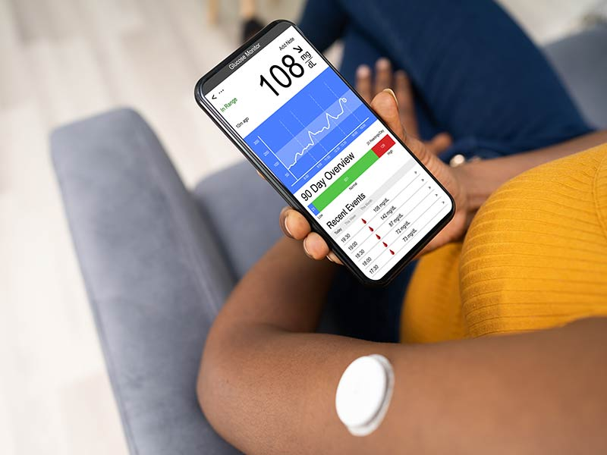
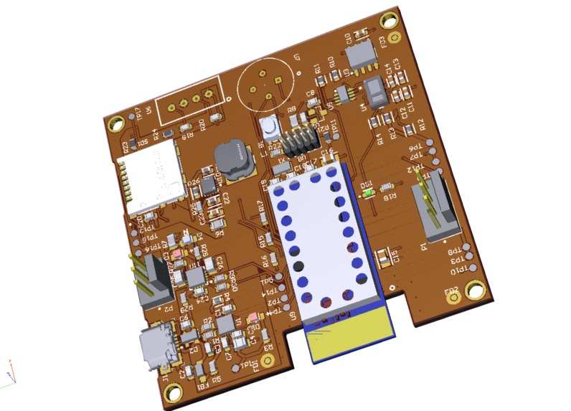
Introduction
Continuous Glucose Monitoring (CGM) systems have revolutionized diabetes management by offering real-time insights into a patient's glucose levels, enabling better control. At the core of these systems is the Printed Circuit Board (PCB), which serves as the backbone for integrating various electronic components like sensors, processors, and communication modules. The design of this PCB is critical in ensuring the reliability, accuracy, and efficiency of the CGM device. The PCB design for CGM systems involves several complex challenges, including the need for precise signal processing, low power consumption, and miniaturization. The sensors must accurately detect glucose levels in the interstitial fluid and transmit this data to the processor for real-time analysis. To achieve this, the PCB must be designed to minimize noise and interference while ensuring that the components are arranged in a way that optimizes performance and reduces power usage, extending the device's battery life.
Furthermore, as CGM devices are often worn continuously by patients, the PCB design must also prioritize durability and comfort. This includes selecting materials that are safe for long-term skin contact and designing the board to fit into a compact, ergonomic form factor. A successful PCB design for CGM not only enhances the device's functionality but also improves the user experience, making it a critical component in the development of next-generation diabetes management solutions.

Slide 8
Literature Survey
TITLE | AUTHOR | YEAR OF PUBLISHING | TECHNOLOGY | DRAWBACKS | REFERENCE LINK
UnpadStat Design: Portable Potentiostat for Electrochemical Sensing Measurements Using Screen Printed Carbon Electrode | Riyanto Setiyono Tias Febriana Hanifa Lestari Anni Anggraeni Yeni Wahyuni Hartati Husein Hernadi Bahti | 20th Jan, 2023 | 1. VLSI 1.1 Analog electronics 1.2 Digital electronics 2. Embedded 2.1 Microcontrollers 3. Electrochemical | Wired communications. Low range of portability. Need of external memory Limited Battery Life Accuracy Limitations Environmental Sensitivity User Complexity Size Constraints | [1]
Design of a Portable Potentiostat with Dual- Microprocessors for Electrochemical Biosensors | Chun-Yueh Huang | 12th July, 2016 | 1. VLSI 1.1 Analog electronics 1.2 Digital electronics 2. Embedded 2.1 Microcontrollers 3. Electrochemical | Two Microcontrollers Wired communications. Needs External memory Complex Design Cost Considerations Power Consumption Size and Portability User Interface Challenges | [2]

Slide 9
Literature Survey
TITLE | AUTHOR | YEAR OF PUBLISHING | TECHNOLOGY | DRAWBACKS | REFERNECE LINK
Building a microcontroller based potentiostat : A inexpensive and versatile platform for teaching electrochemistry and instrumentation | Gabriel N. Meloni | 26th April, 2016 | 1. VLSI 1.1 Analog electronics 1.2 Digital electronics 2. Embedded 2.1 Microcontrollers 3. Electrochemical | Prone to noise Wired communications Needs external storage device Limited Performance Environmental Sensitivity Complexity in Use Calibration Needs Battery Life Constraints | [3]
Design of smartphone controlled low-cost potentiostat for cyclic voltammetry analysis based on ESP32 Microcontroller [4] | Isa Anshori Ghani Faliq Mufiddin Iqbal Fawwaz Ramadhan Eduardus Ariasena Suksmandhira Harimurti Henke Yunkins Cepi Kurniawan | 29th October 2021 | 1. VLSI 1.1 Analog electronics 1.2 Digital electronics 2. Embedded 2.1 Microcontrollers 3. Electrochemical | Wireless communication Prone to noise from wireless medium causes errors Produces unstable signal due to production of background faradaic currents Signals are not precise for analysis Limited Sensitivity Calibration Requirements | [4]

Slide 10
Literature Survey
TITLE | AUTHOR | YEAR OF PUBLISHING | TECHNOLOGY | DRAWBACKS | REFERENCE LINK
Open -Source Potentiostat for Wireless electrochemical Detection with Smartphones [5] | Alar Ainla Maral P. S. Mousavi Maria- Nefeli Tsaloglou Julia Redston Jeffrey G. Bell M. Teresa Fernández- Abedul Geroge M. Whitesides | 16th April, 2018 | 1. VLSI 1.1 Analog electronics 1.2 Digital electronics 2. Embedded 2.1 Microcontrollers 3. Electrochemical 4. GUI (Graphical User Interface) 5. Cloud 6. Wireless communication | Limited Operating Range Dependency on Smartphone Compatibility Potential for Signal Interference Battery Life Concerns Calibration and Maintenance | [5]

Slide 11
Literature Survey
REFERENCES :-
Setiyono, R., Lestari, T. F. H., Anggraeni, A., Hartati, Y. W., & Bahti, H. H. (2023). UnPadStat Design: portable potentiostat for electrochemical sensing measurements using screen printed carbon electrode. Micromachines, 14(2), 268. [1]
Huang, C. (2015b). Design of a Portable Potentiostat with Dual-microprocessors for Electrochemical Biosensors. Universal Journal of Electrical and Electronic Engineering, 3(6), 159–164. [2]
Meloni, G. N. (2016). Building a microcontroller based potentiostat: an inexpensive and versatile platform for teaching electrochemistry and instrumentation. Journal of Chemical Education, 93(7), 1320–1322. [3]
Anshori, I., Mufiddin, G. F., Ramadhan, I. F., Ariasena, E., Harimurti, S., Yunkins, H., & Kurniawan, C. (2022). Design of smartphone-controlled low- cost potentiostat for cyclic voltammetry analysis based on ESP32 microcontroller. Sensing and Bio-Sensing Research, 36, 100490. [4]
Ainla, A., Mousavi, M. P. S., Tsaloglou, M., Redston, J., Bell, J. G., Fernández- Abedul, M. T., & Whitesides, G. M. (2018). Open-Source Potentiostat for Wireless Electrochemical Detection with Smartphones. Analytical Chemistry, 90(10), 6240–6246. [5]

Slide 12
Research Gap
While portable potentiostat have been developed for electrochemical sensing applications using microcontrollers like the ESP32,seeed studio there is limited research on applying these low-cost, open-source platforms specifically for continuous glucose monitoring. Most existing work has focused on prototypes or smartphone-based systems, but has not explored the potential of customized PCB designs with integrated microcontrollers for long-term glucose tracking. This project aims to address this gap by developing a dedicated, portable continuous glucose monitoring system built on a custom PCB with an ESP32 or Seeed studio microcontroller. The custom PCB will enable a compact, integrated design optimized for glucose sensing, with the ESP32 providing processing power, wireless connectivity, and programmability to create a flexible, user-friendly glucose monitoring platform. By leveraging the ESP32's capabilities and a custom PCB layout, this project seeks to create an affordable, accessible solution for continuous glucose monitoring that can be readily adapted for different electrochemical sensing applications beyond just glucose detection.
Differences:
Existing CGM technologies use wired communication between the user and the device, limiting flexibility.
Current CGMs have relatively high power consumption, reducing efficiency.
Most traditional and research-based CGMs are invasive, impacting user comfort.
Our implementation:
Incorporating wireless communication for seamless data transfer between the user and the device.
Focusing on power-efficient, low-power utilization for extended battery life.
Designing a compact, non-invasive PCB to enhance user comfort.

Slide 13
Project Plan
Today
Jul
Aug
Sep
Oct
2024
Pre-Project work
Research paper gathering
Jul 23 - Jul 30
Problem finding
Jul 27 - Aug 5
Capstone Project
Software information gathering
Circuit design and simulation
Aug 5 - Aug 21
Circuit optimization
Aug 21 - Sep 10
Sep 24 - Oct 3
Circuit simulation and PCB design

Slide 14
Analysis - SWOT
Weaknesses
Strengths
1. Sensor Life and Accuracy
2. Battery Life
3. Dependence on Smartphone
1. Real-Time Monitoring
2. Proven Health Benefits
3. Patient Convenience (Non- invasive)
Threats
Opportunities
1. Device malfunction
2. Device range for communication affects the device performance
1. Increased health awareness
2. Technology advancements
3. Shift towards preventive Healthcare
4. Telemedicine and remote patient monitoring

Slide 15
Analysis – 4W1H
Why: The project focuses on developing a wearable Continuous Glucose Monitoring (CGM) device through the design of a customized Printed Circuit Board (PCB). This PCB will integrate various subsystems, including an electrochemical glucose sensor, microcontroller, power management system, and wireless communication module, into a compact and efficient platform.
What: The objective is to develop a PCB for Continuous Glucose monitoring system. This system will integrate electrochemical sensors, microcontrollers, power management systems, and wireless communication into a compact Printed Circuit Board (PCB).
Where: The project is conducted within the Department of Electrical, Electronics and Communication Engineering at GITAM School of Technology in Bengaluru, Karnataka, India. Product is focused for individuals who are willing to have their own personal health care management.
When: The project duration spans from July 2024 to an unspecified date in 2024, aligning with the academic year 2024-2025
How: The methodology includes component selection, circuit design and simulation, integration of components onto the PCB, microcontroller programming, calibration and testing of the system, and data collection and analysis. Key tools involve electrochemical sensors and microcontrollers designed for low power consumption and efficient data transmission.
Refined Objective: The primary goal is to create a reliable and cost-effective PCB for a wearable CGM device that enhances user experience through non-invasive monitoring while addressing challenges such as invasiveness, customization needs, miniaturization, power efficiency, data transmission reliability, and overall user comfort.

Slide 16
Block Diagram
Continuous Glucose Monitoring
Literature survey and abstract
Circuit design and simulation
Testing
NO
analysis
YES
PCB design and testing
PCB

Slide 17
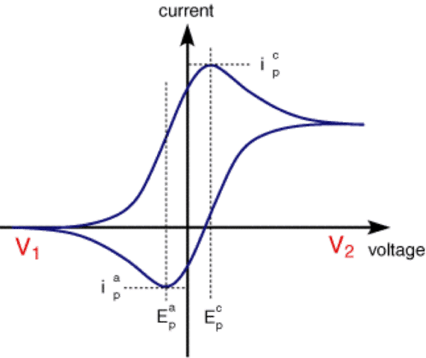
Architecture- Readout circuit
Electrode
CE
RE
WE
Control amplifier
Voltage buffer
Transimpedance Amplifier
plotter
Voltage(E-potential)
Current(I)
GUI (Graphical User Interface)
ADC
Microcontroller (Transmitter)
Microcontroller (Receiver)

Slide 18
Use Cases & Testing
Use Cases
Continuous Glucose Monitoring:
PCB design for Continuous glucose monitoring for an individual using non-invasive techniques.
Individual usage
Personal Health Management
User-Friendly Interfaces
Clinical settings
Patient Monitoring
Research and Trials
Emergency Situations
Test Cases
Laboratory settings:
Initial testing phase for measuring the sensor accuracy and responsiveness for given initial conditions.
Key parameters to evaluate include:
Calibration Accuracy
Response Time
Environmental Stability
Individual and Clinical settings:
Real-Time Monitoring
User Comfort and Compliance
Data Accuracy

Slide 19
Contribution
Team Progress and Movement
Literature review:
Literature review done on existing CGM technologies using various research papers.
Circuit design:
Designing the circuit based on the required calibration
Circuit simulation and analysis:
Simulating the circuit to analyze the data generated for improvement
PCB design:
Designing the finalized circuit using PCB design software
Individual Contribution
PCB design: B. Jashwanth rishi
Circuit design and analysis
PCB design
GUI interface design: B. Dileep
GUI interface design
Interface for glucose monitoring
Data analysis algorithm: D. Sai Bhargavi
Algorithm for data analysis
Data trend analysis

Slide 20




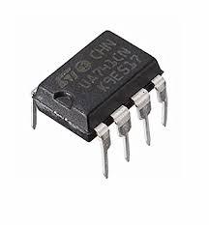
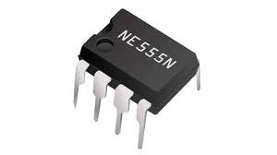
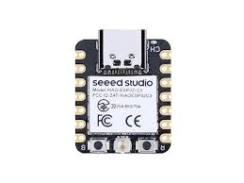

Software/ Hardware information
Software
Multisim
Simulink
Easy EDA
Wokwi
Hardware
Op-amp-LM741
555 timer
ESP-32
Seeed studio

Slide 21
Methodology
Component Selection: Choose the necessary components for the potentiostat circuit, such as the microcontroller, IC’s for suitable customization.
Circuit Design and simulation: Create a circuit layout based on the block diagram. Connect the components according to their functions and ensure proper grounding and power supply connections.
Component Integration: Assemble the selected components onto the PCB board based on the circuit design. Follow the manufacturer's guidelines for component placement and soldering techniques.
Microcontroller Programming: Program the microcontroller to control the DAC output voltage, read the ADC voltage, display data on the touch screen, store data on the SD card, and communicate with a computer via USB.
Calibration and Testing: Calibrate the potentiostat circuit to ensure accurate results. Use reference solutions or standards to verify the circuit's performance. Conduct tests to check the functionality of each component and the overall system.
Data Collection and Analysis: Set the desired parameters on the interface, start the voltage sweep, and record the corresponding current values. Collect and store the data on the SD card. Analyze the data using appropriate software or tools

Slide 22
Implementation and Results – Iteration 1
Iteration 1 : BUFFER based readout circuit
Compatibility Check
Voltage Levels: Verify that the output voltage from the readout circuit matches the input voltage requirements of the microcontroller. Most microcontrollers operate at specific voltage levels (e.g., 3.3V or 5V).
Signal Integrity: Check for signal clarity to avoid data loss. Use tools like oscilloscopes to observe the waveform and ensure it is stable without noise.
Multisim Simulation
Utilize Multisim software to simulate your circuit design:
Design the Circuit: Use Multisim's library to create your circuit with components such as resistors and capacitors.
Run Simulations: Perform various analyses (DC, AC, transient) to see how the circuit behaves under different conditions. This helps identify any problems before building it physically.
Dummy Electrochemical Cell Circuit
Build a test circuit using a dummy electrochemical cell:
This setup allows you to test how well your readout circuit functions under controlled conditions.
Ensure that it accurately measures and responds as it would with real electrochemical sensors, which is crucial for reliable data collection.

Slide 23
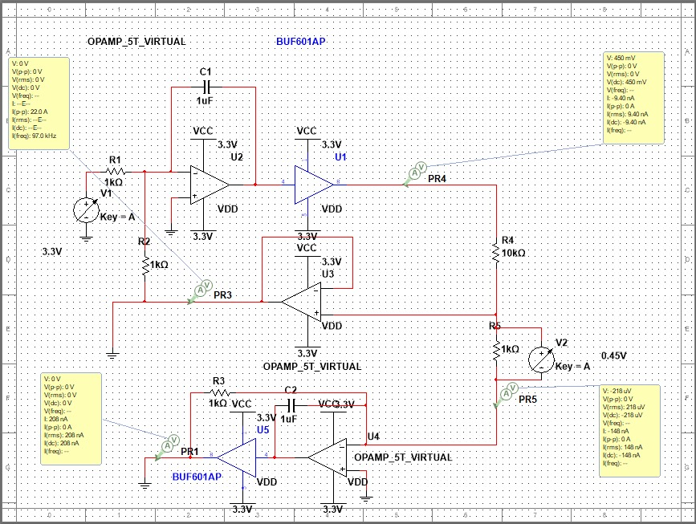
Implementation and Results – Iteration 1
Control amplifier
Voltage buffer
Current to voltage converter
FIG:- Glucose data read out circuit

Slide 24
Implementation and Results – Iteration 2
Iteration 2 : Read out circuit
A potentiostat is an essential electronic device used in electrochemistry to control and measure the voltage difference between a working electrode and a reference electrode in a three-electrode system. It plays a crucial role in various electroanalytical experiments, including cyclic voltammetry.
Key Functions of a Potentiostat
Voltage Control: The potentiostat maintains a constant voltage at the working electrode relative to the reference electrode by adjusting the current supplied through the auxiliary (counter) electrode.
Current Measurement: It measures the current flowing between the working and counter electrodes, providing insights into electrochemical reactions occurring at the working electrode.
Automated Operation: Modern potentiostat are often interfaced with computers, allowing for automated data collection and analysis through dedicated software.
Components of a Electrochemical cell:
Working Electrode: Where the electrochemical reaction occurs.
Reference Electrode: Maintains a stable potential against which the working electrode's potential is measured.
Counter Electrode: Completes the circuit by carrying current.

Slide 25
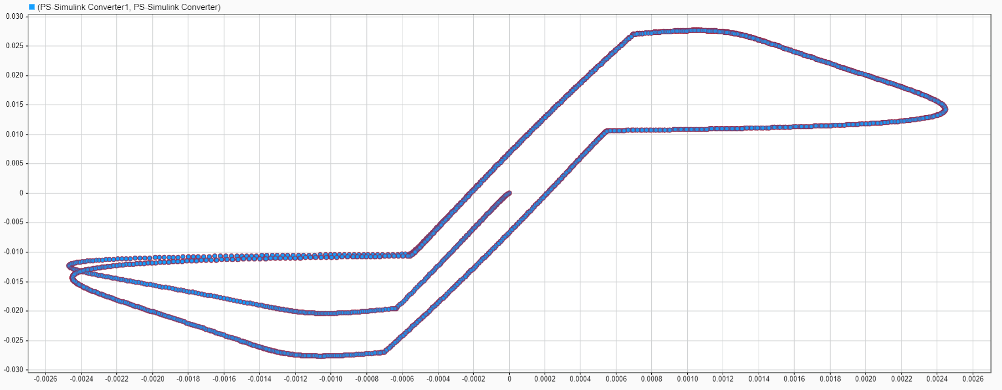
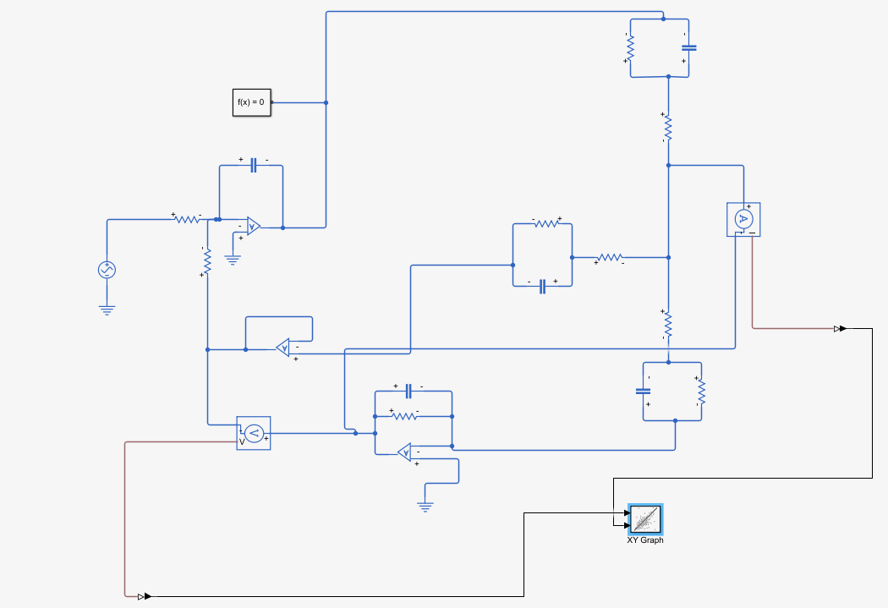
Implementation and Results – Iteration 2
Iteration 2 : Results
Current(I)
Potential /Voltage(V)
FIG:- Dummy electrode read out circuit
FIG:-Readout circuit output graph

Slide 26
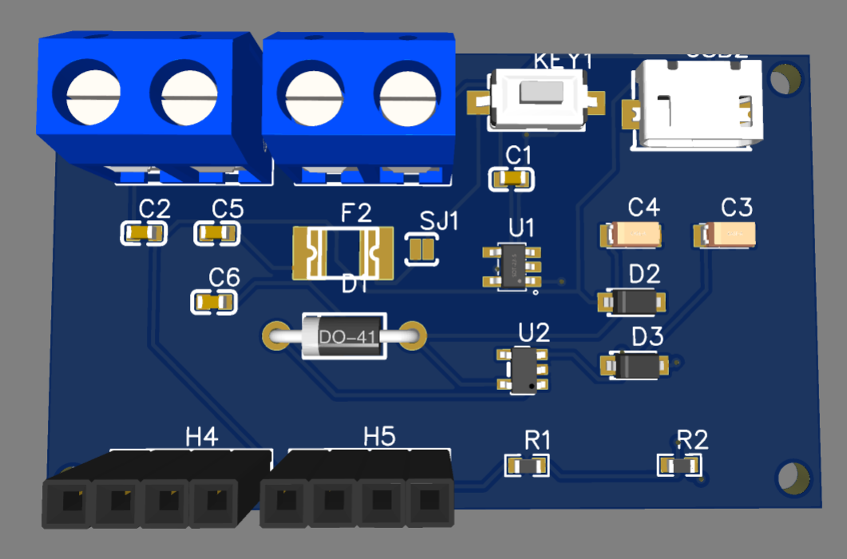
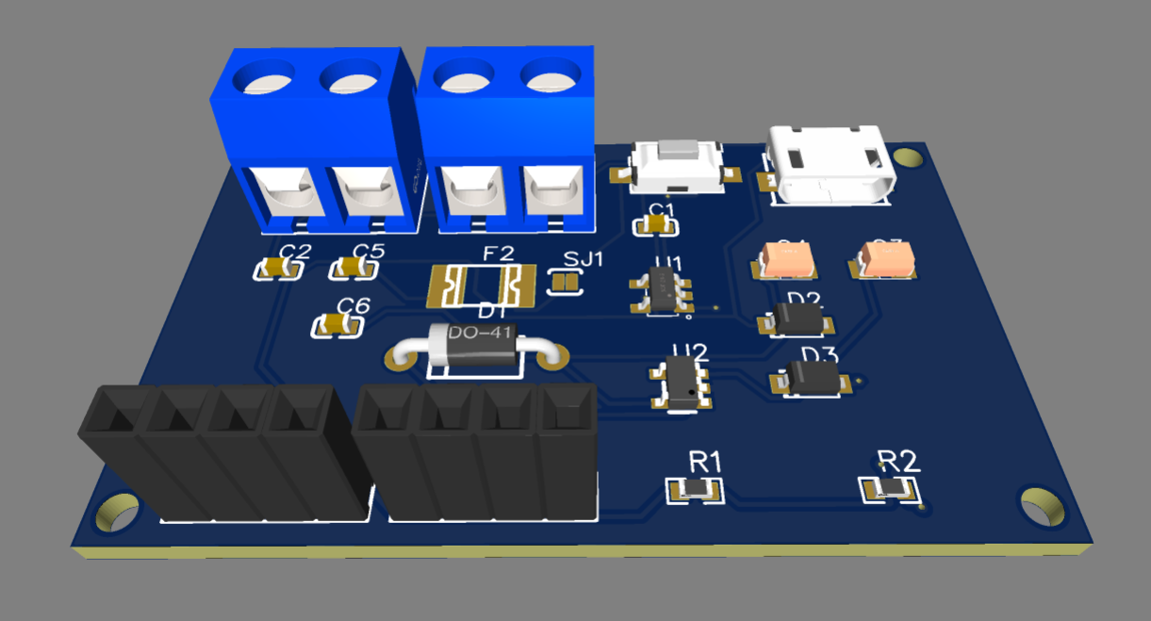
Implementation and Results – Iteration 3
Iteration 2 : Power management system-3.3 V charger and regulator
Designed a PCB to handle charging of an onboard 3.3V LiPo battery, ensuring consistent power supply to the system.
Integrated a 3.3V voltage regulator to stabilize and control the input voltage from the battery, powering the microcontroller and allowing for seamless task execution.
Incorporated a USB Type-B connector to provide an alternative power source, useful for testing and calibration purposes.
The PCB design was integrated into the main circuit as part of a power management system to ensure efficient energy distribution and conservation across components.
FIG: 3D view of Battery charger and voltage regulator

Slide 27
Conclusion
Summary and Conclusion
The project centers on the design and development of a Customized Printed Circuit Board (PCB) for a Continuous Glucose Monitoring (CGM) device.
Aiming to create a non-invasive solution that integrates various subsystems, including an electrochemical glucose sensor interface, microcontroller, power management system, and wireless communication module, into a compact and efficient platform.
This PCB is intended to minimize user discomfort compared to traditional invasive methods, facilitating continuous glucose level monitoring in wearable formats such as smartwatches.
The project emphasizes miniaturization, power efficiency, and robust data transmission capabilities to ensure reliable performance in diverse environments.
Through thorough testing and prototyping, the team seeks to optimize the PCB for power consumption and user comfort, enabling extended operation periods of the device while addressing challenges such as invasiveness and customization needs.
Future work will focus on extensive real-world testing, enhancing the user interface, integrating advanced features like alerts for abnormal glucose levels, and expanding the PCB design for other biosensors beyond glucose monitoring.
Ultimately, the project contributes to improved diabetes management solutions.

Slide 28
Future Work
Future Work
Further Testing and Optimization: Conduct extensive testing of the PCB in real-world scenarios to fine-tune its performance and ensure accuracy in glucose measurements.
Enhanced User Interface: Develop a more intuitive graphical user interface (GUI) for easier interaction and data visualization.
Integration of Additional Features: Explore the addition of features such as alerts for abnormal glucose levels and integration with mobile applications for better data tracking.
Long-term Stability Studies: Investigate the long-term stability and reliability of the electrochemical sensors to ensure consistent performance over extended periods.
Expansion to Other Applications: Consider adapting the PCB design for other types of biosensors beyond glucose monitoring, broadening its applicability in healthcare.

Slide 29
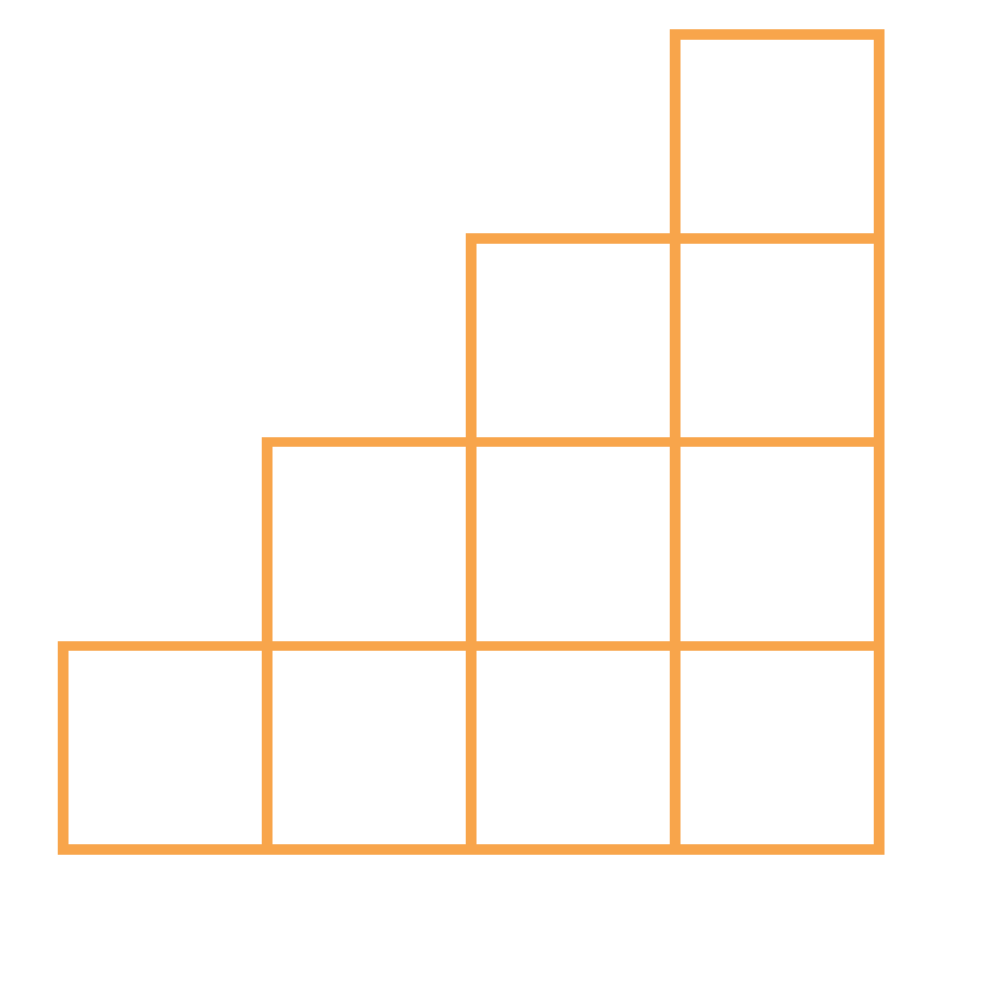
THANK YOU

