Slide 1
JAVASCRIPT
Client side dynamic pages
Object oriented programming language- organizes data as objects rather than functions & logic
Lightwieght, cross platform language, case sensitive
Its not compiled but translated language
For scripting the webpages
Most preferrable as they have built in execution environments
3 places to specify javascript
1. Between the body tag of html
2.Between the head tag of html
3.js file (external javaScript)
JAVASCRIPT VARIABLE
Name must start with a letter (a to z or A to Z), underscore( _ ), or dollar( $ ) sign.
After first letter we can use digits (0 to 9), for example value1.
JavaScript variables are case sensitive, for example x and X are different variables.
Local variable – inside function
Global – accessible by any function

Slide 2
KEYWORDS
Let – block scoped & global scoped, cannot be redeclared in the same scope, must be declared before use
//Hoisting -- behaviour of moving the variables on top of the script
x = 12;
console.log(x); //ReferenceError: Cannot access 'x' before initialization, cannot access before declaration
let x;
CONST
Cannot be reassigned.
It has Block Scope
It can be assigned to the variable on the declaration line.
It’s a Primitive value.
The property of a const object can be changed but it cannot be changed to a reference to the new object
The values inside the const array can be changed, it can add new items to const arrays but it cannot reference a new array.
Re-declaring of a const variable inside different block scopes is allowed.
Cannot be Hoisted.
Creates only read-only references to value.

Slide 3
VAR
Function & global scoped
Hoisting is possible -- Explanation: We get the output without any error because the variable test is hoisted at the top even before the execution of the program began and the variable is initialized with a default value of undefined
Console.log(test) // return undefined and not an error
Var test = 12
Redeclare is possible -- Explanation: We did not get any error when redeclaring the variable if we did the same with the let keyword an error would be thrown

Slide 4
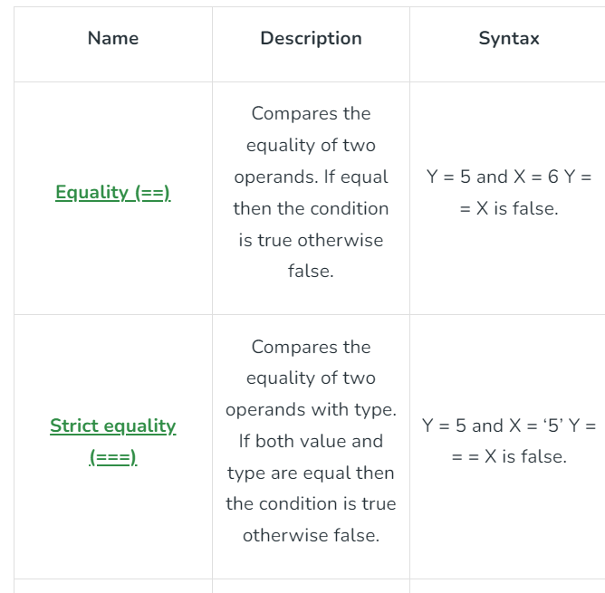
DATA TYPES
Primitive
String: var x=“Rishika”
Number: var y=20
Boolean: var hasHobbies=true
Null : empty value, variable is assigned as contains no value
Undefined : variable is declared but its value has not
been assigned
Non Primitive
Object const var = {};
Array const var = [];

Slide 5
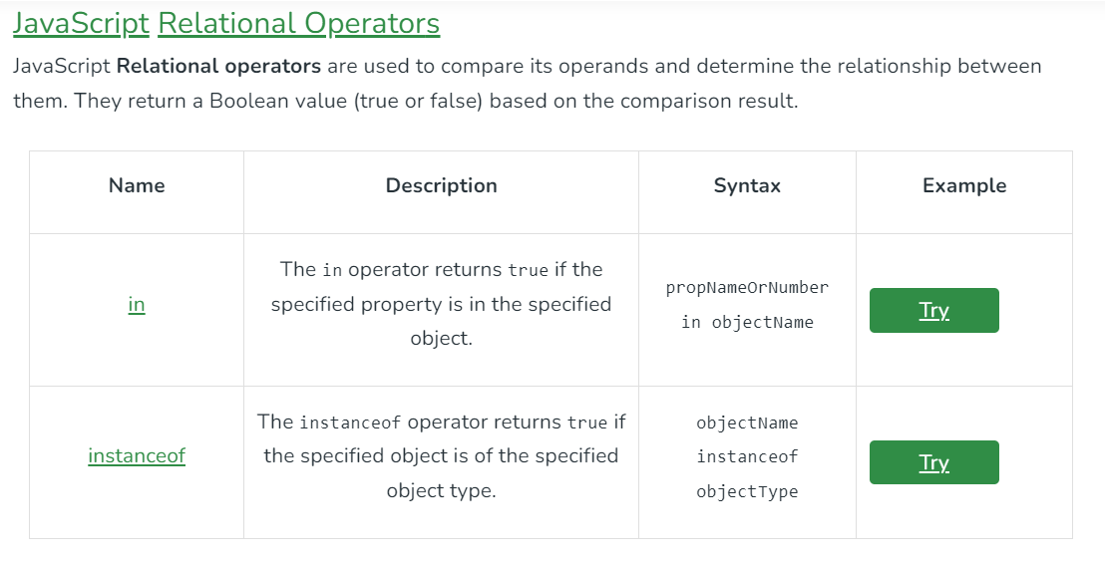
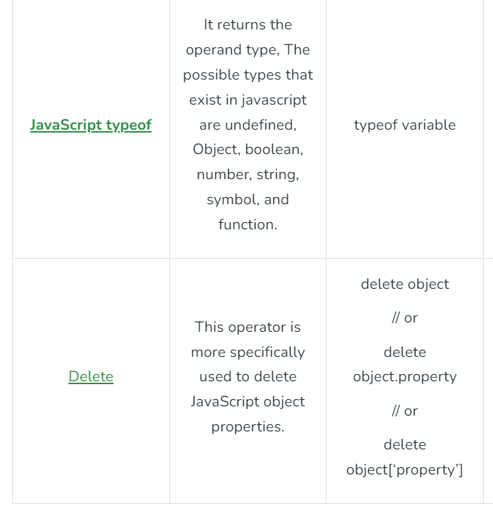
UNARY OPERATORS

Slide 6
CONDITIONAL
var a = 50; // if
if(a == 50) {
console.log("A is 50")
}
var a = 50;// if else if
if( a==100){
console.log("A is 100")
}
else if(a==50){
console.log("A is 50")
}
SWITCH
var grade='B';
var result;
switch(grade){
case 'A':
result="A Grade";
break;
case 'B':
result="B Grade";
break;
case 'C':
result="C Grade";
break;
default:
result="No Grade";

Slide 7
LOOPS
// FOR LOOP iterate over fixed number of elements when the number of iterations are known
for (i=1; i<=5; i++) {
console.log(i)
}
// WHILE LOOP iterate over infinite number of times if iterations are not known
var j= 11;
while (j<=20) {
console.log(j)
j++
}
// DO WHILE LOOP Executes the code infinite number of times and checks if condition is true
var i = 10;
do{
console.log(i)
i++
}
while(i<15)

Slide 8
JAVASCRIPT OBJECT
Classes are blueprints of objects
Class is a template, objects are instances of a class
// Defining class using es6
class Vehicle {
constructor(name, maker, engine) {
this.name = name;
this.maker = maker;
this.engine = engine;
}
getDetails() {
return (`The name of the bike is ${this.name}.`)
}
}
// Making object with the help of the constructor
let bike1 = new Vehicle('Hayabusa', 'Suzuki', '1340cc');
let bike2 = new Vehicle('Ninja', 'Kawasaki', '998cc');
console.log(bike1.name); // Hayabusa
console.log(bike2.maker); // Kawasaki
console.log(bike1.getDetails());

Slide 9
LET & CONST
All const decalarations must be initialized and once initialised cant be reassigned a new value
Let name = “Viswas”
Name = “codeevaluation”
Const name = “visvas” and cannot be reassigned

Slide 10
Short hand object assignment
Const name =“viswas”
Const channel = “codeevaluation”
Const youtube = {
name,
channel }

Slide 11
Destructuring Assignement
Extract values from arrays or objects
Const name = {
first

