Slide 1
REACT JS REFRESHER
Javascript library for building user interfaces show and run in browser
Declarative approach,efficient, open source component based frontend library
Single page application – only one html file getting returned
Npx create-react-app appname
App : javascript function returns html
JSX – HTML looking code in Javascript file
Changes into commands that the DOM understands to render real DOM elements
COMPONENTS – a function which returns JSX or Javascript class that has render method
name starts with a capital letter to show custom component
To pass data in props you send a callback function from child to the parent

Slide 2
Main objective is to improve the speed of app
It uses a virtual DOM for improved performance
Both client side-action takes place on the client, create visually appealing website for the users
server side- action – design and manage the data for exchange when requested
Most websites are built using MVC – model view controller
Why REACT JS
DOM – Document object Model- created by the browser each time a webpage is loaded
It dynamically add or removes data in the backend, each time creates a new DOM when any modification is done which leads to unnecessary wastage of memory and affects the performance of the application
React the whole application divided into components, it creates a virtual DOM, when ever the data is updated it directly does not affect the actual DOM but updates the virtual DOM
INSTALLATION
Node js, npm , react & react dom, webpack, babel
npx create-react-app appname

Slide 3
REACT FEATURES
JSX – javascript XML like HTML syntax used for ReactJS,
Components – functional components with own logic and controls, component based architecture, reusable and maintain code
One way data binding- better control throughout the application, data flows unidirectionals
Virtual DOM – instead of manipulating the actual DOM , the virtual DOM gets created and updated with the latest changes and then compare with the actual DOM and updates only the things actually changed, prevents wastage of memory, and improves speed
Simplicity
Performance

Slide 4
REACT COMPONENT
COMPONENT BASED APPROACH – entire application is broken down into simple logic group of code which is known as component
Core building block of react application , all component exist together but work independently and merge all in a parent component
FUNCTIONAL COMPONENT :
they simple javascript function may or maynot receive data as parameters and return react element.
Stateles component
function ComponentName ( ){
return (
<>
</>
)
}
const ComponentName=() =>{
return (
<></>
)
}

Slide 5
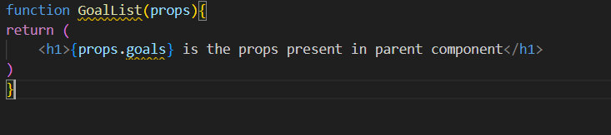
PROPS
Props stands for properties, they read-only immutable from inside of the components
They objects that store values of the attributes like the HTML attribute
They are used to pass data from parent component to the child component
Props are passed to the components as similar to arguments re passed to the function
In parent component
<GoalList goals=“Complete a course” />

Slide 6
REACT EVENTS
Events is an action triggered by user action or system generated
Synthetic events for react
camelCase
JSX function is passed as the event handler
CONDITIONAL RENDERING
Allows to dynamically render UI methods based on certain conditions
If-else
Ternary operator more concise way based on Boolean ? True : false
Switch case for multiple conditional
Enum more readable multiple comditional rendering

Slide 7
REACT ROUTER
Routing is redirecting to different pages based on user actions
Used to display multiple views in a singlepage application
It is used to define and render component based on specified path, it will accept components and render to know what to be rendered
<Router>
<div>
<h1>React Router Example</h1>
<Route path="/" component={App} />
<Route path="/about" component={About} />
<Route path="/contact" component={Contact} />
</div>
</Router>

Slide 8
REACT HOOKS
Hooks allow function components to access state and other react features
3 rules
Only called inside function component
Top level of the component
Cannot be conditional
USE STATE
used to manage the component state, allowing to track the data with in a component and update is as needed
Const[data, setdata] = useState (“ ”)
data-- current state
setData– function used to update the state
useState is the hook and sets the initial value for the data variable

Slide 9
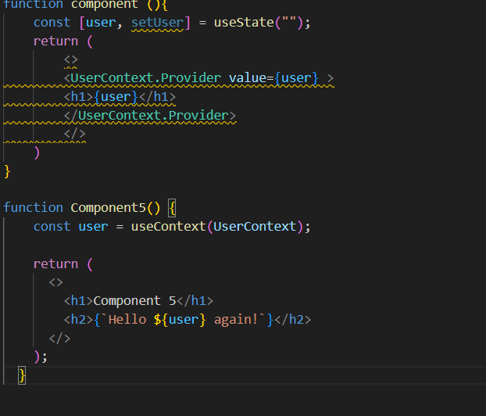
USE EFFECT
Used to manage side effects of the component
like fetching data, timer, directly updating the DOM
Accepts 2 arguments function and a optional dependency array
useEffect( ( )=>{
setTimeout(( )=>{
setCount}
}, [])
USECONTEXT
Usecontext is a way to manage state globally
Share state between deeply nested components

Slide 10
HOOKS
Can be used only in function components
Cannot be rendered conditionally inside the loops, they should be at the top of the component

