Slide 1
React js
Javascript library for building user interfaces
Platform agnostic
Manage state, build virtual component tree
Requires additional library like react DOM to translate to an actual platform like web browser
React Native
Alternative to React DOM
Special built in React component- then compiled to UI elements
Native platform APIs like device camera exposed to Javascript
Connected React to specific platform like ios, android
Special components are compiled at the end to react native apps for the respective platforms not the javascript logic
Input – web browser – react dom
Edit text – native component – android
UITextField – native component – ios
TextInput – ReactNative JSX
React native – logic
Logic in javascript is not compiled
Runs as javascript thread hosted by reactnative
React native maps and compiles reusable components to respective platform equivalents

Slide 2
PROJECT SETUP
npx create-expo-app AwesomeProject cd AwesomeProject npx expo start
npm run –web to run web
Android studio → create device → run → click a to link with android simulator on your local machine

Slide 3
JAVASCRIPT REFRESHER
Object oriented Programming language- Data can be organized into objects,
Weekly typed language – no specific type assignment, data types can be switched dynamically
Verstality – used on wide variety of platforms, broad variety of tasks
Variable - > var name
Constant → const name = “Rishika” // cannot change the value
Let -> let name =“Rishika” name =“Sanjith” // can be changed with in the scope
const name = 'Rishika’; // string
let age = 25; // integer
const hobbies = true; // booleam
age = 30;
function summerizeUser (userName,userAge,userHobbies ){
return (
'Name is ' + userName + ' age is ' + userAge + ' and users hobbies are '+ userHobbies )
}
console.log(summerizeUser(name,age, hobbies))

Slide 4
ARROW FUNCTIONS
const summary = (userName, userAge, userHobbies) => {
return (
'Name is ' + userName + ' age is ' + userAge + ' and users hobbies are '+ userHobbies
)
}
console.log(summary(name, age, hobbies))
const add = (a,b) => a+b; // 2 arguments have parenthesis but returns single statement so no curly braces
const addOne = a => a+1; // 1 argument no parenthesis
const addRandom = ()=> 1+2; // no arguments empty parenthesis
// call the above declared functions console.log(add(10,10));
console.log(addOne(10));
console.log(addRandom());

Slide 5
OBJECT
const person = {
name:'Max',
age: 26,
// greet : ()=>{console.log('Good Morning, I am '+ this.name)} // this refers to the global scope needs usual way of function
//greet: function Greet (){console.log('Good Morning, I am '+ this.name)}
greet (){
console.log('Good Morning, I am '+ this.name)
}
};
const person1 = {...person} // spread operator
console.log(person1)

Slide 6
ARRAY
Since arrays and objects are reference types it can be stored with keyword constant
reference types only store address pointing at the place of memory only the the thing on which the pointer is pointing is changed and not the pointer
Not editing the constant only editing the thing at which the pointer is pointing
const hobbies = ["sports", "cooking", 1]
for (let hobby of hobbies){
console.log(hobby);
}
console.log(hobbies.map(hobby => {return "hobby:" + hobby}) ) // map takes a function to be performed on each element of the array and return a new array
hobbies.push("Coding") // add new element at the end of array
const hobbies1 = hobbies.slice() // copies array, pass arguments to narrow down the range of elements
console.log(hobbies1) // [ 'sports', 'cooking', 1, 'Coding' ]
const hobbies2 = [hobbies]; // creates new array with element first element as hobbies array
console.log(hobbies2); //nested array [ [ 'sports', 'cooking', 1, 'Coding' ] ]
const hobbies3 = [...hobbies]; // spread operator to pull out elements one by one and create new array
console.log(hobbies3); //[ 'sports', 'cooking', 1, 'Coding' ]

Slide 7
REST OPERATOR
const toArray = (arg1, arg2, arg3 )=>{
return [arg1, arg2, arg3]
}
console.log(toArray(1,2,3));
const toArray1 = (...args) => // merge multiple arguments to a array its used as rest operator used in arguments for a function
{
return [...args]
}
console.log(toArray1(1,2,3))

Slide 8
OBJECT DESTRUCTURING
const person = {
name:'Max',
age: 26,
greet (){
console.log('Good Morning, I am '+ this.name)
}
};
const printName = (personData) =>{
console.log(personData.name)
}
printName(person)
const printName1 = ({name}) =>{ // stored in local variable called name
console.log(name)
}
printName1(person)
const {name,age} = person; // used only for destructuring
console.log(name, age)

Slide 9
ARRAY DESTRUCTURING
//unlike objects we can choose any names for array destructuring, in objects we use property names
const hobbies = ['dance','sing'];
const [hobbies1, hobbies2] = hobbies;
console.log(hobbies1); // dance
console.log(hobbies2); //sing

Slide 10
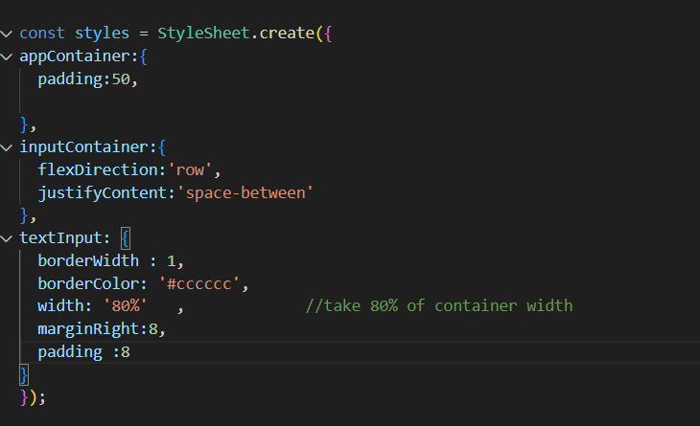
H1 h2 HTML elements do not work in react native as they are not browsers, they don’t have DOM to support HTML elements
To get core components →reactnative.dev – components
No CSS for styling react native components – inline styling using props or stylesheets objects, write styling in javascript
Text string must be rendered with Text component
View for boxes or containers
Button is self closing tag with title prop
LAYOUTS & FLEX BOX
Positioning elements inside of containers
Controlled via style settings applied to element container
Main axis& cross axis→ flex direction column or row which becomes the main axis and space between
<View style={styles.appContainer}>
<View style={styles.inputContainer}>
<TextInput style={styles.textInput}
placeholder="Your course goals!" />

Slide 11
In react native every view organizes it children with the help of flex box
Flex box- organizing child elements in a one dimensional space
It comes up with default column flex direction
Button element does not have style prop
Ios does not support round corners – surround text into view to make the element more generic to all platforms
Styles don’t cascade if the style is given in view its not applied to text element, styling inheritance is not present in native
One code base targets different platform
SCROLLING
In reactnative scrollable has to be implemented – import scroll view
in web app it automatically appears
Scroll view renders all the items in the list and doesnot depend on size, hich can become performance issue
For dynamic lists – flatlists , only loads when datatneded need not have map we give
Data prop, rendered item with call back function & itemData.tem to get the data to be displayed
Works better with objects rather than primitive string data type

Slide 12
Pressable
OnPress={} android_ripple -- to get ripple effect in android
Takes a function for style which will be called in press
Modal
Visible={true / flalse}
animationType={slide, fade}
Image
Source = { require(‘relative path of the image’)}
StatusBar
If the background is darker we need to adjust the status bar according to the color
<StatusBar style={auto/light/dark}/>

Slide 13
Debugging react native apps
Get error messages and look into documentation
Console.log(); -- for component rendered – see in terminal to know the error
Debug javascript -- ? In terminl to get shortcuts m—developer menu, javascript dev tools show network
React remote debugging – react dev tools – npm install –g react-devtools on another terminal
Run command – react-devtools – opens a new devtools window in android enable debug tools– component tree
Click on component – see values state, props, used to simulate and test different things
Reactnative documentation
REACT – NATIVE NAVIGATION
npm install @react-navigation/native
expo install react-native-screens react-native-safe-area-context
npm install @react-navigation/native-stack
npm install @react-navigation/bottom-tabs
import {NavigationContainer} from '@react-navigation/native';
import {createNativeStackNavigator} from '@react-navigation/native-stack';
import { createBottomTabNavigator } from '@react-navigation/bottom-tabs’;
Wrap the <NavigationContainer> component to all the navigation setup
Outside app
const Stack = createNativeStackNavigator();
const BottomTabs = createBottomTabNavigator();

