Slide 1

NATIONAL INSTITUTE OF TECHNOLOGY WARANGAL
NATIONAL INSTITUTE OF TECHNOLOGY, WARANGAL
M.TECH • COMPUTER SCIENCE AND ENGINEERING
PREDICTIVE ENERGY-AWARE AUTO-SCALING
for Cost-Efficient Cloud Resource Management
PROJECT TEAM:
Hrishikesh Chandra • 26CSM1R05
Prakash Kumar • 26CSM1R16
MENTOR:
Prof. Manoj Kumar Patra

Slide 2
M.TECH • CLOUD COMPUTING + MACHINE LEARNING
Predictive Energy-Aware
Auto-Scaling
for Cost-Efficient Cloud Resource Management
Bitbrains GWA-T-12 fastStorage • Python-based simulation
Interactive project presentation | 14 slides
OPEN PRESENTATION →

Slide 3
01 | Problem statement
Why cloud resource allocation needs to respond to changing demand
Workload changes
Resource pressure
Research question
Cloud CPU and memory demand vary over time. Provisioning must respond without leaving too much capacity idle.
Too few VMs can cause overload; too many VMs can increase unused capacity and operating cost.
Can workload forecasting improve autoscaling decisions and balance utilization, energy, and estimated cost?
Project objective
• Predict next-interval fleet CPU and memory demand using historical workload features.
• Compare a reactive baseline with an ML-driven predictive autoscaling policy.
• Estimate energy and operating cost using an explicit simulation model.
Navigation: use Contents / previous / next buttons at the bottom of each slide.
Dataset & features →
ML models →
Autoscaling results →
Energy & cost →
Contents
◀
▶
02

Slide 4
02 | Existing approach and its demerits
Reactive threshold-based autoscaling is the baseline in this experiment
Conventional reactive approach
Limitations to address
• Observe current / recent utilization
• Compare CPU and memory against thresholds
• Scale out when demand is high
• Scale in after sustained low demand
This is responsive, simple, and does not require a forecast.
• Reacts after workload changes are observed
• Can lag sudden demand increases
• Threshold choices affect oscillation and capacity
• May keep excess capacity or encounter overload
• Does not inherently optimize energy or cost
In this project, reactive autoscaling is the comparison baseline—not a claim that every production autoscaler uses the same policy.
Contents
◀
▶
03

Slide 5
03 | Proposed predictive approach
Forecast demand first, then use the forecast to inform VM allocation
01 Trace data
02 Fleet aggregation
03 Feature engineering
04 ML forecasting
05 Autoscaling
06 Evaluation
1,250 VM CSV traces
→
5-minute fleet workload
→
History + trends + time
→
Next 5-minute CPU & memory
→
Predictive vs reactive
→
Utilization + energy + cost
Key design: both policies are evaluated on the same held-out workload period. Predictive decisions use the ML forecast; actual workload is retained for evaluation.
Contents
◀
▶
04

Slide 6
04 | Dataset and selected features
Feature selection is based on signals available in the Bitbrains fleet trace
Dataset
Selected workload signals
Prediction targets
Bitbrains GWA-T-12 fastStorage
• 1,250 VM CSV files
• Source period: 2013-08
• Aggregated into 5-minute fleet intervals
• CPU usage & CPU utilization
• Memory usage & memory utilization
• Active VM count
• Disk read / write throughput
• Network received / transmitted throughput
• Next-interval CPU usage (MHz)
• Next-interval memory usage (KB)
Targets are shifted by one 5-minute interval.
Derived feature groups used by the model
• Lag history: 1, 2, 3, 6 and 12 intervals (5–60 minutes).
• Rolling means: 3, 6 and 12 intervals (15, 30 and 60 minutes).
• Trend changes: CPU, memory and active VM count; 1, 3 and 6 intervals.
• Time context: hour/day-of-week cyclical encoding, weekend flag, and trace coverage.
Contents
◀
▶
05

Slide 7
05 | Feature engineering and prediction target
The model sees current and historical information—not future workload
# Next 5-minute interval becomes the target
targets_df["target_cpu_usage_mhz"] = (
fleet_df["total_cpu_usage_mhz"].shift(-1)
)
targets_df["target_memory_usage_kb"] = (
fleet_df["total_memory_usage_kb"].shift(-1)
)
How to explain this
At time t, the features contain information available up to t. The label is workload at t+1. The timestamp is advanced by five minutes when aligning predictions to the interval being forecast.
Why lags and rolling means?
Why trends and time features?
Lags preserve recent history; rolling means smooth short-term noise and show the recent workload level.
Differences show direction and speed of change; cyclical time features represent recurring daily and weekly patterns.
Contents
◀
▶
06

Slide 8
06 | Machine-learning model comparison
Three regressors were evaluated separately for CPU and memory demand
Linear Regression
Random Forest
XGBoost
Interpretable baseline. Learns a linear relationship between engineered features and next-interval demand.
Ensemble of decision trees. Captures nonlinear relationships and feature interactions.
Gradient-boosted trees. Builds trees sequentially to reduce prediction error.
Evaluation design
• Chronological split: 70% training, 15% validation, 15% testing.
• Validation MAE used to select the best model for each target.
• Final selected models retrained on train + validation, then evaluated on the held-out test period.
• Metrics: MAE, RMSE and R². Insert exact values and selected model names from phase4_final_test_results.csv.
The Phase 4 metric CSV was not available in the files supplied for this presentation, so no model scores or winner are invented.
Contents
◀
▶
07

Slide 9
07 | Cloud VM simulator
Predicted CPU and memory demand are converted into VM requirements
cpu_vms = ceil(
predicted_cpu /
(vm_cpu_capacity * cpu_target)
)
memory_vms = ceil(
predicted_memory /
(vm_memory_capacity * memory_target)
)
required_vms = max(cpu_vms, memory_vms)
What this code does
• Estimates VM count required by CPU
• Estimates VM count required by memory
• Uses the larger requirement
• Applies minimum and maximum VM bounds
The simulator distributes demand across the allocated VMs.
Configured policy targets: 70% CPU utilization and 70% memory utilization; minimum 1 VM; maximum 100 VMs; five-minute decision interval.
Contents
◀
▶
08

Slide 10
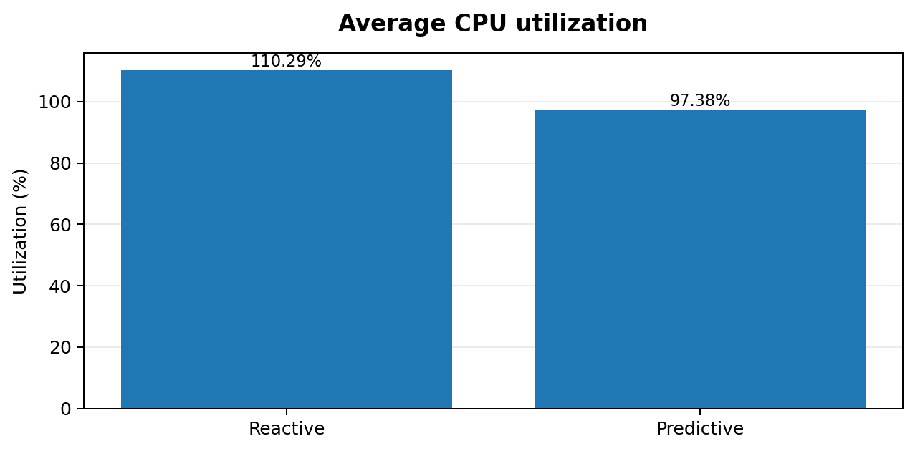
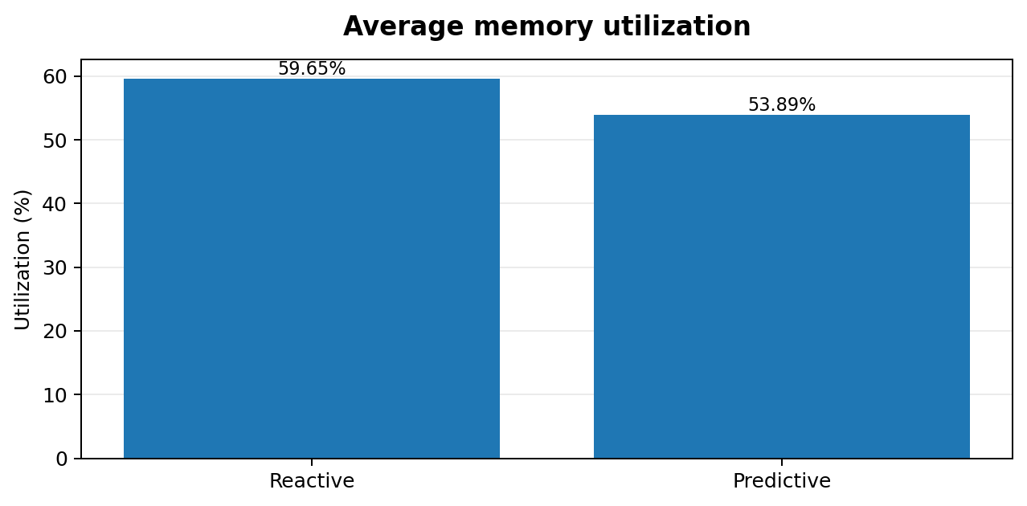
08 | Autoscaling results: resource utilization
Predictive policy lowered the reported average utilization measures
CPU graph
Memory graph
Predictive: 97.38% vs reactive: 110.29% (−12.91 percentage points).
Predictive: 53.89% vs reactive: 59.65% (−5.76 percentage points).
CPU averages above 100% indicate demand exceeded allocated capacity in the simulation; they are not physical CPU meter readings.
Contents
◀
▶
09

Slide 11
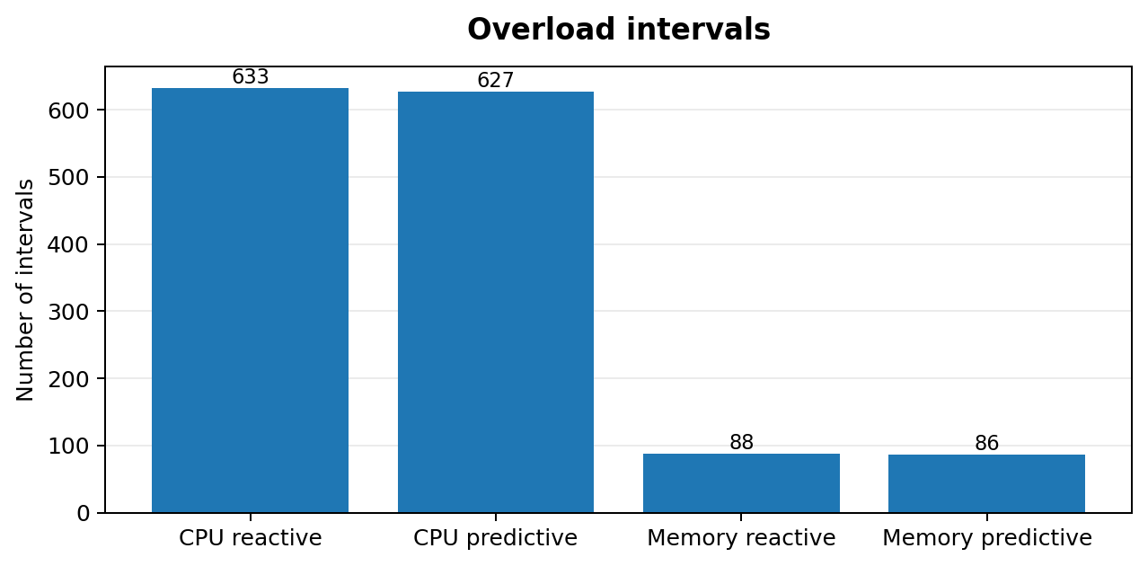
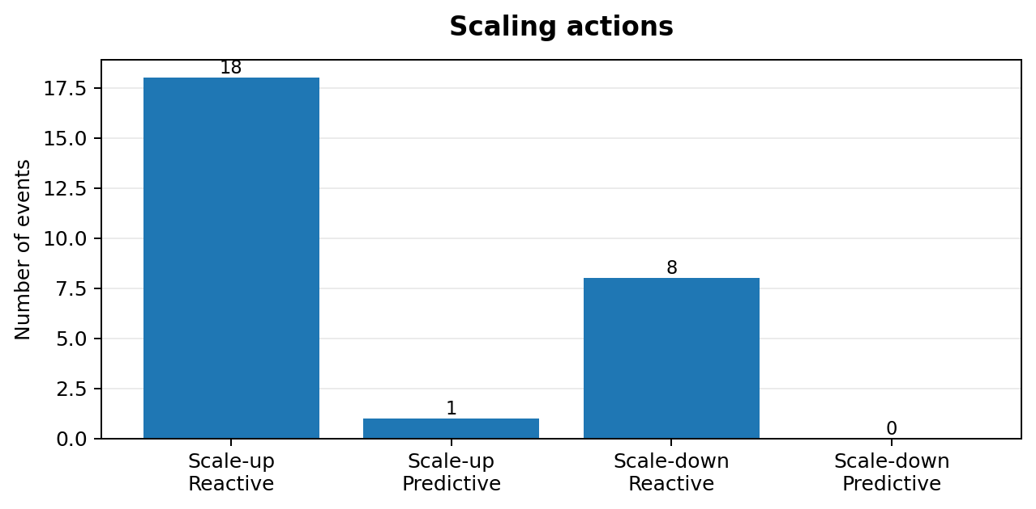
09 | Overload and scaling behaviour
Predictive policy had slightly fewer overload intervals and fewer scaling actions
Overload graph
Scaling graph
CPU: 633 → 627 intervals. Memory: 88 → 86 intervals. Small reductions, not elimination.
Scale-up: 18 → 1. Scale-down: 8 → 0. Predictive policy remained at the 100-VM ceiling on average.
Contents
◀
▶
10

Slide 12
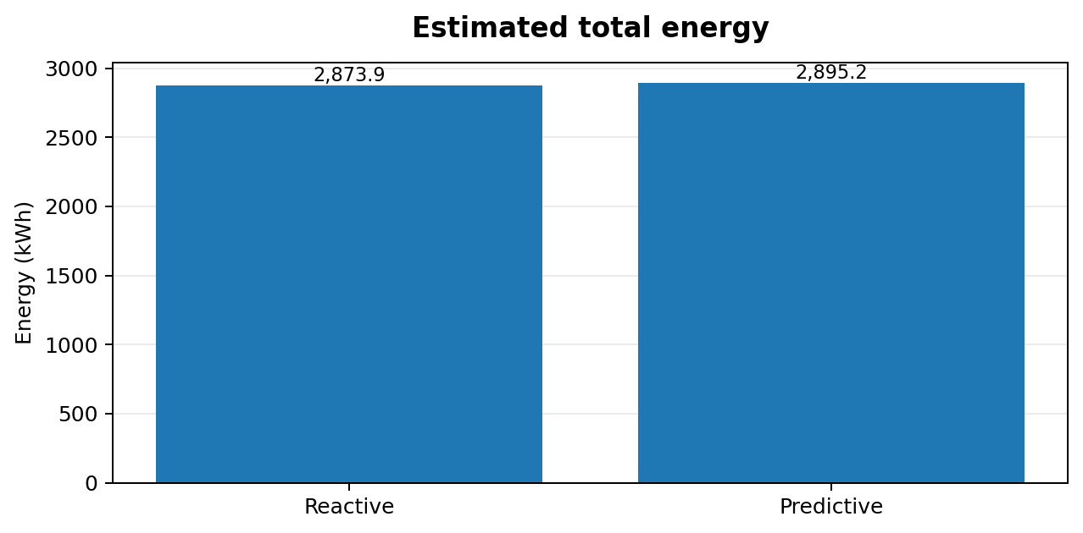
10 | Energy estimation
The predictive policy used slightly more estimated energy in this configuration
Result
Reactive: 2,873.931 kWh
Predictive: 2,895.177 kWh
Difference: +21.246 kWh (+0.74%).
Energy model assumptions: 100 W idle and 200 W maximum per VM; linear CPU-to-power relationship; PUE = 1.5; five-minute intervals. These are simulation assumptions, not measured server power.
Contents
◀
▶
11

Slide 13
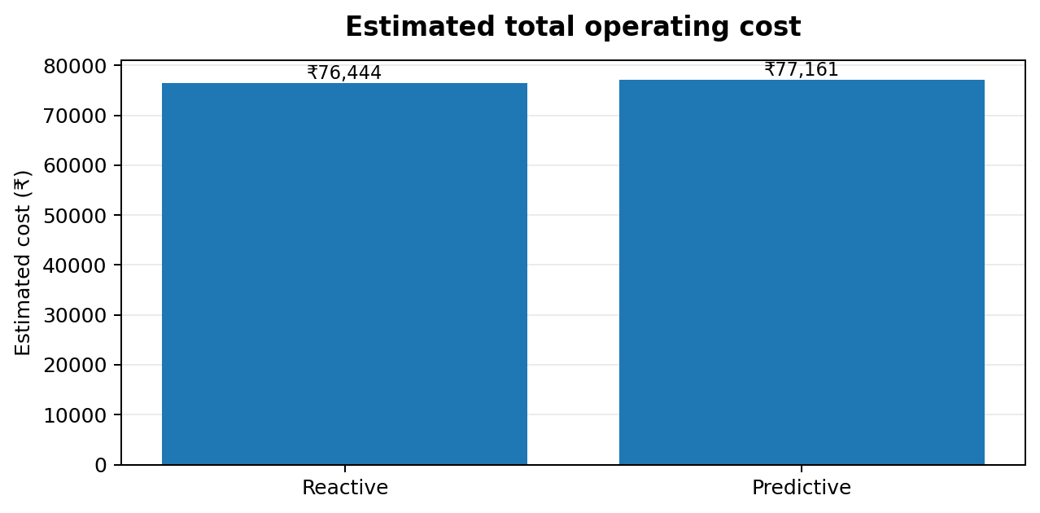
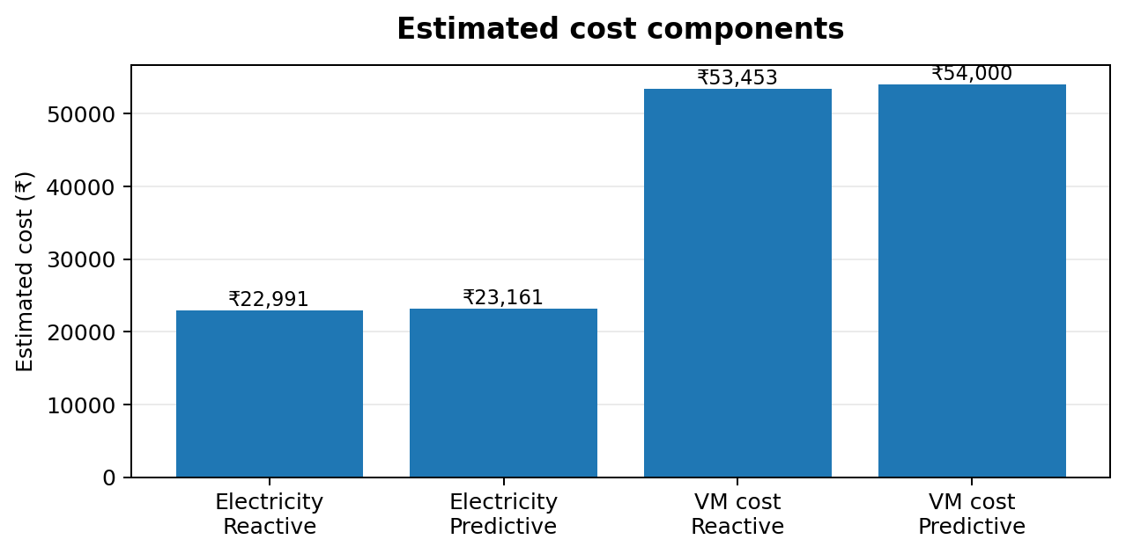
11 | Estimated operating cost
Reactive autoscaling had the lower estimated total cost
Total estimated cost
Cost assumptions
Reactive: ₹76,444.36
Predictive: ₹77,161.42
Difference: +₹717.05 (+0.94%).
Electricity: ₹8/kWh. VM rate: ₹5/VM-hour. Combined estimate is illustrative, not a cloud-provider invoice.
Contents
◀
▶
12

Slide 14
12 | Overall findings: where did prediction help?
Interpret efficiency across multiple dimensions—not one headline metric
Improved indicators
Did not improve
Likely constraint
• Lower average CPU utilization
• Lower average memory utilization
• Slightly fewer overload intervals
• Fewer scaling actions
• Energy +0.74%
• Estimated cost +0.94%
• Average active VMs: 100
• No scale-down events
Both strategies reached the 100-VM maximum. The ceiling may have limited the predictive policy's ability to allocate capacity or scale down.
Efficiency conclusion
Predictive forecasting improved selected utilization and overload indicators, but did not deliver energy or cost savings under the current VM cap, policy thresholds, and assumed power/pricing model.
Contents
◀
▶
13

Slide 15
13 | Conclusion, limitations and next steps
A measured result—and a clear path to improve the experiment
Conclusion
Limitations
Future work
The project built an end-to-end workflow from trace processing and ML forecasting to cloud VM simulation, autoscaling comparison, and energy/cost estimation.
Prediction improved some utilization metrics, but not total energy or cost in this run.
• Python simulation, not live cloud
• Assumed power and tariff values
• VM cap of 100
• No detailed VM boot/shutdown delays
• Trace coverage and missing observations affect fleet aggregation
• Test higher / adaptive VM caps
• Add startup and shutdown delays
• Tune thresholds and cooldowns
• Test forecast error sensitivity
• Validate with measured power and real cloud prices
Dataset reference: Bitbrains GWA-T-12 fastStorage trace, Grid Workloads Archive. Cite the dataset and its associated publication/acknowledgement in the final report.
Thank you
Contents
◀
▶
14

