Slide 1
PFMS
Guided By HIMADRI MAM

Slide 2
PROJECT TITLE
PERSONAL FINANCE MANAGEMENT SYSTEM

Slide 3
PROJECT DEFINITION
Personal Finance Management is the financial management which an individual or a family unit performs to make budget, save, taking into account various financial risks and future life events. When planning personal finances, the individual would consider the suitability to his or her needs of a range of banking products or investments and insurance products or participation and monitoring of individual- or employer-sponsored retirement plan, social security benefits.

Slide 4
Company Profile
Sun Computers.
- Sun Computers takes projects from their clients and projects are made according to the requirements.

Slide 5
TEAM SIZE
  05 TASLIMA ANSARI 2016033800094137
  25 VAIDEHI GANDHI 2016033800093784
  36 RAKESH KESHRI 2016033800093382
  38 SUKRUT KOTHARI 2016033800093633
  98 UTKARSH SINGH 2016033800093664

Slide 6
TOOLS AND TECHNOLOGIES
PLATFORM : ANDROID STUDIO 3.0.4
LANGUAGES : Java And XML
DATABASE : SQLite
ER DIAGRAM : EDraw Max
DESIGNED IN : PHOTOSHOP
DOCUMENTATION : MICROSOFT WORD

Slide 7
PROJECT SCOPE
An Android based mobile application for managing all the investments done by the user which will help them to manage their personal income and expenses with ease via app. It will also help them to control their finances, understand where their money is going, pinpoint the areas of excess expenditure and cut down unnecessary expenses.

Slide 8
Modules
User
Bank
Post
Mediclaim
Insurance
Mutual Funds
Shares
Daily Expense

Slide 9
PROJECT STATUS/WORK DONE TILL NOW
THE BASIC LAYOUT OF THE APPLICATION HAS BEEN DECIDED.
REGISTRATION PAGE FOR CREATION OF ACCOUNT OF THE USER IN THE APP WITH PROPER VALIDATIONS.
LOGIN PAGE FOR ACCESSING THE APPLICATION’S FUNCTIONALITIES AND STORAGE OF THE USER’S PERSONAL DATA ACCORDING TO THEIR RESPECTIVE ACCOUNTS.
DESIGNING OF DASHBOARD FOR EVERY MODULE TO BE USED IN THE APPLICATION.
DESIGNING AND CODING FOR INSERTION AND VIEWING OF DATA IN “BANK” AND “SHARES” MODULE.

Slide 10
E-R DIAGRAM
ER-Diagram

Slide 11
Class Diagram
Class Diagram

Slide 12
DATA DICTIONARY
Data Dictionary

Slide 13
METHODOLOGY
AGILE SOFTWARE DEVELOPMENT METHODOLOGY
Agile software development is an approach to software development under which requirements and solutions evolve through the collaborative effort of self-organizing and cross-functional teams and their customers/end user. It advocates adaptive planning, evolutionary development, early delivery, and continual improvement, and it encourages rapid and flexible response to change.
Scrum is an agile framework for managing knowledge work, with an emphasis on software development. It is designed for teams of three to nine members, who break their work into actions that can be completed within time boxed iterations, called "sprints", no longer than one month and most commonly two weeks, then track progress and re-plan in 15-minute stand-up meetings, called daily scrums

Slide 14
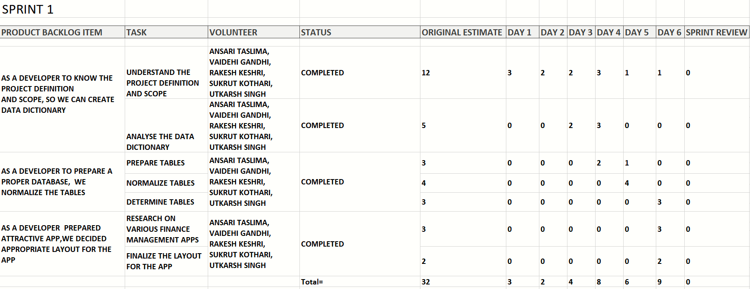
SPRINT BACKLOGS
Sprint 1

Slide 15
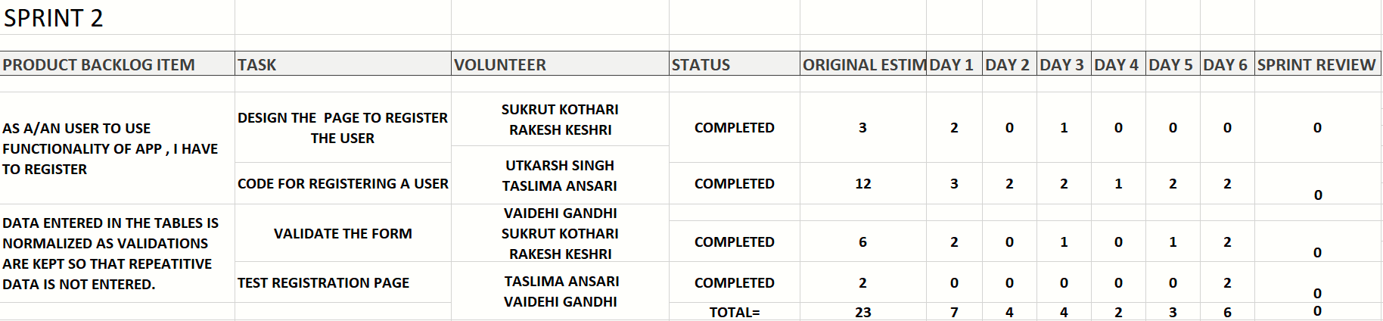
Sprint 2

Slide 16
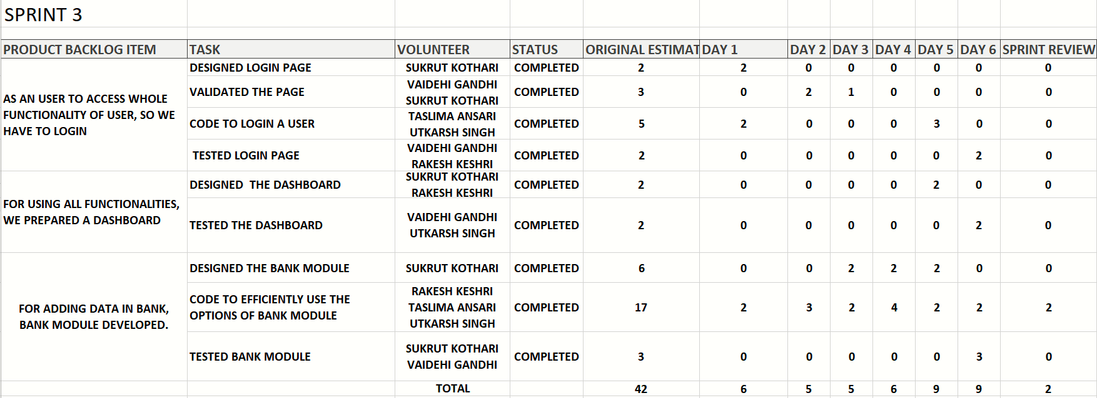
Sprint 3

Slide 17
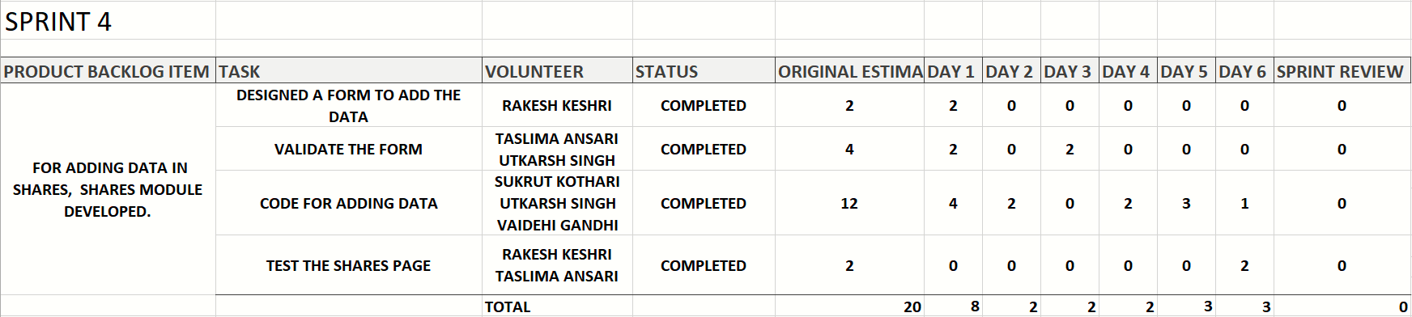
Sprint 4

Slide 18
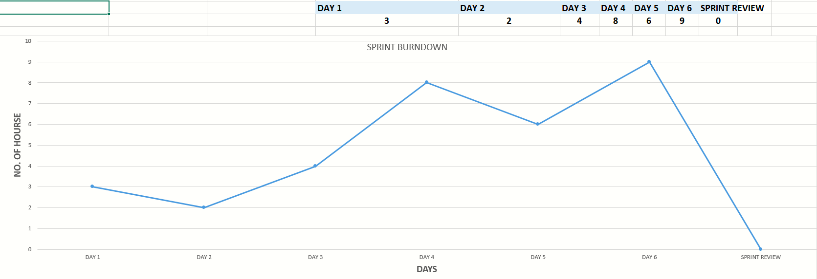
BURNDOWN CHART
BURNDOWN 1

Slide 19
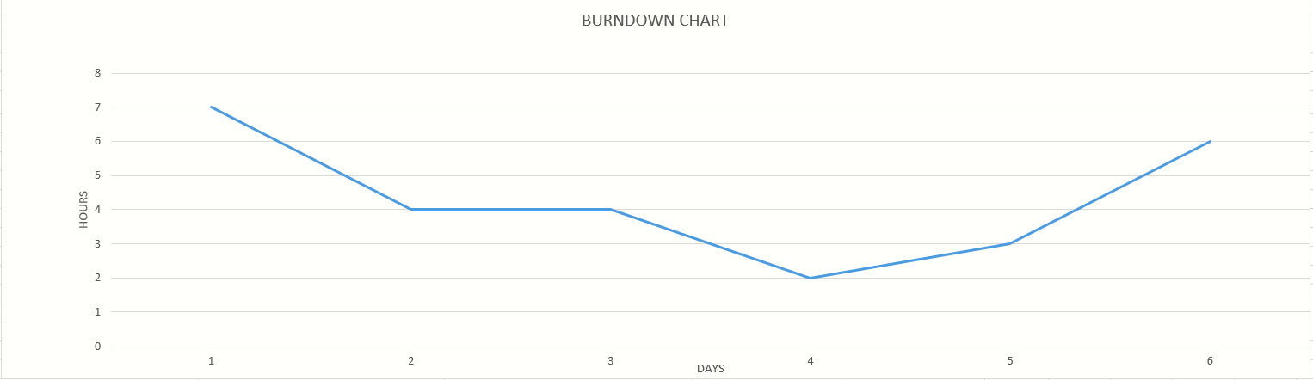
BURNDOWN 2

Slide 20
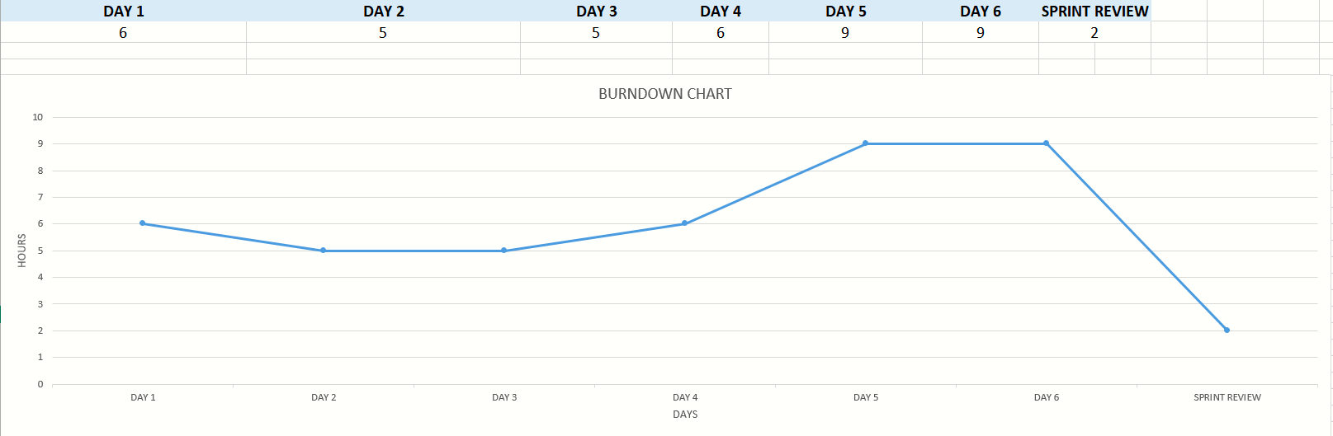
BURNDOWN 3

Slide 21
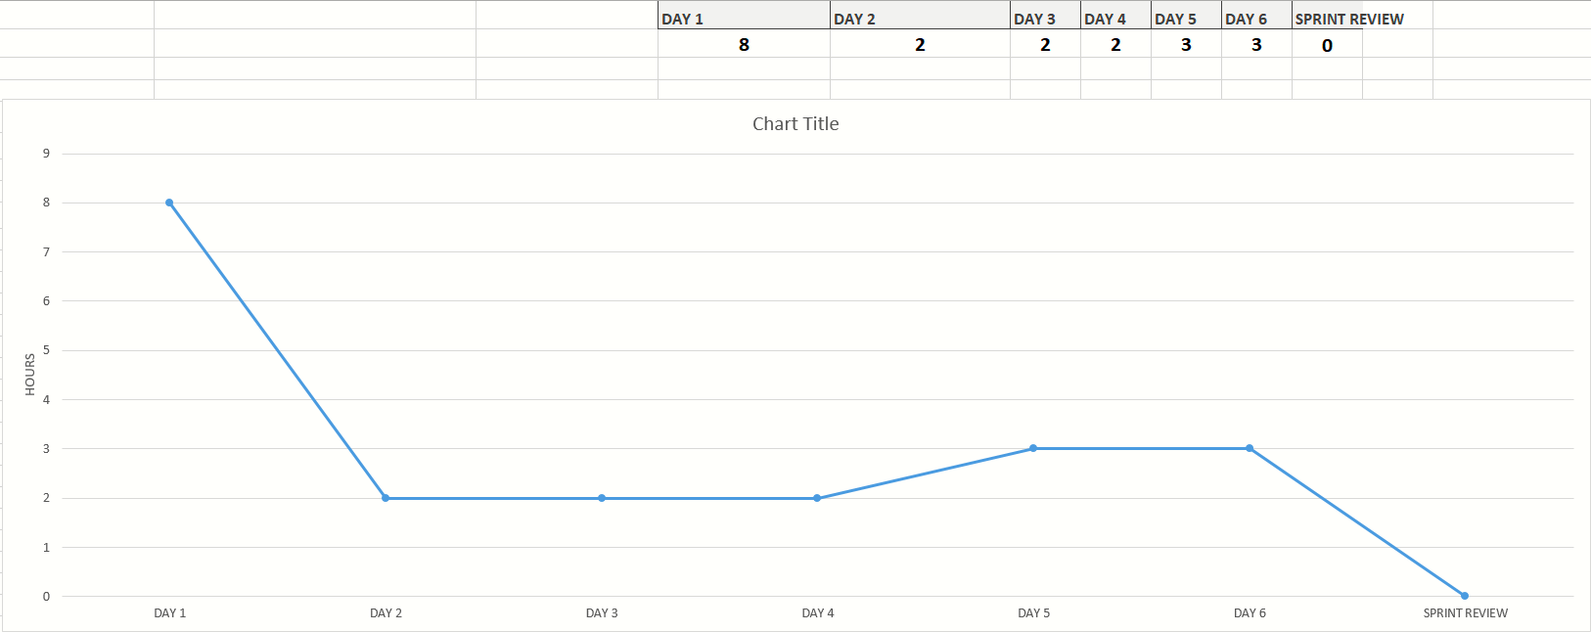
BURNDOWN 4

Slide 22
THANK YOU

