Slide 1

Web scraping to gain company insights
10/18/2024
Rishi Kumar Bethi, Junior Data Scientist

Slide 2
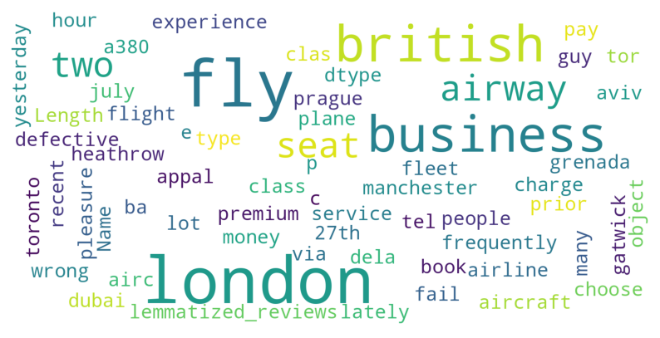
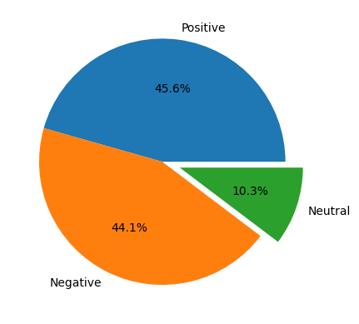
Insights FROM CUSTOMER REVIEWS
From cleaning 1000 reviews given by the customers, we obtained
Positive Reviews - 456
Negative Reviews - 441
Neutral Reviews - 103

