Slide 1
Agentic AI and Game Theory
Rishi Bharadwaj
26-5-25

Slide 2
What is an Agent?
AI Agents are autonomous software entities engineered for goal-directed task execution within bounded digital environments.
Reward
State
Agent
Action
Environment

Slide 3
What is Agentic AI?
Agentic AI describes a class of intelligent systems where multiple specialized AI agents collaborate, communicate, and coordinate to achieve multi-step goals.
Orchestration: Meta-agents or higher-level controllers help coordinate tasks between the different agents.
Shared Memory: Different agents may share memory to aid with communication.
For example, consider a drone-based package delivery system. Each drone would have its own agent responsible for its flight, and there could be one higher level controller that decides which drone gets which package.

Slide 4
LLMs as AI Agents
Within AI agent architectures, LLMs serve as the primary decision-making engine.
They allow the agent to parse user queries
They can plan multi-step solutions
They can generate naturalistic responses.

Slide 5
Core Architectural Components of AI Agents
Perceive
Reason
Act
Learn
AI agents gather and process data from various sources, such as sensors, databases and digital interfaces.
LLMs act as the “brain” of the agent, performing the reasoning and deciding which action to take.
The actions are then performed, for example querying a database or performing an API call
The payoff from the action is fed back to the LLM, so it can continuously learn and improve.

Slide 6
Transformers: The Engine Behind Large Language Models
The transformer is a neural network with a specific structure that includes a mechanism called self-attention or multi-head attention.
Consider the following two sentences:
The chicken didn’t cross the road because it was too tired.
The chicken didn’t cross the road because it was too wide.
In these sentences it refers to different nouns, but in static embeddings the representation of a word is always the same vector.
Transformers can build contextual representations of word meaning, contextual embeddings, by integrating the meaning of these helpful contextual words.

Slide 7
Architecture of the Attention Head
Query Matrix: It represents the current element being compared to preceding inputs.
Key Matrix: It is compared to the Query Matrix to determine similarity weights.
Value Matrix: It is the value of the inputs that gets weighted and summed to compute the output of the current element.
When we are computing the similarity of the current element xi with some prior element xj , we’ll use the dot product between the current element’s query vector qi and the preceding element’s key vector kj .

Slide 8
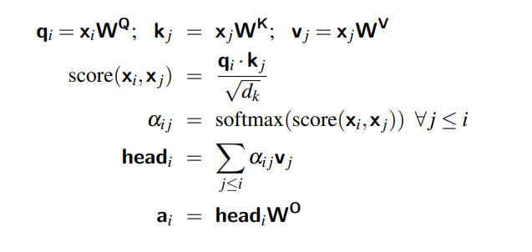

Slide 9
Game Theory and Agentic AI
Areas where game theory is being used in the context of AI Agents are:
Testing the ability of LLM Agents on strategic games.
Using concepts from game theory such as Shapley Value to improve understanding of LLM functioning.
Using concepts from game theory such as Nash Equilibrium to improve algorithm design in scenarios where there are multiple agents.
AI Agents are being trained to bid in auctions.

Slide 10
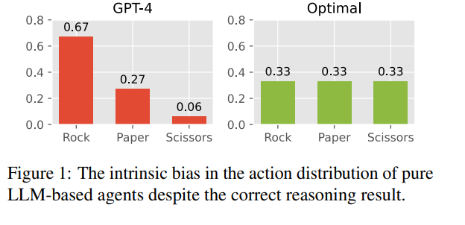
Can LLMs play classic strategy games
Benchmarks like AgentBench and GTBench test LLMs' strategic reasoning in matrix, negotiation, and deception games (e.g., Werewolf).
Benchmarks like TMGbench have tested multiple LLMs across 144 different 2x2 games using different prompting styles such as direct prompting and CoT prompting.
LLM’s often struggle in classic matrix games, not finding the optimal strategy.

Slide 11
Understanding LLM performance with Game Theory
Game theory principles are also being applied to understand and improve LLMs.
For example, when considering a sentence, how the LLM assigns weight to each word is not fully understood.
To further understand this, one approach has been to calculate the Shapley value of each word (input token) in the sentence.
This helps understand the contribution of each input token to the final output of the LLM.

Slide 12
Algorithmic Innovation
Some game theory concepts are also being used to change how agents behave in MARL scenarios.
For example, in Nash Q-Learning, each agent attempts to learns its equilibrium Q-value by maintaining models of other agents’ Q-values and predicting their best responses.
This is in contrast to normal Q-learning where other agents are assumed to be stationary parts of the environment.

Slide 13
Agentic AI use in Auctions
Several studies have been carried out where AI agents are used to bid against each other in first price and second price auction.
Some of the areas of interest in these studies are determining if the agents play the dominant strategy in second price auctions and in determining whether they collude to reduce prices.
One study (Banchio & Skrzypacz, 2022) found that agents trained using Q-learning converged to bid the max possible bid in SPA and colluded to submit a much lower bid in FPA.
Another study (Kolumbus & Nisan, 2022) using regret-minimising agents found that the agents did not necessarily converge to the dominant Nash equilibria.

Slide 14
Strategic Language Agents in Werewolf
LLMs have also been tested on more complex strategy games such as Werewolf.
Use an LLM to extract structured beliefs (facts, potential truths/deceptions) and deduce player roles from dialogue history.
Prompt LLM to propose multiple diverse action candidates to mitigate intrinsic bias.
Feed the observation and all action candidates to an RL policy that determines the action distribution.

Slide 15
Game-Theoretic Workflow Design
For simultaneous games, agents compute best responses iteratively to find Nash Equilibria.
Without guidance, LLMs often fail to reach Nash Equilibrium, especially in complex or sequential games.
Researchers developed structured workflows based on classic game theory to guide LLM agents.
For simultaneous games, agents compute best responses iteratively to find Nash Equilibria.
For sequential games, agents use backward induction over decision trees to derive optimal strategies.

Slide 16
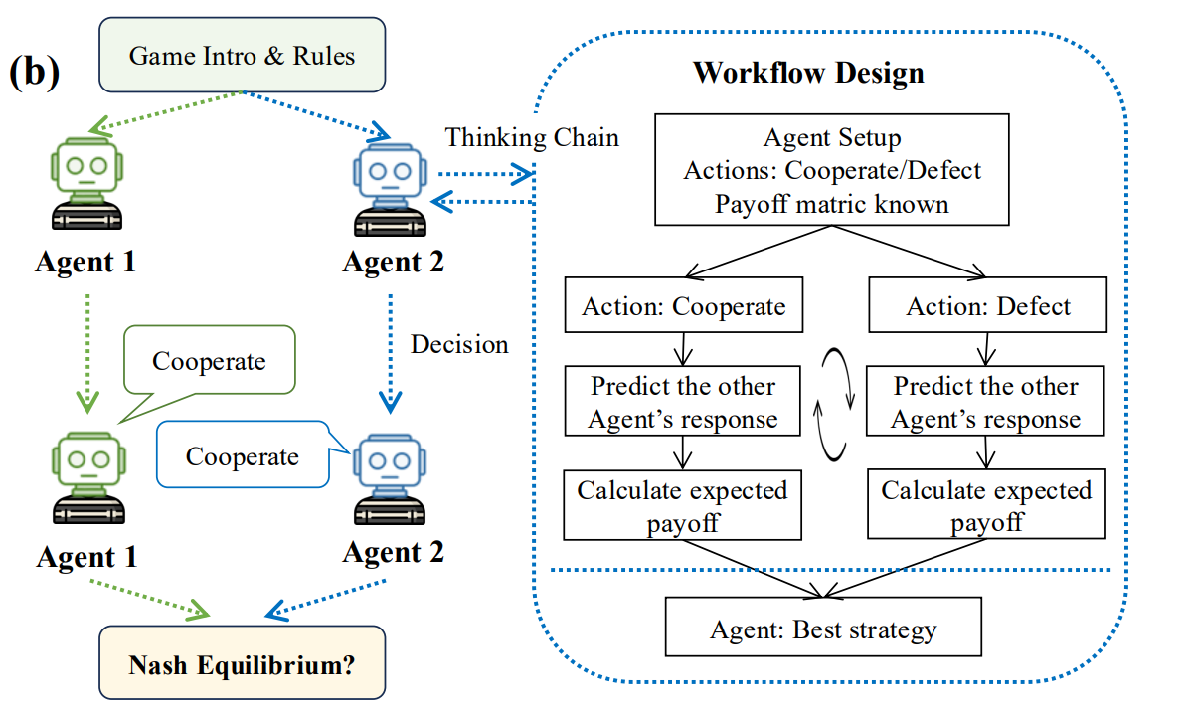
Hua et al., Game-theoretic LLM: Agent Workflow for Negotiation Games, 2024

Slide 17
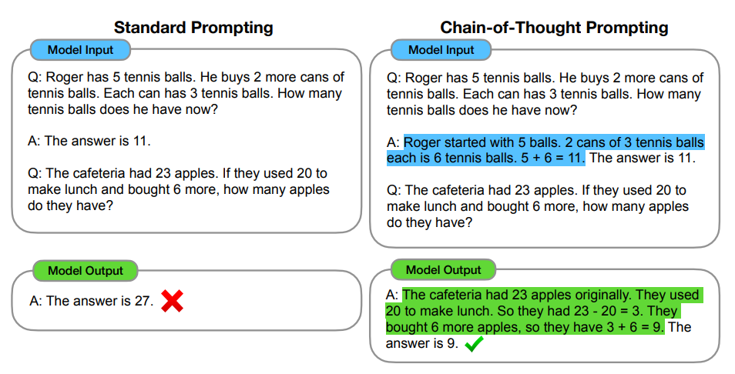
Chain of Thought Prompting

Slide 18
Conclusion
Throughout this journey, we’ve seen how Agentic AI leverages multiple agents working together to solve complex problems.
We explored how LLMs play a central role, acting as the “brain” of these agents.
Game theory principles, like Nash equilibria and Shapley values, help us understand and improve how these agents reason and interact.
Though we’ve made progress, challenges remain—LLMs still struggle with strategic reasoning in benchmarks and auctions.
Combining agentic AI with game theory is opening exciting new possibilities, and the best is yet to come.

Slide 19
Appendix

Slide 20
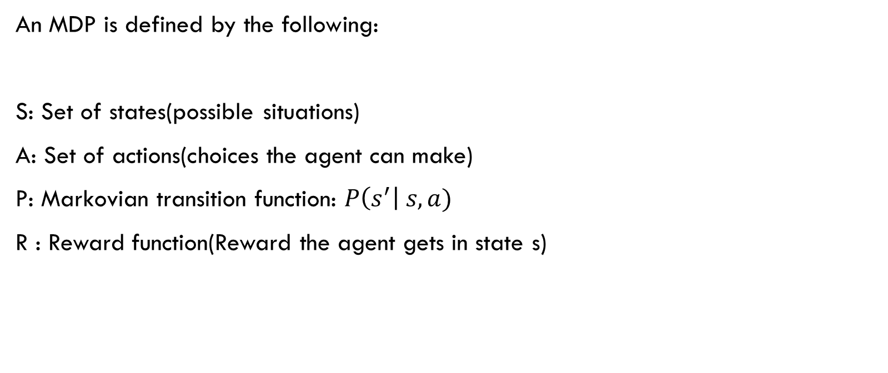
Markov Decision Process
An MDP is defined by the following:
S: Set of states(possible situations)
A: Set of actions(choices the agent can make)
P: Markovian transition function: $P\left(s^{′}\right| s, a)$
R : Reward function(Reward the agent gets in state s)

Slide 21

Utility Function
The agent’s preferences are captured by a utility function, U(s), which assigns a single number to express the desirability of a state.
The expected utility of an action given the current state, EU (a|s), is just the average utility value of the possible next states, weighted by the probability that the next state occurs:
The principle of maximum expected utility (MEU) says that a rational agent should choose the action that maximizes the agent’s expected utility.
$$EU\left(a | s\right)=\sum_{s′}{P\left(s^{′} | a,s\right)U(s)}$$

Slide 22
Markov Property: The next state depends only on the current state s and the action a, not on the previous states.
A solution to an MDP must specify what action a the agent should take in every state s.
This kind of solution is called a policy π.
An optimal policy is a policy that yields the highest expected utility.
Discount factor: The utility of a state sequence is

Slide 23

Bellman Equation
The utility of a state is the immediate reward for that state plus the expected discounted utility of the next state, assuming that the agent chooses the optimal action.
One method of finding the optimal policy involves iteratively solving the bellman equation until state utility values converge. Then in a given state the optimal policy will select the action with most expected utility.

Slide 24
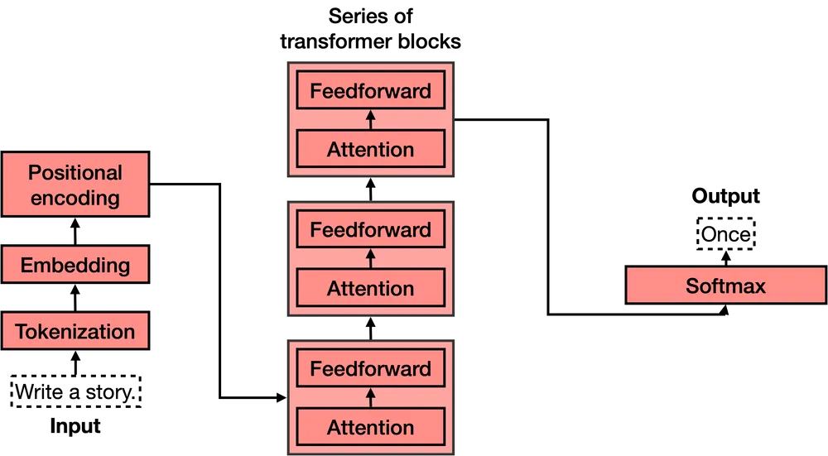

Slide 25
Structured Workflows
The content of different workflow knowledge primarily falls into the following categories:
Operation process related, which describes the required steps and their sequential order to complete tasks.
Condition/rule related, which delineates the actions to be taken when certain conditions or parameters are met.
Tool/data related, which contains the utilization techniques for different tools and the mechanisms of data processing.
This data could be in the form of text, code, flowcharts etc.

Slide 26
References
Sapkota et al., AI Agents vs. Agentic AI: A Conceptual Taxonomy, Applications and Challenges, 2024
Russell & Norvig, Artificial Intelligence: A Modern Approach, 3rd ed., 2010
Speech and Language Processing. Daniel Jurafsky & James H. Martin.
Xiao, R., Ma, W., Wang, K., Wu, Y., Zhao, J., Wang, H., Huang, F., & Li, Y. (2024). FlowBench: Revisiting and Benchmarking Workflow-Guided Planning for LLM-based Agents. Zhejiang University & Alibaba Group.
Hua, W., Liu, O., Li, L., Amayuelas, A., Chen, J., Jiang, L., Jin, M., Fan, L., Sun, F., Wang, W., Wang, X., & Zhang, Y. (2024). Game-theoretic LLM: Agent Workflow for Negotiation Games. Rutgers University et al.

Slide 27
Kolumbus & Nisan, Auctions between Regret-Minimizing Agents, arXiv, 2022
Banchio & Skrzypacz, Artificial Intelligence and Auction Design, arXiv, 2022
Mao et al., ALYMpics: LLM Agents meet Game Theory, arXiv, 2024
Wei, J., Wang, X., Schuurmans, D., Bosma, M., Ichter, B., Xia, F., Chi, E. H., Le, Q. V., & Zhou, D. (2022). Chain-of-Thought Prompting Elicits Reasoning in Large Language Models. Google Research, Brain Team.
Hu, J., & Wellman, M. P. (2003). Nash Q-Learning for General-Sum Stochastic Games. Journal of Machine Learning Research, 4, 1039–1069.
Xu et al., Language Agents with Reinforcement Learning for Strategic Play in the Werewolf Game, arXiv, 2024

Slide 28
Wang et al., Strategic Chain-of-Thought: Guiding Accurate Reasoning in LLMs through Strategy Elicitation, arXiv, 2024
Gandhi et al., Strategic Reasoning with Language Models, arXiv, 2023
De La Fuente et al., Game Theory and Multi-Agent Reinforcement Learning: From Nash Equilibria to Evolutionary Dynamics, arXiv, 2024
Zhang et al., LLM as a Mastermind: A Survey of Strategic Reasoning with Large Language Models, arXiv, 2024
Banchio, M., & Skrzypacz, A. (2022). Artificial Intelligence and Auction Design. arXiv preprint arXiv:2202.05947.
Kolumbus, Y., & Nisan, N. (2022). Auctions between Regret-Minimizing Agents. arXiv preprint arXiv:2110.11855.

