Slide 1
What 1,379 Beauty Reviews Say
Lexicon sentiment analysis of Amazon All Beauty reviews: VADER vs TextBlob
Team 2 | COMP 262 Project Phase 1 | November 5, 2026
Rishi Goyal | [Member 2] | [Member 3] | [Member 4]
Notes:
Presenter: [Member 1]. Introduce the team and the task: build a sentiment analyser for product reviews with two lexicon models. Our dataset is Amazon All Beauty (5-core) from Ni, Li and McAuley, 2019.

Slide 2
Our Phase 1 pipeline in seven steps
1
2
3
4
5
6
7
Explore
Label
Lexicons
Pre-process
Sample
Model
Validate
counts, distributions, duplicates
4-5 Pos, 3 Neu, 1-2 Neg
VADER, TextBlob, SentiWordNet
per model, tested
1,000 random reviews
VADER + TextBlob
metrics + comparison
Who presents what
[Member 1]: intro and dataset | [Member 2]: exploration and duplicates | [Member 3]: pre-processing and lexicon choice | [Member 4]: models, results and live demo
Notes:
Presenter: [Member 1]. Walk through the seven steps; each presenter owns a block. Mention the single script runs everything in under a minute with seed 42.

Slide 3
The dataset at a glance
5,269
991
review rows, 12 columns
reviewers
85
4.77
products (asin)
average star rating
Also: 81% verified purchases, 10.5% have a helpful vote, 1.9% have images. Text fields are 99.9% complete.
Notes:
Presenter: [Member 2]. 5,269 rows, 85 products, 991 reviewers, average rating 4.77. 88% of rows are 5-star, so the data is heavily skewed positive. That skew drives our choice of metric later.

Slide 4
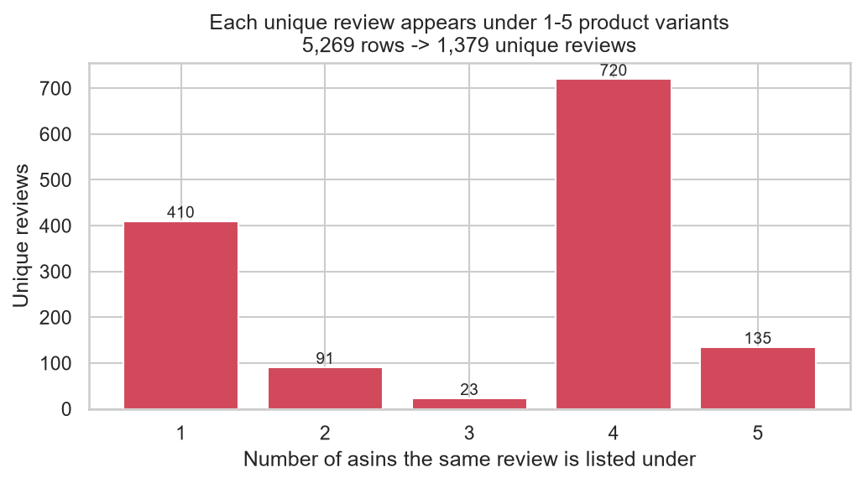
74% of the rows are duplicates
3,890
of 5,269 rows are the same review copied under another product variant
1,379
unique reviews are left. Copies never disagree on the rating, so we safely keep one.
Key = same reviewer + same text + same timestamp
Notes:
Presenter: [Member 2]. Amazon lists one review under every size or colour variant. Same reviewer, same text, same timestamp, different asin. 3,890 of 5,269 rows are copies; ratings never conflict, so we keep one copy. Only 1,379 unique reviews remain, and all modelling uses them. Without this, the same review could land in both the dev and test data.

Slide 5
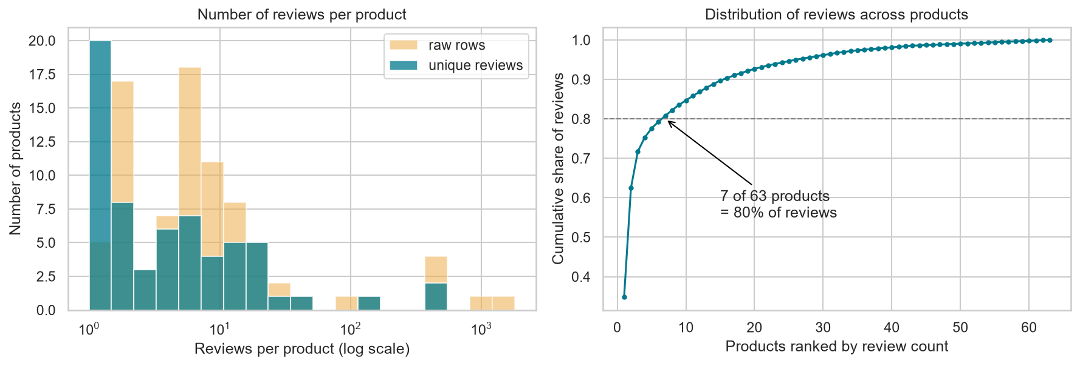
A few products and one-time reviewers
62.5%
of unique reviews belong to just 2 products
86%
Products: median 4 reviews, max 480 (raw: 1,794)
Users: 5-core in raw rows (4-12 each), but mean 1.39 unique reviews
So what: product averages from a few reviews are unreliable; matters for the Phase 2 recommender
of reviewers wrote only one unique review
Notes:
Presenter: [Member 2]. After de-duplication: 63 products, median 4 reviews each, max 480. The top 2 products hold 62.5% of reviews; 7 products hold 80%. Per user: the 5-core promise of 5+ reviews mostly comes from copies; 86% of reviewers actually wrote only one review.

Slide 6
Mixed opinions take more words
29 words
median review length (mean 56.8, max 962)
106
long outliers above the 161-word IQR fence: kept, and checked in testing
124 reviews have 3 words or fewer ("Love it!"): kept. 1 empty review: removed.
Notes:
Presenter: [Member 2]. Median review is 29 words; IQR fence is 161 words, giving 106 long outliers (7.7%). 2- and 3-star reviews are the longest (median about 115 words). Happy and angry customers are brief. This predicts that Neutral will be hardest for lexicons: long, mixed text.

Slide 7
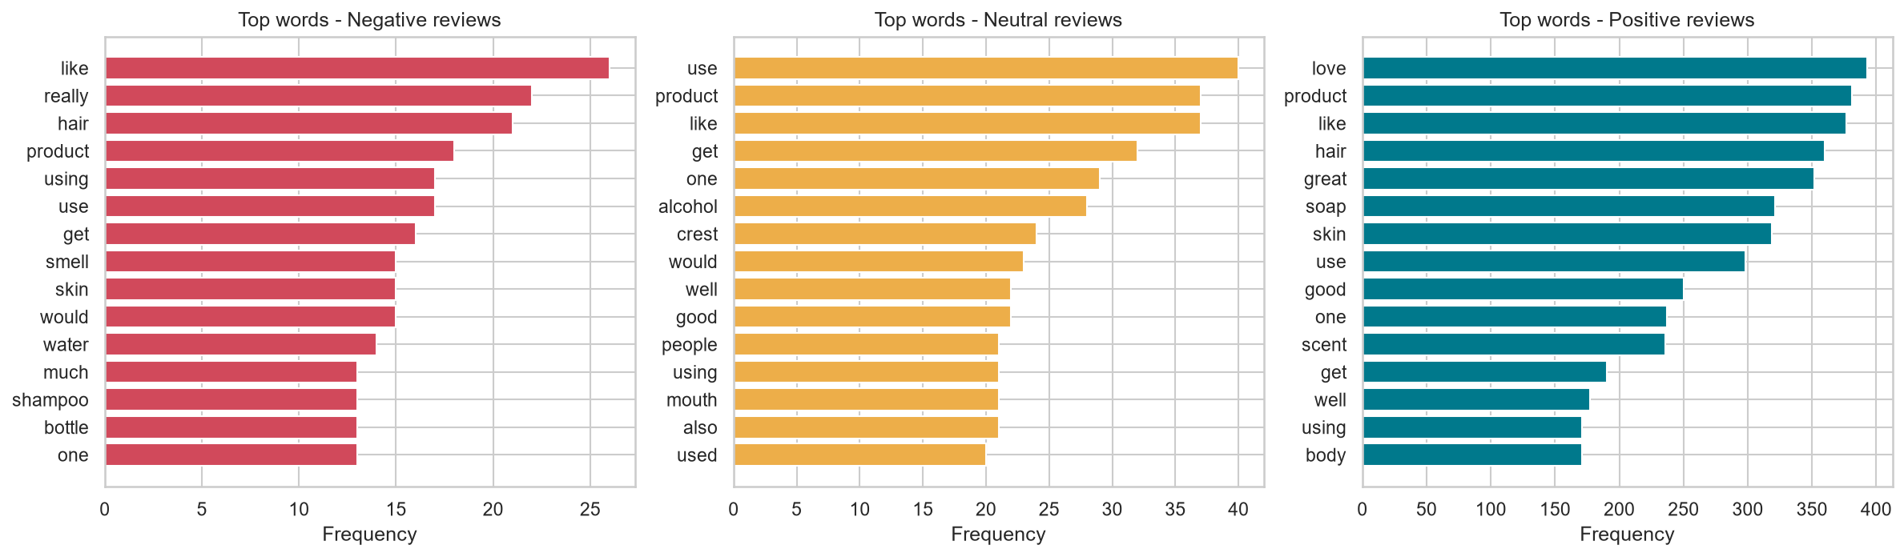
Complaints rarely use negative words
"like" is top-3 in every class; VADER scores "It smells like chemicals." +0.36
Unverified buyers rate lower: 4.39 vs 4.78 average
1-star reviews get helpful votes most often: 33% vs 4.6% for 4-star
Notes:
Presenter: [Member 2]. Top-15 negative words contain no negative word: like, really, hair, smell, water. Complaints are descriptive ('felt like water'). 'like' is top-3 in every class and VADER scores it positive (+0.36 for 'It smells like chemicals'). Other relationships: unverified reviews average 4.39 vs 4.78 verified; 1-star reviews are 7x more likely than 4-star to get a helpful vote.

Slide 8
Labels, columns and the leak we removed
Column | Role | Why
reviewText | Model input | Main opinion text
summary | Model input | Short, opinion-dense headline
"Five Stars" titles | Removed | Auto-generated from the rating: leaks the label
overall | Label only | Ground truth, never shown to models
reviewerID + time | De-dup key | Identifies one written review
verified, vote, style | Exploration | No opinion words
1,259
Positive (4-5 stars)
91.3% of unique reviews
64
Neutral (3 stars)
4.6% of unique reviews
56
Negative (1-2 stars)
4.1% of unique reviews
Notes:
Presenter: [Member 3]. Labels from rating: 91.3% Positive, 4.6% Neutral, 4.1% Negative. Input text = summary + review body. We remove Amazon's auto-generated 'Five Stars' titles (22% of reviews) because they restate the rating: label leakage. Rating is used only as ground truth; reviewerID + text + time is the de-dup key; metadata (verified, vote, image, style) is exploration only.

Slide 9
Why VADER and TextBlob, not SentiWordNet
Probe sentence | VADER | TextBlob | SentiWordNet
This moisturizer is not good. | -0.34 | -0.35 | +0.08
This moisturizer is GOOD!!! | +0.67 | +1.00 | +0.44
The scent is nice, but it broke me out terribly. | -0.83 | -0.20 | +0.27
Love it :) | +0.80 | +0.50 | +0.50
Not bad at all. | +0.43 | +0.35 | -0.63
Chosen: VADER
Built for short, informal opinions: negation, CAPS, !!!, emoticons, 'but'
Chosen: TextBlob
Adjective lexicon + subjectivity; makes different mistakes
Rejected: SentiWordNet
No negation or emphasis; needs sense disambiguation
Scores range from -1 to +1. Teal = positive, rose = negative.
Notes:
Presenter: [Member 3]. We scored probe sentences with all three lexicons. SentiWordNet keeps 'not good' positive, ignores CAPS and !!!, and calls 'Not bad at all' strongly negative: no negation rules and it needs word-sense disambiguation. VADER handles negation, emphasis, emoticons and 'but'. TextBlob is adjective-based with negation and gives subjectivity, and it fails differently from VADER, which makes the comparison informative.

Slide 10
Each lexicon needs its own pre-processing
VADER: light
TextBlob: targeted
Keep CAPS, !!!, emoticons
Keep all stop words
Unescape HTML, drop URLs
"sooooo" -> "soo"
Lower-case, expand "isn't"
Drop stop words, KEEP not / very / but
Lemmatise, drop punctuation
Tested, not assumed: dropping "not" lowers macro-F1 for both models; TextBlob gains +0.046 from the targeted pipeline.
Notes:
Presenter: [Member 3]. NLTK's stop-word list contains 'not', 'no', 'very', 'but', so the classic pipeline destroys lexicon signals. VADER: keep case, punctuation and stop words; only unescape HTML, strip URLs, squeeze 'sooooo'. TextBlob: lower-case, expand contractions, drop stop words but keep negations and intensifiers, lemmatise. Ablation on the 378-review development set (never the test set): VADER best with light cleaning; TextBlob best with P3 (0.506 vs 0.460). Removing negations hurts both.

Slide 11
1,000-review test sample, two scorers
VADER
TextBlob
7,500-word human-rated lexicon (-4 to +4)
Rules: !!!, CAPS, "very", "but", negation in a 3-word window
Compound score: Pos >= 0.05, Neg <= -0.05
Tuned: +/- 0.40
2,900 scored words, mostly adjectives
Intensifier x1.3, negation x-0.5, then average
Polarity: Pos > 0, Neg < 0, else Neutral
Tuned: Pos >= 0.075, Neg <= 0.05
+ 378-review development set for every modelling choice
Notes:
Presenter: [Member 4]. 1,000 random unique reviews (seed 42) are the test sample: 911 Positive, 51 Neutral, 38 Negative. The other 378 reviews are a development set for pre-processing and threshold choices. VADER: compound score, >= 0.05 Positive, <= -0.05 Negative. TextBlob: averaged polarity, > 0 Positive, < 0 Negative. Tuning: grid-search thresholds on the dev set to maximise macro-F1.

Slide 12
VADER wins, but neither finds Neutral
0.469
VADER macro-F1 vs 0.404 for TextBlob (default thresholds)
91.1%
accuracy of always saying Positive: higher than both models
Accuracy rewards ignoring the 9% minority, so we rank models by macro-F1.
Notes:
Presenter: [Member 4]. Main metric is macro-F1 because 91% of reviews are positive. Always-Positive baseline: 91.1% accuracy but macro-F1 0.318. VADER default: 89.1% accuracy, macro-F1 0.469, Negative F1 0.43. TextBlob default: 86.6%, 0.404, Negative F1 0.23. Neutral F1 is about 0.02-0.04 for both. Tuning helps VADER to 0.490 (Neutral F1 0.18) but not TextBlob (0.391), because the dev set has only 13 neutral reviews.

Slide 13
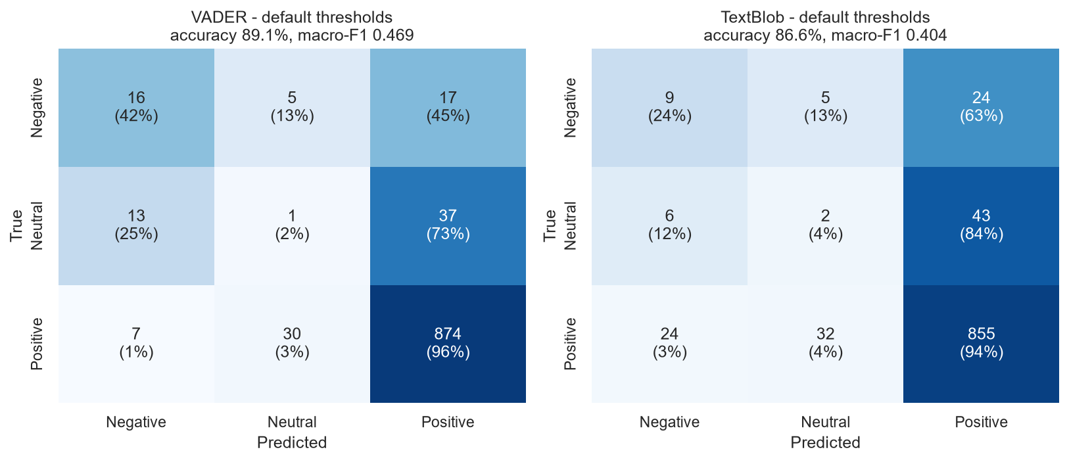
Most mistakes are "Positive"
73-84%
of neutral reviews predicted Positive
42% vs 24%
negative reviews caught: VADER vs TextBlob
Agreement 91.8%, Cohen's kappa 0.42, score correlation r = 0.27
Notes:
Presenter: [Member 4]. Read the rows: 73% of neutral reviews are called Positive by VADER, 84% by TextBlob. VADER catches 42% of negative reviews vs 24% for TextBlob. The models agree on 92% of reviews but Cohen's kappa is only 0.42: they disagree on the hard cases.

Slide 14
Where lexicons break down
Polite criticism
"Not So Great for Volume... a bit smoother, but..." VADER: +0.98 on a 2-star review
Misspelled sentiment
"dissapointed", "Unpleasent" are not in either lexicon
Domain complaints
"Didn't smell like redcurrant and basil" has no negative word
Notes:
Presenter: [Member 4]. Accuracy falls from about 95% on 11-30 word reviews to 74% on reviews over 150 words: long reviews are mixed. Error patterns: polite criticism full of positive words; sentiment only in the title; misspellings ('dissapointed', 'Unpleasent') missing from the lexicon; domain complaints with no negative word ('didn't smell like redcurrant'). On all 1,378 unique reviews the results are almost identical, so the sample is representative.

Slide 15
Live demo: one script, end to end
> python team2_phase1_lexicon_sentiment.py
STEP 1 Data exploration -> 9 figures
STEP 2 Labels, columns, outliers
STEP 3 Lexicon probe sentences
STEP 4 Per-model pre-processing
STEP 5 Sample 1,000 + ablation
STEP 6 VADER and TextBlob scores
STEP 7 Metrics, confusion matrices
Done. 16 figures, 13 tables, run_log.txt
Reproducible: seed 42, downloads the data itself
Documented: sections follow assignment steps 1-7
Outputs: ./figures (charts), ./results (CSV tables, full log)
Deliverables: .py source, analysis report with screenshots, this deck
Notes:
Presenter: [Member 4]. Run python team2_phase1_lexicon_sentiment.py. Show the console sections Step 1 to Step 7, then open figures/ and results/09_comparison_table.csv. Total runtime is under a minute.

Slide 16
Takeaways and next steps
Questions?
Clean first
74% of rows were copies; 1,379 real reviews
Measure fairly
Macro-F1, not accuracy, on 91% positive data
VADER > TextBlob
0.469 vs 0.404 macro-F1; Neutral is unsolved
Phase 2
ML models on the same 1,000 reviews, recommender, LLM tasks
Notes:
Presenter: all members, one point each. Close with the Phase 2 plan, then take questions.

