Slide 1

SUITS AI
Your Legal Intelligence, Tailored to You
Multi-Agent AI System for Legal Document Analysis & Decision Support
RNSIT Agentic AI Hackathon | Problem Statement 3 | AI Legal Document Action Agent

Slide 2
THE PROBLEM
Everyone signs legal documents. Very few truly understand them.
1
Complex Language Barrier
2
Hidden Risks & Obligations
Rental agreements, NDAs, and terms of service are filled with legal jargon — creating a dangerous gap between what people sign and what they actually understand.
Critical penalties, liability clauses, and auto-renewal traps are buried in dense paragraphs. Easy to miss, costly to overlook.
3
No Accessible Guidance
4
Uninformed Decision-Making
Most people can't afford a lawyer for every document. They need a smart assistant that makes legal text approachable.
Without understanding what they're agreeing to, people sign away rights, accept unfair terms, and expose themselves to risk.
RNSIT Agentic AI Hackathon | PS-3
Suits AI

Slide 3
OUR SOLUTION
Suits AI — A Multi-Agent Legal Intelligence Platform
6 specialized AI agents work together to analyze, simplify, assess risk, benchmark, advise, and verify — so you can make informed decisions.
Plain Language Simplifier
Clause-Level Risk Scoring
Contextual Q&A via RAG
Breaks down complex legal text into simple English anyone can understand.
Scores every clause 1-10, flags dangerous patterns with color-coded alerts.
Ask questions about your document — get clear, source-grounded answers.
Industry Benchmark
AI vs AI Negotiator
Verified Final Report
Compares your clauses against fair market standard terms.
Two AI agents debate your contract — Advocate vs Challenger.
Hallucination guard catches errors before the final advisory is delivered.
RNSIT Agentic AI Hackathon | PS-3
Suits AI

Slide 4
ARCHITECTURE
Multi-Agent DAG Pipeline — 3 Waves + Verification
Document Ingestion
KEY PROPERTIES
INPUT
6 Specialized AI Agents
PyMuPDF + OCR + LLM Segmenter
3 Parallel Execution Waves
WAVE 1
Clause Classifier
Plain Language
Graceful Partial Failure Handling
parallel
Cross-Clause Verification
Claude Sonnet 4.5 (blocking)
Claude Sonnet 4.5 (non-blocking)
Real-Time SSE Progress Streaming
WAVE 2
Risk Analyzer
Benchmark
Multi-Model via OpenRouter
parallel
Claude Sonnet 4.5
Claude Sonnet 4.5
WAVE 3
Advisory Synthesis
Hallucination Verifier
sequential →
Claude Sonnet 4.5
Claude Sonnet 4.5 (critic)
RNSIT Agentic AI Hackathon | PS-3
Suits AI

Slide 5
TECH STACK
Built for Speed, Reliability & Multi-Model Intelligence
Backend
AI / LLM
RAG Pipeline
Python 3.11+ / FastAPI Async everywhere SSE streaming via Starlette
Claude Sonnet 4.5 (Anthropic) GPT-4o-mini / Gemini 2.0 Flash Routed via OpenRouter
sentence-transformers ChromaDB vector store Hybrid search + LLM reranking
Document Processing
Frontend
Data & Config
PyMuPDF (PDF parsing) pytesseract (OCR fallback) fpdf2 (report generation)
React 19 + TypeScript Tailwind CSS 4 + Framer Motion Vite 8 build
Pydantic v2 (validation) File-based JSON storage SHA-256 deduplication
RNSIT Agentic AI Hackathon | PS-3
Suits AI

Slide 6

PRODUCT
Onboarding & Intelligent Chat
Personalized Onboarding
1
Location
Jurisdiction-aware analysis (India, USA, UK, Canada, UAE, Singapore)
2
Profession
Adapts depth of analysis (Lawyer, Business Owner, Student...)
3
Use Case
Prioritizes relevant features (Risk, Compliance, Negotiation...)
Context-aware legal Q&A grounded in uploaded documents via RAG.
RNSIT Agentic AI Hackathon | PS-3
Suits AI

Slide 7
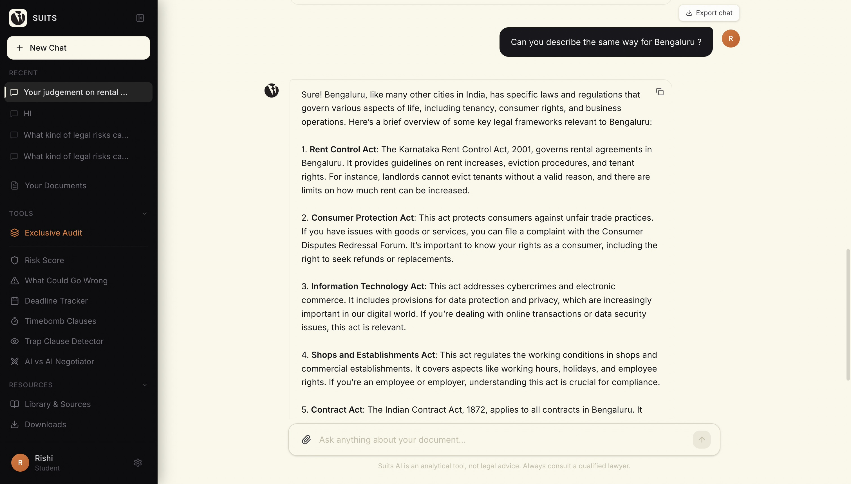
PRODUCT
AI-Powered Legal Chat & Knowledge Base
Smart Legal Q&A
Ask anything about your uploaded document
Answers grounded in actual clauses via RAG
Jurisdiction-aware (Indian legal context)
Conversation memory across questions
Source citations in every response
Legal Knowledge Library
Built-in Indian legal references — Contract Act 1872, Rent Control Acts, Shops & Establishments Act, and more.
RNSIT Agentic AI Hackathon | PS-3
Suits AI

Slide 8
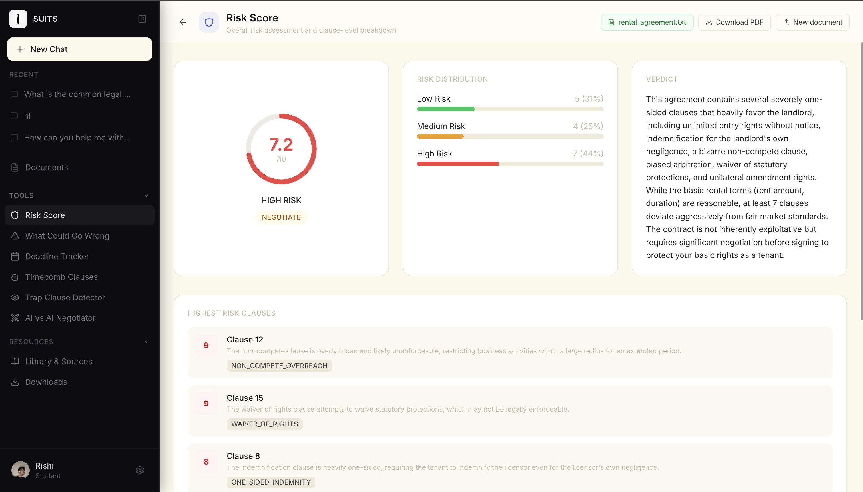
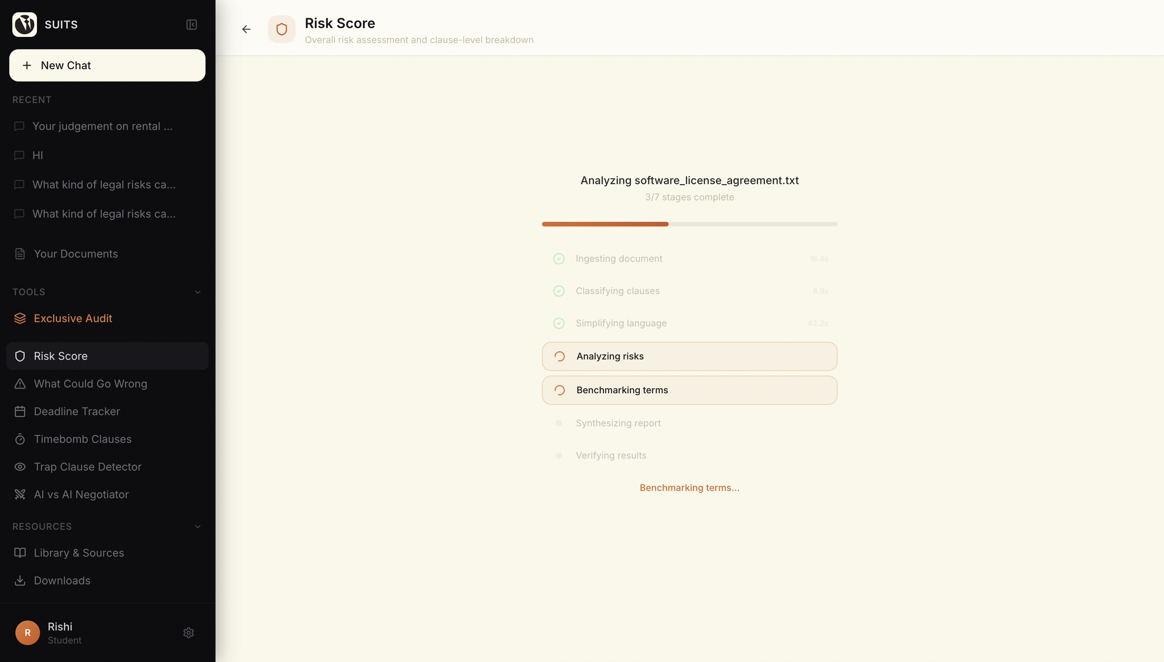
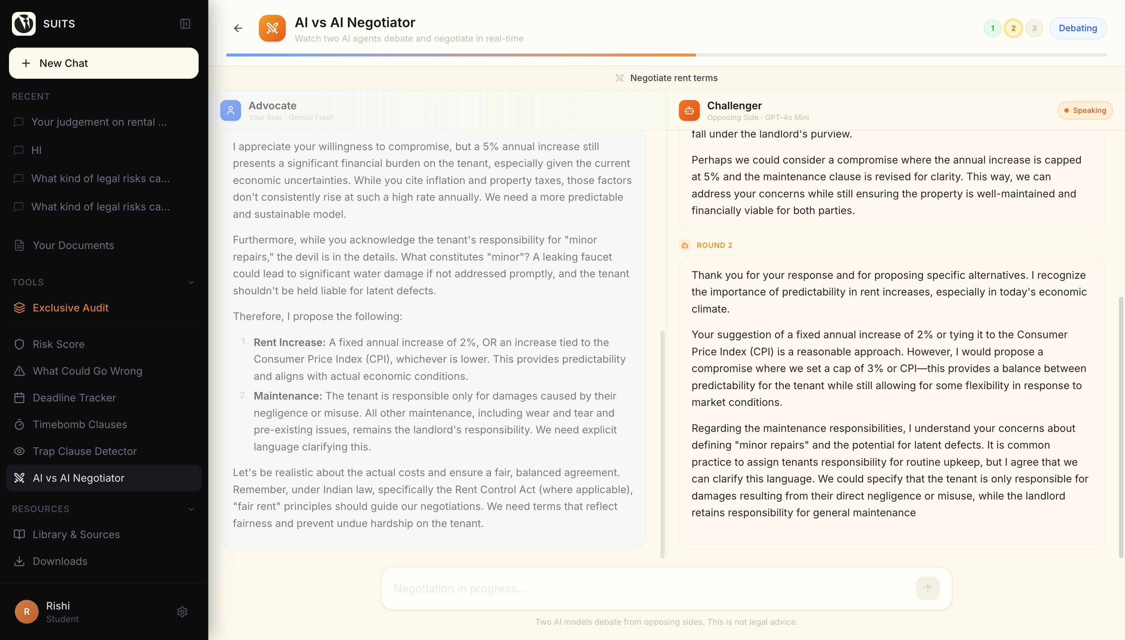
PRODUCT
Analysis Tools — Risk, Pipeline & Negotiation
Real-Time Agent Pipeline Progress (SSE)
Risk Score Dashboard — Clause-Level Breakdown with Verdict
RNSIT Agentic AI Hackathon | PS-3
Suits AI
AI vs AI Negotiator — Advocate vs Challenger Debate

Slide 9
WHAT SETS US APART
Beyond Summarization — A True Legal Action Agent
1
Multi-Model Intelligence
|
Each agent uses the optimal AI model for its task — Claude for deep analysis, GPT-4o-mini for chat, Gemini for creative negotiation. Not one model fits all.
2
Hallucination Guard
|
Every clause reference is cross-checked against source. The Verifier catches factual errors, cross-clause conflicts, and fabricated citations before the final report.
3
Jurisdiction-Aware
|
Built-in Indian legal context — Rent Control Acts, Section 27, Shops & Establishments. Not generic AI summarization, but legally grounded analysis.
4
Real-Time Transparency
|
Users see exactly which agent is running, on which model, in real-time via SSE streaming. Full pipeline visibility — no black box.
5
Actionable Decisions
|
Delivers a verdict (Sign / Negotiate / Walk Away), negotiation playbook, and prioritized action items — not just a summary.
RNSIT Agentic AI Hackathon | PS-3
Suits AI

Slide 10
Thank You
"Making legal understanding accessible, safe, and actionable for everyone."
Suits AI — Multi-Agent Legal Document Intelligence
RNSIT Agentic AI Hackathon | Problem Statement 3
AI Legal Document Action Agent

