Slide 1


Manipal University Jaipur
School of Computer Science and Engineering
Department of Computer Science and Engineering
DSE3170 Project Based Learning-3 Presentation
On
Crop Recommendation System
Using Machine Learning, Explainable AI and Fertilizer Recommendation
Presented by [Student 1 name] ([Reg. No.]) [Student 2 name] ([Reg. No.]) [Student 3 name] ([Reg. No.]) |  | Under the Guidance of [Guide name] [Designation] Dept. of Data Science and Engineering
Notes:
Introduce the team and the guide. One line on the project: a system that tells a farmer which crop to grow from a soil test and the weather, explains why, and suggests a fertilizer. Replace the bracketed names before presenting.

Slide 2
Outline
Introduction
Literature Survey
Research Gap
Problem Statement
References
Motivation
Objective
Proposed Methodology
Abstract
Result and Discussion on Outcome (Conference Paper/ Patent/ Copyrights)
Notes:
The talk follows the department outline: abstract, introduction, motivation, objective, literature survey, research gap, problem statement, proposed methodology, results and outcome, and references.

Slide 3
Abstract
Farmers often choose crops by habit. Soil tests and weather data are available, but turning them into a decision is hard.
We built a system that recommends crops from 7 inputs (N, P, K, pH, temperature, humidity, rainfall), explains each recommendation and suggests a fertilizer.
Ten machine learning algorithms were trained and tested on 2,200 samples of 22 crops. Random Forest and Naive Bayes were best: 99.55% (438 of 440 test samples).
SHAP and LIME show that humidity and rainfall matter most, followed by N, P and K.
For fertilizer, XGBoost reached 97.69% accuracy; a nutrient-gap rule tells the farmer which nutrient to add or skip.
99.55%
crop accuracy (Random Forest)
97.69%
fertilizer accuracy (XGBoost)
22 crops
10 algorithms compared
Notes:
Summarise the whole project in one minute: the problem, what we built, the main numbers. Crop model: Random Forest and Naive Bayes both 99.55% on 440 unseen samples. Fertilizer model: XGBoost 97.69%. Explanations: humidity and rainfall matter most.

Slide 4
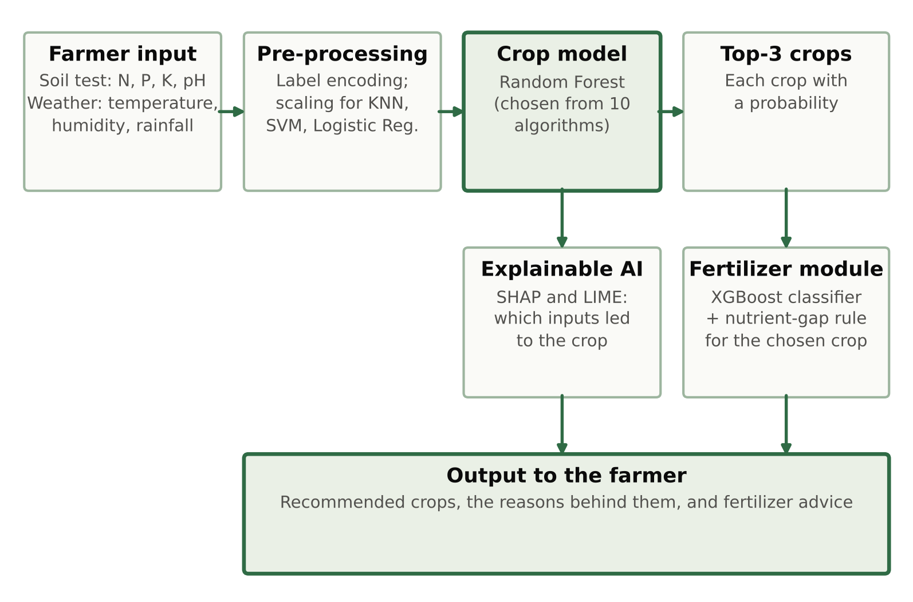
Introduction
Choosing the right crop for the soil and the season decides a farmer's income for the whole year.
Machine learning can learn from soil (N, P, K, pH) and weather (temperature, humidity, rainfall) which crop suits a field [1].
Proposed system: recommend the crop, explain why, advise on fertilizer
Notes:
Choosing a crop is the first decision of every season. A soil test gives N, P, K and pH, and the weather gives temperature, humidity and rainfall. Machine learning can learn which crop suits such a field. The diagram is the whole system: the farmer's input goes to the crop model, which gives the top 3 crops; then the explanation and the fertilizer advice.

Slide 5
Motivation
1
2
3
Crop choice by habit
The data exists
Advice needs reasons
Farmers often sow what neighbours grow or what paid well last season, even when soil and rainfall have changed.
Soil Health Card tests give N, P, K and pH, and weather data is public. Turning these numbers into a decision is the hard part.
A crop name with no explanation is hard to trust, and the next question is always: which fertilizer?
Our motivation: give the farmer advice they can check and act on: the crop, the reason behind it, and the fertilizer.
Notes:
Three reasons for the project. Farmers often decide by habit. The data needed for a better decision exists but is hard to use. And a recommendation with no reason is hard to trust; the next question is always which fertilizer to use.

Slide 6
Objective
Recommend the most suitable crops (top 3, with probabilities) from soil N, P, K, pH and the weather.
1
Compare 10 machine learning algorithms on the same train/test split and choose the best with clear reasons.
2
Check whether the high accuracy of the chosen model is a sign of overfitting.
3
Explain every recommendation with SHAP and LIME.
4
Recommend a fertilizer: predict a product and compare the soil with the crop's needs.
5
Write up the work as a research paper in IEEE conference format.
6
Notes:
Six objectives. Read them in order; each one maps to a part of the results later.

Slide 7
Literature Survey
Ref. | Study | Work | Key idea / relevance
[1] | Liakos et al. (2018) | Review: ML in agriculture | Groups work into crop, livestock, water and soil management
[2] | van Klompenburg et al. (2020) | Review: crop yield prediction | Temperature, rainfall and soil type among the most used features
[3] | Kumar et al. (2015) | Crop selection method | Chooses a crop sequence to improve the yield rate
[4] | Pudumalar et al. (2017) | Ensemble crop recommender | Combines several classifiers on soil data
[5] | Doshi et al. (2018) | AgroConsultant | Compares classifiers using soil and climate inputs
[6] | Harvestify (GitHub) | Crop and fertilizer web app | Source of our crop dataset and crop nutrient table
[7] | Lundberg and Lee (2017) | SHAP | Splits a prediction into feature contributions
[8] | Ribeiro et al. (2016) | LIME | Explains one prediction with a local linear model
[9] | Ryo (2022) | Explainable AI in agriculture | Explainable ML for agricultural data analysis
Notes:
Earlier work falls into three groups: reviews of machine learning in agriculture, crop recommenders, and methods for explaining models. Harvestify is the open-source project our crop dataset comes from.

Slide 8
Research Gap
What earlier work does
What our project does
Models compared on different splits, usually by accuracy only
10 algorithms on the same split: accuracy, precision, recall, F1, cross-validation, time and an overfitting check
A crop name is given with no reason
SHAP and LIME explain every recommendation: overall, per crop and per farmer
Fertilizer advice built as a separate project
A fertilizer module linked to the recommended crop: ML model plus nutrient-gap rule
Notes:
For each gap in earlier work, the right column says what our project does about it.

Slide 9
Problem Statement
Given the N, P, K and pH of a soil sample and the temperature, humidity and rainfall of the area, recommend the crops that best suit these conditions, explain which inputs led to the recommendation, and suggest how to correct the soil with fertilizer.
Inputs
Soil test: N, P, K, pH
Weather: temperature, humidity, rainfall
Crop Recommendation System
ML model, XAI and fertilizer module
Outputs
Top 3 crops with probabilities
Reasons (SHAP, LIME)
Fertilizer advice
Notes:
Read the statement, then walk through the strip: seven inputs go in, three kinds of output come out.

Slide 10
Proposed Methodology
1
Data collection
2
Pre-processing
3
Training
3 public datasets: crops (2,200 rows), fertilizer (99 rows), crop nutrient needs (22 crops)
Label encoding, stratified 80/20 split (1,760 / 440), scaling for KNN, SVM, LR
10 algorithms, default settings, 5-fold cross-validation on the training data
6
Fertilizer advice
5
Explanation
4
Testing
XGBoost classifier plus nutrient-gap rule for the chosen crop
SHAP (TreeSHAP) and LIME on the Random Forest
Accuracy, precision, recall, F1 on 440 unseen samples; overfitting check
Notes:
Six steps, in the order of the numbers: data, pre-processing, training, testing, explanation, fertilizer advice. The next slides go through each step.

Slide 11
Methodology: Datasets
Dataset | Source | Rows | Classes | Inputs
Crop Recommendation | Kaggle [10] | 2,200 | 22 crops, 100 each | N, P, K, temperature, humidity, pH, rainfall
Fertilizer Prediction | Kaggle [11] | 99 | 7 fertilizers | Temperature, humidity, moisture, soil type, crop type, N, P, K
Crop nutrient needs | Harvestify [6] | 22 | one row per crop | Required N, P, K and pH
Balanced: exactly 100 samples per crop, no missing values, no duplicates
Fertilizers: Urea 22, DAP 18, 28-28 17, 14-35-14 14, 20-20 14, 17-17-17 7, 10-26-26 7 rows
All three are public, so anyone can repeat our experiments with our code
Notes:
Three public datasets. The crop dataset trains the crop model, the fertilizer dataset trains the fertilizer model, and the nutrient table drives the nutrient-gap rule. Links: paper/DATASETS.md.

Slide 12
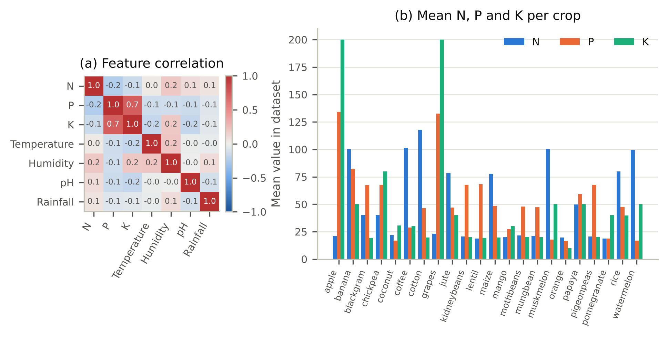
Methodology: Data Analysis
P and K are strongly related (r = 0.74); all other pairs are weak (−0.23 to 0.21)
Apple and grapes need the most P and K; cotton needs the most N (about 118)
Stratified 80/20 split: 1,760 training and 440 test samples (20 per crop); scaling for KNN, SVM, LR
Notes:
Left: correlation between the seven inputs; only P and K move together. Right: average N, P, K per crop; apple and grapes need far more P and K, cotton the most N. Then the split: 80% for training, 20% for testing, 20 test samples per crop.

Slide 13
Methodology: Algorithms
Logistic Regression
Naive Bayes
KNN (k = 5)
SVM (RBF)
Decision Tree
Straight boundary for each crop
Each crop's average and spread per input
Vote of the 5 closest samples
Widest gap between crops; can curve
Yes/no questions on one input at a time
Random Forest (chosen)
XGBoost
LightGBM
AdaBoost (default)
AdaBoost (depth-3)
100 trees on random samples; majority vote [12]
Adds trees that fix earlier errors [13]
Fast gradient boosting
50 one-split stumps
200 small trees
Same 1,760 training and 440 test samples for all ten; default settings, no tuning
Notes:
Ten algorithms from the main families. KNN works by proximity: it votes among the five most similar training samples. Random Forest, XGBoost, LightGBM and AdaBoost combine many trees. AdaBoost is tested in two forms because the setting matters a lot.

Slide 14
Methodology: XAI and Fertilizer
Explainable AI
SHAP [7]: splits each prediction into a contribution from every input; exact for tree models (TreeSHAP [14])
Global importance, importance per crop, and the explanation for one farmer
LIME [8]: fits a simple local model around one farmer's input (2,000 perturbed samples)
Agreement between SHAP and LIME measured on 100 test samples
Fertilizer recommendation
ML model: 8 algorithms on 99 rows; 5-fold cross-validation repeated 10 times (50 tests)
Nutrient-gap rule: gap = crop needs − soil has, for N, P and K
The biggest gap decides: soil short of it → add urea (N), DAP or SSP (P), MOP (K); soil has extra → skip that nutrient
Notes:
Left: how the explanations are made. Right: the two parts of the fertilizer module, the ML model and the nutrient-gap rule.

Slide 15
Result: Algorithm Comparison
Algorithm | Test accuracy | F1-score | Errors | 5-fold CV accuracy | Training time
Random Forest (chosen) | 99.55% | 99.55% | 2 | 99.38 ± 0.61% | 0.24 s
Naive Bayes (tied best) | 99.55% | 99.54% | 2 | 99.49 ± 0.42% | <0.01 s
AdaBoost (depth-3 trees) | 99.32% | 99.30% | 3 | 98.75 ± 0.29% | 0.92 s
XGBoost | 99.09% | 99.08% | 4 | 99.26 ± 0.14% | 1.02 s
LightGBM | 98.86% | 98.86% | 5 | 99.03 ± 0.39% | 1.44 s
SVM (RBF) | 98.41% | 98.40% | 7 | 97.90 ± 1.03% | 0.16 s
Decision Tree | 97.95% | 97.94% | 9 | 98.52 ± 0.68% | 0.01 s
KNN (k = 5) | 97.95% | 97.93% | 9 | 96.53 ± 1.21% | <0.01 s
Logistic Regression | 97.27% | 97.25% | 12 | 96.82 ± 0.66% | 0.04 s
AdaBoost (default stumps) | 17.50% | 8.56% | 363 | 31.93 ± 5.85% | 0.14 s
Random Forest and Naive Bayes tie at 99.55% (2 errors in 440). The top five algorithms are within 3 test samples of each other.
Notes:
Test accuracy is on the 440 samples the models never saw. Random Forest and Naive Bayes tie at 99.55%, 2 mistakes each. The top five are within three test samples. AdaBoost with default settings is the one failure, explained two slides later.

Slide 16
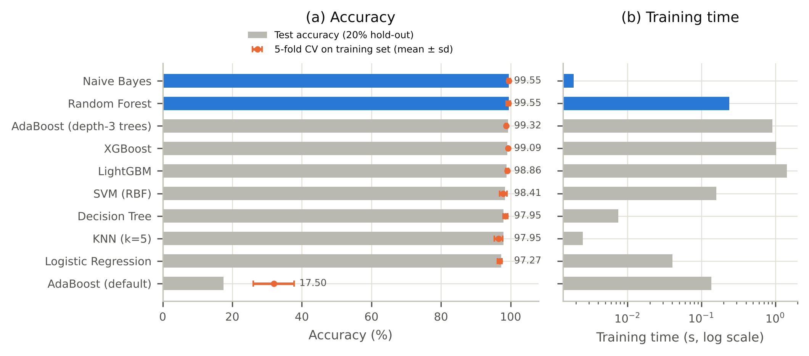
Why We Chose Random Forest
Joint best: 99.55% on 440 test samples
Stable: 99.38 ± 0.61% in cross-validation
Top-3 list: tree votes give every crop a probability
Explainable: TreeSHAP is exact for trees; trains in 0.24 s
Notes:
Accuracy alone cannot separate the top models, so we chose on four other points. Naive Bayes is an equally accurate backup, but it cannot be explained exactly.

Slide 17
Why AdaBoost (Default) Failed
17.50%
Default: 50 one-split stumps
99.32%
200 trees of depth 3
A stump makes one split, so it can only divide 22 crops into 2 groups.
Each boosting round adds very little, and most crops are never separated.
A depth-3 tree separates up to 8 groups, and the same algorithm then works.
Lesson: the weak learner was too weak, not boosting itself.
Notes:
The default AdaBoost uses stumps, trees with one split. One split can only divide 22 crops into two groups, so boosting adds very little. With depth-3 trees the same algorithm reaches 99.32%. A low AdaBoost score here is a setting problem, not a boosting problem.

Slide 18
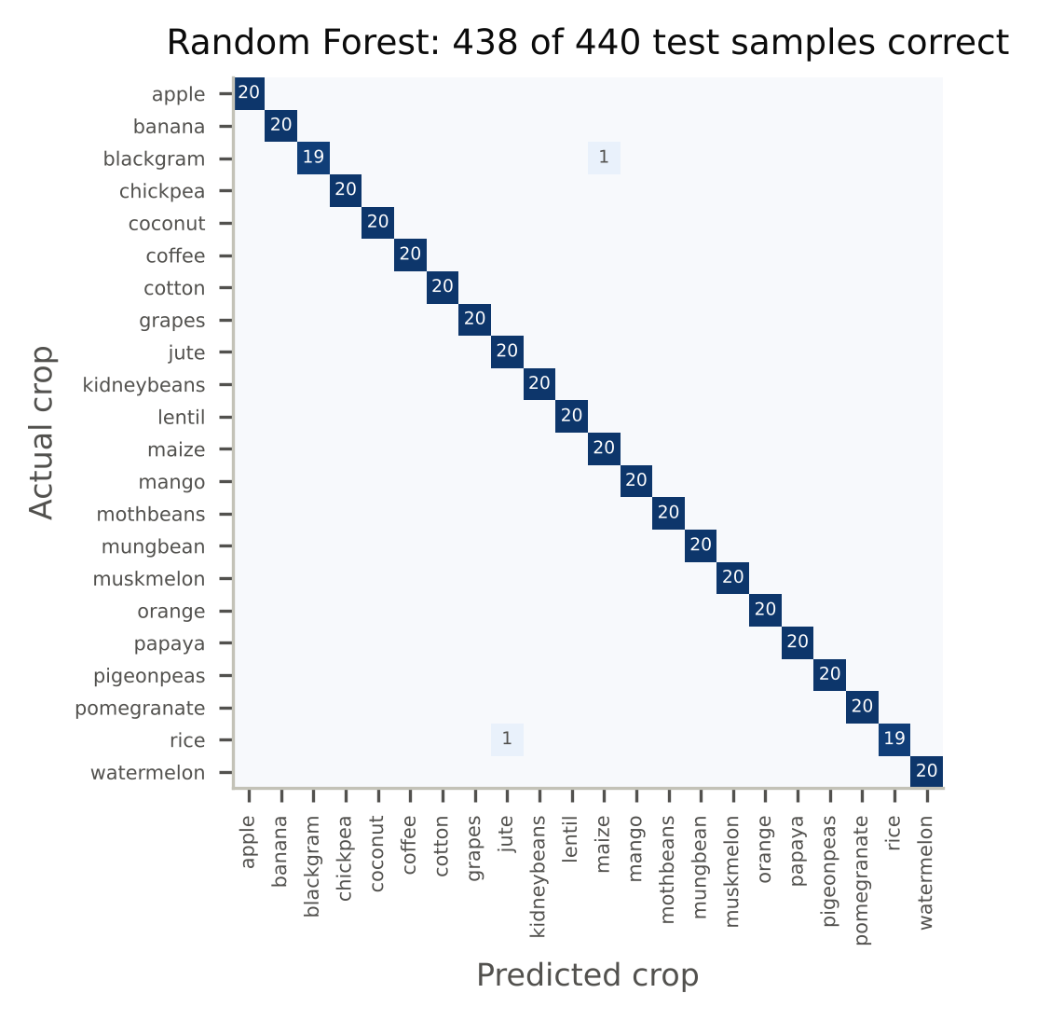
Result: Testing Random Forest
438 / 440
test samples correct; 20 of 22 crops perfect
Mistake 1: rice → jute
Same N, P, K (about 80-47-40) and humidity near 80%; they differ mainly in rainfall (236 vs 175 mm).
Mistake 2: blackgram → maize
Same average humidity (65%) and similar potassium.
Notes:
Rows are the true crop, columns the predicted crop. Only two mistakes, both between crops that really are similar in the data.

Slide 19
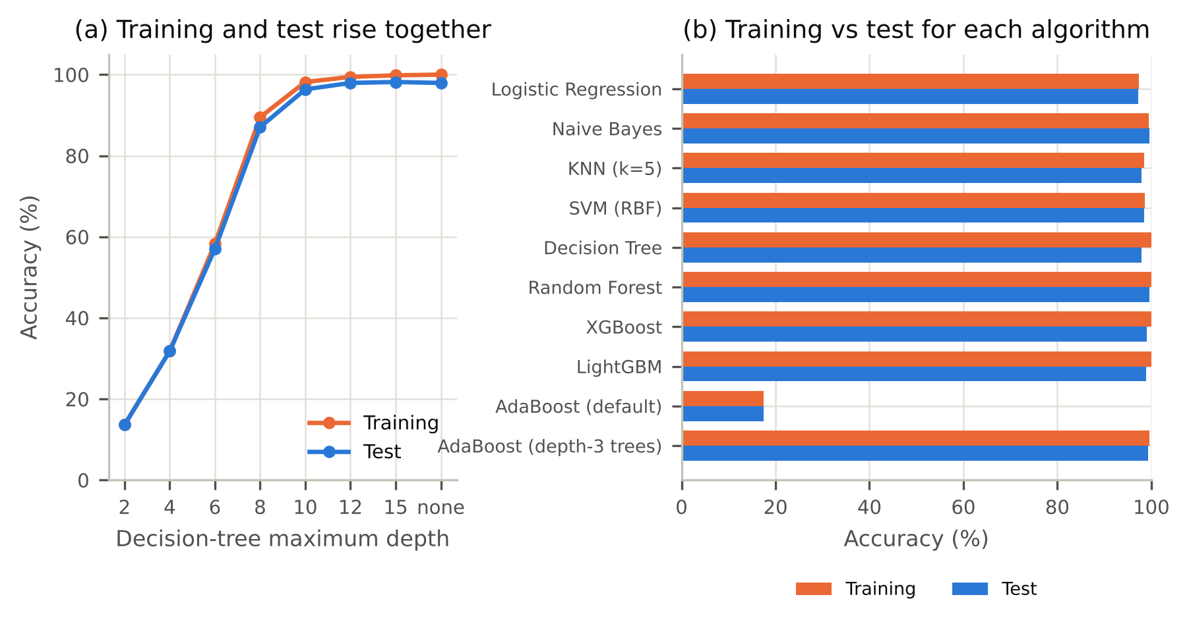
Is 99.5% Overfitting? No
Training vs test gap: 0.45 points for Random Forest; largest 2.05 (single decision tree)
Shuffled labels: Random Forest drops to 4.61%, the chance level for 22 crops (4.55%)
Accuracy is high because the crops are well separated in this dataset
Notes:
Overfitting means high training accuracy and much lower test accuracy. Here the gap is under one point for most models, and the depth curve shows training and test rising together. With shuffled labels the model drops to chance.

Slide 20
Result: Six Farmers' Top-3 Crops
Farmer | Soil N-P-K | Temp., humidity, rain | 1st choice | 2nd choice | 3rd choice
F1 | 18-17-31 | 31.7 °C, 45.2%, 94 mm | mango (0.98) | orange (0.01) | pigeon peas (0.01)
F2 | 22-44-24 | 24.3 °C, 56.3%, 59 mm | moth beans (0.72) | pigeon peas (0.10) | maize (0.08)
F3 | 3-67-24 | 17.0 °C, 19.9%, 103 mm | kidney beans (0.99) | pigeon peas (0.01) | blackgram (0.00)
F4 | 34-75-24 | 23.5 °C, 51.3%, 192 mm | pigeon peas (0.98) | moth beans (0.02) | blackgram (0.00)
F5 | 76-54-45 | 24.3 °C, 77.6%, 185 mm | jute (0.91) | rice (0.08) | papaya (0.01)
F6 | 117-76-47 | 25.6 °C, 77.4%, 93 mm | banana (0.99) | cotton (0.01) | blackgram (0.00)
All six first choices match the crop actually grown. When the model is less sure (F2: 0.72), the 2nd and 3rd choices give real alternatives.
Notes:
Six test samples treated as six farmers. All six first choices are right. For F2 the model is less sure, so the second and third choices matter.

Slide 21
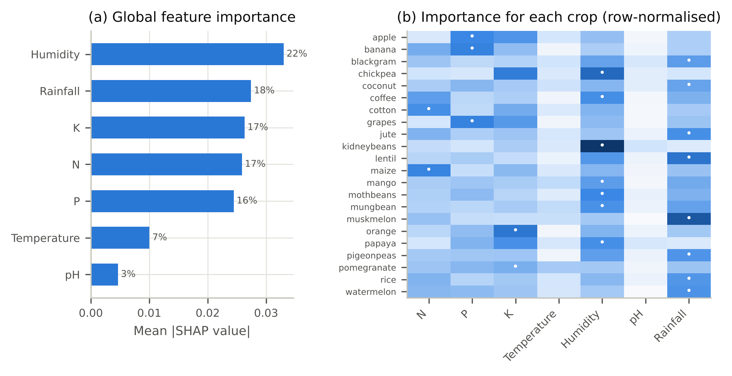
Result: Which Inputs Matter Most
Overall: humidity 22%, rainfall 18%, K 17%, N 17%, P 16%, temperature 7%, pH 3%
Deciding input per crop: rainfall 8 crops, humidity 7, P 3, N 2 (cotton, maize), K 2
Notes:
SHAP over all test samples: humidity and rainfall matter most, then K, N and P. The right panel shows the deciding input changes by crop, for example nitrogen for cotton and phosphorus for apple and grapes.

Slide 22
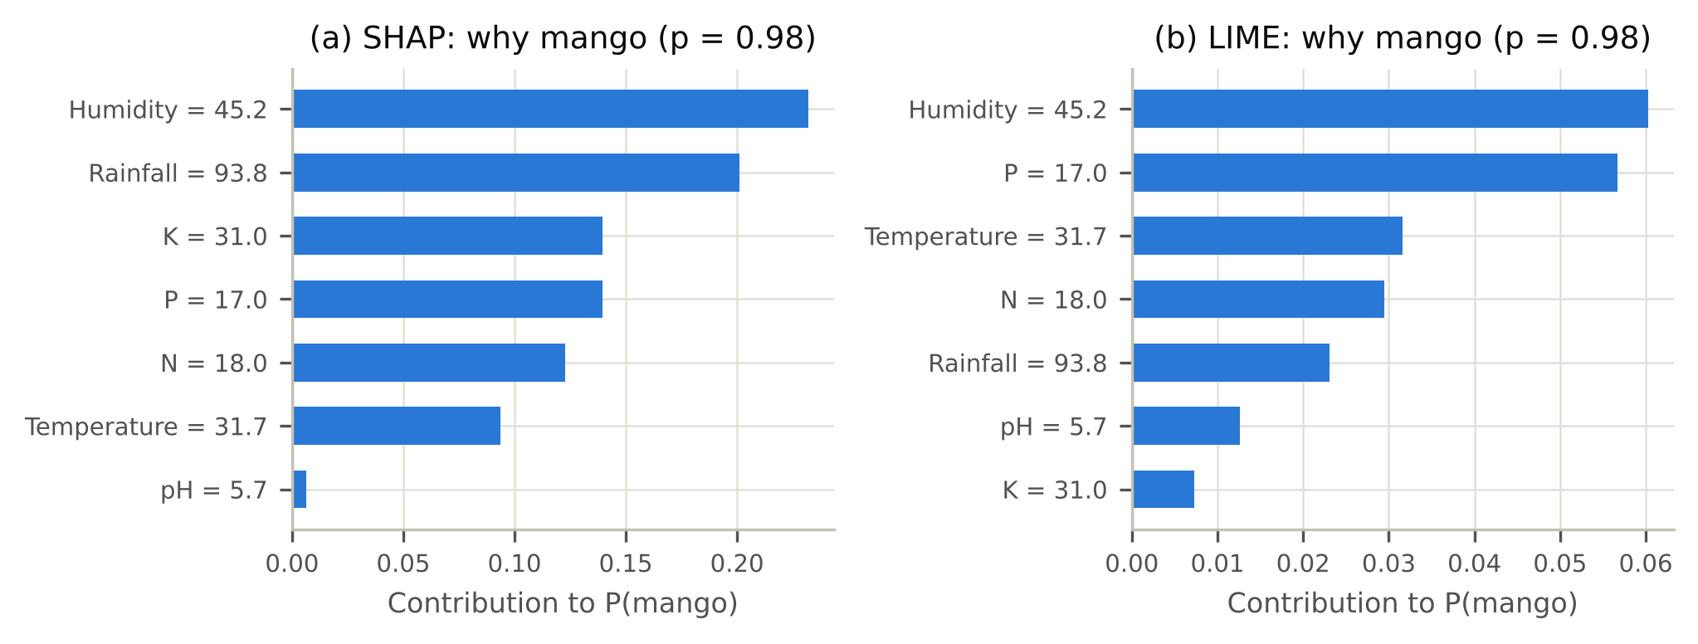
Result: Why Farmer F1 Got Mango
Farmer F1 → mango (0.98): humidity 45.2% and rainfall 93.8 mm push most towards mango; the low N, P and K also fit.
SHAP vs LIME: same top reason in 66% of 100 test samples and 78% overlap in the top 3, so the farmer sees only the top 2–3 reasons.
Notes:
SHAP and LIME for one farmer. Both put humidity first. They do not agree on every detail, so the system shows only the top two or three reasons.

Slide 23
Result: Fertilizer Algorithms
Algorithm | Accuracy | F1-score
XGBoost (chosen) | 97.69 ± 3.20% | 95.02%
Decision Tree | 96.28 ± 4.00% | 92.24%
Random Forest | 95.07 ± 4.43% | 89.22%
Logistic Regression | 94.35 ± 4.56% | 87.59%
SVM (RBF) | 88.09 ± 5.19% | 77.61%
AdaBoost (depth-3) | 86.19 ± 12.09% | 74.14%
KNN (k = 5) | 71.41 ± 10.40% | 63.13%
Naive Bayes | 66.74 ± 9.59% | 60.58%
97.69%
XGBoost accuracy, averaged over 50 tests
Why 50 tests? Only 99 rows, so one 80/20 split leaves about 20 test rows. We ran 5-fold cross-validation 10 times.
7 fertilizers: Urea, DAP, 28-28, 14-35-14, 20-20, 17-17-17, 10-26-26
Notes:
Eight algorithms on the fertilizer data. With only 99 rows we averaged 50 tests. XGBoost is best at 97.69%. KNN and Naive Bayes are weak.

Slide 24
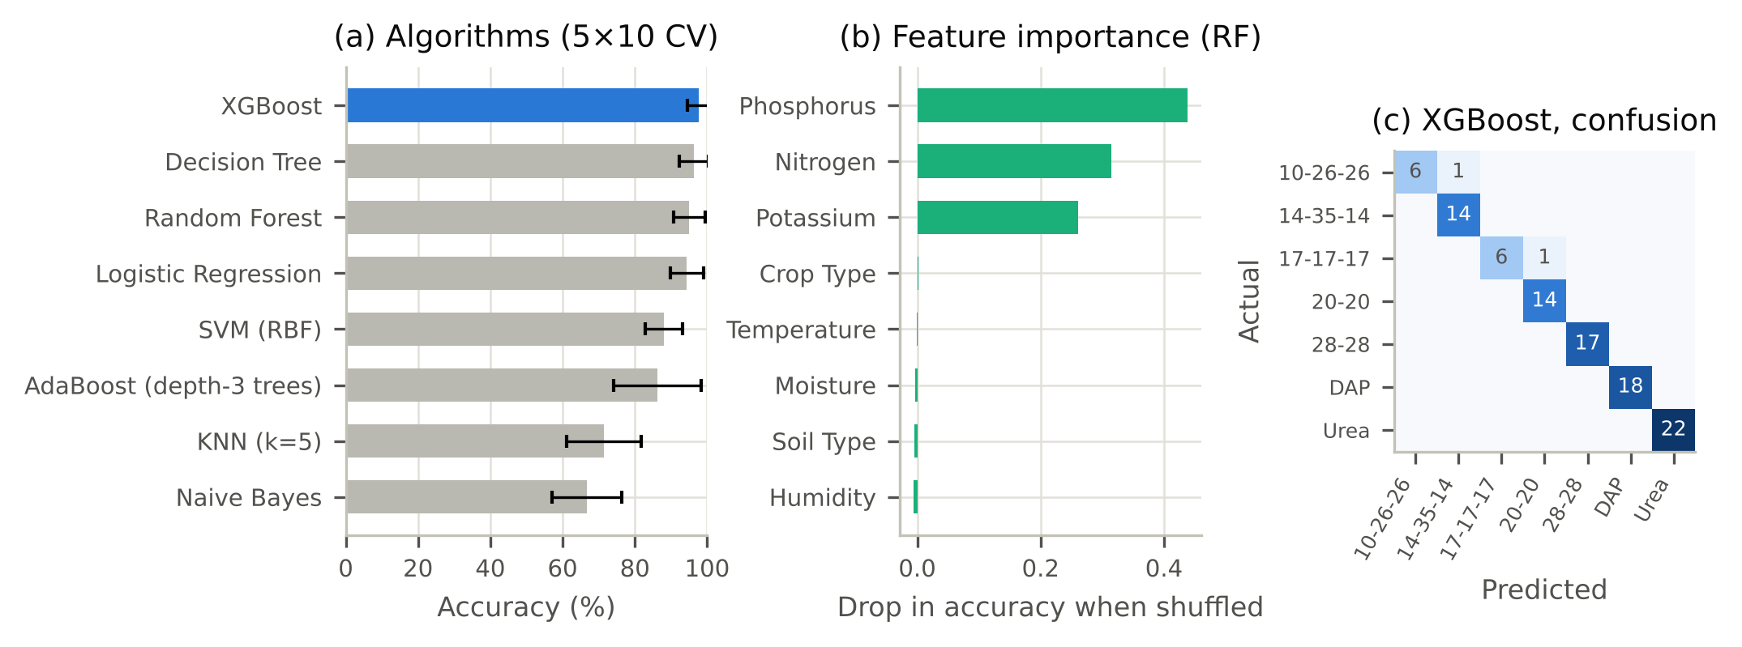
Result: What Decides Fertilizer
Soil N, P, K decide it: importance P 0.44, N 0.31, K 0.26; temperature, humidity, moisture, soil and crop type 0.006 or less.
Only 2 mistakes in 99: 10-26-26 read as 14-35-14, 17-17-17 as 20-20. KNN and Naive Bayes fail because they weigh all 8 inputs equally.
Notes:
Permutation importance: shuffle one input and see how much accuracy drops. Only phosphorus, nitrogen and potassium matter. That makes sense: a fertilizer supplies what the soil lacks.

Slide 25
Result: Nutrient-Gap Advice
gap = what the crop needs − what the soil has. The biggest gap decides: soil short → add it; soil has extra → skip it.
Farmer | Soil N-P-K | Crop | Needs N-P-K | Biggest gap | Advice
F1 | 18-17-31 | mango (1st) | 20-20-30 | P low by 3 | Add phosphate (DAP or SSP)
F1 | 18-17-31 | orange (2nd) | 20-10-10 | K high by 21 | Skip potash this season
F3 | 3-67-24 | kidney beans (1st) | 20-60-20 | N low by 17 | Add nitrogen (urea)
F4 | 34-75-24 | pigeon peas (1st) | 20-60-20 | P high by 15 | Skip phosphate this season
F6 | 117-76-47 | banana (1st) | 100-75-50 | N high by 17 | Skip nitrogen this season
F6 | 117-76-47 | cotton (2nd) | 120-40-20 | P high by 36 | Skip phosphate this season
The recommended crop usually needs little correction (F1: P short by 3). A second-choice crop needs more (F6 → cotton: 36 extra P).
Notes:
The rule compares the farmer's soil with what the crop needs. For the recommended crop the gaps are small; for a second-choice crop they are bigger. F3 is short of nitrogen, so the advice is urea.

Slide 26
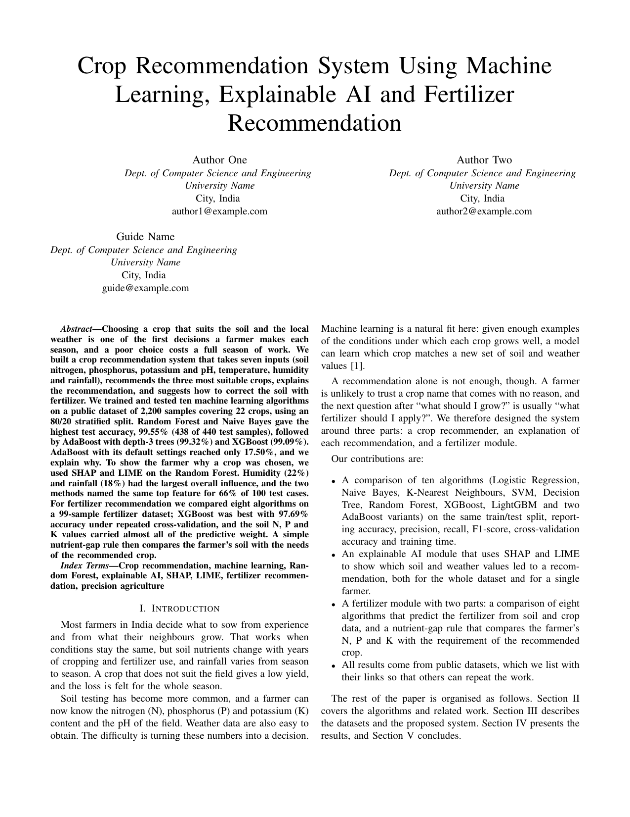
Outcome: Paper, Patent, Copyright
Conference paper
8-page IEEE conference paper: “Crop Recommendation System Using Machine Learning, Explainable AI and Fertilizer Recommendation”. Status: [submitted to ___ / under review]
Patent
Not filed: software and algorithms are excluded under Section 3(k) of the Patents Act, 1970 [16].
Copyright
Code, paper and report are protected automatically under the Copyright Act, 1957. Data sources are credited.
Notes:
The main outcome is the conference paper. A patent does not apply because software and algorithms are excluded in India. Copyright covers our code, paper and report automatically. Fill in the paper's submission status.

Slide 27
Conclusion and Future Scope
Conclusion
Random Forest: 99.55% on 440 unseen samples, with a top-3 crop list
No overfitting: training–test gap of 0.45 points
SHAP: humidity and rainfall matter most; the deciding input changes by crop
XGBoost: 97.69% fertilizer accuracy, plus nutrient-gap advice
Future scope
Test on real Soil Health Card reports with district rainfall data
Fertilizer amounts in kg/ha from soil-test dose rules
Tune the best models
Mobile app with explanations in the farmer's own language
Notes:
Four findings on the left, four next steps on the right. The most important next step is testing on real Soil Health Card data.

Slide 28
References (1/2)
[1] K. G. Liakos, P. Busato, D. Moshou, S. Pearson and D. Bochtis, “Machine learning in agriculture: A review,” Sensors, vol. 18, no. 8, p. 2674, 2018.
[2] T. van Klompenburg, A. Kassahun and C. Catal, “Crop yield prediction using machine learning: A systematic literature review,” Computers and Electronics in Agriculture, vol. 177, p. 105709, 2020.
[3] R. Kumar, M. P. Singh, P. Kumar and J. P. Singh, “Crop selection method to maximize crop yield rate using machine learning technique,” in Proc. ICSTM, 2015, pp. 138–145.
[4] S. Pudumalar, E. Ramanujam, R. H. Rajashree, C. Kavya, T. Kiruthika and J. Nisha, “Crop recommendation system for precision agriculture,” in Proc. ICoAC, 2017, pp. 32–36.
[5] Z. Doshi, S. Nadkarni, R. Agrawal and N. Shah, “AgroConsultant: Intelligent crop recommendation system using machine learning algorithms,” in Proc. ICCUBEA, 2018, pp. 1–6.
[6] Gladiator07, “Harvestify,” GitHub repository, 2023. https://github.com/Gladiator07/Harvestify
[7] S. M. Lundberg and S.-I. Lee, “A unified approach to interpreting model predictions,” in Advances in Neural Information Processing Systems, vol. 30, 2017, pp. 4765–4774.
[8] M. T. Ribeiro, S. Singh and C. Guestrin, “‘Why should I trust you?’: Explaining the predictions of any classifier,” in Proc. ACM SIGKDD, 2016, pp. 1135–1144.
Notes:
References in IEEE style, numbered as cited on the slides.

Slide 29
References (2/2)
[9] M. Ryo, “Explainable artificial intelligence and interpretable machine learning for agricultural data analysis,” Artificial Intelligence in Agriculture, vol. 6, pp. 257–265, 2022.
[10] A. Ingle, “Crop Recommendation Dataset,” Kaggle. https://www.kaggle.com/datasets/atharvaingle/crop-recommendation-dataset
[11] “Fertilizer Prediction,” Kaggle. https://www.kaggle.com/datasets/gdabhishek/fertilizer-prediction
[12] L. Breiman, “Random forests,” Machine Learning, vol. 45, no. 1, pp. 5–32, 2001.
[13] T. Chen and C. Guestrin, “XGBoost: A scalable tree boosting system,” in Proc. ACM SIGKDD, 2016, pp. 785–794.
[14] S. M. Lundberg et al., “From local explanations to global understanding with explainable AI for trees,” Nature Machine Intelligence, vol. 2, no. 1, pp. 56–67, 2020.
[15] F. Pedregosa et al., “Scikit-learn: Machine learning in Python,” Journal of Machine Learning Research, vol. 12, pp. 2825–2830, 2011.
[16] Government of India, The Patents Act, 1970 (Act No. 39 of 1970).
Notes:
References in IEEE style, numbered as cited on the slides.

Slide 30
Thank You
Questions?
Crop Recommendation System · DSE3170 Project Based Learning-3
Notes:
Thank the audience and invite questions. Likely questions: is 99.5% overfitting (slide on overfitting), why Random Forest, why AdaBoost failed, and whether it works on real farms (future scope).

