Slide 1

AWS Solution Architect (UNIT-3:Networking & Content Delivery)
Dr. Munsifa Firdaus Khan Barbhuyan
School of Computing Science and Engineering & Artificial Intelligence
munsifafirdauskhan@vitbhopal.ac.in

Slide 2
Amazon API Gateway
Introduction to API
API stands for Application Program Interface. An API Gateway is a management tool that acts as an interface between users and microservices. The Amazon API Gateway is an AWS service that allows users to create, publish, secure, maintain and monitor APIs at any scale.
You can create APIs in your client application and can also make them available to third-party developers.
It is serverless. It supports HTTP, WebSocket, and REST APIs. API Gateway is a type of server that provides the service of API which is used to customize each client.
The Netflix API Gateway is the most popular example of API Gateway.
Many e‑commerce site uses an API gateway to provide the endpoint for retrieving the details of all products from mobile clients with only a single request. So, This invokes many different services like the proper information of product, and product reviews and then combines the results.

Slide 3
Amazon API Gateway
What is Amazon API Gateway?
Amazon API Gateway is a fully managed service by Amazon Web Services that enables developers to create, publish, monitor, and secure APIs at any scale.
It acts as a gateway between client applications and backend services, handling requests and routing them to the appropriate service.
It simplifies API management, reduces infrastructure complexity, and scales automatically to meet the demand.
Whether you're creating RESTful APIs, WebSocket APIs, or handling serverless applications, AWS API Gateway supports a wide range of use cases with flexible, cost-effective solutions.

Slide 4
Amazon API Gateway
Key Features of Amazon API Gateway
1. Traffic Management: API Gateway provides robust traffic management capabilities, such as load balancing, request throttling, and caching. These features ensure that your API performs optimally, even under heavy traffic.
2. Security Features: With IAM roles, custom authorizers, and Cognito integration, AWS API Gateway helps secure your APIs by offering features like authentication, authorization, and access control.
3. Version Management: API Gateway allows you to manage different versions of your API, ensuring that clients using different versions get the correct functionality and updates.
4. Scalability: AWS API Gateway scales automatically to accommodate any level of traffic, ensuring that your API can handle sudden surges or high-volume requests without downtime.
5. Monitoring and Analytics: Amazon CloudWatch is integrated into API Gateway, allowing you to monitor API performance and track request logs. This helps you keep an eye on health and diagnose issues efficiently.

Slide 5
Amazon API Gateway
How Amazon API Gateway Works?
Amazon API Gateway acts as an interface between client applications and backend services. When a client sends a request, the API Gateway routes it to the appropriate backend service based on the API configuration. Once the backend processes the request, the service sends a response back to the API Gateway, which then passes it to the client.
A simplified flow of API gateway can be represented as :
Client Request → API Gateway → Backend Service (AWS Lambda, EC2, etc.) → Response → API Gateway → Client

Slide 6
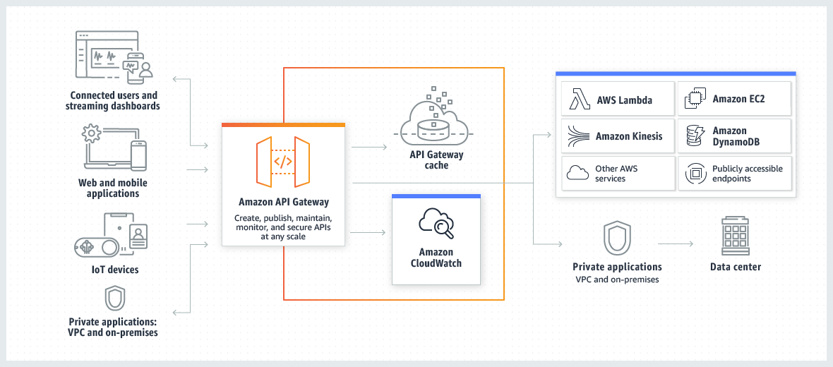
Amazon API Gateway
This architecture minimizes client-side complexity while centralizing API management.

Slide 7
Amazon API Gateway
What types of APIs does Amazon API Gateway support?
AWS API Gateway supports different API types to cater to various use cases:
REST APIs Private and Public: Representational State Transfer (REST) is an architectural style that defines a set of constraints to be used for creating web services. REST API is a way of accessing web services in a simple and flexible way without having any processing.
SOAP APIs: Simple Object Access Protocol(SOAP) is a network protocol for exchanging structured data between nodes. It uses XML format to transfer messages. It works on top of application layer protocols like HTML and SMTP for notations and transmission.
GraphQL APIs: GraphQL is an open-source data query and manipulation language for APIs and a runtime for fulfilling queries with existing data.
WebSocket APIs: Web API is an API as the name suggests, it can be accessed over the web using the HTTP protocol. It is a framework that helps you to create and develop HTTP based RESTFUL services. The web API can be developed by using different technologies such as java, ASP.NET, etc. Web API is used in either a web server or a web browser.

Slide 8
AWS CloudFront: CDN Cloud Service
Introduction
AWS CloudFront is like a super-fast delivery service for your website’s content. It’s a Content Delivery Network (CDN) that helps websites, videos, APIs, and apps load faster by storing copies of content in multiple locations around the world. When someone visits your site, CloudFront delivers the content from the nearest location, reducing wait times and improving performance.
AWS CloudFront makes it possible for companies to swiftly and effectively distribute content to users worldwide, including static or dynamic data, videos, images, and APIs.
CloudFront caches copies of your content in strategically located servers known as edge locations. When a user makes a request for your content, CloudFront delivers it from the nearest edge location, reducing latency and improving load times. This ensures low-latency delivery, high transfer speeds, and an optimized user experience.
CloudFront is an essential component of the AWS ecosystem since it easily integrates with other AWS services like Amazon S3, EC2, Lambda@Edge, and API Gateway.

Slide 9
AWS CloudFront: CDN Cloud Service
Key Components of AWS CloudFront
The following are the Key Components of AWS CloudFront:
Edge Locations: Data centers worldwide that cache content closer to users.
Origin Server: The main server hosting the original content (e.g., S3 bucket, EC2 instance, or on-premises server).
Distribution: The configuration for delivering content via CloudFront.
Web Distribution (for websites, APIs, and static/dynamic content)
RTMP Distribution (for streaming media, though deprecated)
Cache Behaviours: Defines caching rules (TTL, cookies, query strings, etc.).
Signed URLs & Signed Cookies: Secure access for private content.
Lambda@Edge: Runs custom logic at edge locations (e.g., modifying HTTP headers, URL rewrites).

Slide 10
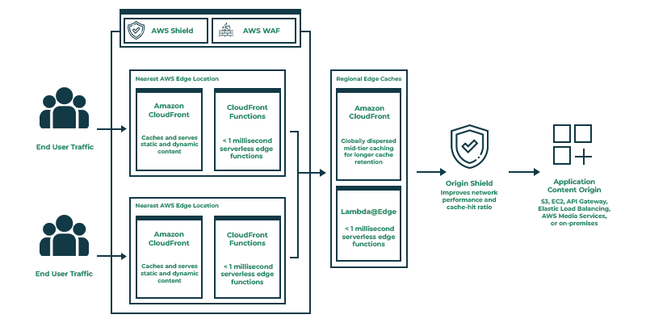
AWS CloudFront: CDN Cloud Service

Slide 11
AWS CloudFront: CDN Cloud Service
How does AWS CloudFront work
Step 1: User Requests Content - A user asks for something like an image, video, or webpage from a website or app.
Step 2: DNS Routes the Request - The DNS (Domain Name System) finds the closest CloudFront server and sends the request there for faster delivery.
Step 3: CloudFront Checks for Cached Content - CloudFront checks if the requested content is already stored in the nearest server:
If it’s stored: CloudFront gives the content right away.
If not stored: CloudFront sends the request to the main server to get the content.
Step 4: Content Comes from the Origin Server - The main server (like Amazon S3, EC2, or your own server) sends the requested content to the nearest CloudFront server.
Step 5: CloudFront Caches the Content - CloudFront saves the content in the server so that it can be used again in the future, making the system faster.

Slide 12
AWS CloudFront: CDN Cloud Service
How does AWS CloudFront work
Step 6: CloudFront Delivers Content - CloudFront sends the content to the user from the nearest server, which makes it load faster because it’s closer to the user.
Step 7: Future Requests - For future requests, CloudFront gives the content directly from its cache, making the process even quicker.
Step 8: Cache Update (When Needed) - CloudFront checks with the main server regularly to see if the content has been updated. If it has, CloudFront fetches the new version and updates the cache for future use.

Slide 13
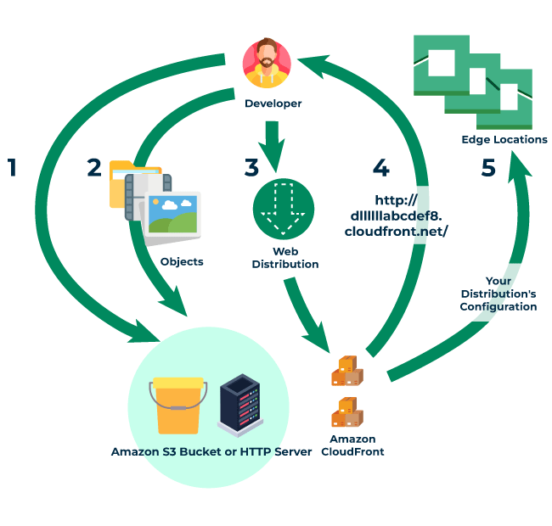
AWS CloudFront: CDN Cloud Service

Slide 14
AWS CloudFront: CDN Cloud Service
Key Features of AWS CloudFront
Faster Content Delivery Across the Globe: CloudFront stores copies of your content in multiple locations worldwide. When someone requests it, they get it from the nearest location, making your website or app load much faster.
Works Seamlessly with AWS Services: You can easily connect CloudFront with S3 (for storing files), EC2 (for hosting websites), API Gateway (for APIs), Route 53 (for domains), AWS WAF (for security), and ELB (for load balancing).
Built-in Security & Protection Against Attacks: CloudFront helps block DDoS attacks and malicious traffic using AWS Shield and AWS WAF. It also supports secure HTTPS connections and access control to protect your content.
Efficient Caching for Both Static & Dynamic Content
Static content like images, JavaScript, and CSS files are stored and delivered instantly.
Dynamic content like APIs or personalized pages are optimized to load faster without unnecessary delays.
Budget-Friendly & Scales with Your Needs: You only pay for what you use, and AWS offers 1 TB of free data transfer per month in its Free Tier.
Super Low Latency & High Performance : CloudFront automatically finds the fastest route to deliver content, ensuring smooth user experiences with minimal delays.

Slide 15
AWS CloudFront: CDN Cloud Service
Companies using AWS CloudFront
Company | Use Case
United States Department of Defense | Secure content distribution across its extensive network.
Walmart | Enhances performance and reliability of its online retail platform.
Amazon | Accelerates content delivery for its e-commerce operations.
Netflix | Streams high-quality video content globally with low latency.
Disney | Supports Disney+ with scalable and secure content delivery.
BMW | Enhances vehicle connectivity and digital services via CloudFront.
McDonald's | Optimizes customer experience with machine learning and analytics.
Capital One | Supports banking services with high-security cloud solutions.

Slide 16
AWS Direct Connect
Introduction
AWS Direct Connect enables a direct, dedicated connection between your internal network and AWS, bypassing internet service providers for a faster, more secure link. This setup uses a high-speed Ethernet fiber-optic cable which connects directly from your network's router to an AWS Direct Connect router at an AWS location. With this dedicated connection, you can create virtual interfaces to access AWS services, such as Amazon S3 or Amazon VPC in a streamlined manner.
AWS Direct Connect is a cloud service that provides businesses with a secure, high-bandwidth, and low-latency connection from their on-premises infrastructure directly to AWS services. By bypassing the public internet, it ensures private, more reliable, and secure data transfer. This direct connection is typically set up using fiber-optic cables or Ethernet links to AWS Direct Connect locations, ensuring better network performance and security for mission-critical applications.

Slide 17
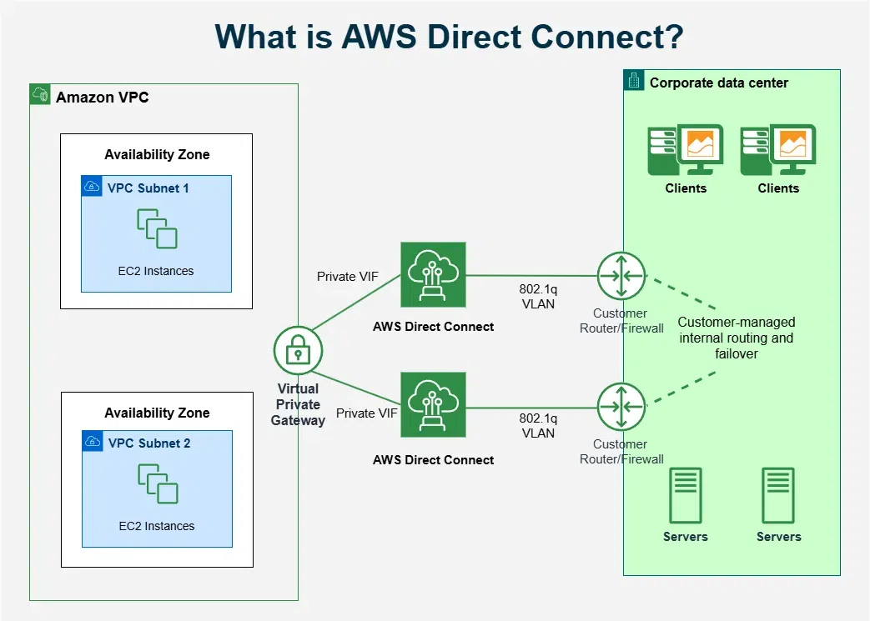
AWS Direct Connect

Slide 18
AWS Direct Connect
AWS Direct Connect Working
AWS Direct Connect works by creating a dedicated physical connection between your on-premises network and an AWS Location. This connection uses fiber and ethernet cables to link your network directly to an AWS router, avoiding the public internet. Once the physical connection is in place, a virtual interface (VIF) is set up to create a secure connection between your network and AWS, allowing you to access AWS services easily and securely.

Slide 19
AWS Direct Connect
Setting Up AWS Direct Connect
Step 1: Connect an AWS Direct Connect Location - Select an AWS Direct Connect location that is closest to your infrastructure. AWS provides a list of available locations on the Direct Connect portal.
Step 2: Select a Network Service Provider - Pick a network service provider from the AWS Direct Connect Partners page. This provider will bridge the connection between your on-premises network and AWS. When choosing, consider factors like bandwidth and location.
Step 3: Provision a Dedicated Network Connection - Provision a dedicated network connection between your infrastructure and the chosen service provider’s location. This physical link ensures the high performance and reliability of your AWS connection.
Step 4: Configure the Virtual Interface - Log in to the AWS Management Console and navigate to Direct Connect. Create a virtual interface by providing the VLAN ID, routing, and other configuration details. Once completed, your AWS Direct connect connection will be ready to access AWS service services such as Amazon VPC and Storage Services.
AWS Management Console -> Direct Connect -> Create virtual interface

Slide 20
AWS Direct Connect
Benefits of Using AWS Direct Connect
It provides a connection with high bandwidth and low latency, hence reliability and performance are increased.
Since a dedicated private connection is established completely bypassing the public internet hence adds to the security of your connection.
Data transfer over AWS Direct Connect is very cost-effective as compared to using the typical public network.

Slide 21
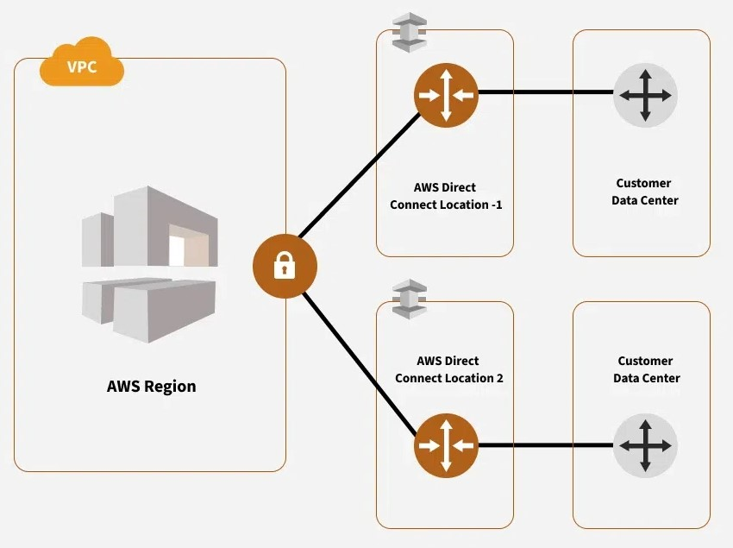
AWS Direct Connect
Use Cases of AWS Direct Connect
In the accompanying image, you can see how AWS Direct Connect enables a secure private connection between customer data centers and AWS. Two Direct Connect locations are set up to ensure high availability and redundancy. This configuration can support mission-critical workloads and provide continuity even if one connection experiences downtime. Each Direct Connect location connects back to the AWS Region's Virtual Private Cloud (VPC) where AWS resources can be directly accessed. This setup highlights the flexibility and reliability of AWS Direct Connect for businesses that require a constant and private connection to their AWS environment enhancing performance and security across multiple use cases.

Slide 22
AWS Direct Connect
Difference Between AWS Direct Connect vs Site to Site VPN
Attribute | AWS Direct Connect | AWS Site-to-Site VPN
Network | Provides a dedicated, private network connection that bypasses the public internet. | Utilizes an encrypted tunnel over the public internet for connectivity.
Time to Establish | Typically takes longer to set up, as it requires physical connection setup and configuration. | Faster to set up, as it only involves configuration on both ends with no physical setup required.
Pricing | Higher cost due to dedicated infrastructure and setup requirements. Suitable for consistent, high-bandwidth use cases. | Generally more cost-effective, as it uses an existing internet connection, making it ideal for lower-budget or intermittent use.
Security | Offers a private, secure connection that doesn’t go through the public internet, enhancing data security and reducing exposure risks. | Relies on encryption over the public internet, which is secure but may have potential exposure risks compared to a fully private connection.

Slide 23
AWS Direct Connect
Pricing of AWS Direct Connect
There is no minimum setup fee for AWS Direct Connect, you have to pay for what you use. Pricing is based on the following factors:
1. Capacity: It is the maximum rate at which can be transferred through the network, capacity of a connection is measured in megabits per second(Mbps) or gigabits per second(Gbps).
2. Port hours: It measures the time for which a port is allocated for use with AWS, even when do transfer is happening at that time you are charged for port hours, Port hours depend on two factors namely, dedicated connection or hosted connection.
Dedicated connections: physical connections from your premises port to the AWS network port. These are billed as long as they are allocated for use, you can request for dedicated connection through the AWS Direct Connect section of the AWS Management Console.
Hosted connections: logical and you can request for hosted connection by directly contacting your Delivery Partner.
3. Data transfer out (DTO): It refers to the total traffic out of the AWS from your network and is charged per gigabyte (GB).
4. Data Transfer In (DTI): Just opposite of the DTO, it is the total traffic received in the network from outside the AWS.

Slide 24
AWS Networking and Content Delivery
Introduction
Amazon Web Services (AWS) provides a comprehensive range of networking and content delivery services to enable secure, high-performance, and reliable cloud solutions. These services help organizations connect, manage, protect, and deliver applications and content globally.
Key AWS Networking and Content Delivery Components
Amazon VPC (Virtual Private Cloud): Create isolated, customizable cloud networks for your AWS resources, enabling fine-grained control over IP addressing, subnets, and security settings.
AWS Transit Gateway: Acts as a central hub to connect multiple VPCs and on-premises networks, simplifying network architecture and management.
AWS PrivateLink: Securely connects VPCs to supported AWS services, SaaS vendors, or other VPCs, without exposing traffic to the public internet.
AWS Direct Connect: Establishes dedicated, high-bandwidth private connections from on-premises data centers to AWS, providing lower latency and stable network performance.
AWS VPN: Provides encrypted tunnels for connecting on-premises resources to VPCs, supporting both site-to-site and client-to-site access.

Slide 25
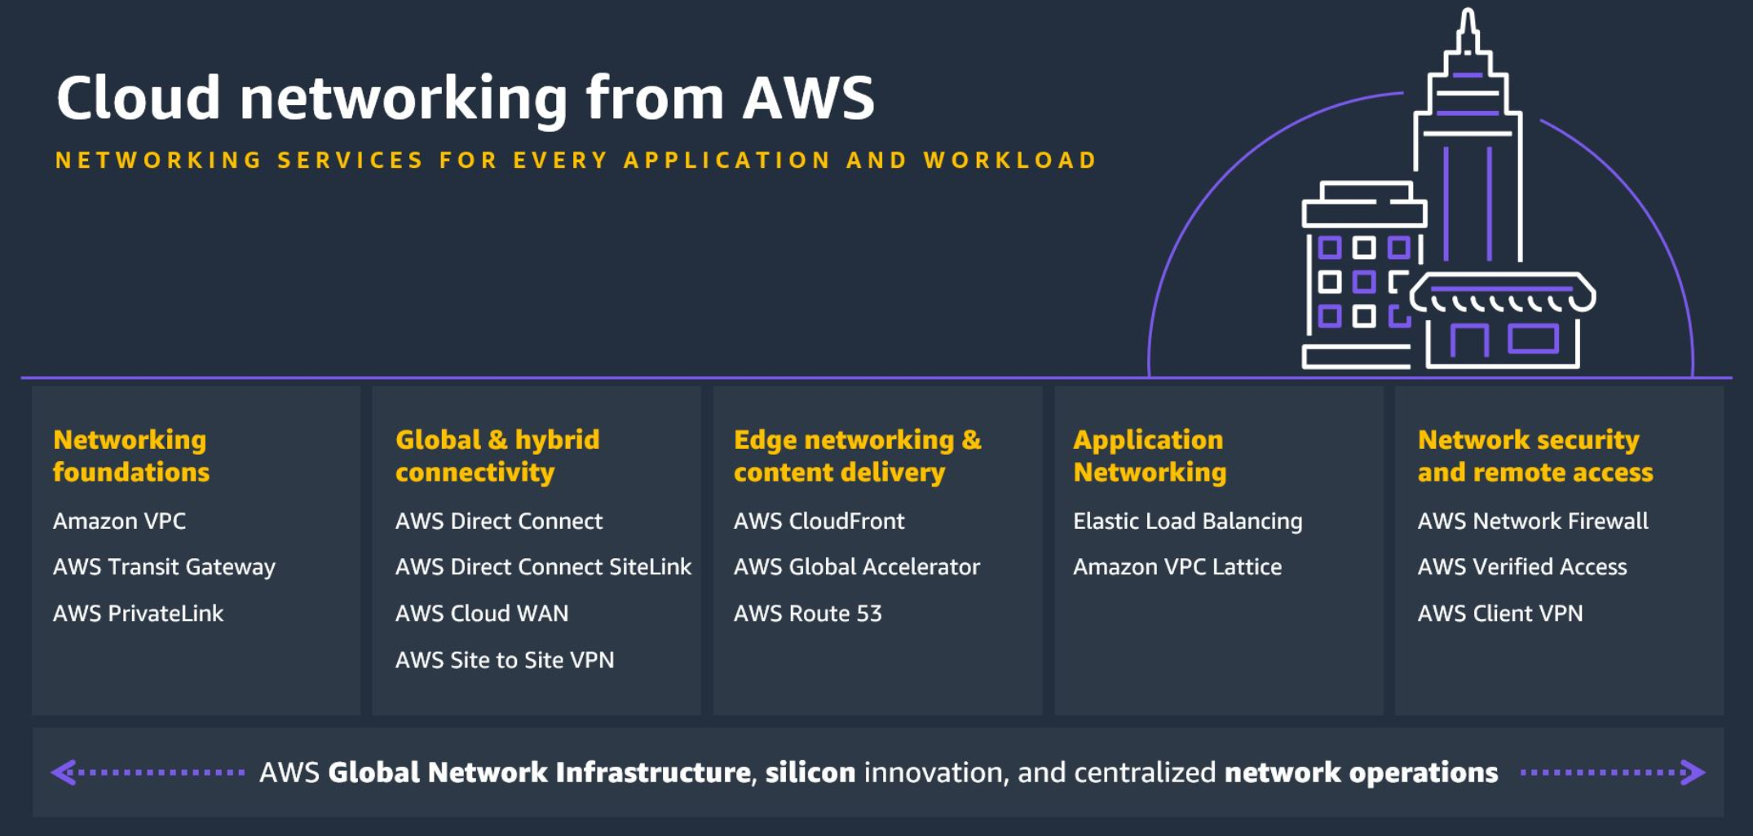
AWS Networking and Content Delivery

Slide 26
AWS Networking and Content Delivery
Key AWS Networking and Content Delivery Components
Amazon Route 53: A highly available Domain Name System (DNS) web service that translates domain names into IP addresses and directs end-user requests to AWS or external resources. Advanced routing options like latency-based and geo DNS help optimize user access.
Elastic Load Balancing (ELB): Distributes incoming application or network traffic across multiple targets (e.g., EC2 instances), automatically scaling in response to demand and improving application resilience.
AWS Global Accelerator: Uses AWS’s global network to optimize the path and availability of internet traffic to distributed applications, improving performance for users worldwide.
Amazon CloudFront: AWS’s global Content Delivery Network (CDN) service that delivers websites, APIs, video, and other content to users with low latency by caching data at hundreds of edge locations around the world. It integrates with security services like AWS Shield and WAF.
AWS App Mesh and Cloud Map: Provide service discovery and mesh networking for microservices-based architectures for improved monitoring and traffic control.

Slide 27
AWS Networking and Content Delivery
How AWS Networking and Content Delivery Work
Network Foundations: Start with an Amazon VPC—your private, isolated cloud network. You can extend it using Transit Gateway, Direct Connect, VPN, and PrivateLink, tailoring connectivity to your hybrid cloud needs.
Traffic Routing and Management: Use Route 53 for domain management and advanced routing. Leverage Elastic Load Balancing to distribute workloads and optimize utilization.
Global Performance and Security: AWS Global Accelerator and CloudFront accelerate content delivery and application access globally, using AWS’s robust infrastructure for speed, security, and reliability.
Content Delivery: CloudFront caches your content at edge locations, serving users from the closest location to minimize latency and bandwidth costs. Dynamic content delivery is enhanced with intelligent routing and edge computing capabilities.

Slide 28
AWS Networking and Content Delivery
Benefits
Security: End-to-end encryption, access control, firewalls, and monitoring ensure data confidentiality and integrity.
Scalability: Services automatically adjust capacity and routing in response to changing traffic and application needs.
Performance: Globally distributed networks and edge locations reduce latency and improve load times for users anywhere in the world.
Reliability: Multi-region infrastructure and advanced routing protect against outages and ensure high availability.

Slide 29
AWS Networking and Content Delivery
Benefits
Security: End-to-end encryption, access control, firewalls, and monitoring ensure data confidentiality and integrity.
Scalability: Services automatically adjust capacity and routing in response to changing traffic and application needs.
Performance: Globally distributed networks and edge locations reduce latency and improve load times for users anywhere in the world.
Reliability: Multi-region infrastructure and advanced routing protect against outages and ensure high availability.

Slide 30
AWS Networking and Content Delivery
Real-Life Applications of AWS Networking and Content Delivery
Streaming Platforms (e.g., Hulu, Amazon Prime Video): These platforms use Amazon CloudFront, AWS’s content delivery network (CDN), to deliver video on demand to millions of viewers, ensuring high-quality live and on-demand streaming with minimal buffering and latency.
Global Game Delivery (e.g., King, Rovio, Supercell): Gaming companies distribute static and dynamic game assets using CloudFront, supporting millions of concurrent users and providing seamless gameplay across international markets.
Expedia: Uses AWS for robust, secure, and highly available infrastructure, ensuring customers receive consistently fast and uninterrupted booking experiences regardless of traffic spikes.
Novartis: Leveraging AWS networking and storage services, Novartis processes and stores large volumes of medical data securely, supports global research teams, and provides reliable digital health platforms for patients
Supply Chain Optimization: Businesses use AWS networking to track shipments in real time, analyze logistics data for route optimization, and ensure reliable worldwide connectivity

Slide 31
Amazon VPC (Virtual Private Cloud)
Introduction
Amazon VPC or Amazon Virtual Private Cloud is a service that allows its users to launch their virtual machines in a protected as well as isolated virtual environment defined by them. You have complete control over your VPC, from creation to customization and even deletion. It's applicable to organizations where the data is scattered and needs to be managed well. In other words, VPC enables us to select the virtual address of our private cloud and we can also define all the sub-constituents of the VPC like subnet, subnet mask, availability zone, etc on our own.
We can place the necessary resources and manage access to those resources in the VPC, a private area of Amazon that we control.
A default "VPC" will be generated when we register an AWS account, allowing us to manage the virtual networking environment, the IP address, the construction of subnets, route tables, and gateways.

Slide 32
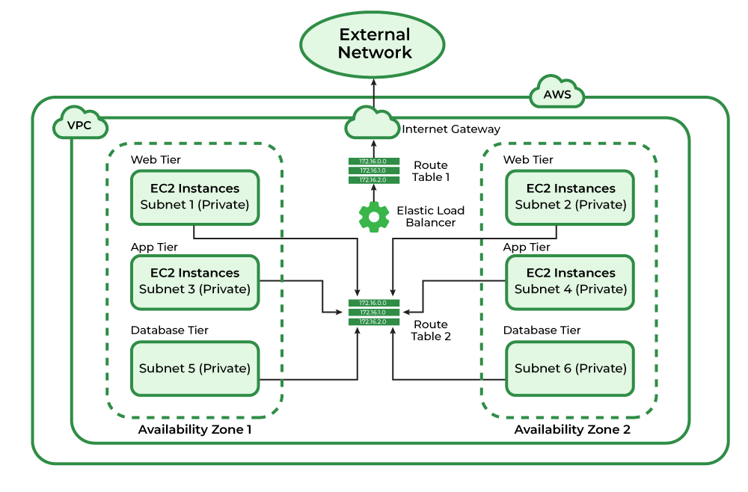
Amazon VPC (Virtual Private Cloud)
Amazon VPC (Virtual Private Cloud) Architecture
The basic architecture of a properly functioning VPC consists of many distinct services such as Gateway, Load Balancer, Subnets, etc. Altogether, these resources are clubbed under a VPC to create an isolated virtual environment. Along with these services, there are also security checks on multiple levels. It is initially divided into subnets, connected with each other via route tables along with a load balancer.

Slide 33
Amazon VPC (Virtual Private Cloud)
Amazon VPC (Virtual Private Cloud) Components
VPC: You can launch AWS resources into a defined virtual network using Amazon Virtual Private Cloud (Amazon VPC). With the advantages of utilizing the scalable infrastructure of AWS, this virtual network closely mimics a conventional network that you would operate in your own data center. /16 user-defined address space maximum (65,536 addresses)
Subnets: A subnet is a smaller portion of the network that typically includes all the machines in a certain area. We can add as many as subnets we need in one availability zone. Each subnet must reside entirely within one availability zone. The public subnets will be attached to Internet Gateway which enables Internet access. The private subnets will not have internet access. To reduce traffic, the subnet will divide the big network into smaller, connected networks. Up to /16, 200 user-defined subnets.
Route Tables: Route Table contains a set of rules, called route which helps us to route the network traffic. A single VPC can have as many as route tables it requires. They are mainly used to Define the protocol for traffic routing between the subnets.

Slide 34
Amazon VPC (Virtual Private Cloud)
Amazon VPC (Virtual Private Cloud) Components
Network Access Control Lists: NACL for VPC serve as a firewall by managing both inbound and outbound rules. There will be a default NACL for each VPC that cannot be deleted.
Internet Gateway(IGW): With the help of IGW (Internet Gateway), the resources present (e.g: EC2) in the VPC will enable to access the Internet. One VPC can't have more than one IGW. If resources are running in a certain VPC then IGW can not be detached from that particular VPC.
Network Address Translation (NAT): An internal host can communicate with an internet server with help of NAT. The internet and a private network are separated by a NAT device. As a whole It will enable the connection between the private subnet and the internet.

Slide 35
Amazon VPC (Virtual Private Cloud)
Amazon VPC Benefits
Advanced Security and Isolation: Provides logical network isolation, security groups, and network ACLs for precise inbound/outbound filtering at subnet and instance levels. Enables private connectivity to AWS services without exposing resources to the public internet.
Flexibility and Control: Customize your IP address range, networking topology, routing tables, and subnets to suit your workload requirements.
Seamless Scalability: Easily scale resources up or down, deploy across multiple availability zones, and take advantage of auto-scaling without hardware constraints.
Integrated Monitoring and Management: Use VPC flow logs for detailed visibility into traffic, Network Access Analyzer for compliance, and monitoring tools for infrastructure health.
Cost Savings: Eliminate the need for costly on-premises hardware, benefit from pay-as-you-go pricing, and automate routine network management tasks.
High Availability and Disaster Recovery: Design environments for fault tolerance using multi-AZ deployments, robust routing, and NAT gateways.
Easy Integration: Integrate seamlessly with AWS services (EC2, RDS, S3, Lambda) and third-party solutions, supporting diverse workloads within the same virtual network.

Slide 36
Amazon VPC (Virtual Private Cloud)
Use cases of Amazon VPC
Using VPC, you can host a public-facing website, a single-tier basic web application, or just a plain old website.
The connectivity between our web servers, application servers, and database can be limited by VPC with the help of VPC peering.
By managing the inbound and outbound connections, we can restrict the incoming and outcoming security of our application.

Slide 37
AWS VPC Peering
Introduction
Virtual Private Cloud Peering is known as VPC Peering. It is an AWS networking function that provides safe and direct communication between different VPCs. By using the VPC peering feature organizations can establish private connections that facilitate the secure and smooth transfer of resources and data across various VPCs in the AWS Cloud. By establishing communication between different environments and maintaining the integrity of each VPC environment setting, VPC peering makes network management easier.
In the AWS ecosystem, VPC peering is an essential service for creating scalable, networked infrastructure structures. Amazon peering provides an effective way of linking Virtual Private Clouds (VPCs) and offers strong networking capabilities inside AWS. In this Article, the complexities of VPC peering are addressed with an effective way of explanation. This article clarifies how to establish smooth communication across different cloud environments in AWS.

Slide 38
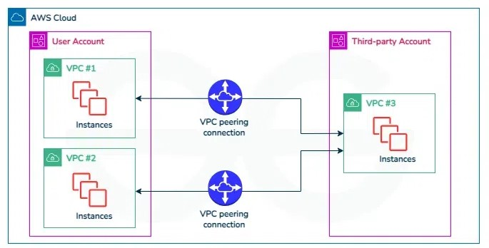
AWS VPC Peering
AWS VPC Peering Architecture
The following architecture diagram illustrates on usage of VPC peering connections to connect VPCs in your account with a VPC in the third-party account.

Slide 39
AWS VPC Peering
AWS VPC Peering Connection Lifecycle
The lifecycle of AWS VPC peering connection involves with serval key stages. Those are discuss as follow:
Initiation: The life cycle process starts with initating a request to peer two VPCs. This request involves with specifying the VPCs to be peered and their respective settings.
Approval: After the request is raised, the adminstrator of the receiving VPC have to accept that peering connection. This step involves both the parties to agress the connection establishment.
Establishment: One Both approved the peering connection, the VPC peering connection is established. This enables the communication between two VPCs, if they were within same network, i.e., allowing instances in one VPC to communicate with other VPC's instance using private IP address.
Configuration: After once, the connection is established, adminstrator may ensure configuring the route tables and security groups to control flow of the traffic between peered VPCs. This steps ensure the communication should be done in secured and follow with desired network paths.

Slide 40
AWS VPC Peering
AWS VPC Peering Connection Lifecycle
Utilization: With this peered connections, the resources within the peered VPCs can communicate with each other seamlessly. This provides various use cases such as data replication, resource sharing and application integration across multiple VPCs.
Monitoring And Maintenance: Adminstrators continuously monitor the performance and security of the VPC peering connection. They may also perform the maintenance tasks such as updating route tables or adjusting security group rules as needed to optimize the connection's performance and ensuring its reliability.
Termination ( Optional ): If need arises, the adminstrators can look for terminating the VPC peering connection. This effectively serves as the network link between the VPCs and prevents further communication between them.

Slide 41
AWS VPC Peering
Advantages of VPC Peering
The following are the advantages of VPC peering:
Seamless Communication: It helps in directing and securing the connection between the VPCs. It facilitates with this in sharing of resources and data transfers.
Cost Efficiency: On establishing the private network communication based VPC peering removes the need of expensive public internet data transport making cost efficiency.
Simplified Network Management: VPC peering simplifies the network architecture making it easier of network management and resolving complexities associated with traditional networking.
Resource Access: VPC peering provides the access to the resources in different VPCs enhancing the efficiency of organizations services across interconnected networks.

Slide 42
AWS VPC Peering
Pricing for a VPC Peering Connection
The following tabular format discusses the pricing details of VPC Peering:
Component | Description | Cost
VPC Peering Connection | It used for establishment of VPC Peering connection | $0.01 per GB
Data Transfer between VPCs | It used for transfering the data between VPCs | $0.02 per GB
NAT Gateway | If it is used for data transfer | Additional fee
Data Processing | If data processing has done in VPC | Variable (Charge varies based on many parameters)
Support | It used for provding support to VPC Connection | Variable (Charge varies based on many parameters)

