Slide 1
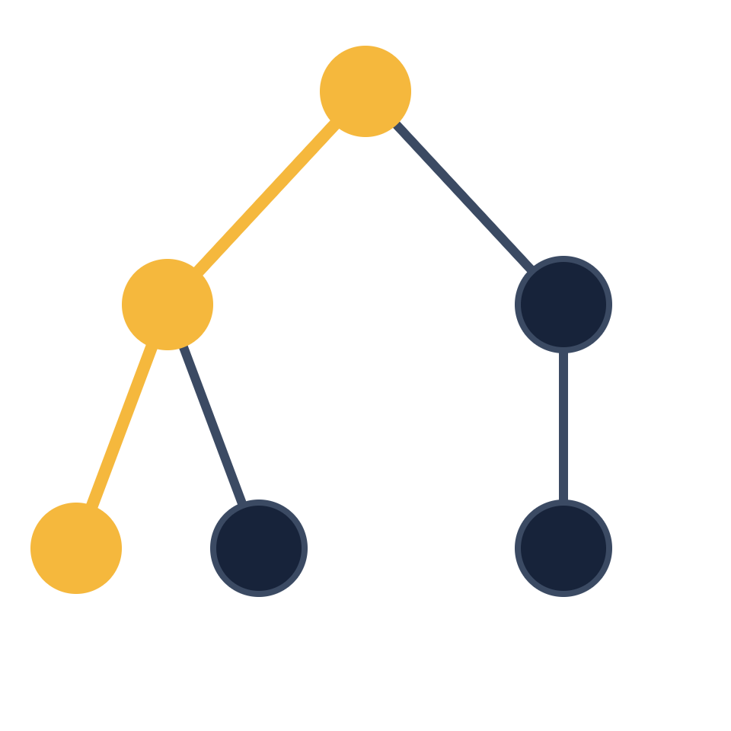
Depth First Search
Made with Claude
DATA STRUCTURES AND ALGORITHMS
Go deep first, backtrack when stuck.
A graph traversal algorithm
Notes:
Welcome. This deck introduces Depth First Search, usually shortened to DFS. It is one of the two core ways to walk through a graph or tree, and it shows up in interviews, compilers, puzzle solvers and many everyday programs.

Slide 2
What is DFS
Made with Claude
OVERVIEW
DFS explores a graph by following one path as far as it can, then backtracking to try the next one.
Uses a stack
Marks visited
Backtracks
Either the call stack through recursion, or an explicit stack you manage yourself.
Remembering seen nodes stops the search from looping forever in a cycle.
At a dead end it steps back to the last node that still has unexplored neighbors.
Depth First Search
2 / 10
Notes:
Define DFS in one sentence: pick a direction and keep going until you cannot, then back up and try another direction. Three ideas make it work: a stack to remember where you came from, a visited set so you never repeat yourself, and backtracking when you hit a dead end.

Slide 3
How it works
Made with Claude
ALGORITHM
1
2
3
4
Visit
Go deeper
Backtrack
Finish
Mark the current node as visited.
Move to an unvisited neighbor and repeat.
With no unvisited neighbors left, return to the previous node.
Stop once every reachable node has been visited.
Rule of thumb: always prefer going deeper before going wider.
Depth First Search
3 / 10
Notes:
Walk through the four steps slowly. Visit marks the node. Go deeper picks any unvisited neighbor and repeats. Backtrack happens when every neighbor is already visited. The search finishes when nothing reachable is left. The next slide shows this on a real graph.

Slide 4
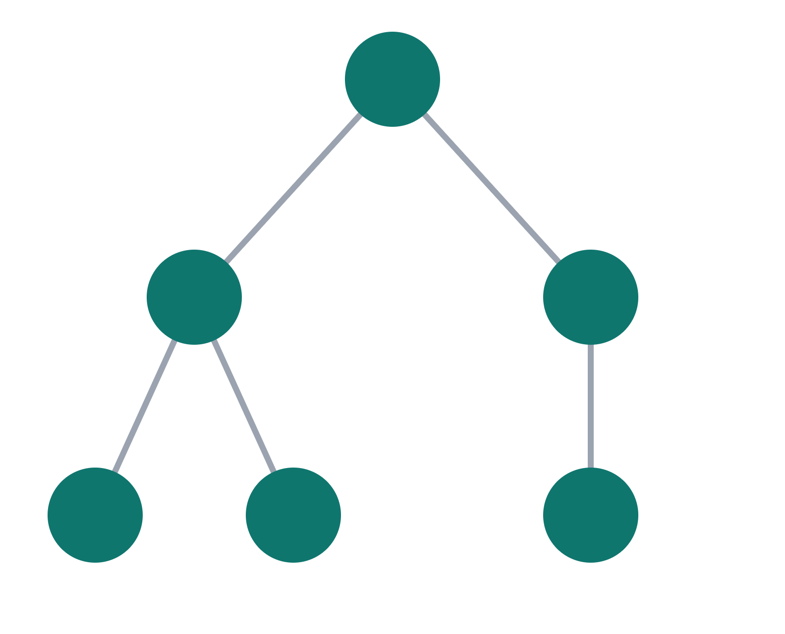
Traversal example
Made with Claude
WORKED EXAMPLE
1
A
Starting at A, DFS follows the left branch all the way down before it ever touches C.
2
5
VISIT ORDER
B
C
A → B → D → E → C → F
D and E are dead ends, so DFS backtracks to B, then to A, before it visits C and F.
3
4
6
D
E
F
Depth First Search
4 / 10
Notes:
Trace the numbered badges on the graph. Start at A, go to B, then D. D has no unvisited neighbors, so back up to B and visit E. E is also a dead end, so back up to B and then A, and finally go down the right side to C and F. This assumes neighbors are tried left to right.

Slide 5
Recursive implementation
Made with Claude
CODE
VISITED SET
def dfs(graph, node, visited=None):
Skips nodes already seen, so cycles never cause an infinite loop.
if visited is None:
visited = set()
visited.add(node)
CALL STACK
print(node)
Each call remembers where to resume once a deeper call returns.
for nb in graph[node]:
if nb not in visited:
dfs(graph, nb, visited)
return visited
Depth First Search
5 / 10
Notes:
This is the classic version. The function marks the node, prints it, then calls itself on every neighbor that has not been visited. There is no explicit base case: when all neighbors are visited the loop ends and the function returns, which is the backtracking step.

Slide 6
Iterative implementation
Made with Claude
CODE
EXPLICIT STACK
def dfs_iterative(graph, start):
Replaces the call stack, so deep graphs do not hit a recursion limit.
visited = set()
stack = [start]
while stack:
REVERSED
node = stack.pop()
Pushing neighbors in reverse keeps the same left-to-right visit order.
if node not in visited:
visited.add(node)
print(node)
for nb in reversed(graph[node]):
stack.append(nb)
Depth First Search
6 / 10
Notes:
The iterative version does the same job with a list used as a stack. Pop a node, skip it if it was already visited, otherwise mark it and push its neighbors. Python caps recursion depth at roughly a thousand calls by default, so this form is safer for very deep graphs.

Slide 7
Complexity
Made with Claude
ANALYSIS
TIME
SPACE
O(V + E)
O(V)
Every vertex and every edge is processed once.
The visited set plus the stack, which can reach V in the worst case.
V is the number of vertices and E is the number of edges.
Depth First Search
7 / 10
Notes:
Time is linear in the size of the graph: each vertex is visited once and each edge is examined once, giving O(V plus E). Space is O(V) in the worst case because of the visited set and the stack or recursion depth, for example on a long chain of nodes. With an adjacency matrix instead of adjacency lists the time becomes O(V squared).

Slide 8
DFS and BFS compared
Made with Claude
COMPARISON
Aspect | DFS | BFS
Data structure | Stack or recursion | Queue
Exploration | Deep first, then backtrack | Level by level
Shortest path | Not guaranteed | Guaranteed (unweighted)
Memory | Grows with path depth | Grows with frontier width
Best for | Cycles, ordering, mazes | Nearest nodes, short routes
Both run in O(V + E) time. The difference is the order of exploration.
Depth First Search
8 / 10
Notes:
BFS and DFS cost the same in time, so the choice is about what you need. If you want the fewest hops in an unweighted graph, use BFS. If you want to explore every possibility, detect cycles, or produce an ordering of dependencies, DFS is the natural fit.

Slide 9






Applications
Made with Claude
USE CASES
Path finding
Cycle detection
Topological sort
Find a route between two nodes, as in a maze.
Spot circular dependencies in graphs.
Order tasks so every dependency comes first.
Connected components
Web crawling
Backtracking puzzles
Group nodes that can reach one another.
Follow links deep into a site before moving on.
Solve Sudoku, N-Queens and similar puzzles.
Depth First Search
9 / 10
Notes:
DFS is a building block rather than an end in itself. Cycle detection and topological sorting rely on tracking the recursion path, which DFS gives for free. Backtracking puzzles such as Sudoku are really DFS over a tree of possible moves.

Slide 10
Key takeaways
Made with Claude
RECAP
1
Go deep first, then backtrack when stuck.
2
Keep a visited set so cycles never trap the search.
3
Runs in O(V + E) time using recursion or a stack.
Next step: practice DFS on trees, grids and adjacency lists.
Depth First Search
10 / 10
Notes:
Close with the three ideas to remember: go deep then backtrack, track what you have visited, and expect linear time. A good way to cement it is to implement DFS on a small grid or adjacency list yourself and trace the visit order by hand.

