Slide 1
TOP GAMES
inside the gaming industry
RED FOX
Team
Ian Lim
Rishi Sheth
Yann Chye
Michelle Hocking

Slide 2
Motivation - part 1
Examine trends in the gaming industry in the past 5 years
Is it saturated? Is it growing?
Are there more games being released over time?
Questions
Do number of games released differ by
year?
month?
Hypothesis
Number of games released increases from 2015 to 2019.
Justification - gaming industry is booming, more games being released over time
Number of games released will differ by month of the year.
Justification - more games may be released around holiday seasons/close to winter

Slide 3
Motivation - part 2
Find out what factors make certain games more popular/more highly rated
What time of year should it be released?
What platform should it be launched on?
Do game genre play a role?
Questions
Do game ratings differ by
The month of release?
The number of platform on which the game is released?
Further question - which platform has the most number of games? The most number of user rating?
The game’s genre?
Hypothesis
Games released during peak release period (per Aim 1) will be more highly rated.
Games that are released on more platforms will be more highly rated
Justification - The game will cater to a wider audience.
Game ratings will differ by genre.
Justification - Certain genre may be more well-received than others.

Slide 4
Presentation flow
Data sourcing and cleaning
Part 1 - Trends in game releases over time
Interesting association with years and months
Part 2 - What makes some games more highly rated than others
Spoiler alert - choose the right genre

Slide 5

DATA
Scope
Data limited to 5 years
(1/1/2015-31/12/2019)
All game data sourced from on RAWG database
https://rawg.io/apidocs

Slide 6
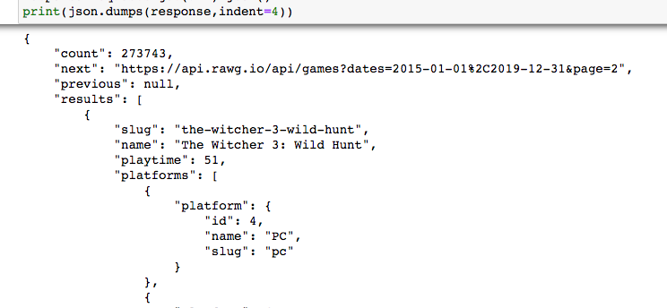
Data
Useful information for us
Name
Platforms (eg. PC, XBox etc.)
Date released
User rating
Metacritic score
Genres (eg. adventure, platformer etc.)
Example API call (looped over 500 pages)

Slide 7
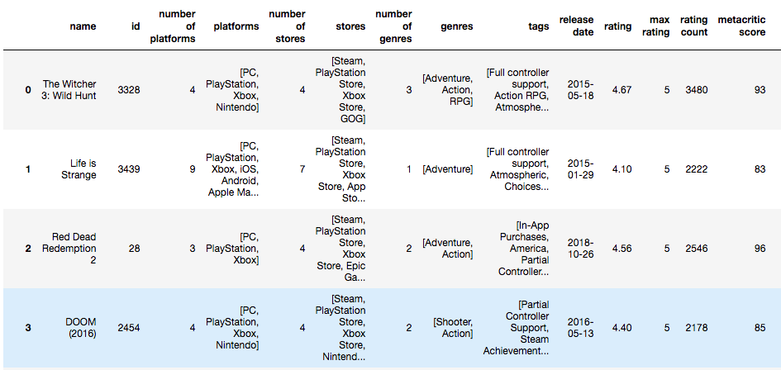
Data
Created a single dataframe of games meeting the following criteria:
Available on at least 1 store
Available on at least 1 platform
Have at least 1 rating
Have at least 1 metacritic score

Slide 8
Data cleanup
Data conversions
Dates and numbers stored as strings
ratings and metacritic values to floats
Release date to date value using pd.to_datetime
Missing variables required for analysis
Year - extracted from the release date using df.dt.year
Month - extracted from the release date using df.dt.month
Users - RAWG database user summary for each game was stored in categories of -
Yet
Owned
Beaten
To Play
Dropped
Playing
Total number of users extracted as number of users who ‘owned’ + ‘playing’ + ‘beaten’ the game

Slide 9
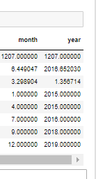
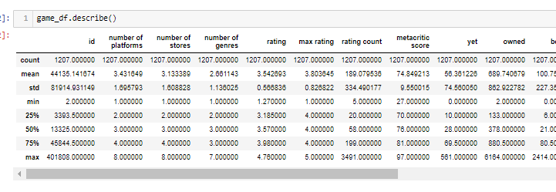
DESCRIPTIVES

Slide 10
DESCRIPTIVES
Some key takeouts
The Metacritic score dataset has high variability. The mean and median being close together however indicates the dataset has to be a relatively symmetrical distribution
The rating has measures of variability of relative magnitude although slightly higher proportionally (slightly more variable)
The month series data is skewed to the right and shows slightly more games have been released in the later half of the year
Similarly for year of release distribution, mean and median centered around 2016 indicates more games released in the early years 2015-2016, than in the remaining years 2017-2019

Slide 11
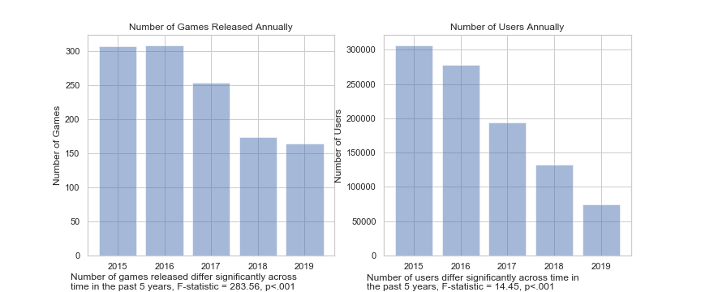
Part 1 Trends in game released over time
Number of game releases and users are both in declining, with a more rapid drop off in users

Slide 12
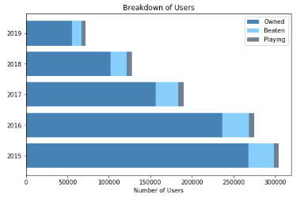
Part 1 Trends in game released over time
Drilling down - falling user numbers are primarily driven by a significant reduction in overall people owning the game
Limitation!
User categories included Yet, To Play, Owned, Beaten, Playing and Dropped. Due to no specific definitions in the API documentation, users was assumed to Owned, Beaten and Playing

Slide 13
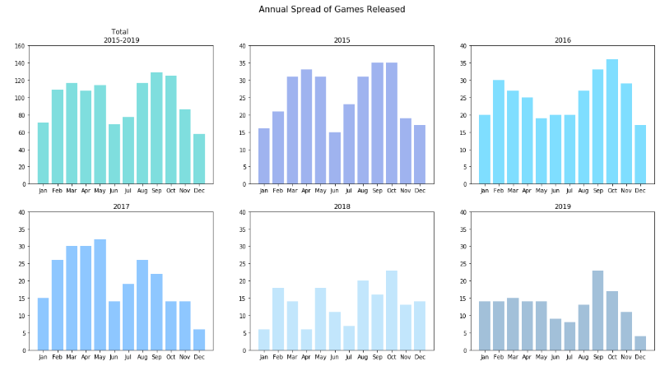
Part 1 Trends in game released over time
In terms of the trend across months, the number of games released generally drops off in the middle of the year (June/July) and spikes September/October. In the most recent years, whilst the number of games released has dropped has changed the shape of the in the 1st 6 months (ie it has flattened) these observations can still be seen

Slide 14
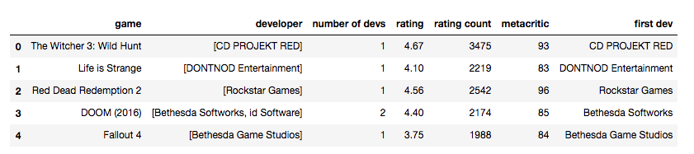
Part 1 Post Hoc exploration
We think this is due to the seasonal cycle in the northern hemisphere, with not many people huddled at home playing games in summer and more people being indoors around winter/holiday times such as Thanksgiving. The gaming industry might be catering to an increase in gaming interest around that time.
One assumption here that can be tested - game developers mainly reside in the northern hemisphere (therefore catering to the seasons of the northern hemisphere)
Therefore we extend the dataset ( another bunch of API calls) to add the developers of the games we have

Slide 15
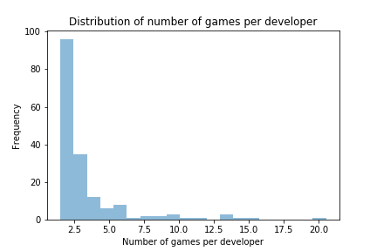
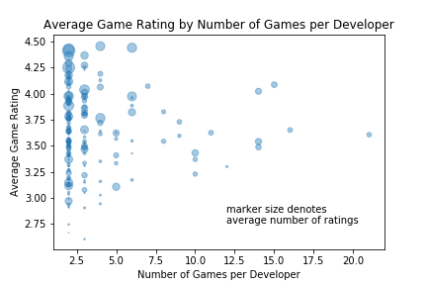
Part 1 Post Hoc exploration
Preliminary clean up
Most games have multiple developers, so we take the first developer (*assuming* they are the main developer)
Looking at the average number of games released by developers, most developers only released a few games
We do some exploratory data visualisations to see whether more prolific developers have more highly rated games
Does not look like it … so revert to main story

Slide 16
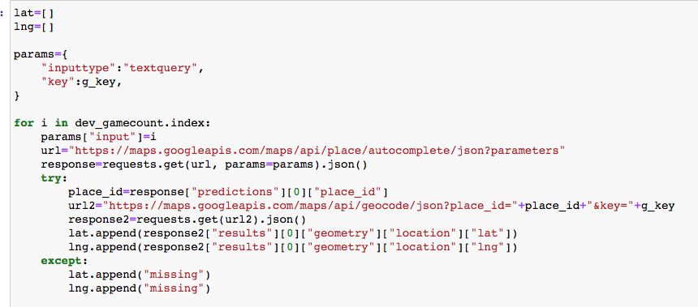
Part 1 Post Hoc exploration
Next step - Using google maps api autocomplete function, get the latitude and longitude of each developer’s office
After that, drop all missing developers/google maps can’t find a match/location
Limitation!
Autocomplete function tries to match the string (ie. the developer’s name) as best as it can to do the location search. Relying entirely on google’s amazing-ness

Slide 17
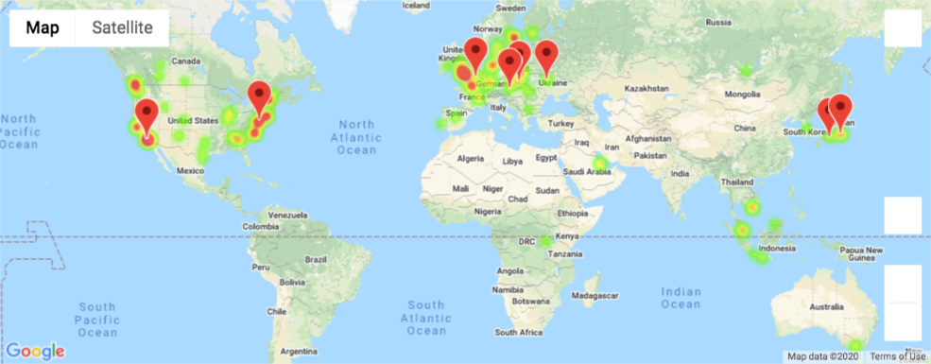
Part 1 Post Hoc exploration
Decide we only want to look at developers who have released at least 2 games in the past 5 years, assuming they are ‘serious’ developers
Plotted them on google maps as a heatmap, weighted by average ratings of each developer’s games
Here also showing the top 10 developers based on highest average game rating
As suspected, a large number of developers reside in the northern hemisphere - USA, Europe, Japan

Slide 18
Part 2 Factors affecting game rating
Second part of our story, knowing now that new game releases may likely be dwindling (market saturation?) and seem to be dominated by USA/Europe/Japan, we want to further find out what factors might make a game better received/standout
We have three factors we want to examine
Timing of release
Gaming platforms
Game Genres

Slide 19
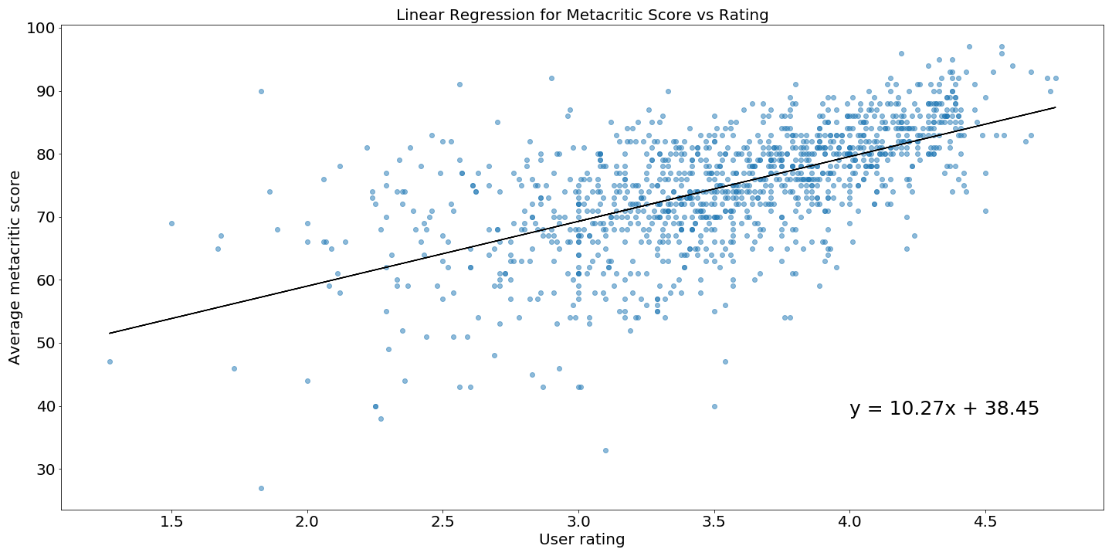
USER rating vs. Metacritic score?
Dataset has 2 measures of rating
Users’ rating
Metacritic score (i.e. critics)
Our initial thoughts were to use the users’ rating for our analysis however we needed to be sure that this was not too different to the metacritic score and that the measures were largely interchangeable when talking about popularity
Findings
Users’ rating and metacritic score are strongly correlated
Correlation coefficient is 0.61
Higher user rating is associated with higher metacritic score
Based on this we chose the users’ rating to define ‘popular’

Slide 20
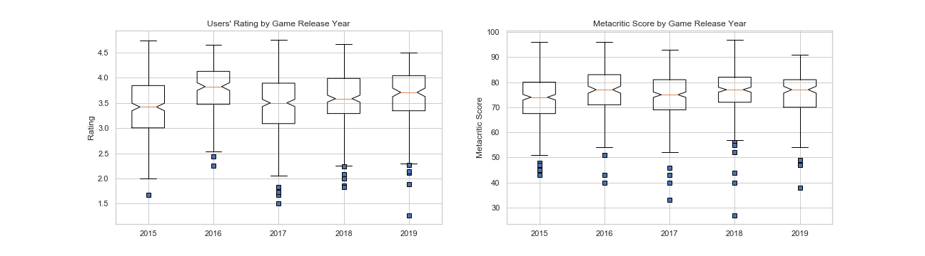

USER rating vs. Metacritic score?
Looking at ratings another way, it’s also clear that the medians in both datasets across all years show there aren’t significant skews in either popularity measure

Slide 21
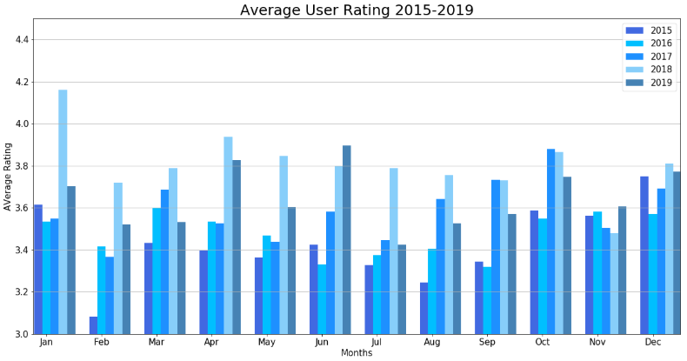
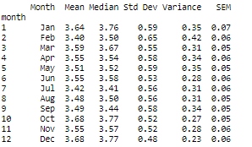
Part 2 Timing of Release
Games released in the last few months of the year tend to rate higher than in earlier months. Statistically, the mean is closer to the median and the spread in the ratings is smaller

Slide 22
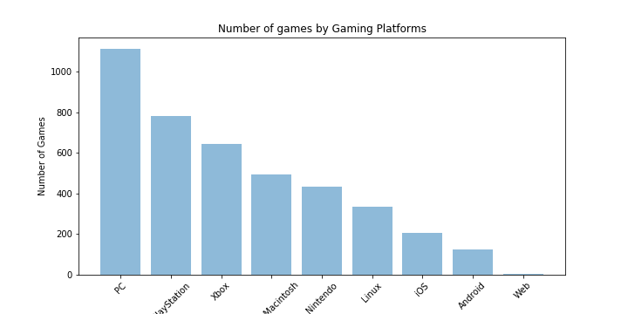
Part 2 Gaming Platforms
Observations:
PC is the most popular platforms with the most number of games, followed by PlayStation and Xbox

Slide 23
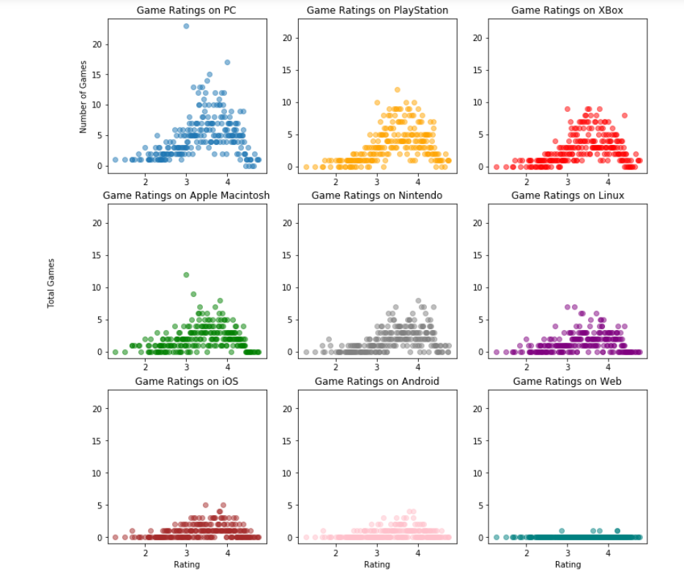
Part 2 Gaming Platforms
Most popular platforms:
PC, Xbox and Playstation
More highly rated games

Slide 24
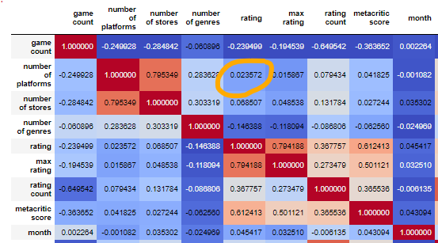
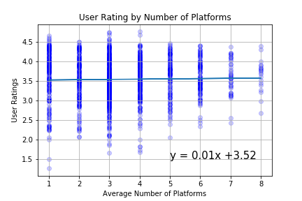
Part 2 Gaming Platforms
Performed tests to find if the popularity of games will increase by hosting on more platforms
Observations:
Weak correlation between ratings & no. of platforms
Popularity of games not affected by no. of platforms hosted
high correlation between number of stores and number of platforms (to be expected). Also to be expected is the strong correlation between metacritic score and rating

Slide 25
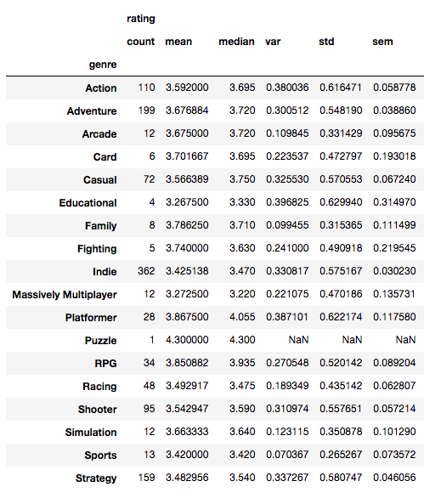
Part 2 Game Genres
Once again, each game may span multiple genres. We shall only look at the first listed genre of each game, *assume*ing that it is the game’s main genre
Our summary suggest that there are MANY genres. We decide to only look into the genres that have at least 100 games in the past 5 years. This narrows it down to 4 genres
Action
Adventure
Indie
Strategy

Slide 26
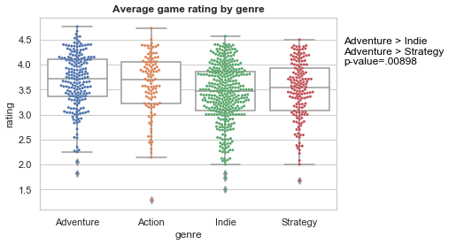
Part 2 Game Genres
Ran an ANOVA - there was a statistically significant difference in game rating by genre
So we followed up with multiple t-tests across all (6) comparison pairs
With p-value < (0.05/6) considered significant
We found that
Adventure > Indie
Adventure > Strategy

Slide 27
SUMMARY
High correlation between user rating and the metacritic score
Number of game releases and users declining in past 5 years
Monthly variation in game release - spike in release around Oct-Jan
Developers clustered along the coast of US, Europe, and Japan (Northern hemisphere)
Game ratings affected by
Timing of release
Game genre
PC is the most popular gaming platform
Popular games are driven by user ratings on platforms

Slide 28

POST-Mortem
@#$%& GitHub and branches
Difficulty defining game popularity
- rating? Rating count? User count?
Additional thoughts
Is decline in game releases due to real effect? Or is it due to the website being less used as time goes by? More time - validate across different game stores/game developer sites to match/corroborate number of games etc.

Slide 29



QUESTIONS?

