Slide 1
CSE7301 - INTERNSHIP Final Review Presentation WEB DEVELOPMENT
Student Details
Name | Rishi Anand
Roll No | 20211CDV0032
Section | 08-CDV-01
Batch No. | SEC-37
Under the Supervision of,
Ms. Meena Kumari K.S
Assistant Professor
School of Computer Science & Engineering
Presidency University
Name of the Program: B.Tech
Name of the HoD: Dr. S Pravinth Raja
Name of the Program Project Coordinator: Ms. Suma N G
Name of the School Internship/Project Coordinators: Dr. Sampath A K

Slide 2
Content
About Company or Organization
Working domain or the technology
About your team and reporting Manager
Internship Certificate
Introduction
Literature Review
Research Gaps identified
Proposed System
Objectives
System design and implementation
Timeline of the Internship
Expected Outcomes
Conclusion
References
Github Link

Slide 3

About Company or Organization
UptoSkills, with a stellar 4.8 ⭐ Google rating from 3.7k reviews, is a leading tech-enabled platform connecting 100k Colleges, 100Mn candidates and 1.5Mn corporates.
For Candidates:
We empower candidates by providing access to internships, job opportunities, an AI-driven job matching system, and comprehensive employability assessments. Our national-level hackathons and competitions are designed to enhance skills and competitiveness, ensuring candidates are well-prepared for the job market.
For Colleges:
UptoSkills supports faculties by offering access to national-level faculty development programs, AI-driven proctoring software, and comprehensive employability assessments. We also establish MOUs with colleges to enhance their branding and visibility across the nation.

Slide 4
Working domain or the technology – Web Development
Web development refers to the process of building and maintaining websites. It involves both front-end (user interface) and back-end (server-side) development.
Key Technologies:
HTML – Structure of web pages
CSS – Styling and layout
JavaScript – Interactive elements
Back-end Languages – Python, PHP, Node.js
Databases – MySQL, MongoDB

Slide 5
About your team and reporting Manager
My reporting manager is Mr. Shivam Agarwal who is a trainer in UptoSkills.
Single team that consists of 20-25 members led by a Team Lead.
The team has 2 sub-teams that deal with frontend and backend.
I belong to the backend sub-team.
The HRMS generates an offer letter automatically. The backend part of that process is handled by my team.

Slide 6
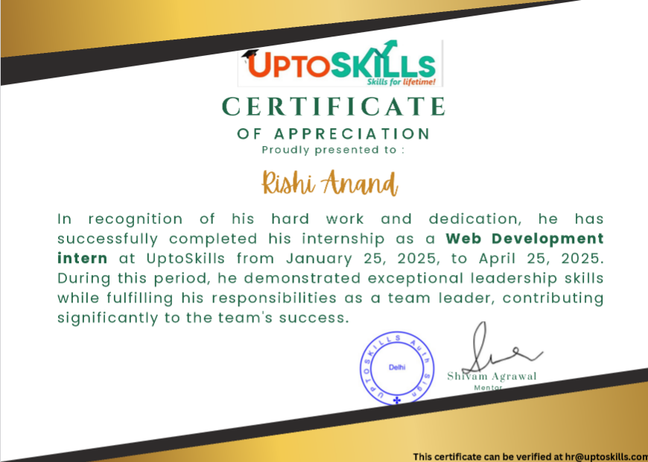
Internship Certificate

Slide 7
Introduction
This internship provided hands-on experience in full-stack web development, focusing on both frontend replication and backend implementation.
It was conducted under the guidance of Uptoskills, a tech learning platform dedicated to bridging academic knowledge and industry demands.
Technologies Used:
Frontend: HTML, CSS, JavaScript
Backend: Node.js, Express.js
Templating: EJS
Tools: Nodemailer, Git/GitHub

Slide 8
Introduction
Main Tasks Covered:
Website Replication:
Recreated the homepage of the Uptoskills platform to improve HTML/CSS proficiency.
Form Handling with Email Integration:
Developed a backend for a form that sends submitted details to a specified email using Nodemailer.
Blog Website Project:
Built a dynamic blog using EJS and Express.js with features like post creation, editing, and deletion (CRUD operations).
Goal: To enhance real-world development skills, understand web app workflows, and strengthen full-stack development fundamentals.

Slide 9
Literature Review
Sl No | Title | Description | Advantages | Limitations
1. | HRMS, Adarsh A N1 and Dr. T. Mahalakshmi Student, IV Semester MCA1Professor and Principal, Department of Computer Applications, Sree Narayana Institute of Technology, Kollam, Kerala, India | The Human Resource Management System (HRMS) is a web-based platform designed to streamline and automate HR processes in software companies. It facilitates employee management, attendance tracking, project progress monitoring, payroll generation, and job applications. | Improved HR Efficiency Enhanced Employee Management Centralized Data Handling Better Recruitment Process User-Friendly Interface Scalability | Initial Implementation Cost Data Security Risks. Technical Maintenance Required Internet Dependency
2. | An Implementation of Human Resource Management System (HRMS), Article in International Journal of Advanced Scientific Research & Development (IJASRD) · January 2018 | The document appears to be a research paper from IJSRD, discussing a specific technology, methodology, or innovation in a technical field. It includes an abstract, methodology, results, and conclusions, focusing on a particular problem and its solution. | Efficiency Cost-effectiveness Innovation Scalability Environmental Impact | Complexity Practical Constraints Cost of Implementation: Dependency on Specific Conditions Future Improvements Needed
3. | HRMS: IS THE ROLE CHANGING FROM BEING ADMINISTRATIVE TOSTRATEGIC? Goldy Mahajan, Prof.Versha Mehta, International Journal of Computers & Technology, Volume 3, No. 1, AUG, 2012. | The document explores the evolving role of Human Resource Management Systems (HRMS) from being primarily administrative to a more strategic function. It discusses how HRMS is integrating with advanced technologies to enhance decision-making, workforce management, and overall business performance. | Automation of Administrative Data-Driven Decision Making Improved Employee Experience Strategic HR Alignment Regulatory Compliance | Implementation Costs Data Security Risks Resistance to Change Dependence on Technology Customization Challenges

Slide 10
Literature Review
Sl No | Title | Description | Advantages | Limitations
4. | A Study on the Role of HRMS in Talent Management and Retention in Current Context, Mr. Cherian Xavier, International Journal of Research Publication and Reviews, Vol 5, no 6, pp 2541-2548 June 2024 | The research paper explores the role of Human Resource Management Systems (HRMS) in talent management and employee retention. It examines how HRMS enhances talent identification, development, and retention through automation, advanced data analytics, and AI-driven decision-making. | Automates Talent Management Enhances Decision-Making Improves Employee Engagement Reduces Administrative Burden Ensures Compliance | High Implementation Costs Data Privacy Concerns Resistance to Change Dependence on System Accuracy
5. | Impact of Implementing ERP in HRMS in Diversified Organization (Conglomerate), M. Bithalis Raja*, and R. Gayatri, I J C T A, 9(5), 2016, pp. 2103-2109 | It explores how ERP systems impact HR management in large organizations, focusing on factors like data accuracy, employee satisfaction, decision-making, and training. Key findings include a strong correlation between training and ERP accuracy, the necessity of expert users, and the advantages of cloud computing and SaaS in HR management. | Improved Data Accuracy & Reliability Better Decision-Making Enhanced Employee Satisfaction Automation of HR Processes | High Implementation Cost Complexity in Usage Training Dependency Time-Consuming Implementation
6. | Success Factors for the Global Implementation of ERP / HRMS Software, University of Nebraska at Omaha | The implementation of Enterprise Resource Planning (ERP) in HRMS helps organizations streamline HR functions, improve data accuracy, and support decision-making. However, it also comes with challenges such as high costs, resistance to change, and integration issues. | Improved Data Accuracy & Reliability Better Decision-Making Automation of HR Functions Employee Satisfaction & Flexibility Integration Across Departments | High Implementation Cost Complexity in Usage Resistance to Change Time-Consuming Deployment

Slide 11
Literature Review
Sl No | Title | Description | Advantages | Limitations
7. | A REVIEW OF AUTOMATION TECHNOLOGY, International Journal of Engineering Sciences & Emerging Technologies, Oct. 2023. | The paper "A Review of Automation Technology" explores advancements in automation, covering industrial automation, smart grids, cybersecurity, and robotics. It highlights how automation improves efficiency, reduces human error, and enhances productivity while also discussing challenges like high costs and job displacement | Increases Efficiency Improves Accuracy Cost Savings in the Long Run Enhances Safety | High Initial Cost Job Displacement Security Risks Complexity in Integration
8. | Artificial Intelligence and Automation in Human Resource Development: A Systematic Review, Human Resource Development Review 2024, Vol. 23(2) 199–229 | The paper "Artificial Intelligence and Automation in Human Resource Development: A Systematic Review" explores the impact of AI and automation on HR development (HRD). It highlights both the benefits and challenges these technologies bring to HRD, including efficiency improvements, workforce upskilling, and ethical concerns such as job displacement and privacy risks. | Increases Efficiency Enhances Decision-Making Improves Talent Development Employee Satisfaction | High Implementation Cost Job Displacement Security and Privacy Risks Bias in AI Algorithms
9. | Study of benefits of HR automation in organisations, International Journal of Academic Research and Development. | The study "Study of Benefits of HR Automation in Organizations" explores how automation in Human Resources (HR) improves efficiency, decision-making, and employee satisfaction. It highlights the advantages of HR automation while acknowledging challenges like employee resistance and integration issues. | Increases Efficiency Improves Decision-Making Enhances Employee Satisfaction Reduces Processing Time. | High Initial Cost Resistance to Change Data Security Risks Reduces Human Interaction

Slide 12
RESEARCH GAPS IDENTIFIED
1. Lack of Integration Between Frontend and Backend in Basic Learning Projects
Many training programs and tutorials treat frontend and backend separately, lacking real-world scenarios where they must work together. This leads to confusion when implementing full-stack features like form submissions or dynamic content rendering.
2. Limited Exposure to Real-time Functional Features
Tasks like sending emails, implementing authentication, or using templating engines are often skipped or simulated. As a result, learners miss out on understanding asynchronous operations and real-world API integrations.
3. Inadequate Focus on Code Reusability and Scalability
Beginner projects often focus only on functionality, not structure or maintainability.
There's a gap in learning modular design, middleware usage, and file structuring in Node.js applications.

Slide 13
RESEARCH GAPS IDENTIFIED
4. Minimal Hands-On Experience with CRUD Operations
While CRUD is a core concept in web development, its actual implementation in templating systems like EJS is rarely emphasized.
This project bridges that gap through dynamic blog post creation, editing, and deletion.
5. Absence of Deployment and Real-User Testing Scenarios
Most beginner-level internships do not touch on deployment or handling user interaction beyond local development.
Even though this internship focused on development, it laid groundwork for future production-ready workflows.

Slide 14
Proposed Method
To build and integrate user-interactive, full-stack web modules that replicate real-world functionalities using modern web technologies.
Modules of the Proposed System:
Website Interface Replication
Recreate the Uptoskills landing page.
Responsive and styled using HTML, CSS, and JavaScript.
Emphasis on layout accuracy and visual fidelity.
Form Submission with Email Notification
A form that collects candidate details.
Backend developed in Node.js + Express.js.
Sends confirmation/details to the specified email using Nodemailer.
Blog Website Project (CRUD Application)
Users can create, read, update, and delete blog posts.
Developed using Express.js with EJS templating engine.
Data dynamically rendered; user actions update UI in real time.

Slide 15
Proposed Method
Key Features:
Modular code structure for maintainability.
Middleware for parsing and handling requests.
RESTful routing and server-side rendering with EJS.
Secure form handling with validation.
Reusable components (layouts, partials) in EJS.
Tech Stack Used:
Frontend: HTML, CSS, JavaScript
Backend: Node.js, Express.js
Templating: EJS
Mailer Service: Nodemailer
Development Tools: Git, VS Code

Slide 16
Objectives
1. Consolidating Core Web Development Abilities
2. Getting Hands-on Experience in Backend Development
3. Using Full-Stack Development in a Real-World Project
4. Developing Problem-Solving and Debugging Skills
5. Enhancing Project Planning and Development Discipline
6. Exposure to Web Development Tools and Frameworks
7. Develop a disciplined approach to writing clean, maintainable code and following best practices.

Slide 17
SYSTEM DESIGN AND IMPLEMENTATION
A. Website Replication Module
Frontend-focused task using HTML, CSS, and JavaScript.
Emphasis on layout fidelity, responsiveness, and navigation bar replication.
No backend logic; purely static HTML/CSS-based UI development.
B. Backend Form Submission Module
Form built with HTML/CSS, connected to a backend via Express.js.
Upon form submission:
Data is validated.
Processed by the backend.
Email is triggered using Nodemailer with the submitted details.
Includes error handling for invalid inputs or mail failures.

Slide 18
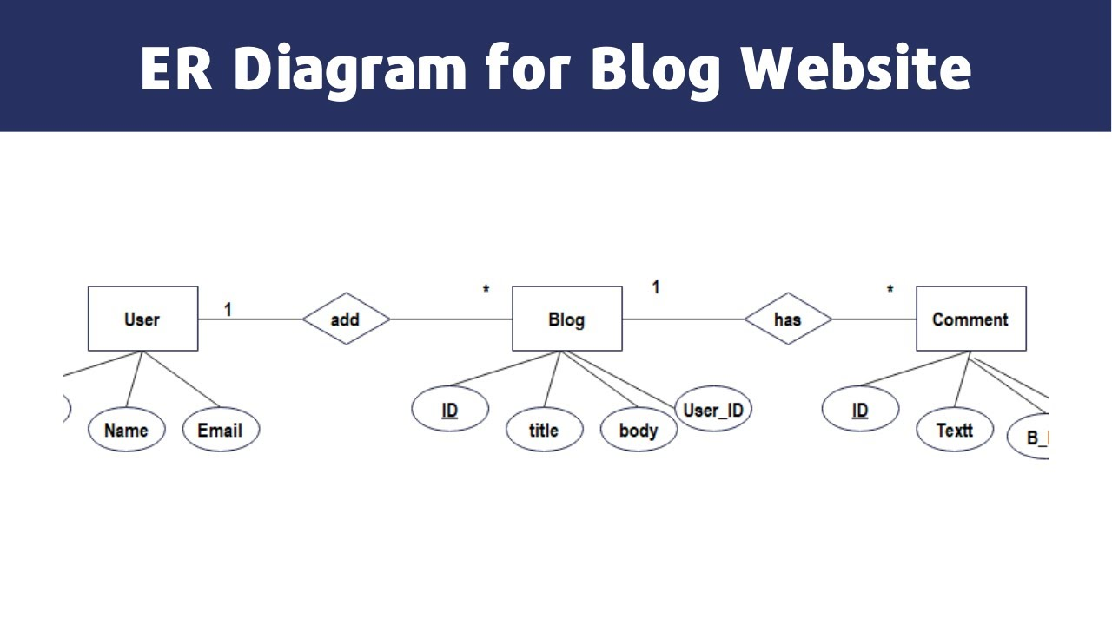
SYSTEM DESIGN AND IMPLEMENTATION

Slide 19
SYSTEM DESIGN AND IMPLEMENTATION
C. Blog Website (Full Stack CRUD App)
Built using:
Node.js & Express.js (server/backend)
EJS (templating engine)
HTML/CSS/JS (frontend styling and interactivity)
Features include:
Create Post
Read/View All Posts
Update Post
Delete Post
Routing is handled through RESTful architecture.

Slide 20
SYSTEM DESIGN AND IMPLEMENTATION
Tools & Technologies
HTML/CSS/JS: UI and styling
Node.js & Express.js: Server-side logic and API endpoints
EJS: Dynamic rendering of pages with injected content
Nodemailer: Email sending service configured with SMTP
Git/GitHub: Version control and repository management
Design Patterns
MVC (Model-View-Controller): Although no database is involved in the initial stages, the code is structured to allow easy migration to MVC.
Separation of Concerns: Code is modularized into routes, views, and logic handlers for maintainability.
Deployment (Optional/Future Scope)
Can be deployed to platforms like Render, Vercel, or Heroku.
MongoDB or another database can be integrated for persistent blog storage.

Slide 21
Timeline of Project

Slide 22
Expected Outcomes
Improved Front-End Development Skills
The website cloning exercise served to solidify core principles of HTML, CSS, and JavaScript.
2. Acquired Practical Backend Development Experience
Constructed a Node.js and Express.js server from ground up.
3. Built Full-Stack Application Skills
The blog site project enabled the combination of front-end and back-end skills into a functional web application.
4. Enhanced Debugging and Problem-Solving Abilities
Resolved server errors using terminal logs and custom error messages.
5. Development Tool Exposure and Best Practices
Used Git and GitHub for version control, learning how to commit changes, roll back, and keep track of code repositories.
6. Time and Task Management Skills
Divided each task into rational steps: planning, developing, testing, and reviewing.
7. Increased Confidence and Readiness for Future Projects
Consult open-source communities and official documentation when stuck.

Slide 23
Conclusion
The internship provided hands-on experience in modern web development practices using technologies like HTML, CSS, JavaScript, Node.js, Express.js, and EJS.
Successfully developed:
A replicated responsive website interface.
A functional backend form that sends email notifications.
A dynamic blog application with full CRUD operations.
Strengthened skills in:
Frontend and backend integration
Server-side rendering
Modular coding and real-world problem solving
The internship bridged the gap between theoretical learning and practical implementation, fostering industry-level development skills and readiness for professional roles in web development.

Slide 24
References
1. A Comprehensive Review of Web Designing and Web Development: Concepts, Practices and Trends, Elakiya K, International Journal of Research Publication and Reviews, Vol 4, No 4, April 2023
2. "Evaluating Web Frameworks: A Comparative Study for Selecting the Optimal Technology Based on Development Requirements" by Ayod Bhad (February 2025)
3. N. Teodoro and C. Serrão, "Web application security: Improving critical web-based applications quality through in-depth security analysis," International Conference on Information Society (i-Society 2011), London, UK, 2011, pp. 457-462, doi: 10.1109/i-Society18435.2011.5978496.
4. Responsive Web Design Techniques, Waseem I. Bader, Abdelaziz I. Hammouri, nternational Journal of Computer Applications (0975 – 8887) Volume 150 – No.2, September 2016
5. "Performance Optimization in Web Applications" by Prathyusha Kosuru, published in the European Journal of Advances in Engineering and Technology in 2019
6. “Exploring the Role of Progressive Web Applications in Modern Web Development” by Viskhan Magomadov, published in the Journal of Physics: Conference Series (2020)
7. Ara, J., Sik-Lanyi, C. & Kelemen, A. Accessibility engineering in web evaluation process: a systematic literature review. Univ Access Inf Soc 23, 653–686 (2024).

Slide 25
References
8. "Artificial Intelligence in Web Development: Enhancing Automation, Personalization, and Decision-Making" by Nitesh Upadhyaya, published in the International Journal of Advanced Research in Science, Communication and Technology in August 2024.
9. "Microservices Architecture: Accelerating Feature Development And Scalability Through Monolith Decomposition" by Kuciuk Artiom
10. Vayadande, Kuldeep. (2024). Development of Latest Technologies in Web Development: A Survey of Methods and Trends.

Slide 26
Github Link
https://github.com/Rishi100304/Internship

Slide 27
Thank You

