Slide 1
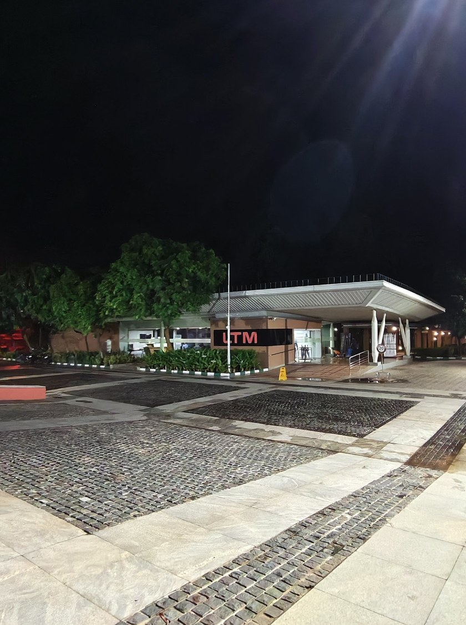
My Journey at LTM
LTIMindtree
Learning, building and growing at LTIMindtree
Ayush Jaiswal
Graduate Engineer Trainee | Java FS Batch

Slide 2
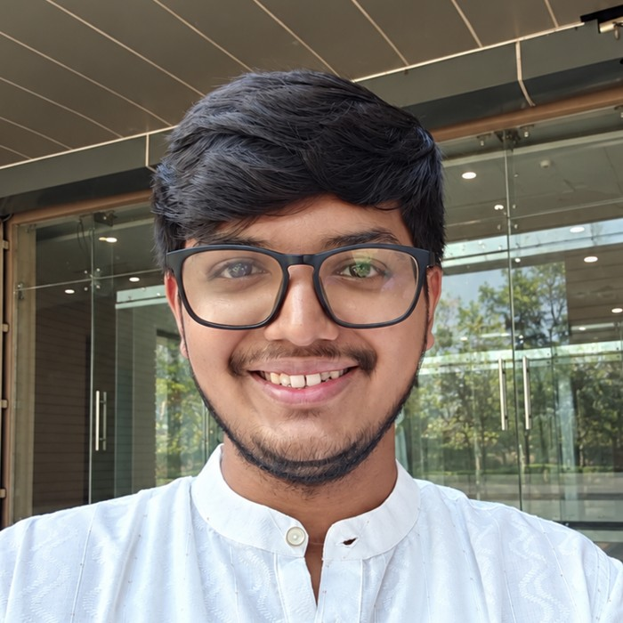



About Me
Who I am
Ayush Jaiswal, Graduate Engineer Trainee, Java FS Batch
Education
B.Tech, Institute of Technical Education and Research
Interests
Exploring hidden mysteries of the sea and space

Slide 3
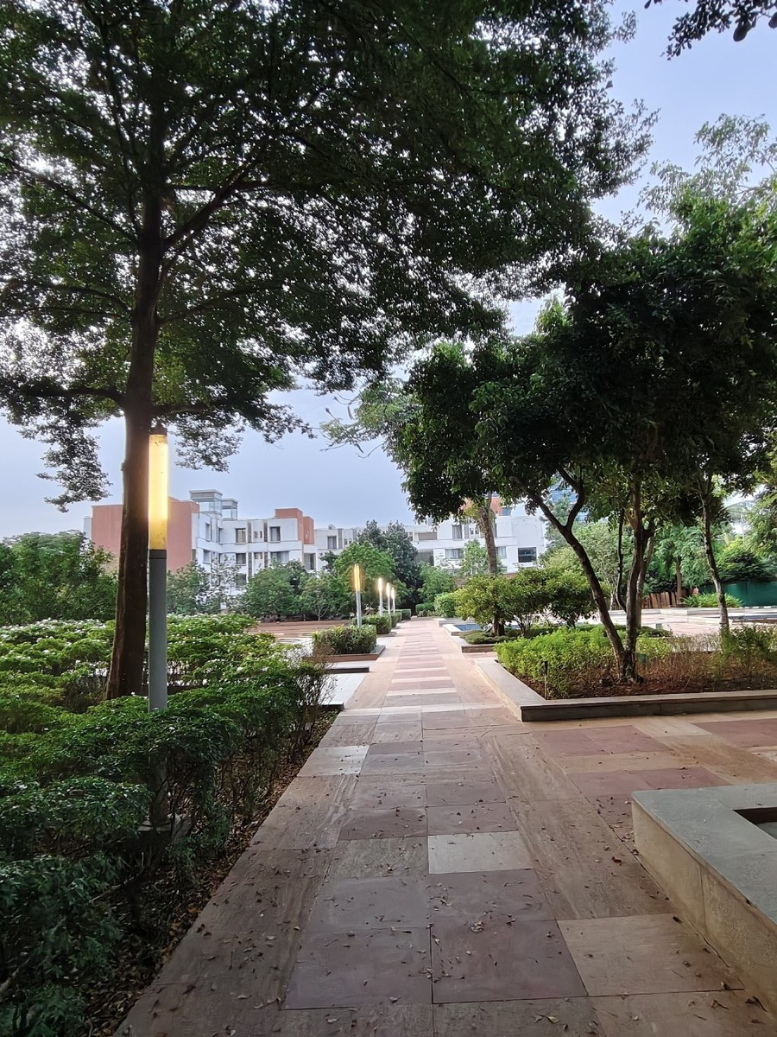



Joining LTM
Joining date
29 July 2026
Location
Kalinga Campus, Bhubaneswar
First impression
Peaceful greenery, away from the city's noise

Slide 4
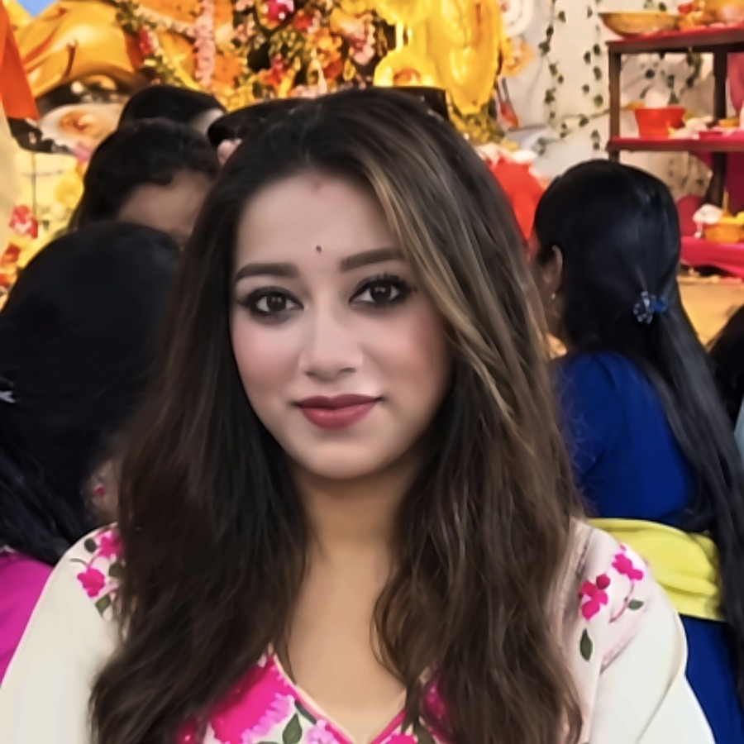
Training Roadmap
1
2
3
4
MONTH 1
MONTH 2
MONTH 3
FINAL 10 DAYS
Core Java
Spring Boot
Angular
Communication
A strong foundation in Java
Backend development
Frontend development
Training ends 28 Oct 2026
My Communication Trainer
3 months of training | 29 July to 28 October 2026

Slide 5


Skills I Picked Up
Technical
Soft skills
Core Java
Spring Boot (backend)
Angular (frontend)
SQL and Git
Gained confidence
Overcame fear of public speaking
Communication training
Teamwork on a 7-member project

Slide 6

Final Project: BookHeaven
BookHeaven
A book rental app, our final project
7
Built with
Angular and Spring Boot
team members

Slide 7
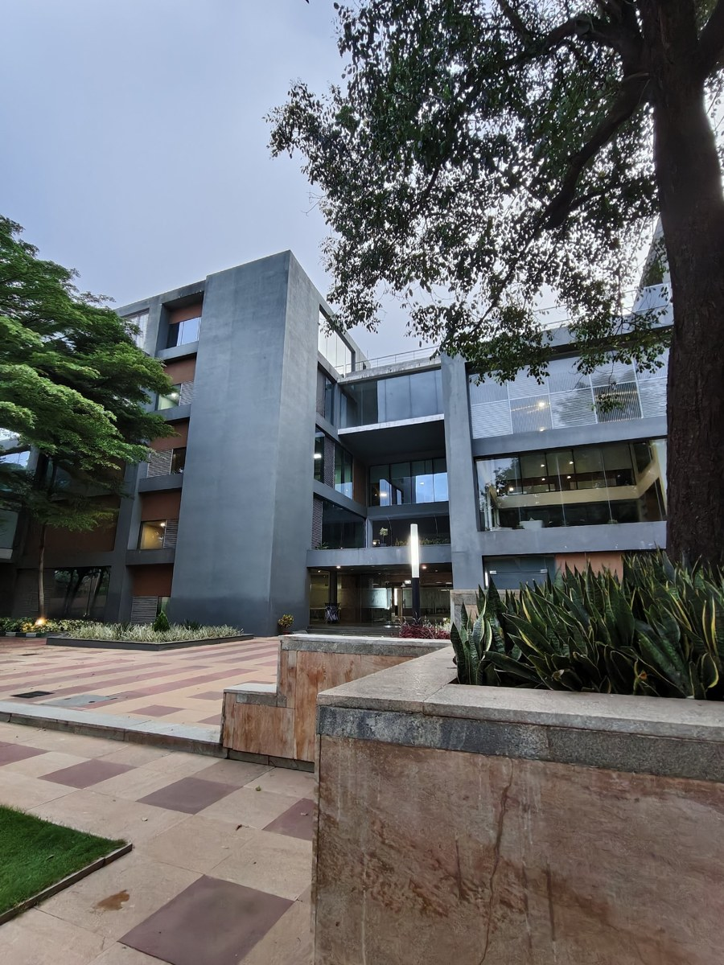



Moments and Growth
Memorable moments
Chats, laughs and little gossips with friends
How I've grown
More confident, with no fear of public speaking
What's next
Using my skills on real projects at LTM

Slide 8
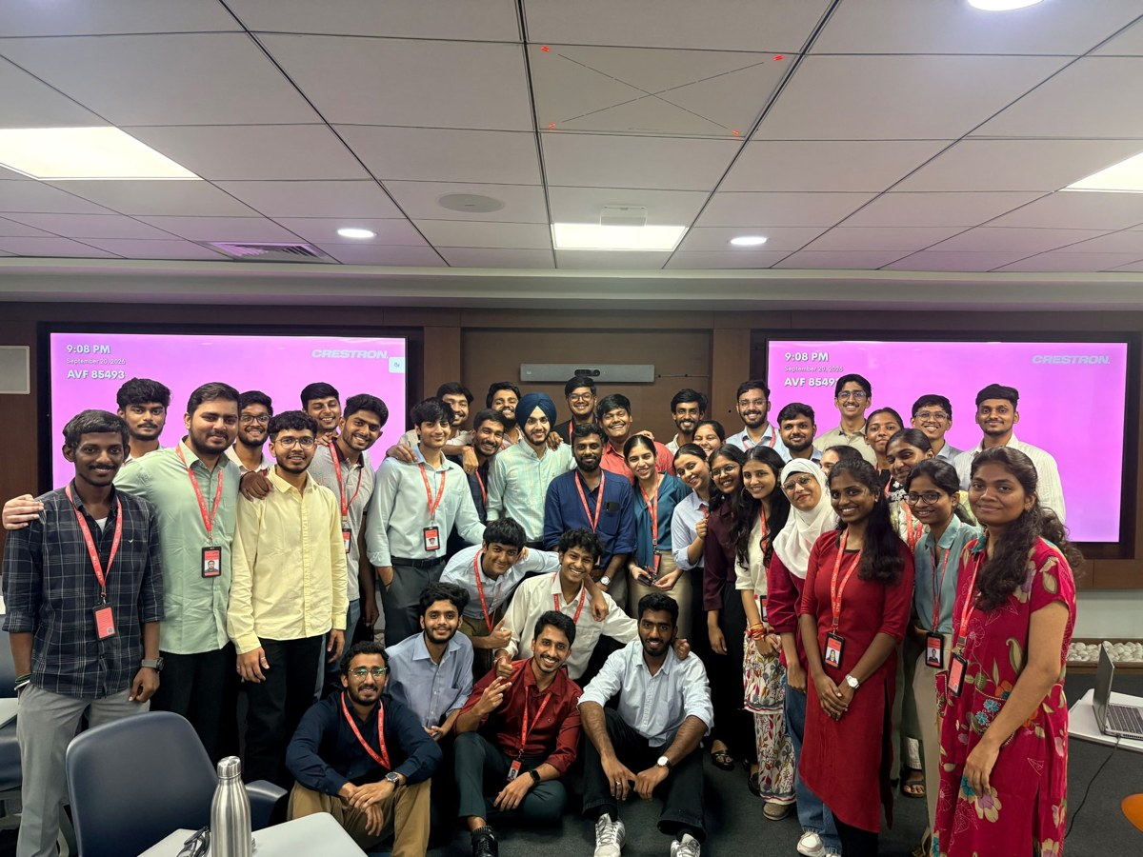
Thank You
To my trainers, Sainath Sir and Ayush Sir, and to my friends who made this journey a beautiful one.
Questions?
The friends who made this journey beautiful

