Slide 1
Design and Analysis of Algorithms
Dr. D. Sudha
Assistant professor
Department of CSE
Kakatiya Institute of Technology
Warangal, INDIA
(Ph : 2597371, Email : navi@iitk.ac.in)

Slide 2
Syllabus:
UNIT-I
Introduction: Algorithm analysis, Performance analysis, Space complexity and time complexity, Big „O‟
notation, Omega notation, Theta notation, Different mathematical approach‟s for solving time complexity of
algorithms
Sets and Disjoint Set Union: Introduction, Union, Find operations
Divide and Conquer: General method, Binary search, Merge sort, Quick sort, Strassen‟s matrix multiplication

Slide 3
UNIT-II
Greedy Method: General method, Knapsack problem, Job sequencing with deadlines, Optimal storage on
tapes, Optimal merge patterns, Single source shortest paths
Back Tracking: General method, N-Queens problem, Sum of subsets, Graph coloring problem.
UNIT-III (9)
Dynamic Programming: General method, Multistage graphs, All pairs shortest paths, Single source shortest
paths, Optimal binary search trees, String editing, 0/1 Knapsack problem, Reliability design problem,
Travelling sales person problem

Slide 4
UNIT-IV (9)
Branch and Bound: General method, Least cost (LC) search, The 15-puzzle problem, Control abstractions for
LC search, 0/1 Knapsack problem, Travelling sales person problem
NP Hard and NP Complete Problems: Basic concepts - Nondeterministic algorithms, The classes NP hard and
NP complete; COOK‟s theorem, NP hard graph problems - Clique decision problem, Node cover decision
problem, Traveling sales person decision problem

Slide 5
Text Book:
[1] E.Horowitz, S.Sahni, S.Rajasekaran, Fundamentals of Computer Algorithms, 2nd ed. Hyderabad: Universities
Press, 2018

Slide 6
Course Outcomes
CO1: apply divide and conquer strategy for searching and sorting techniques with
performance
CO2: analyze algorithms using greedy and backtracking methods
CO3: design of algorithms using dynamic programming approach
CO4: evaluate the classes P, NP ,NP-Hard and NP-Complete

Slide 7
Unit-I Chapter-1
Introduction,
Time complexity & Space Complexity; Asymptotic notations

Slide 8
Algorithm
Definition
An algorithm is a finite set of instructions that accomplishes a particular task.
All algorithms must satisfy the following criteria.
Criteria
1. Input
: Zero or more quantities are externally supplied.
: At least one quantity is produced.
Output
Definiteness : Each instruction is clear and
unambiguous.
Statements such as “add 6 or 7 to x”
or “Compute 5/0” are not permitted”

Slide 9
4. Finiteness
: The algorithm should terminate after a finite numbe r of steps.
5. Effectiveness : Instruction is basic enough to be
carried out.

Slide 10
Algorithm Vs Program:
A step-by-step logical procedure to solve a problem
Independent of any programming language
Focuses on logic and problem-solving strategy
Written using plain language, pseudocode, or flowcharts
Used for design and analysis (time & space complexity)
Implementation of an algorithm using a programming language
Language-dependent (C, C++, Python, Java, etc.)
Focuses on syntax and execution
Written using specific programming constructs
Used for actual execution on a computer

Slide 11
Anaysis of Algorithm:
Priori Analysis
- done before execution, H/w independent.
- Approximate analysis
Posteriori Analysis
- after running on sys, H/w dependent
-accurate

Slide 12
Pseudo code for expressing algorithms
We present most of our algorithms using pseudo code that resembles C and Pascal.
1.
2.
Comments begin with // and continue until end of the line. Blocks are indicated with matching braces: { and }.
i.
ii.
A compound statement Body of a procedure.
3.
An identifier begins with a letter.
The data types of variables are not explicitly declared.
The types will be clear from the context.
Whether a variable is global or local to a procedure will also be evident from the context.
We assume simple data types such as integer, float, char, boolean, and so
on.
Compound data types can be formed with records.

Slide 13
node = record
{
datatype_1 data_1;
:
datatype_n data_n;
node *link
}
data items of a record can be accessed with → and period( . )
C style :-
struct node
{
datatype_1 data_1;
:
datatype_n data_n;
struct node *link
}

Slide 14
Assignment of values to variables is done using the
assignment statement.
< variable > := < expression >
There are two boolean values true and false. To produce these values, logical operators and, or and not and the relational operators <, ≤,=, ≠, ≥ and > are provided.
Elements of multidimensional arrays are accessed using [ and ]. For example the (i,j)th element of the array A is denoted as A[i,j].
The following looping statements are used: for, while, and repeat until.

Slide 15
The general form of a while loop:
while( condition ) do
{
statement_1;
:
statement_n;
}

Slide 16
The general form of a for loop:
for variable := value1 to value2 step step do
Here value1, value2, and step are arithmetic expressions.
The clause “step step” is optional and taken as +1 if it does not occur.
step could be either positive or negative.
variable is tested for termination at the start of each iteration.

Slide 17
The for loop can be implemented as a while loop as follows:
variable:=value1;
incr:=step;
while( ( variable – value2)*step ≤ 0) do
{
<statement 1>
:
<statement n>
variable :=variable+incr;
}

Slide 18
The general form of a repeat-until loop:
repeat
<statement 1>
:
<statement n> until ( condition )
The statements are executed as long as condition is false.

Slide 19
8. A conditional statement has the following
forms:
if< condition > then < statement >
if< condition > then < statement 1> else
< statement 2>
9. Input and output are done using the instructions read
and write.

Slide 20
10. Procedure or function starts with the word
Algorithm.
General form :
Algorithm Name( <parameter list> )
{
body
}
where Name is the name of the procedure.
Simple variables to procedures are passed by value.
Arrays and records are passed by reference

Slide 21
Ex:-Algorithm that finds and returns the maximum of n given numbers
Algorithm(a,n)
// a is an array of size n
{
Result:=a[1];
for i:=2 to n do
if a[i]>Result then Result:=a[i];
return Result;
}

Slide 22
Ex:-Write an algorithm to sort an array of n integers using bubble sort.
Algorithm(a,n)
// a is an array of size n
{
for i:=1 to n-1 do
{
for j:=1 to n-i do
{
if( a[j] >a[j+1] ) then
t=:a[j]; a[j]:=a[j+1]; a[j]:=t;
}
}
}

Slide 23
Performance Analysis (machine independent)
There are many things upon which the performance will depend.
Does the program efficiently use primary and Secondary storage?
Is the program's running Time acceptable for the task?
Does it do what we want it to do?
Does it work correctly according to the specifications of the task?
Does the program contain documentation that shows how to use it and how it works?
Is the program's code readable?

Slide 24






How to achieve them?
Practice Practice Practice
Good programming style, experience, and practice
Discuss and think.
Think Think Think

Slide 25
Space Complexity
The space needed by a program has the following components.
Instruction space
Instruction space is the space needed to store the compiled version of the program instructions.
The amount of instruction space that is needed depends on the compiler used to compile the program into machine code.

Slide 26
Data space
Data space is the space needed to store all constant and variable values. Data space has two components.
Space needed by constants( ex; 1 and 2 in max of n num algorithm) and simple variables( such as i, j, n etc).
Space needed by a dynamically allocated objects such as arrays and class instances.
Space taken by the variables and constants varies from language to language and platform to platform.

Slide 27
Environmental stack space
The environment stack is used to save information needed to resume execution of partially completed functions.
Each time a function is invoked the following data
are saved on the environment stack.
The return address .
The values of all local variables and formal parameters in the function being invoked( necessary for recursive functions only).

Slide 28
Example :
Linear Search

Slide 29
Recursive algorithm
Algorithm rfactorial(n)
// n is an integer
{
fact=1;
if(n=1 or n=0) return fact;
else fact=n*rfactorial(n-1);
return fact;
}
Each time the recursive function rfactorial is invoked,
the current values of n and fact and the program location to return to on completion are saved in the environment stack.

Slide 30
Execution
n : 2
R:
void main()
{int R=rfactorial(3);
printf(R);}
n : 3
int rfactorial(n){ fact=1
if (n=0 or n=1)return fact else
fact=n*rfactorial(n-1); return fact;
}
int rfactorial(n){ fact=1;
if (n=0 or n=1)return fact; else
fact=n*rfactorial(n-1); return fact;
}
location to return
n : 1
int rfactorial(n){ if (n=0 or n=1) return 1;
else
fact=n*rfactorial(n-1); return fact;
}
fact n
1
fact=1
1
4000
fact
1
fact=2*
n
2
3000
fact n
1
fact=3*
3
2000
Stack

Slide 31
Summary of space complexity
The space needed by a program depends on several factors.
We cannot make an accurate analysis of the space requirements of a program unless we know the computer or compile that will be used.
However, we can determine the components that depend on the characteristics of the problem instance
(e.x., the number of inputs and outputs or magnitude of the numbers
involved ) to be solved.
Ex:-1. Space requirements of a program that sorts n elements can be expressed as a function of n.
2. Space requirements of a program that adds two m×n
matrices can be expressed as a function of m, n.

Slide 32
Contd..
The size of the instruction space is independent of the problem
instance to be solved.
The contribution of the constants and simple variables to the data space is also independent of the problem instance to be solved.
Most of the dynamically allocated memory( ex., arrays, class instances etc) depends on problem instance to be solved.
The environmental stack space is generally independent of the
problem instance unless recursive functions are in use.

Slide 33
Contd..
Therefore, We can divide the total space needed by a program into two parts:
Fixed Space Requirements (C)
Independent of the characteristics of the problem instance ( I )
instruction space
space for simple variables and constants.
Variable Space Requirements (S_{P}(I))
depend on the characteristics of the problem instance ( I )
Number of inputs and outputs associated with I
recursive stack space ( formal parameters, local variables, return address ).
– Therefore, the space requirement of any problem P can be written as
S(p)=C +S_{p}( Instance characteristics )

Slide 34
Note:
When analyzing the space complexity of an algorithm, we concentrate only on estimating
S_{p} (Instance characteristics ).
We do not concentrate on estimating fixed part c .
We need to identify the instance characteristics of the problem to measure S_{p}

Slide 35
Example1
Algorithm abc(a,b,c)
{
return a+b+b*c+(a+b-c)/(a+b)+4.0;
}
Problem instance characterized by the specific values of a,b,and c.
If we assume one word (4 bytes) is adequate to store the values of each a, b, and c , then the space needed by abc is independent of the instance characteristics.
Therefore, S_{abc}( instance characteristics)=0

Slide 36
Example2
Algorithm sum(a,n)
{
s:=0;
for i:=1 to n do
s:=s+a[i];
return s;
}
Recall: Address of the
first element of the array will be passed .
Problem instance characterized by n.
The amount of space needed does not depend on the value of n.
Therefore, S_{sum}(n)=0

Slide 37
Example3
Algorithm RSum(a,n)
{
if(n ≤ 0) then return 0;
else return RSum(a,n-1)+a[n];
}
Type | Name | Number of bytes
formal parameter: int | a | 2
formal parameter: int | n | 2
return address ( used internally) |  | 2
Total per one recursive call |  | 6
Total no.of recursive calls n, therefore
S_{RSum} (n)=6(n+1)

Slide 38
Example4
Calculate space complexity s_{p}(n) for the following algorithm
Algorithm rfactorial(n)
{
fact=1;
if (n=0 or n=1)return fact; else
fact=n*rfactorial(n-1); return fact;
}

Slide 39
Contd..
Time Complexity:
T(P)=C+T_{P}(I)
The time, T(P), taken by a program, P, is the sum of its compile time C and its run (or execution) time, T_{P}(I).
The compile time does not depend on the instance characteristics.
We will concentrate on estimating run time T_{p}(I).

Slide 40
If we know the characteristics of the compiler to be used, we can determine the
No. of additions , subtractions, multiplications, divisions, compares, and so on.
Then we can obtain an expression for T_{p}(n) Of the form
T_{P}(n)=c_{a}ADD(n)+c_{s}SUB(n)+c_{m}MUL(n)+c_{d}DIV(n)+…….. where,
n denotes the instance characteristics.
c_{a}, c_{s}, c_{m}, c_{d} and so on denote the time needed for an addition ,
subtraction, multiplication, division and so on. And
ADD, SUB, MUL, DIV, and so on are functions whose values are the no.of additions, subtractions, multiplications, divisions, and so on.

Slide 41
Obtaining such an exact formula is an impossible task, since time needed for an addition, subtraction, and so on, depends an numbers being added, subtracted, and so on.
The value of Tp(n) for any given n can be obtained only experimentally.
Even with the experimental approach, one could face difficulties.
In a multiuser system the execution time of a program p depends on the number of other programs running on the computer at the time program p is running.

Slide 42
Contd..
As there were some problems in determining the execution time using earlier methods, we will go one step further and count only the number of program steps.
program step
program step is loosely defined as a syntactically or semantically meaningful program segment whose execution time is independent of the instance characteristics.
– Example
result = a + b + b * c + (a + b - c) / (a + b) + 4.0;
sum = a + b + c;

Slide 43
The number of steps assigned to any program statement
depends on the kind of statement.
Comments are counted as zero number of steps.
An assignment statement which does not involve any calls to other functions counted as one step.
For loops, such as the for, while, and repeat-until, we consider the step counts only for the control part of the statement.
The control parts for for and while statements have the following forms:
for i:= <expr1> to <expr2> do while ( <expr> ) do

Slide 44
Each execution of the control part of a while statement is one,
unless <expr> is a function of instance characteristics.
The step count for each execution of the control part of a for statement is one, unless <expr1> and <expr2> are functions of the instance characteristics.
The step count for each execution of the condition of a conditional statements is one, unless condition is a function of instance characteristics.
If any statement ( assignment statement, control part, condition etc.) involves function calls, then the step count is equal to the number of steps assignable to the function plus one.

Slide 45
Methods to compute the step count
Introduce global variable count into programs with initial value zero.
Statements to increment count by the appropriate amount are introduced into the program.
The value of the count by the time program terminates is the number steps taken by the program.
Tabular method
Determine the total number of steps contributed by each
statement per execution × frequency
Add up the contribution of all statements

Slide 46
Method-I: Introduce variable count into programs
EX:- Iterative sum of n numbers
Algorithm sum(a, n)
{
s:=0;
count:=count+1; // for assignment statement for i:=1 to n do
{ count:=count+1; // For for
s:=s+a[i];
count:=count+1; // for assignment statement
}
count:=count+1; // for last time of for
return s;
count:=count+1; // for return
}
2n + 3 steps
Note : Step count tells us how the run time for a program changes with changes in the instance characteristics.

Slide 47
Ex:- Addition of two m×n matrices
Algorithm Add(a,b,c,,m,n)
{
for i:=1 to m do
{
for j:=1 to n do
{
c[i,j]:=a[i,j]+b[i,j];
}
}
2mn + 2m+1 steps
}

Slide 48
EX:- Recursive sum of n numbers
Algorithm RSum(a,n)
{
count:=count+1; // for the if conditional if(n ≤ 0) then
{
return 0;
count:=count+1; // for the return
}
else
{
return RSum(a,n-1)+a[n];
count:=count+1;
// For the addition, function invocation and return
}
}

Slide 49
When analyzing a recursive program for its step count, we often
obtain a recursive formula for the step count.
We obtain the following recursive formula for above (RSum)
algorithm.
2
If n=0
If n>0
t_{RSum} (n)=
2+ t_{RSum}(n-1)

Slide 50
One way of solving such recursive formula is by repeated substitutions for each occurrence of the function t_{RSum} on the right side until all such occurrences disappear:
t_{RSum} (n) = 2+t_{RSum}(n-1)
= 2+2+t_{RSum}(n-2)
= 2(2)+t_{RSum}(n-2)
:
:
= n(2) +t_{RSum}(n-n)
=2n+t_{RSum}(0)
= 2n+2
The step count for Rsum is 2n+2

Slide 51
Method-II: Tabular method
EX:- Iterative sum of n numbers
Statement | s/e | frequency | Total steps
Algorithm sum(a, n) | 0 | -- | 0
{ | 0 | -- | 0
s:=0 ; | 1 | 1 | 1
for i:=1 to n do | 1 | n+1 | n+1
s:=s+a[i]; | 1 | n | n
return s; | 1 | 1 | 1
} | 0 | -- | 0
Total |  |  | 2n+3

Slide 52
EX:- Addition of two m×n matrices
Statement | s/e | frequency | Total steps
Algorithm Add(a,b,c,m, n) | 0 | -- | 0
{ | 0 | -- | 0
for i:=1 to m do | 1 | m+1 | m+1
for j:=1 to n do | 1 | m(n+1) | mn+m
c[i,j]:=a[i,j]+b[i,j] ; | 1 | mn | mn
} | 0 | -- | 0
Total |  |  | 2mn+2m+1

Slide 53
EX:- Recursive sum of n numbers
Statement | s/e | Frequency n=0 n>0 |  | Total n=0 | steps n>0
Algorithm RSum(a,n) | 0 | -- | -- | 0 | 0
{ | 0 | -- | -- | 0 | 0
if( n ≤ 0 ) then | 1 | 1 | 1 | 1 | 1
return 0; | 1 | 1 | 0 | 1 | 0
else return
Rsum(a,n-1)+a[n] ; | 1+x | 0 | 1 | 0 | 1+x
} | 0 | -- | -- | 0 | 0
Total |  |  |  | 2 | 2+x
x=t_{RSum}(n-1)

Slide 54
Best, Worst, Average Cases
Not all inputs of a given size take the same number of program steps.
Sequential search for K in an array of n integers:
Begin at first element in array and look at each element in
turn until K is found.
Best-Case Step count:-
Minimum number of steps executed by the algorithm for the given parameters.
Worst-Case Step count:-
Maximum number of steps executed by the algorithm for the given parameters.
Average-Case Step count:-
Average number of steps executed by an algorithm.

Slide 55
Contd..
5 ms
Worst -case time
4 ms
3 ms
Running Time
Best-case time
2 ms
1 ms
A B
C
D
Input
E
F
G
A time + B time+ ………..+G time
Average-case time =
7 ( total number of possible inputs )

Slide 56
Inexactness of step count.
Both the instructions x=y; and x=y+z+(x/y) count as one
step.
Therefore, two analysts may arrive at 4n²+6n+2 and 7n²+3n+4 as the step count for the same program.
Any step count of the form c₁n²+c₂n+c₃ could be a correct step count for the program.
Because of the inexactness of what a step count stands for, the exact step count is not very useful for comparison of algorithms.

Slide 57
Asymptotic efficiency
Asymptotic efficiency means study of algorithms efficiency for large inputs.
To compare two algorithms with running times f(n) and g(n), we need a rough measure that characterizes how fast each function grows as n grows.
Hint: use rate of growth
Compare functions asymptotically!
(i.e., for large values of n)

Slide 58
Rate of Growth
Ex:- F(n)=n²+100n+log₁₀n+1000
n | f(n) | n2 |  | 100n |  | log10n |  | 1000
 | value | value | % | value | % | value | % | value | %
1 | 1,101 | 1 | 0.1 | 100 | 9.1 | 0 | 0.0 | 1,000 | 90.83
10 | 2,101 | 100 | 4.76 | 1,000 | 47.6 | 1 | 0.05 | 1,000 | 47.60
100 | 21,002 | 10,000 | 47.6 | 10,000 | 47.6 | 2 | 0.001 | 1,000 | 4.76
1,000 | 1,101,003 | 1,000,000 | 90.8 | 100,000 | 9.1 | 3 | 0.0003 | 1,000 | 0.09
10,000 | 101,001,004 | 100,000,000 | 99.0 | 1,000,000 | 0.99 | 4 | 0.0 | 1,000 | 0.001
1,00000 | 10,010,001005 | 10,000,000,000 | 99.9 | 10,000,000 | 0.099 | 5 | 0.0 | 1,000 | 0.00

Slide 59
The low order terms and constants in a function are relatively insignificant for large n
n² + 100n + log₁₀n + 1000 ~
_{n}2
i.e., we say that n² + 100n + log₁₀n + 1000 and n² have the same
rate of growth
Some more examples
n⁴ + 100n² + 10n + 50 is ~n⁴
10n³ + 2n² is ~n³
n³ - n² is ~n³
constants
– 10 is ~1
– 1273 is ~1

Slide 60
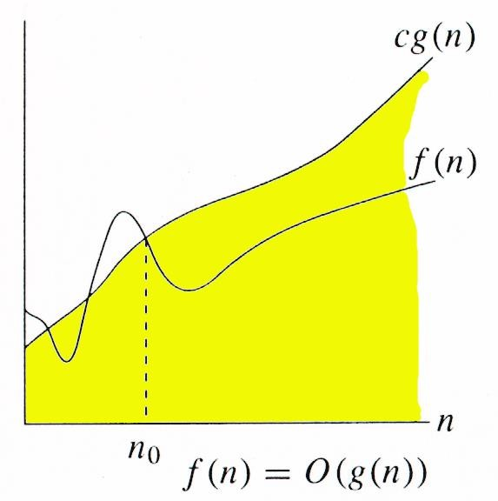
Asymptotic Notations
Asymptotic notation describes the behavior
of functions for the large inputs.
Big Oh(O) notation:
The big oh notation describes an upper bound on the asymptotic growth rate of the function f.
Definition: [Big “oh’’]
f(n) = O(g(n)) (read as “f of n is big oh of g of n”) iff there exist positive constants c and n₀ such that
f(n) ≤ cg(n) for all n, n ≥ n₀.

Slide 61
The definition states that the function f(n) is at most c times the function g(n) except when n is smaller than n₀.
In other words, f(n) grows slower than or same rate as” g(n).
When providing an upper –bound function g for f, we normally use a single term in n.
Examples
– f(n) = 3n+2
3n + 2 <= 4n, for all n >= 2, ∴3n + 2 = Ο (n)
– f(n) = 10n²+4n+2
10n²+4n+2 <= 11n², for all n >= 5, ∴ 10n²+4n+2 =
Ο (n²)
– f(n)=6*2^{n}+n²=O(2^{n}) /* 6*2^{n}+n² ≤7*2^{n} for n≥4 */

Slide 62
It also possible to write 10n²+4n+2 = O(n³) since 10n²+4n+2 <=7n³ for n>=2
Although n³ is an upper bound for 10n²+4n+2, it is not a tight upper bound; we can find a smaller function (n²⁾ that satisfies big oh relation.
But, we can not write 10n²+4n+2 =O(n), since it does not satisfy the big oh relation for sufficiently large input.

Slide 63
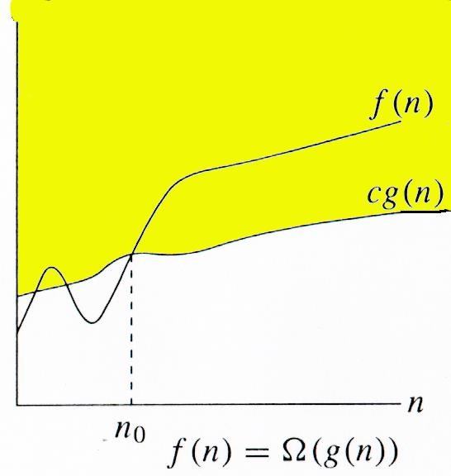
Omega (Ω) notation:
The omega notation describes a lower bound on the asymptotic growth rate of the function f.
Definition: [Omega]
f(n) = Ω(g(n)) (read as “f of n is omega of g of n”) iff there exist positive constants c and n₀ such that f(n) ≥ cg(n) for all n,
n ≥ n₀.

Slide 64
The definition states that the function f(n) is at least c times the function g(n) except when n is smaller than n₀.
In other words,f(n) grows faster than or same rate as” g(n).
Examples
– f(n) = 3n+2
3n + 2 >= 3n, for all n >= 1, ∴3n + 2 = Ω (n)
– f(n) = 10n²+4n+2
10n²+4n+2 >= n², for all n >= 1, ∴ 10n²+4n+2 = Ω (n²)
It also possible to write 10n²+4n+2 = Ω(n) since 10n²+4n+2 >=n for n>=0
Although n is a lower bound for 10n²+4n+2, it is not a tight lower bound; we can find a larger function (n²⁾ that satisfies omega relation.
But, we can not write 10n²+4n+2 = Ω(n³), since it does not satisfy the omega relation for sufficiently large input.

Slide 65
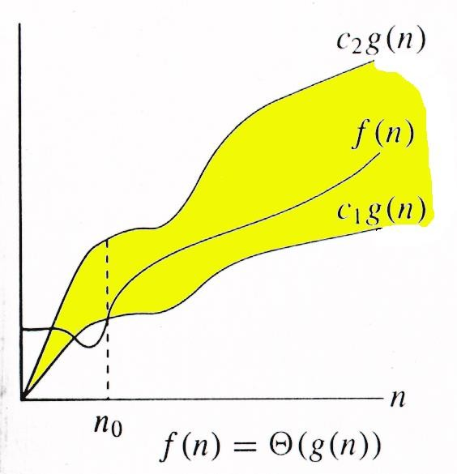
Theta (Θ) notation:
The Theta notation describes a tight bound on the asymptotic growth rate of the function f.
Definition: [Theta]
f(n) = Θ(g(n)) (read as “f of n is theta of g of n”) iff there exist positive constants c₁, c₂, and n₀ such that c₁g(n) ≤ f(n) ≤ c₂g(n) for all n, n ≥ n₀.

Slide 66
The definition states that the function f(n) lies between c1 times the function g(n) and c2 times the function g(n) except when n is smaller than n₀.
In other words,f(n) grows same rate as” g(n).
Examples:-
– f(n) = 3n+2
3n <= 3n + 2 <= 4n, for all n >= 2, ∴ 3n + 2 = Θ (n)
– f(n) = 10n²+4n+2
n²<= 10n²+4n+2 <= 11n², for all n >= 5, ∴ 10n²+4n+2 = Θ (n²)
But, we can not write either 10n²+4n+2= Θ(n) or 10n²+4n+2= Θ(n³),
since neither of these will satisfy the theta relation.

Slide 67
Little Oh(O) notation:
The big oh notation describes a strict upper bound on the asymptotic growth rate of the function f.
Definition: [Little “oh’’]
f(n) = o(g(n)) (read as “f of n is little oh of g of n”) iff
Lim n->∞
f(n)
= 0
g(n)

Slide 68
The definition states that the function f(n) is less than c times the function g(n) except when n is smaller than n₀.
In other words, f(n) grows slower than” g(n).
Examples
– f(n) = 3n+2=o(n²)
Since
3n+2
Lim n->∞
= 0
_{n}2
However, 3n+2 ≠ o(n)
The little oh notation is often used in step-count analyses.
The step count of 3n+ o(n) would mean that the step count is 3n plus terms that are asymptotically smaller than n.
When performing such an analysis , one can ignore portion of the program that are known to contribute less than Θ(n) steps.

Slide 69
Big-Oh, Theta, Omega and Little-oh
Tips :
Think of O(g(n)) as “less than or equal to” g(n)
Upper bound: “grows slower than or same rate as” g(n)
Think of Ω(g(n)) as “greater than or equal to” g(n)
Lower bound: “grows faster than or same rate as” g(n)
Think of Θ(g(n)) as “equal to” g(n)
“Tight” bound: same growth rate
Think of o(g(n)) as “less than to” g(n)
Strict Upper bound: “grows slower than ” g(n)
(True for large N)

Slide 70
Functions ordered by growth rate
Function | Name
1 | Growth is constant
logn | Growth is logarithmic
n | Growth is linear
nlogn | Growth is n-log-n
_{n}2 | Growth is quadratic
_{n}3 | Growth is cubic
₂n | Growth is exponential
n! | Growth is factorial
1 < logn < n < nlogn < n² < n³ < 2^{n} < n!

Slide 71
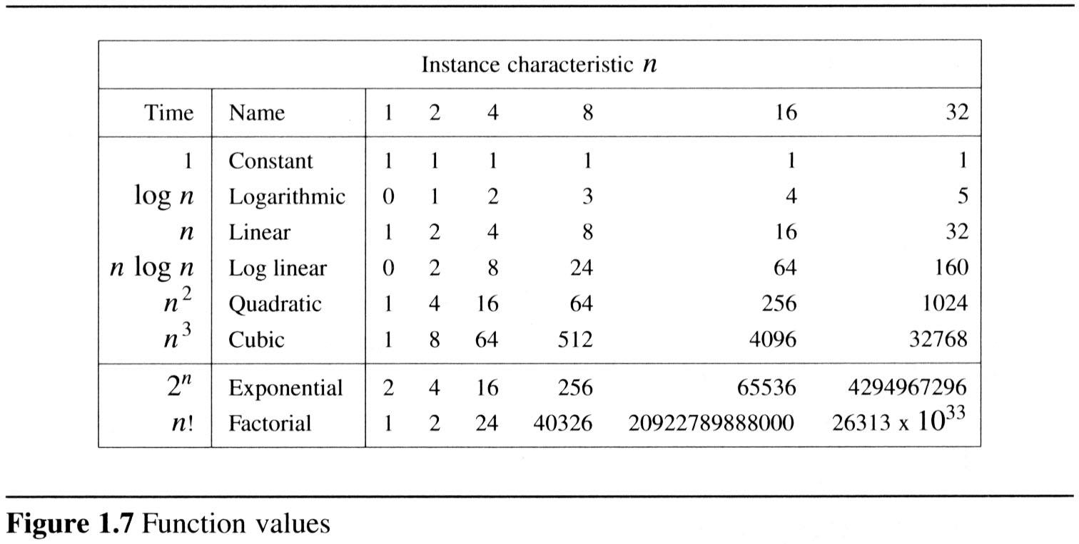
– To get a feel for how the various functions grow with n, you are advised to study the following figs:

Slide 72
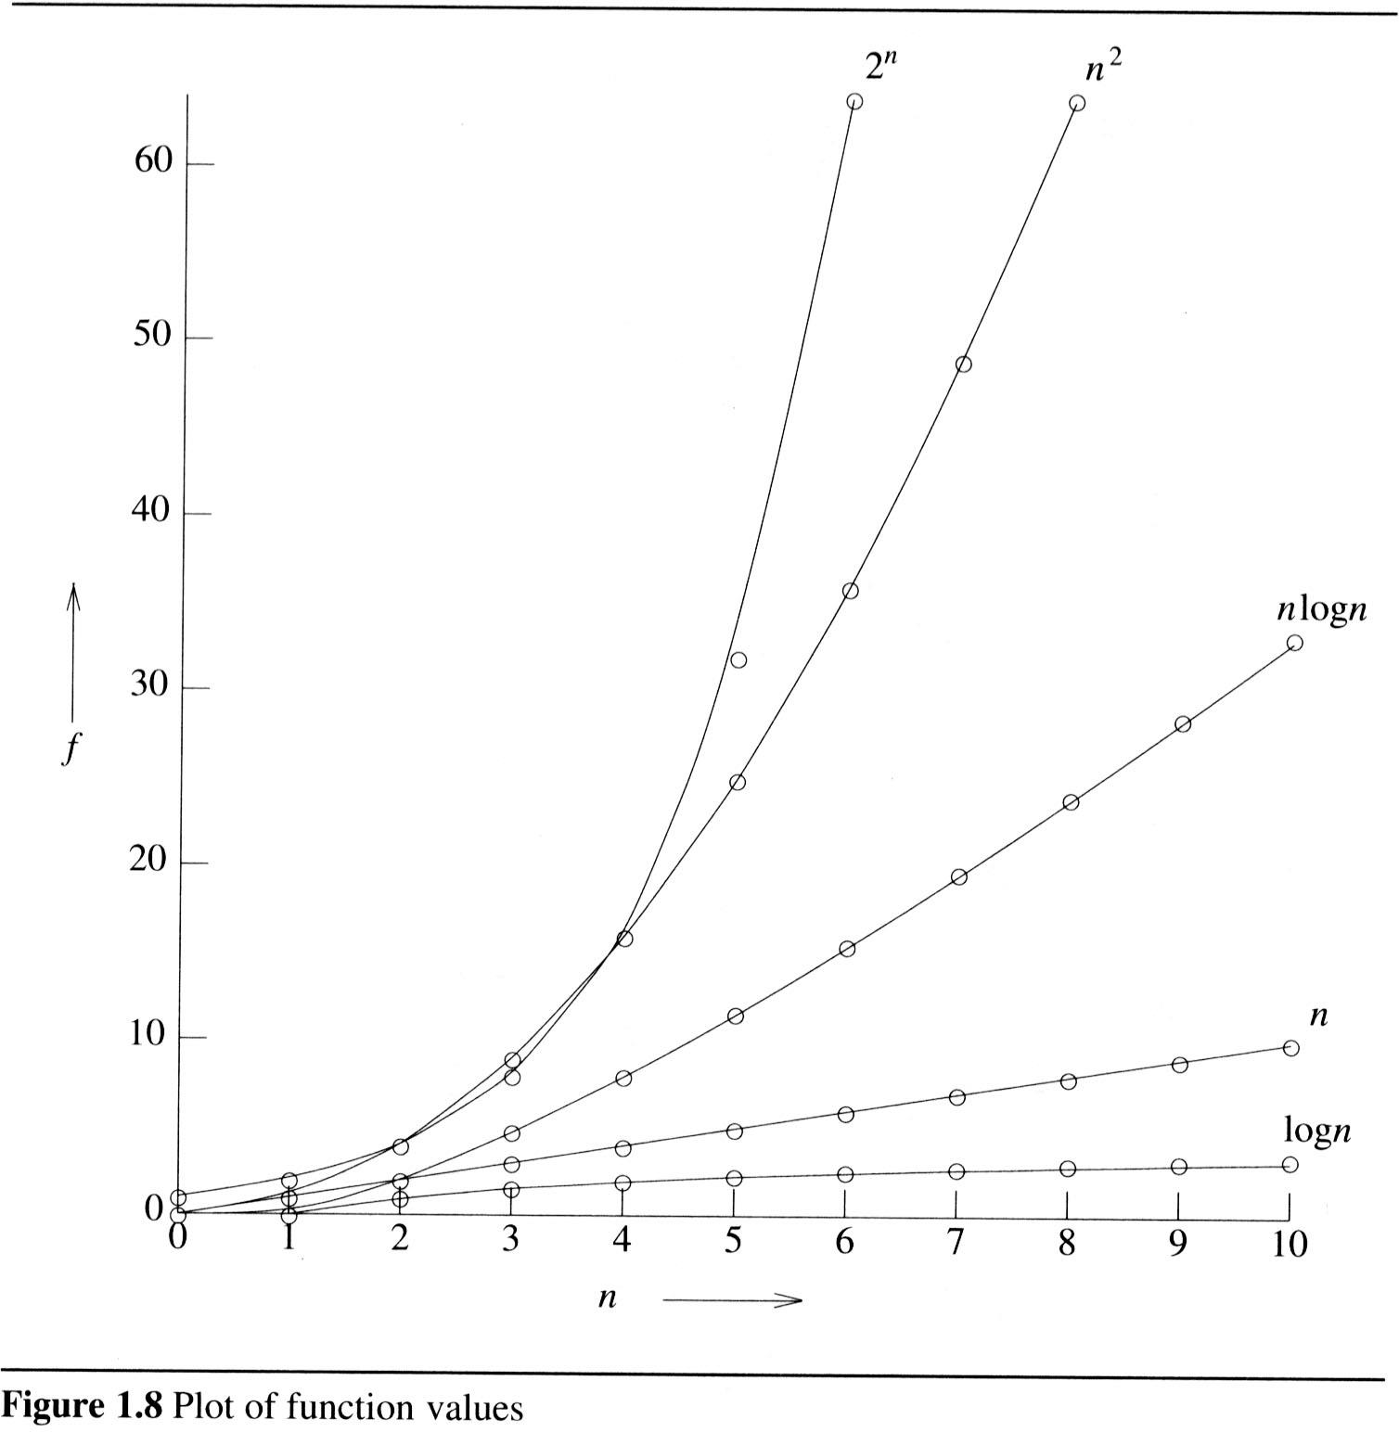
2

Slide 73
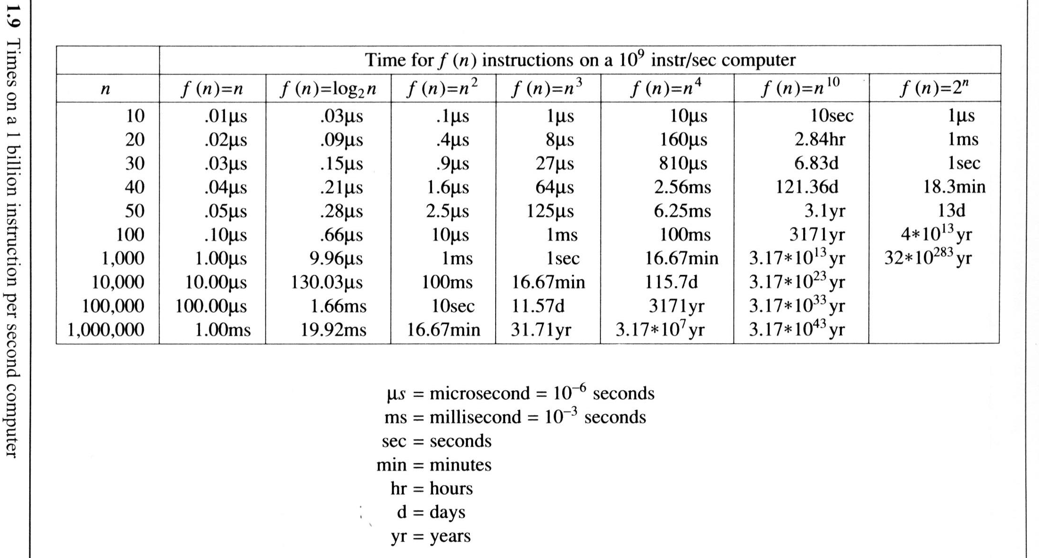
The following fig gives the time needed by a 1 billion instructions per second computer to execute a program of complexity f(n) instructions.

Slide 75
Probabilistic analysis

Slide 76
The Hiring Problem
You are using an employment agency to hire a new assistant.
The agency sends you one candidate each day.
You interview the candidate and must immediately decide whether or not to hire that person. But if you hire, you must also fire your current office assistant—even if it’s someone you have recently hired.
Cost to interview is c_{i} per candidate.
Cost to hire is c_{h} per candidate.
You want to have, at all times, the best candidate seen so far.
When you interview a candidate who is better than your current assistant, you fire the current assistant and hire the candidate.
You will always hire the first candidate that you interview.
Problem: What is the cost of this strategy?

Slide 77
Pseudo-code to Model the Scenario
Hire-Assistant (n)
best ← 0 ;;Candidate 0 is a least qualified candidate
for i ← 1 to n
do interview candidate i
if candidate i is better than candidate best
then best ← i
hire candidate i
Cost Model:
We are not concerned with the running time of Hire-Assistant.
We want to determine the total cost of hiring the best candidate.
If n candidates interviewed and m hired, then cost is nc_{i}+mc_{h}.
Have to pay nc_{i} to interview, no matter how many we hire.
So, focus on analyzing the hiring cost mc_{h}.
m varies with order of candidates.

Slide 78
Best-Case Analysis
Best case is when the agency sends you the best applicant on the first day.
Cost is nc_{i}+c_{h}.

Slide 79
Worst-case Analysis
In the worst case, we hire all n candidates.
This happens if each candidate is better than all those who came before. Candidates come in increasing order of quality.
Cost is nc_{i}+nc_{h}.
If this happens, we fire the agency.
What should happen in the average case?

Slide 80
Probabilistic analysis
Probabilistic analysis is the use of probability in the analysis of problems.
Generally, we use probabilistic analysis to analyze the running time of an algorithm.
Sometimes, we can also use it to analyze quantities
such as the hiring cost in procedure Hire-Assistant.

Slide 81
Hiring problem-Average –case Analysis
An input to the hiring problem is an ordering of the n applicants.
There are n! different inputs.
To use probabilistic analysis, we assume that the candidates arrive in a random order .
Then we analyze our algorithm by computing an expected running time.
The expectation is taken over the distribution of the possible inputs.
Thus, we are averaging the running time over all possible inputs.

Slide 82

Indicator Random Variable
A powerful technique for computing the expected value of a random variable.
Convenient method for converting between probabilities and expectations.
Takes only 2 values, 1 and 0.
Indicator Random Variable X_{A}=I{A} for an event A of a sample space is defined as:
if A occurs,
⎩0 if A does not occur.
I{A} = ^{⎧1}
⎨
The expected value of an indicator Random Variable associated with an event A is equal to the probability that A occurs.

Slide 83
Indicator RV – Example1
Problem: Determine the expected number of heads in one
coin flip.
Sample space is s{ H,T}
Indicator random variable
X_{A}= I{ coin coming up with heads}=1/2
The expected number of heads obtained in one flip of the coin is equal to the expected value of indicator random variable.
Therefore, E[X_{A}] = 1/2

Slide 84
Indicator RV – Example2
Problem: Determine the expected number of heads in n
coin flips.
Let X be the random variable denoting the total number of
heads in n coin flips.
Define n indicator random variables, X_{i}, 1 ≤ i ≤ n.
Let X_{i} be the indicator random variable for the event that the i^{th} flip results in a Head.
X_{i} = I{the i^{th} flip results in H}
Then X = X₁ + X₂ + …+ X_{n}
E[X_{i}] = Pr{H} = ½, 1 ≤ i ≤ n.
Expected number of heads is E[X] = E[∑_{i=1..n} X_{i}].
= ∑_{i=1..n} E[ X_{i}] = ∑_{i=1..n} ½ = n/2.
^{= ∑}i=1..n ^{X}i.

Slide 85
Back to the Hiring Problem
We want to know the expected cost of our hiring algorithm, in terms of how many times we hire an applicant.
Random variable X(s) is the number of applicants that are hired, given the input sequence s.
Indicator random variable X_{i} for applicant I = 1 if applicant i is hired, 0 otherwise.
What is E[X]?

Slide 86
Probability of Hiring i-th Applicant
Probability of hiring i is probability that i is better than the previous i-1 applicants…
Pr[X_{i} = 1] = 1/i.
Suppose n = 4 and i = 3.
Ex:-Probability that 3rd applicant is better than the 2 previous ones.
1234 2134 3124 4123
8/24 = 1/3
1243 | 2143 | 3142 | 4132
1324 | 2314 | 3214 | 4213
1342 | 2341 | 3241 | 4231
1423 | 2413 | 3412 | 4312
1432 | 2431 | 3421 | 4321

Slide 87
Analysis of the Hiring Problem
Compute E[X], the number of candidates we expect to hire.
E[ X ] = E ⎡∑^{n}
_{X} ⎤
⎢
i ⎥⎦
⎣
i=1
= ∑ E[ X_{i} ]
i=1
n
n
= ∑
1
i=1 ^{i}
= ln n +
O(1)
1
Expected hiring cost = O(c_{h}ln n).

Slide 88
Amortized Analysis
Data structures are subjected to a sequence of operations rather than one operation.
In this sequence, one operation possibly performs certain modifications that have an impact on the run time of the next operation in the sequence.
One way of assessing the worst case run time of the entire sequence is to add worst case efficiencies for each operation.
This may result in an excessively large and unrealistic time complexity.

Slide 89
Amortized analysis concentrates on finding the average complexity of a worst case sequence of operations.
Amortized analysis considers interdependence between operations.
– For example, if an array is sorted and only a very few new elements are added, then re-sorting this array will be must faster than sorting it for the first time.

Slide 90
Amortized Analysis
AMORTIZED ANALYSIS:
You try to estimate an upper bound of the total work T(n) required for a sequence of n operations…
Some operations may be cheap some may be expensive. Overall, your algorithm does T(n) of work for n operations …
Therefore, by simple reasoning, the amortized cost of each operation is T(n)/n

