Slide 1
Email Phishing Detection Using Machine Learning
Presented by: Sachi Rane(200) & Yash Dhumali(163)
Course:BSc IT
Academic Year:2025-26

Slide 2
INTRODUCTION
Email phishing is a major cybersecurity threat.
Attackers trick users into revealing sensitive information.
Manual detection is difficult and time-consuming.
Machine Learning helps automate phishing detection.

Slide 3
PROBLEM STATEMENT
Increase in phishing attacks via emails.
Users find it hard to identify fake emails.
Traditional security methods are not always effective.
Need for an automated phishing detection system.

Slide 4
OBJECTIVES
To detect phishing emails automatically.
To classify emails as Phishing or Legitimate.
To use machine learning for accurate prediction.
To provide a simple command-line interface

Slide 5
DATASET DESCRIPTION
Dataset name: emails.csv
Contains phishing and legitimate emails.
Stored in the dataset folder.
Used for training and testing the model.

Slide 6
TECHNOLOGIES USED
Programming Language: Python
Libraries:
Pandas
NumPy
Scikit-learn
Concepts:
Machine Learning
Natural Language Processing (NLP)

Slide 7
SYSTEM ARCHITECTURE
Input Email Text
Text Preprocessing
Feature Extraction
Machine Learning Model
Prediction Output

Slide 8
WORKING OF THE SYSTEM
Dataset is loaded and cleaned.
Text is converted into numerical features.
Machine learning model is trained.
User enters an email.
System predicts phishing or safe email.

Slide 9
MODULES USED
preprocess.py – cleans email text
model.py – handles model training
phishing_detection.py – main execution file

Slide 10
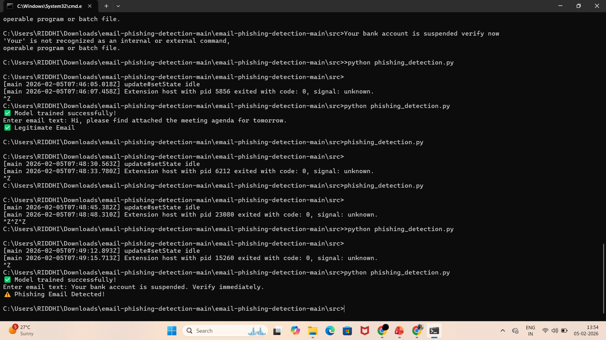
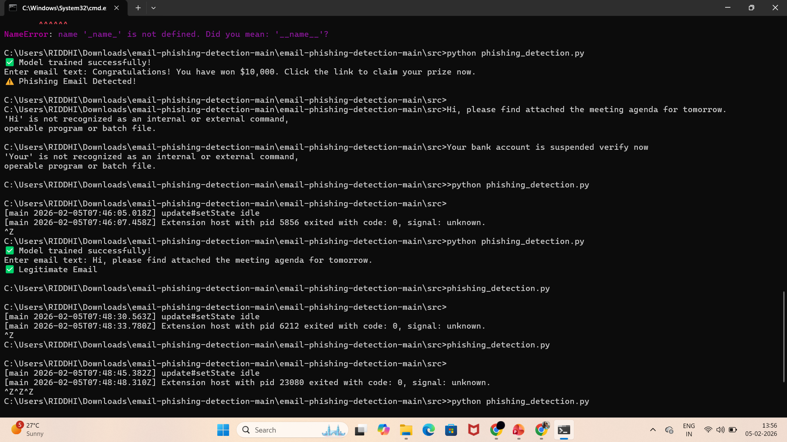
OUTPUT SCREENSHOTS
Model trained successfully
User enters email
Prediction result shown

Slide 11
ADVANTAGES
Fast and automated detection
Reduces risk of cyber fraud
Easy to use
Improves email security

Slide 12
LIMITATIONS
Accuracy depends on dataset quality
Cannot detect completely new phishing patterns
Command-line based interface

Slide 13
FUTURE SCOPE
Web-based application
Real-time email scanning
Deep learning integration
Browser or email client extension

Slide 14
CONCLUSION
Email phishing is a serious security threat.
Machine learning helps detect phishing effectively.
The system successfully classified emails.
Project achieves its objectives.

