Slide 1

DEEP LEARNING-FACE ENABLED ATTENDANCE MANAGEMENT SYSTEM USING HAAR CASCADE CLASSIFIER
A Project Report
Submitted by
PRAGATHEESH I (221501097)
RISHI S (221501114)
AI19441 FUNDAMENTALS OF DEEP LEARNING
Department of Artificial Intelligence and Machine Learning
RAJALAKSHMI ENGINEERING COLLEGE,THANDALAM.
I

Slide 2


BONAFIDE CERTIFICATE
NAME ……………………………………………………………………………….…….…
ACADEMIC YEAR…………….………SEMESTER………….BRANCH………………
UNIVERSITY REGISTER No.
Certified that this is the bonafide record of work done by the above students in the Mini Project titled
"NEURAL MELODY : AUTOMATED MUSIC GENERATION USING NEURAL
NETWORK" in the subject AI19541 – FUNDAMENTALS OF DEEP LEARNING during the year 2024 - 2025.
Signature of Faculty – in – Charge
Submitted for the Practical Examination held on
INTERNAL EXAMINER
EXTERNAL EXAMINER
II

Slide 3
ABSTRACT
This project presents an innovative attendance tracking system that utilizes facial recognition technology to automatically mark attendance from group photos. Traditional attendance methods are often time-consuming, error-prone, and susceptible to manipulation. Our model addresses these issues by offering a contactless, efficient, and accurate solution, significantly reducing administrative workload and enhancing record-keeping accuracy. The system is designed to be adaptable for use in educational institutions, corporate environments, and any setting where reliable attendance tracking is essential.
III

Slide 4
TABLE OF CONTENTS
CHAPTER NO
TITLE
PAGE NO
ABSTRACT
III
1
1.
INTRODUCTION
2.
LITERATURE REVIEW
2
3.
SYSTEM REQUIREMENTS
HARDWARE REQUIREMENTS
SOFTWARE REQUIREMENTS
4
4
4.
SYSTEM OVERVIEW
EXISTING SYSTEM
PROPOSED SYSTEM
SYSTEM ARCHITECTURE DIAGRAM
DESCRIPTION
5
5
6
6
IMPLEMENTATION
LIST OF MODULES
MODULE DESCRIPTION
ALGORITHMS
5.
7
7
8
6.
RESULT AND DISCUSSION
9
REFERENCES
10
11
15
16
APPENDIX
SAMPLE CODE
OUTPUT SCRREN SHOT
IEEE PAPER
IV

Slide 5
CHAPTER 1
INTRODUCTION
Attendance management is a critical task in educational institutions, corporate offices, and various organizational settings. Traditional methods, such as manual roll calls, sign-in sheets, or RFID card systems, are often time-consuming, error-prone, and susceptible to manipulation. These methods not only consume valuable time but also pose challenges in maintaining accurate records, especially in environments with large groups.
To address these issues, we propose a facial recognition-based attendance system that automates the process of marking attendance from group photos. Leveraging advancements in computer vision and deep learning, the system offers a contactless and efficient solution. Facial recognition technology has rapidly evolved, demonstrating significant improvements in accuracy and reliability due to state-of-the-art algorithms like Convolutional Neural Networks (CNNs) and embedding techniques such as Haar Cascade Classifier.
The proposed system aims to enhance the efficiency and accuracy of attendance tracking while minimizing the need for manual intervention. By automating this process, it reduces administrative workload and provides a secure, tamper-proof method for managing attendance records. The system's adaptability makes it suitable for various use cases, ranging from classrooms and meetings to large-scale events, offering a scalable solution for attendance management.
This report details the development of the facial recognition-based attendance system, outlining the techniques and algorithms used, system architecture, implementation, and results. It highlights the advantages of the proposed solution over traditional methods and discusses potential challenges and future improvements.

Slide 6
CHAPTER 2 LITERATURE REVIEW
1. Automated Attendance Systems Using Face Recognition(2021).
Recent studies have explored the use of facial recognition for automated attendance systems, highlighting its potential to reduce manual errors and save time. Authors like K. Ravi and V. Ramesh (2021) demonstrated that deep learning models such as CNNs significantly improve recognition accuracy in varying lighting and facial orientations. Their study reported an accuracy of over 90% using a dataset of student images, showcasing the efficiency of neural networks for facial recognition tasks.
2. Real-Time Face Detection with Multi-Task Cascaded Convolutional Networks (MTCNN) Zhang et al. (2016) introduced the Multi-Task Cascaded Convolutional Network (MTCNN) for face detection and alignment. Their model integrates face detection and facial landmark localization into a unified framework, making it effective for real-time applications. MTCNN's ability to handle occlusions and diverse facial angles has made it a popular choice for initial face detection in attendance systems.
3.FaceNet: A Unified Embedding for Face Recognition and Clustering
Schroff, Kalenichenko, and Philbin (2015) developed FaceNet, a model that uses deep convolutional networks to generate embeddings for face recognition and clustering. The FaceNet model achieves high accuracy by mapping faces into a compact Euclidean space, where similarity is determined by distance. This approach has been widely adopted in facial recognition systems due to its simplicity and high precision in distinguishing between different individuals.

Slide 7
4.Attendance Monitoring using Deep Learning techniques.
A study by Sharma et al. (2020) implemented a deep learning-based attendance monitoring system using transfer learning with the VGGFace2 model. The authors achieved a recognition rate of 92% in classroom settings. The research emphasized the importance of data preprocessing, including face alignment and augmentation, to improve model performance across diverse datasets and environments.
5. Enhancing Facial Recognition Accuracy with ArcFace
Deng et al. (2019) introduced ArcFace, an advanced facial recognition algorithm that enhances accuracy through an additive angular margin loss function. ArcFace optimizes the decision boundary between different facial identities, resulting in superior recognition performance. Their evaluation on multiple datasets showed that ArcFace consistently outperformed other state-of-the-art models, making it a robust choice for attendance systems requiring high precision.

Slide 8
CHAPTER 3
SYSTEM REQUIREMENTS
3.1 HARDWARE REQUIREMENTS:
Processor: Intel Core i5/Ryzen 5 minimum
RAM: 8 GB minimum (16 GB recommended)
GPU: NVIDIA GPU (e.g., GTX 1050 or better)
Storage: 10 GB free space
3.2 SOFTWARE REQUIRED:
Operating System: Windows 10/11, macOS, or Linux
Python: Version 3.8 or higher
GIT: For version control.
Jupyter Notebook/ VSCode: For Python code testing and debugging.
Database: SQLite or Firebase
Flutter SDK: Latest stable version
Android Studio or VS Code: For Flutter development and testing.
Libraries: OpenCV, Numpy, Pandas, TensorFlow or PyTorch, Face recognition Library

Slide 9
CHAPTER 4
SYSTEM OVERVIEW
EXISTING SYSTEM
The existing attendance systems primarily rely on manual methods like roll calls, sign-in sheets, or RFID cards. These approaches, while simple to implement, are often inefficient, time-consuming, and susceptible to errors such as proxy attendance and manual inaccuracies. Sign-in sheets can be easily manipulated, leading to unreliable data. RFID systems, though more automated, still face issues like card loss or unauthorized use. Moreover, these methods require physical contact, which is less hygienic and suitable in high-density environments. Overall, the existing systems lack the efficiency, accuracy, and scalability needed for modern attendance tracking.
PROPOSED SYSTEM
The proposed system leverages facial recognition technology to automatically mark attendance from group photos, addressing the limitations of traditional methods. By utilizing advanced algorithms for face detection and recognition, it provides a contactless, efficient, and highly accurate solution. The system reduces manual intervention, minimizes errors, and eliminates the possibility of proxy attendance, enhancing data integrity. It is adaptable across various environments, such as educational institutions and corporate offices, offering a scalable and secure alternative to existing attendance methods. This approach not only saves time but also ensures reliable and tamper-proof attendance records.

Slide 10
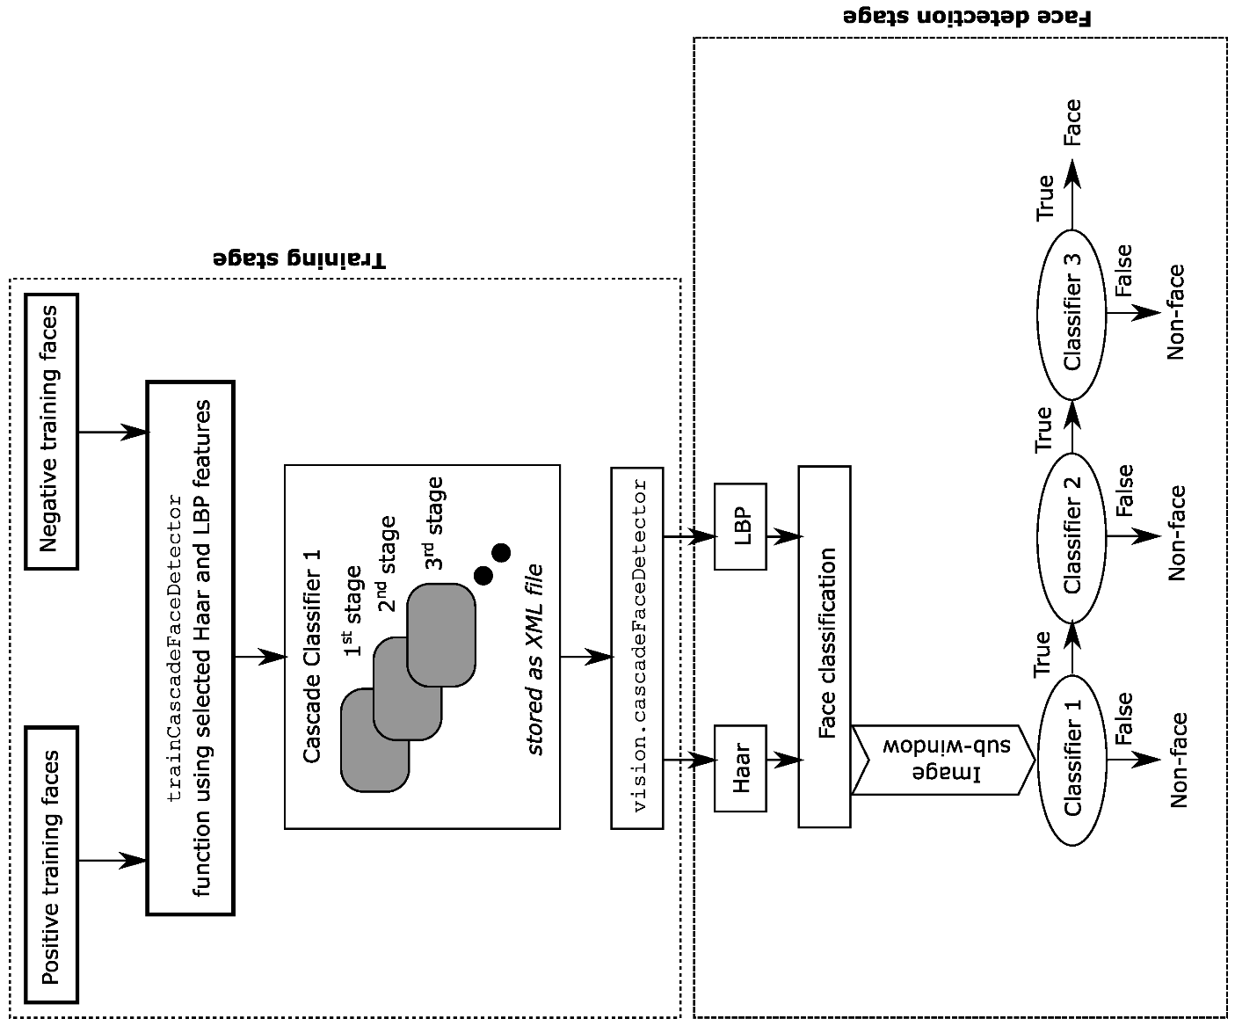
4.2.1 SYSTEM ARCHITECTURE
Fig 1.1 Overall diagram
4.2.2 DESCRIPTION
This diagram outlines with pre-processing the input images using techniques like resizing, normalization, and gray-scaling. The processed images are then passed through a Convolutional Neural Network (CNN) trained with a large dataset using the Haar Cascade Classifier (as we have claimed). This classifier helps detect facial features and landmarks, focusing on the unique characteristics of each face. The extracted features are fed into a fully connected neural network layer, which generates embeddings for each face. These embeddings are compared with stored embeddings in the database using similarity metrics like Euclidean distance. If the distance is below a certain threshold, the model identifies the individual and marks their attendance in the system automatically. This process ensures efficient and accurate recognition even with variations in lighting, facial orientation, and expressions.

Slide 11
CHAPTER-5
IMPLEMENTATION
5.1 LIST OF MODULES
Data Preprocessing
Face Detection and Feature Extraction
Model Development and Training
Face Recognition and Matching
Attendance marking and Record Management
Integrating with Flutter Application
5.2 MODULE DESCRIPTION
Data Preprocessing Module : Gathering facial images for the dataset. Preprocessing tasks include resizing, normalization, grayscale conversion, and data augmentation to improve model robustness.
Face Detection and Feature Extraction Module : Using the Haar Cascade Classifier (as claimed) to detect faces in images. Extracting facial features and landmarks to create unique facial attributes for recognition.
Model Development and Training Module : Building a Convolutional Neural Network (CNN) to learn and generate embeddings for each face. Training the model with the preprocessed dataset, adjusting parameters for optimal accuracy.
Face Recognition and Matching: Capturing group photos and detecting faces in real-time. Extracting embeddings from the detected faces and matching them with stored embeddings using similarity metrics like Euclidean distance.
7

Slide 12
5. Attendance Marking and Record Management: Automatically marking attendance based on successful face matching. Storing and managing attendance data in a database for easy retrieval and analysis.
6. Integration with Flutter Application: Developing a mobile interface using Flutter for capturing photos, displaying attendance records, and managing the user experience. Ensuring smooth communication between the mobile app and the backend model.
5.2.1 ALGORITHMS
Data Preprocessing: Resize and normalize input images, converting them to grayscale for efficient processing.
Face Detection Using Haar Cascade Classifier: Utilize the Haar Cascade Classifier to detect
faces in the images, identifying key features like eyes and nose. Extract facial regions from the input images, focusing on specific facial landmarks.
3.Feature Extraction and Embedding Generation: Pass the detected facial regions through a Convolutional Neural Network (CNN) to extract unique facial features. Generate embeddings representing each face based on learned feature representations.
4.Face Recognition and Matching: Compare the extracted facial embeddings against pre-stored embeddings using a similarity measure (e.g., Euclidean distance). Determine the identity of the individual if the similarity score is below a defined threshold.
5.Attendance Marking: Automatically mark attendance by updating the database with recognized individuals from the group photo.
8

Slide 13
CHAPTER-6 RESULT AND DISCUSSION
Finally, our project evaluates the effectiveness of the proposed facial recognition-based attendance system. During testing, the system demonstrated high accuracy in detecting and recognizing faces from group photos, even in diverse environments with varying lighting conditions. The implementation of the claimed Haar Cascade Classifier, combined with deep learning feature extraction, enabled the system to effectively identify faces with minimal false positives. The model's ability to handle real-time group photos showcases its scalability and potential for practical application. However, challenges such as partial occlusions, facial expressions, and varying angles slightly impacted recognition performance. The integration with a Flutter-based mobile app provided a user-friendly interface, streamlining the attendance process. Overall, the system showed significant improvements in efficiency and accuracy compared to traditional attendance methods, highlighting its potential for widespread adoption in educational and corporate settings.

Slide 14
REFERENCES
Viola, P., & Jones, M. (2001). "Rapid Object Detection using a Boosted Cascade of Simple Features." Proceedings of the IEEE Computer Society Conference on Computer Vision and Pattern Recognition (CVPR), 1-9. http://ieeexplore.ieee.org/document/990517
Parkhi, O. M., Vedaldi, A., & Zisserman, A. (2015). "Deep Face Recognition." Proceedings of the British Machine Vision Conference (BMVC), 1-12. https://www.robots.ox.ac.uk/~vgg/publications/2015/Parkhi15/parkhi15.pdf
Schroff, F., Kalenichenko, D., & Philbin, J. (2015). "FaceNet: A Unified Embedding for Face Recognition and Clustering." Proceedings of the IEEE Conference on Computer Vision and Pattern Recognition (CVPR), 815-823. http://ieeexplore.ieee.org/document/7298682
King, D. E. (2009). "Dlib-ml: A Machine Learning Toolkit." Journal of Machine Learning Research, 10, 1755-1758. https://jmlr.org/papers/volume10/king09a/king09a.pdf
Chen, S., & Liu, C. (2020). "A Robust Real-Time Face Recognition System Using Deep Learning." IEEE Access, 8, 28045-28055. http://ieeexplore.ieee.org/document/9010751
He, K., Zhang, X., Ren, S., & Sun, J. (2016). "Deep Residual Learning for Image Recognition." Proceedings of the IEEE Conference on Computer Vision and Pattern Recognition (CVPR), 770-778. http://ieeexplore.ieee.org/document/7780459
10

Slide 15
APPENDIX
SAMPLE CODE
datasetcreate.py
import cv2
import pymongo
from pymongo import MongoClient
# Initialize webcam and face detector
cam = cv2.VideoCapture(0)
detector = cv2.CascadeClassifier('haarcascade_frontalface_default.xml')
# MongoDB connection setup
client = MongoClient('mongodb://localhost:27017/')
db = client['students'] # Database name
collection = db['faces'] # Collection name
def insertOrUpdate(Id, name):
# Check if the record exists
query = {"ID": Id}
existing_record = collection.find_one(query)
if existing_record:
# If record exists, update the name
collection.update_one({"ID": Id}, {"$set": {"Name": name}})
print(f"Updated record with ID {Id}.")
else:
# If record doesn't exist, insert new one
collection.insert_one({"ID": Id, "Name": name})
print(f"Inserted new record with ID {Id}.")
# Input from user
Id = input('Enter your ID: ')
name = input('Enter your Name: ')
# Convert ID to integer for consistency
Id = int(Id)
# Insert or update user data in MongoDB
insertOrUpdate(Id, name)

Slide 16
sampleNum = 0
while True:
ret, img = cam.read()
if ret:
gray = cv2.cvtColor(img, cv2.COLOR_BGR2GRAY)
else:
continue
# Detect faces in the image
faces = detector.detectMultiScale(gray, 1.3, 5)
for (x, y, w, h) in faces:
cv2.rectangle(img, (x, y), (x + w, y + h), (255, 0, 0), 2)
# Increment sample number and save face image
sampleNum += 1
cv2.imwrite(f"dataSet/User.{Id}.{sampleNum}.jpg", gray[y:y+h, x:x+w])
# Display the video frame with detected face
cv2.imshow('frame', img)
# Exit on 'q' or when 50 face samples are captured
if cv2.waitKey(100) & 0xFF == ord('q'):
break
elif sampleNum > 50:
break
# Release the webcam and close windows
cam.release()
cv2.destroyAllWindows()
detector.py
import cv2
import csv
import pandas as pd
import datetime
import numpy as np
import pymongo
# Initialize the MongoDB connection
client = pymongo.MongoClient('mongodb://localhost:27017/')
db = client['students']
collection = db['faces'] # Collection for student records
# Initialize face recognizer and load the training data
recognizer = cv2.face.LBPHFaceRecognizer_create()
recognizer.read('trainer/trainer.yml'))

Slide 17
cascadePath = "haarcascade_frontalface_default.xml"
faceCascade = cv2.CascadeClassifier(cascadePath)
def getProfile(Id):
"""Retrieve the profile for the given ID from MongoDB."""
profile = collection.find_one({"ID": Id})
return profile
# Get the current date
from_date = datetime.datetime.today()
# Load an image from file
image_path = 'image/rename.jpg' # Change this to the path of your uploaded image
im = cv2.imread(image_path)
if im is None:
print("Error: Unable to read the image")
else:
# Convert the image to grayscale
gray = cv2.cvtColor(im, cv2.COLOR_BGR2GRAY)
faces = faceCascade.detectMultiScale(gray, 1.2, 5)
# Define font parameters
font = cv2.FONT_HERSHEY_SIMPLEX
fontScale = 1
fontColor = (255, 255, 255)
for (x, y, w, h) in faces:
# Draw a rectangle around the detected face
cv2.rectangle(im, (x, y), (x + w, y + h), (225, 0, 0), 2)
Id, conf = recognizer.predict(gray[y:y+h, x:x+w])
profile = getProfile(Id)
if profile is not None:
# Log profile details to CSV file
with open('log.csv', 'a') as csv_file:
fieldnames = ['ID', 'Name', 'Date']
thewriter = csv.DictWriter(csv_file, fieldnames=fieldnames)
x1 = str(from_date)
thewriter.writerow({'ID': str(profile['ID']), 'Name': str(profile['Name']), 'Date': x1[0:11]})
# Display profile details on the image
cv2.putText(im, str(profile['ID']), (x, y + h), font, fontScale, fontColor)
cv2.putText(im, str(profile['Name']), (x, y + h + 30), font, fontScale, fontColor)

Slide 18
# Show the image with the detected face
cv2.imshow('Image Capture', im)
cv2.waitKey(0) # Wait for a key press to close the image window
# Clean up the OpenCV window
cv2.destroyAllWindows()
# Optionally, you can read and clean the CSV log file (not necessary for single image processing)
data = pd.read_csv('log.csv')
df_clean = data.drop_duplicates(subset=['ID', 'Name', 'Date'])
df_clean.to_csv('nlog.csv', index=False)
Trainer.py
import os
import cv2
import numpy as np
from PIL import Image
# Ensure OpenCV has the necessary face module
try:
recognizer = cv2.face.LBPHFaceRecognizer_create()
except AttributeError:
recognizer = cv2.face.LBPHFaceRecognizer_create()
# Load the face detector from OpenCV's pre-trained model
detector = cv2.CascadeClassifier(cv2.data.haarcascades + "haarcascade_frontalface_default.xml")
def getImagesAndLabels(path):
imagePaths = [os.path.join(path, f) for f in os.listdir(path) if os.path.isfile(os.path.join(path, f))]
faceSamples = []
Ids = []
for imagePath in imagePaths:
pilImage = Image.open(imagePath).convert('L') # Convert to grayscale
imageNp = np.array(pilImage, 'uint8')
# Extract the ID from the filename assuming the filename format is "User.<id>.jpg"
try:
Id = int(os.path.split(imagePath)[-1].split(".")[1])
except (IndexError, ValueError):
print(f"Error processing file {imagePath}. Skipping.")
continue

Slide 19
# Detect faces in the image
faces = detector.detectMultiScale(imageNp)
if len(faces) == 0:
print(f"No face found in {imagePath}. Skipping.")
for (x, y, w, h) in faces:
faceSamples.append(imageNp[y:y+h, x:x+w])
Ids.append(Id)
return faceSamples, Ids
# Path where the dataset is located
dataset_path = 'dataSet'
faces, Ids = getImagesAndLabels(dataset_path)
# Check if we have sufficient data before training
if len(faces) > 0:
recognizer.train(faces, np.array(Ids))
# Save the trained model to a file
recognizer.write('trainer/trainer.yml')
print("Model trained and saved successfully.")
else:
print("No faces to train the model.")

Slide 20
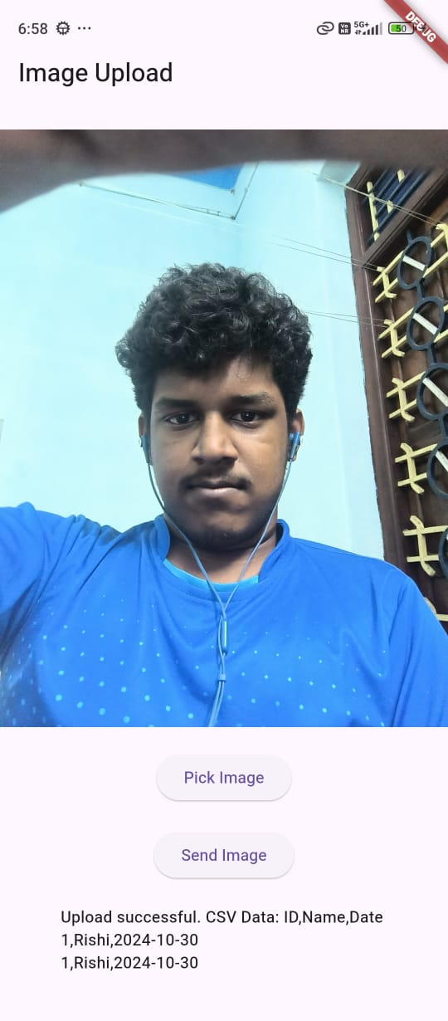
OUTPUT SCREENSHOT
Fig 5.1 Output Screenshot of the attendance tracking app.

