Slide 1
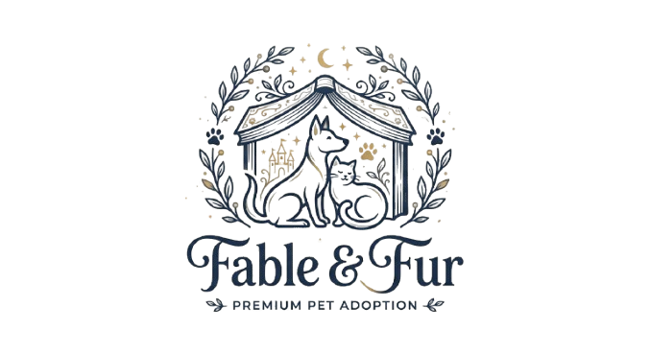
Fable & Fur
Fable & Fur
Product: Pet adoption matchmaking app
Stack: React + Vite + Express + SQLite
User flow: Browse, match, and review pets
Goal: Help rescue pets find suitable homes
Outcome: Strong MVP concept with polished UX
Project Review Presentation
Full-stack app combining responsive UI, secure auth, and SQLite-backed match tracking.

Slide 2
Project Overview
Why the app matters
Problem
Adoption journeys are often scattered and uncertain for both adopters and rescues.
Users need a simple, guided way to discover pets that truly fit their lifestyles.
Solution
Fable & Fur presents a playful swipe-based experience to simplify pet discovery.
Pet browsing is transformed into a more engaging and confidence-building process.
Audience
People looking for a companion that matches their family, home, and daily routine.
This app helps reduce mismatch and increase adoption confidence.

Slide 3
Core Features
What the product delivers today
• Swipe-style pet matching with like, favorite, and skip actions
• Filter controls for pet type, age, and energy level
• User signup and login with validation and persisted session state
• Protected pages for the matching and dashboard experience
• Dashboard metrics tracking likes, favorites, and skipped pets
• SQLite data model covering shelters, pets, users, and match records

Slide 4
System Architecture
How the app is organized
Frontend
React + Vite
Backend
Express API
Database
SQLite
The frontend requests pet data and match events from the API, while Express validates auth requests and writes application data into SQLite tables.

Slide 5
User Journey
From discovery to adoption intent
1. Browse
Users land on the home page and learn about the experience.
2. Sign in
A guest can create an account or log in to continue.
3. Match
Users filter and swipe through pet profiles based on fit.
4. Review
Dashboard summarizes likes and favorites for reflection.
5. Adopt
The app sets up a clear next step toward a real connection.

Slide 6
Review Assessment
Strengths and opportunities
Strengths
• Clear product concept
• Strong visual storytelling
• Functional full-stack MVP
• Good user onboarding
Opportunities
• Add real testing coverage
• Improve edge-case validation
• Expand the adoption workflow
• Increase personalization

Slide 7
Final Verdict
Fable & Fur is a promising, polished concept with a clear product story and a functional full-stack implementation. It demonstrates strong potential as a pet-adoption MVP and delivers an engaging user experience.
Recommended next steps: expand the adoption journey, strengthen validation, and add automated testing to support broader rollout.

