Slide 1
MACHINE FAULT DIAGNOSIS AGENT
CAPSTONE PROJECT
Presented By:
1.-Rishika –G.B.Pant University of Agriculture and Technology –Information Technology

Slide 2
OUTLINE
Problem Statement
Proposed System
System Development Approach
Result
Conclusion
Future Scope
References

Slide 3
Problem Statement
Problem Statement No. 33 – Machine Fault Diagnosis Agent
This agent helps detect faults in machines like lathes, mills, or pumps based on vibrations, temperature, or unusual noises. It can answer: "Why is my CNC machine vibrating too much?" or "What could cause overheating in a hydraulic pump?". It suggests basic maintenance actions and safety precautions.

Slide 4
Proposed system
STEPS TO CREATE AI AGENT:: --
--First we log into the IBM Cloud and clear all the resources like storage etc.
--Then we go to the navigation menu where we select the watsonx service and from there we select the Watson.ai option.
--There we select the AI Agent >> --AI lab(Beta)>> --watsonx.ai home page.
-- Scroll down and go to new project and add details.
--Associate watsonx.ai studio and watsonx.ai runtime service.
--Again go to watsonx.ai home page and go to the AI AGENT option.
--Here we can give our agent the tools and instruction.
DEPLOYMENT OF THE AI AGENT::--
--After the model creation use
--Click on the deploy button at right top corner and create a deployment space
--After this deploy the project
--We can now preview our project and ask the agent questions

Slide 5
Proposed system
The proposed system aims to build an agent that can answer the quieries related to the faults in a particular machine. The solution will consist of the following components:
SERVICES USED:
--We will use watsonx.ai service to create an agent that can help in MACHINE FAULT DIAGNOSIS.
--We can use tools for our assistant like GOOGLESEARCH,WIKIPEDIA etc to gather information about particular machine fault.
ARCHITECTURE USED:
--ReAct
FRAMEWORK USED:
--LangGraph
MODEL:
llama- 3-3-70b-instruct
DATA:
--The Agent will get input about Machine fault from user and the agent uses tools to give information about fault.

Slide 6
System Approach
The following services were used for the creation of the Machine Fault Diagnosis Agent :
IBM Cloud Lite services
IBM Granite AI model
Watsonx.ai service

Slide 7
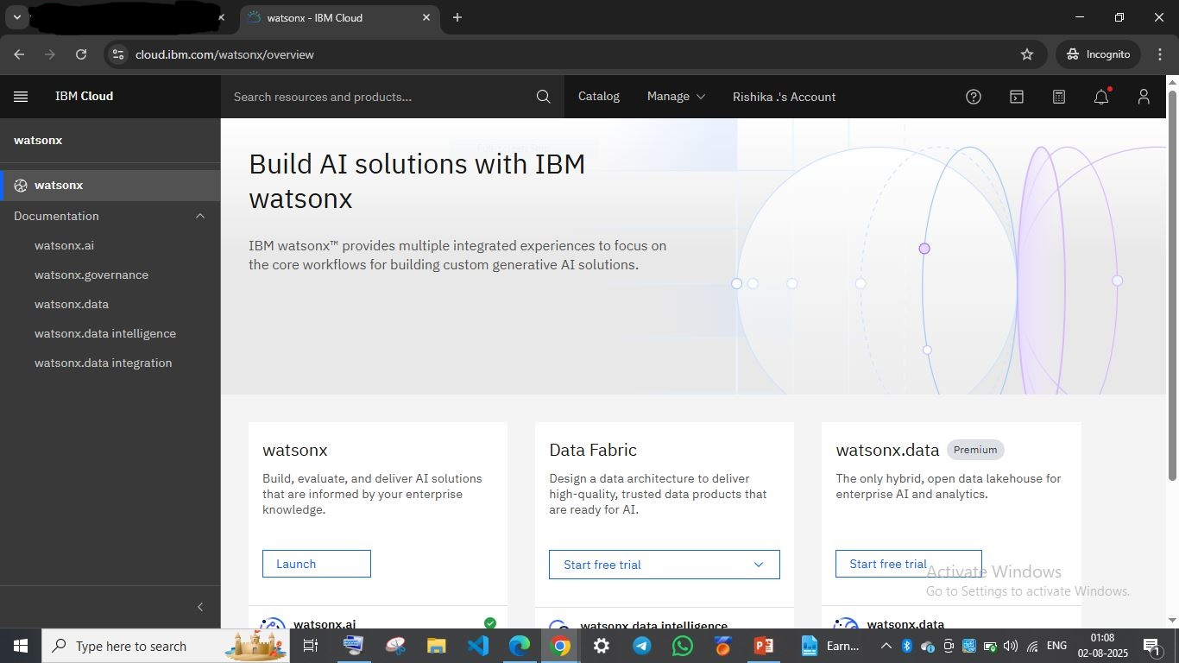

Slide 8
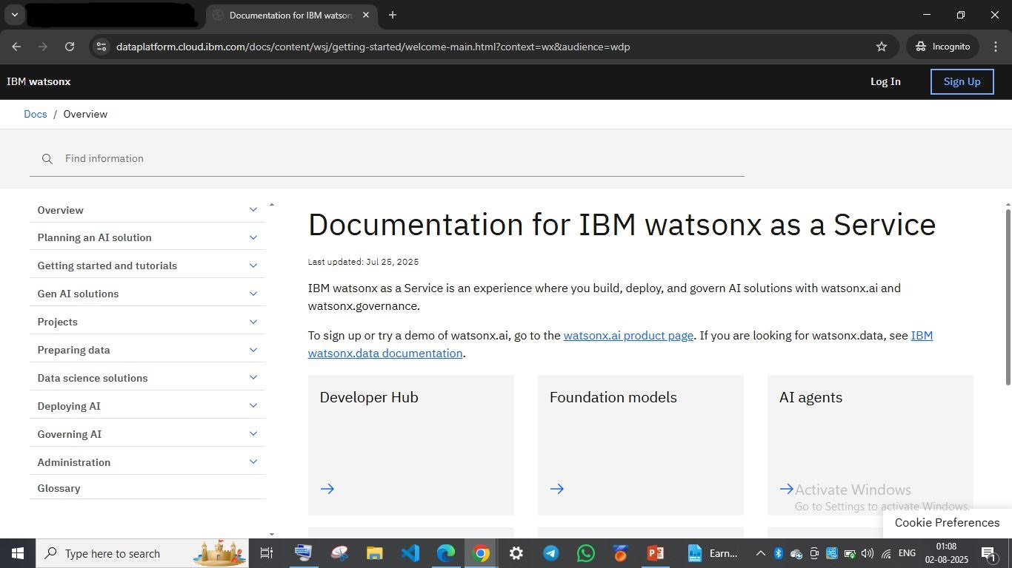

Slide 9
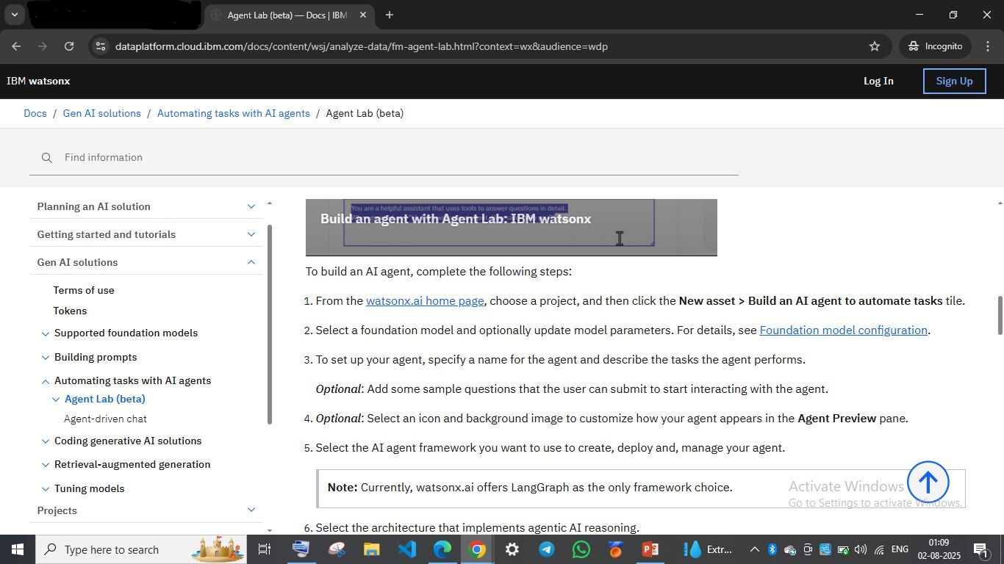

Slide 10
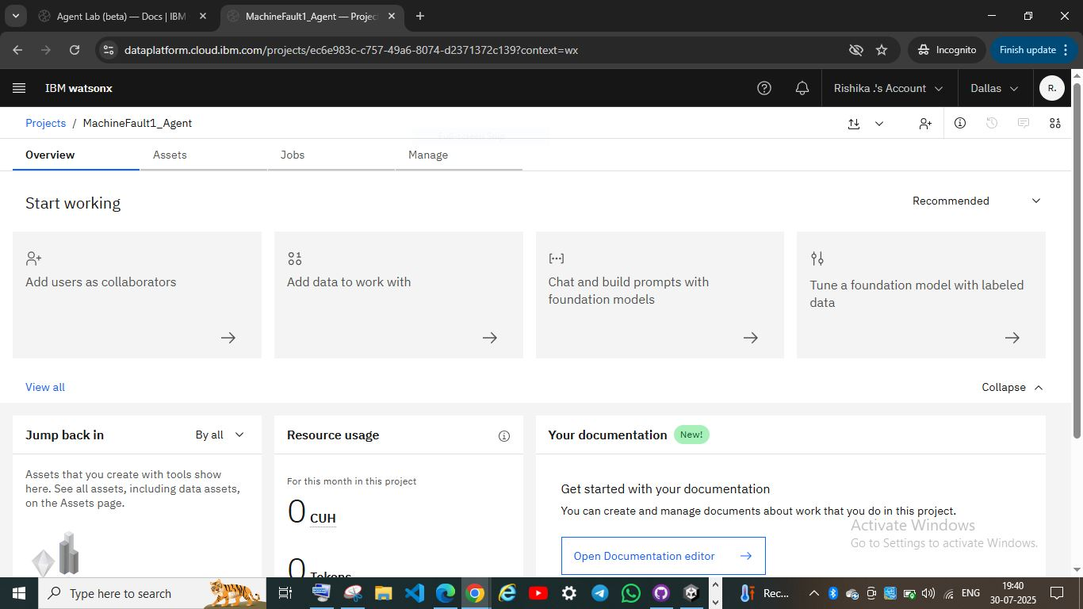
Project MachineFault1_agent

Slide 11
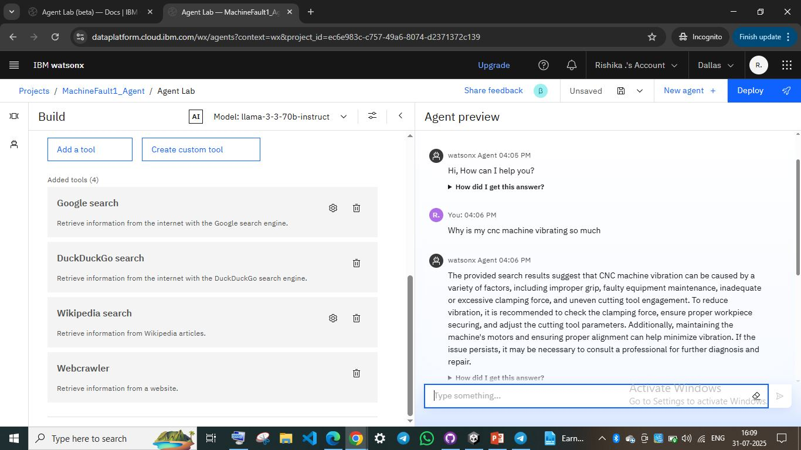
This is the preview of MachineFault Agent before deployment RESULT

Slide 12
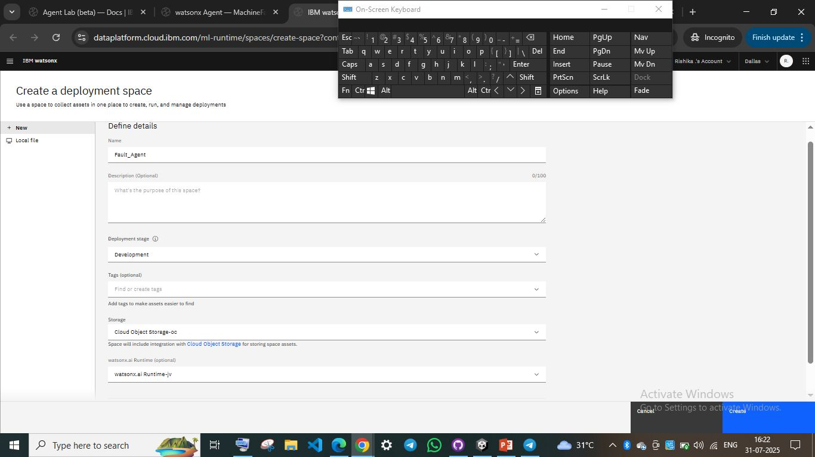
Deployment space creation

Slide 13
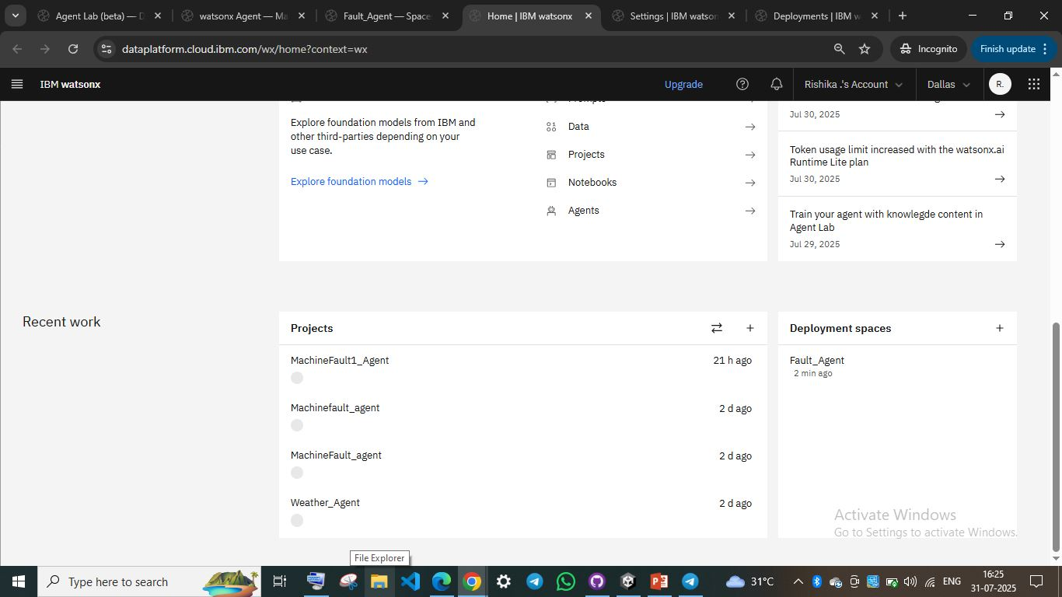

Slide 14
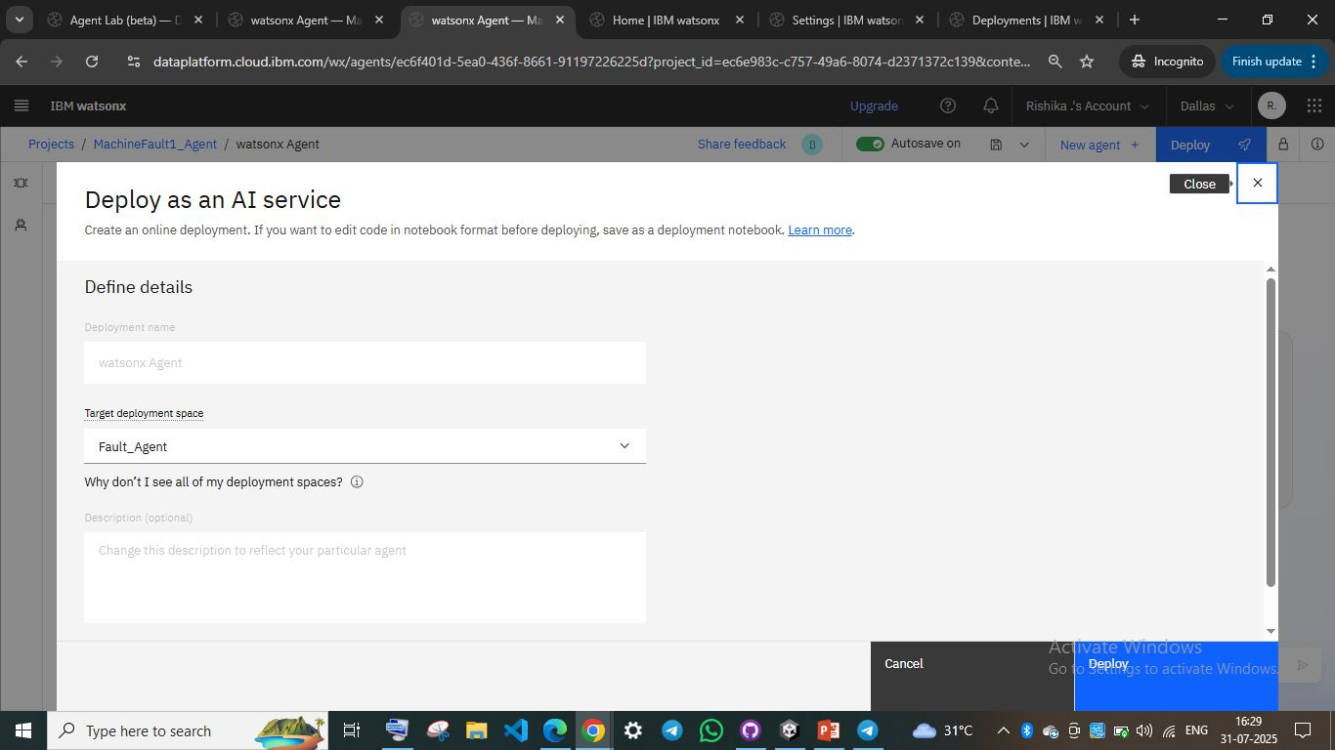
DEPLOYING THE AGENT

Slide 15
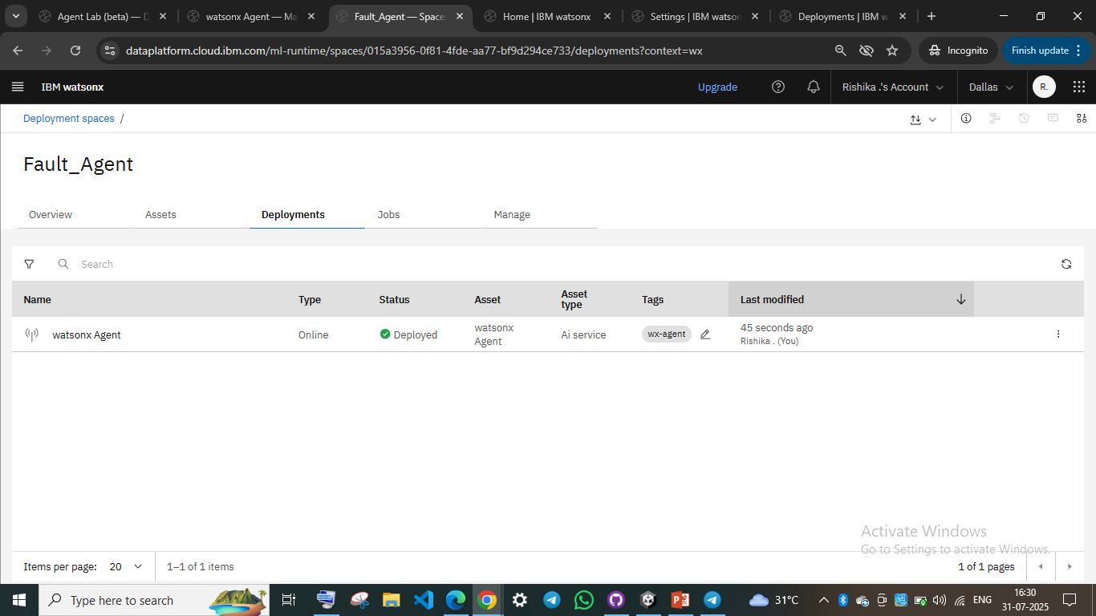
AGENT DEPLOYED

Slide 16
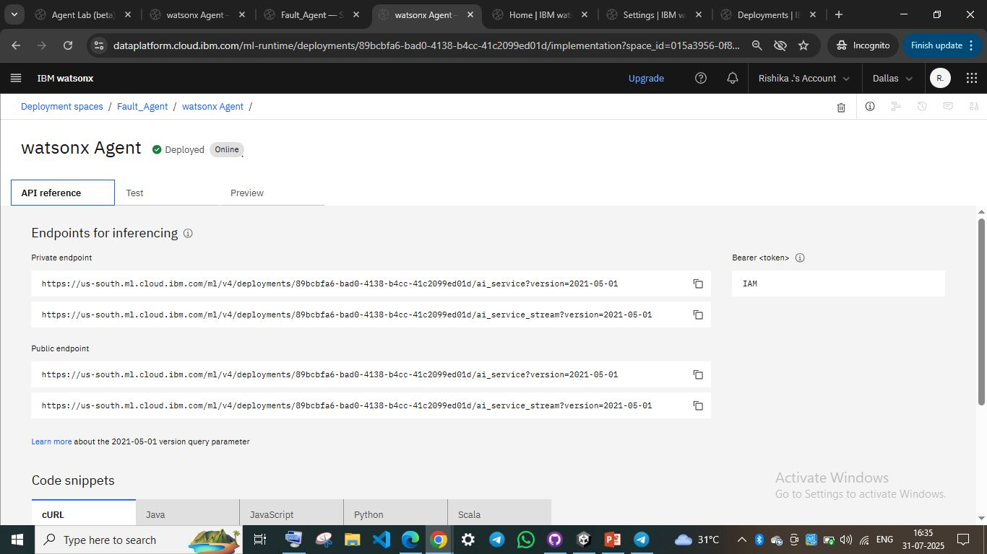
RESULT

Slide 17
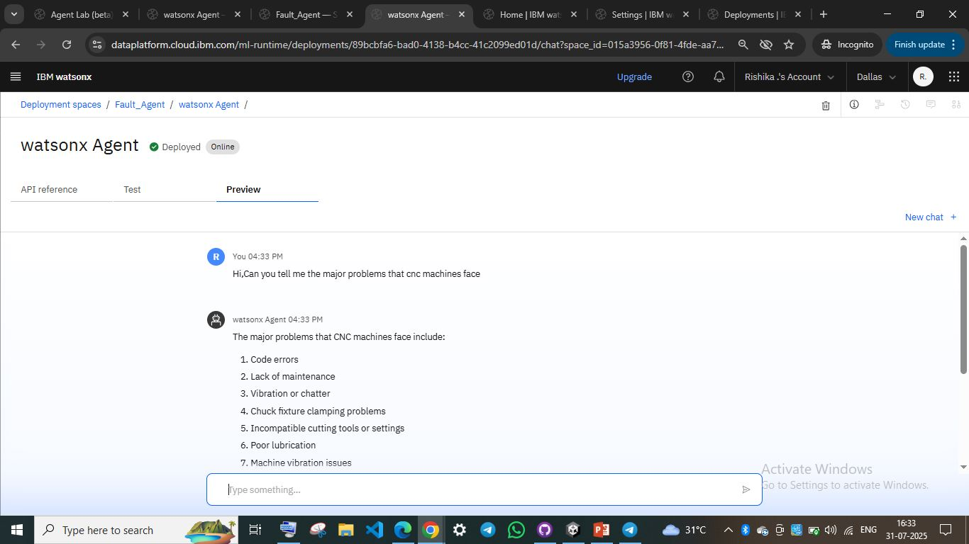
RESULT

Slide 18
conclusion
The Machine Fault Diagnosis Agent has the ability to detect and diagnose faults in industrial machinery such as lathes, mills and pumps by analyzing key factors like vibrations , unusual noises etc . It enhances efficiency by offering clear answers to specific fault related questions and gives basic maintenance steps and safety measures . This project can have problems due to insufficient data about fault which can lead to wrong information and steps against a particular fault , for improvement we can used IOT or real time monitoring with this project so we can get the actual fault that is happening in the particular machine

Slide 19
Future scope
The future scope of the Machine Fault Diagnosis Agent includes expanding its capabilities into self maintenance by integrating real time sensor data and machine learning for early fault detection. It can evolve to support voice commands and visual input for a more intuitive user experience(LVM).

Slide 20
References
IBM Cloud
Watsonx.ai
Google Search
DuckDuck Go
Wikipedia
WebCrawler

Slide 21
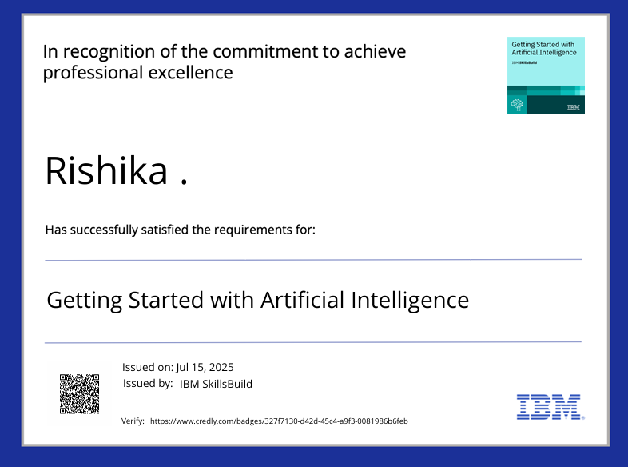
IBM Certifications

Slide 22
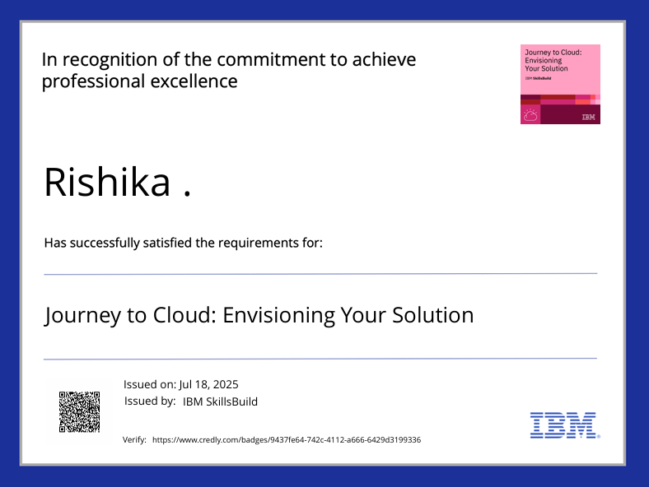
IBM Certifications

Slide 23
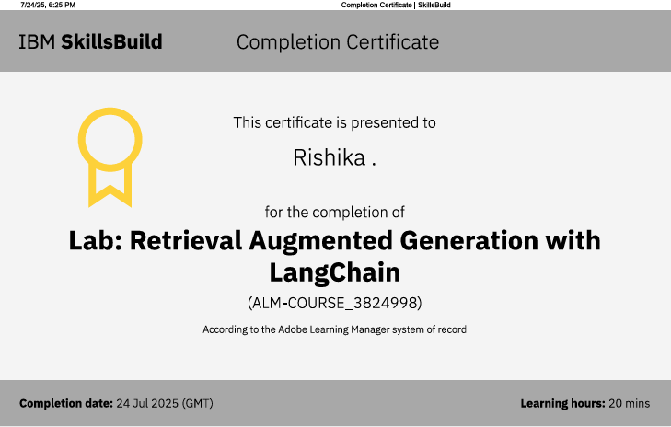
IBM Certifications

Slide 24
THANK YOU

