Slide 1
CODEGENIE
AI-Powered Code Generation using CodeLlama Description

Slide 2
INTRODUCTION
AI-Powered Coding Companion!
Challenge: Developers waste time on repetitive coding, debugging, and searching for solutions.
Vision: CodeGenie, powered by CodeLlama, automates code generation, debugging, and explanations—boosting productivity and efficiency.
Impact: Faster development, fewer errors, and smarter coding for all—from beginners to professionals.

Slide 3
Problem Statement
Complex Code Understanding
High Error Rates
Lack of AI-Assisted Coding Tools
Existing tools lack real-time AI for code explanation, debugging, and generation.
Manual coding is prone to errors, requiring extensive debugging and troubleshooting.
Understanding intricate code structures slows learning and delays development
Repetitive coding and debugging waste developers' time, reducing efficiency.
Time- Consuming Development

Slide 4
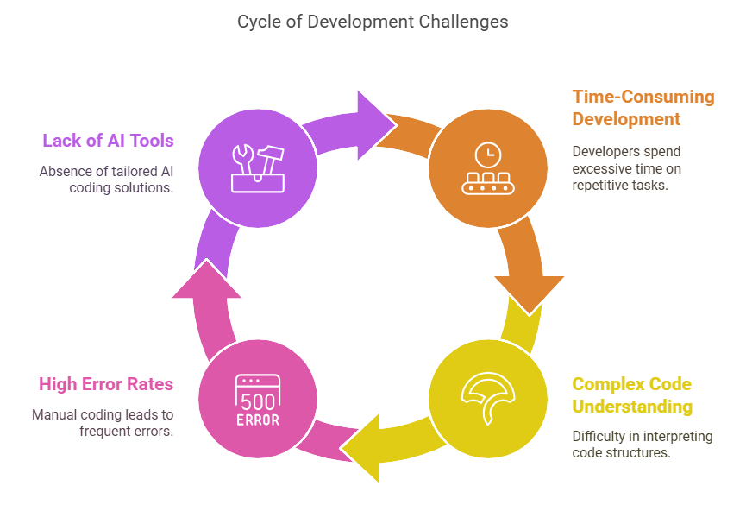

Slide 5
Solution
CodeGenie – AI-Powered Code Generation
Automated Code Generation – Converts text descriptions into optimized code snippets.
AI Debugging – Detects and fixes errors, reducing debugging time.
Code Explanation – Simplifies complex code for better understanding.
Multi-Language Support – Works with Python, Java, C++, JavaScript.
IDE Integration – Seamlessly connects with VS Code, PyCharm, etc.
Collaboration & Customization – Adapts to user preferences and supports teamwork.

Slide 6
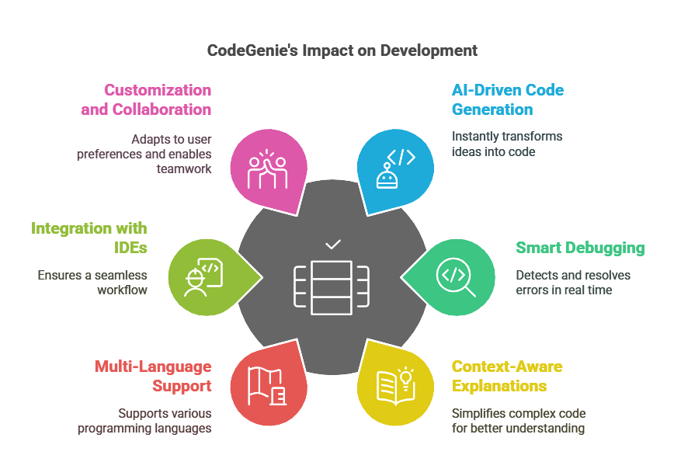
Unique Selling Proposition

Slide 7
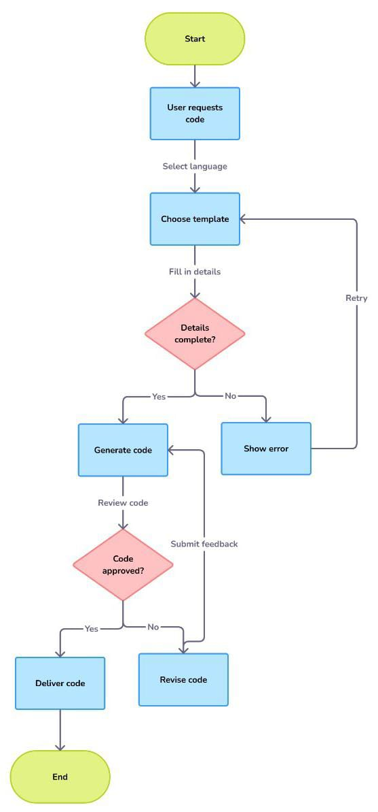
FLOWCHART

Slide 8
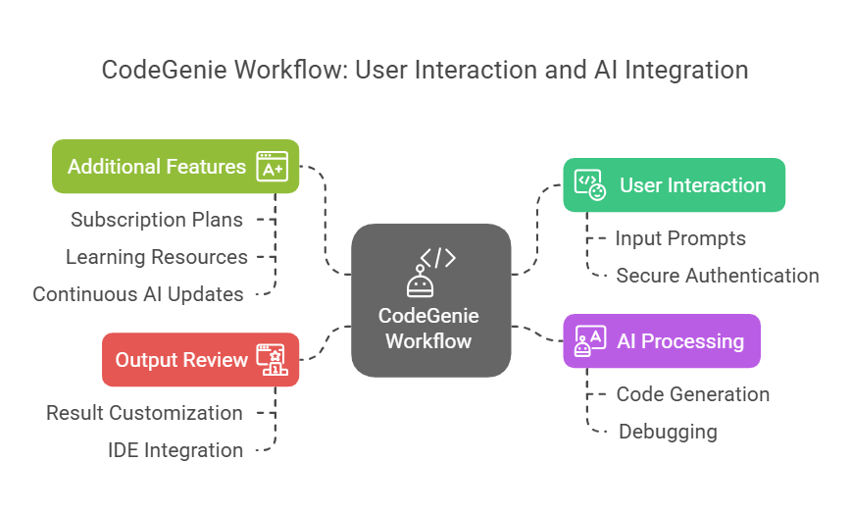

Slide 9
Results
Enhanced Engagement – Intuitive UI with dark & light mode ensures seamless navigation.
Higher Adoption – Clear features attract developers, teams, and educational institutions.
Boosted Productivity – AI-driven coding reduces development time and errors.
Stronger Community – Blogs, resources, and chatbots enhance collaboration.
Revenue Growth – Pricing plans drive conversions and scalability.
Scalable & Secure – Built on a modern tech stack for high performance and integrations.
Global Accessibility – Responsive design, browser extension, and mobile support.

Slide 10
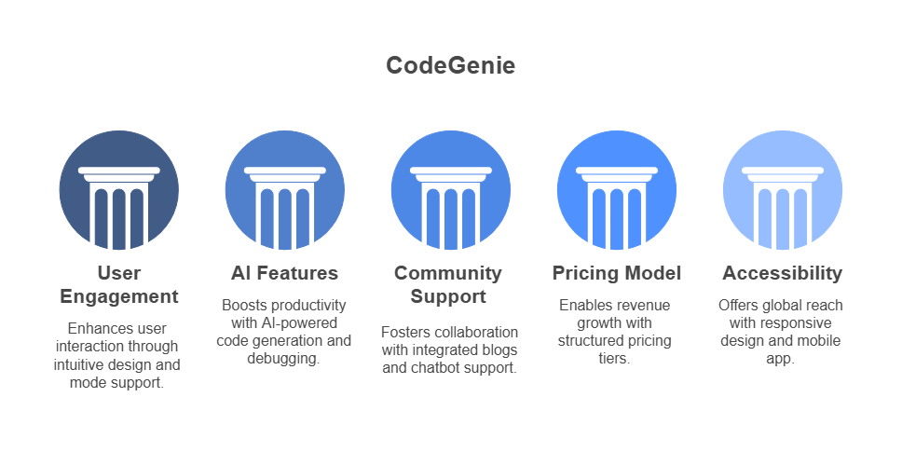

Slide 11
THANKYOU!
All Queries are Welcomed

