Slide 1


CMR TECHNICAL CAMPUS
UGC AUTONOMOUS
Kandlakoya, Medchal Road, Hyderabad – 501 401.
DEPARTMENT OF COMPUTER SCIENCE & ENGINEERING
(DATASCIENCE)
BATCH NO: 22
PERFORMANCE ANALYSIS ON STUDENTS FEEDBACK USING MACHINE LEARNING ALGORITHMS
Presented by:
CH.Rushikesh 207R1A6715
A.Abhishek Karthik 207R1A6701
B.Bhanu Prakash 207R1A6710
Under the Guidance of:
Dr. K.Srinivas Rao
(Head of the Department)

Slide 2
AGENDA
Abstract
Introduction
Existing System
Proposed System
System Architecture
UML Diagrams
Algorithms Used
Code
Result
Conclusion & Future Scope
References

Slide 3
ABSTRACT
The study uses supervised learning techniques to perform opinion mining, which involves identifying the sentiment and emotion in students feedback. It involves the use of advanced computational methods to analyze feedback data from students. This process aims to evaluate students performance and identify areas of strength and weakness. By collecting large volumes of feedback data, machine learning algorithms can be used to extract valuable insights that can help improve the quality of instruction and support student success. Techniques such as sentiment analysis and natural language processing can be used to classify feedback data and identify key topics and themes. The results of this analysis can be used to make data-driven decisions that improve the educational experience for both students and teachers. Performance analysis on students feedback using machine learning algorithms is a promising research area that has the potential to transform the way educational institutions evaluate and improve student performance.

Slide 4
INTRODUCTION
The main objective of student feedback system is to evaluate the student performance. This student feedback system collects student’s textual feedback comments and then classify them using SVM algorithm.
Once the student submits feedback by login to the portal, the feedback is analyzed through the analyzer. Feedback then classified into a positive, negative and neutral polarity using support vector machine algorithm.
This polarity helps to calculate whether the performance is good bad or moderate.

Slide 5
EXISITING SYSTEM
The paper spotlight on victimization Opinion Mining method for classifying the student's comments acquired during module evaluation survey. The mined and preprocessed datasets have been based to numerous supervised evaluations taking out rule like aid Vector Naïve Bayes (NB), Nearest Neighbor (KNN).
The paper projected a web feedback system that is concerning automating the method of recording student’s feedback. The projected system collects the feedback submitted by students and so classifies them as positive feedbacks or negative feedbacks victimization SVM classifier.

Slide 6
DISADVANTAGES
In the existing work, the system does not calculate large amount of data sets.
This system is less performance due to lack of learning, Natural Language Processing.

Slide 7
PROPOSED SYSTEM
The data is collected from the students in the form of the feedback of the college. The feedback consists of the textual reviews. Then the data pre-processing is done on the data that is collected. Later the Opinion classification is performed on the dataset and the results are obtained.
The review contains textual input about the college. Pre-processing is the progression of concentrated effort the data from redundant elements. It enlarges the accurateness of the results by dropping errors in the data. Not by means of pre-processing, such as enchantment corrections, may lead the system to disregard important words.

Slide 8
ADVANTAGES
Accurateness is outlined because of the quantitative relation of entire classifications that place unit specifically to the entire style of knowledge set.
The proposed system projected a web feedback system that is concerning automating the method of recording student’s feedback.

Slide 9
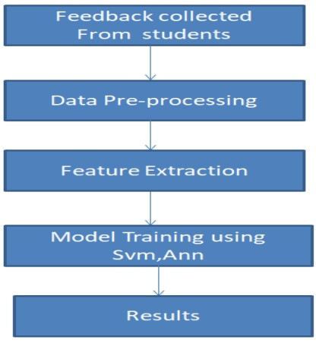
ARCHITECTURE

Slide 10
UML DIAGRAMS
i) use case diagram

Slide 11
ii) Sequence diagram

Slide 12
iii) Class diagram

Slide 13
iv) Activity diagram
Upload dataset
Read dataset
Train dataset
Test dataset
Predict result

Slide 14
ALGORITHMS USED
Svm
Random forest
Decision tree
Gradient boosting

Slide 15
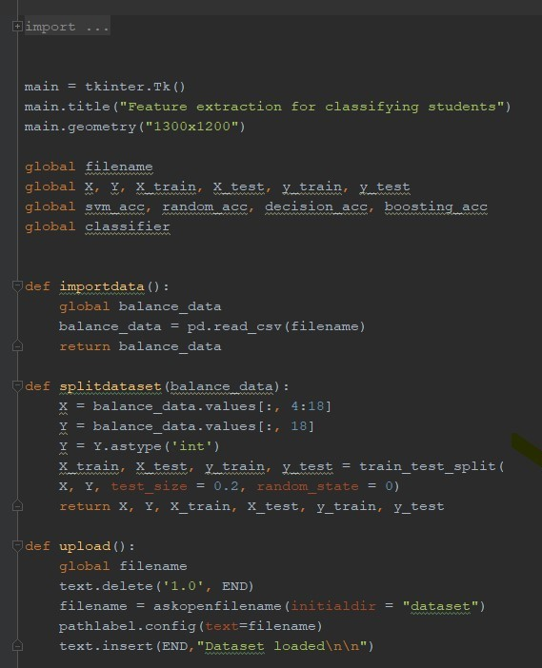
CODE

Slide 16
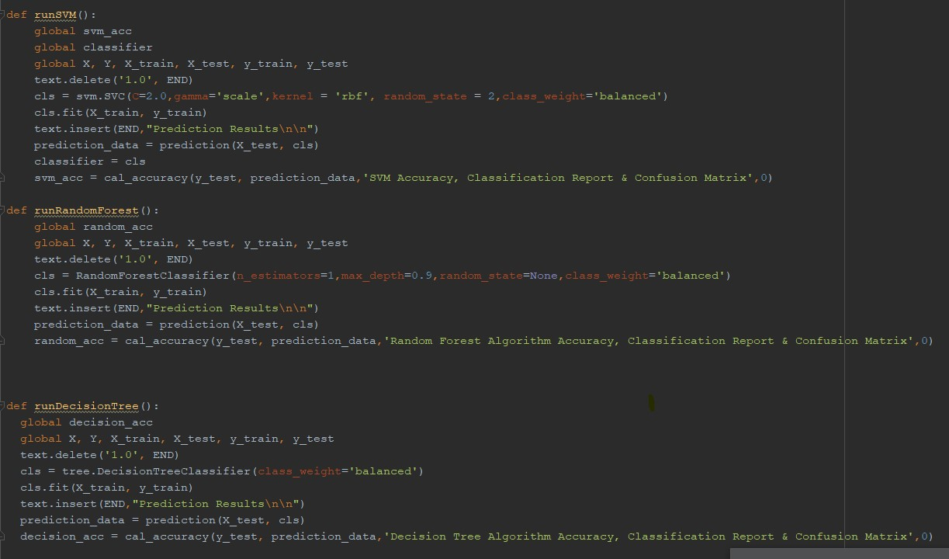

Slide 17
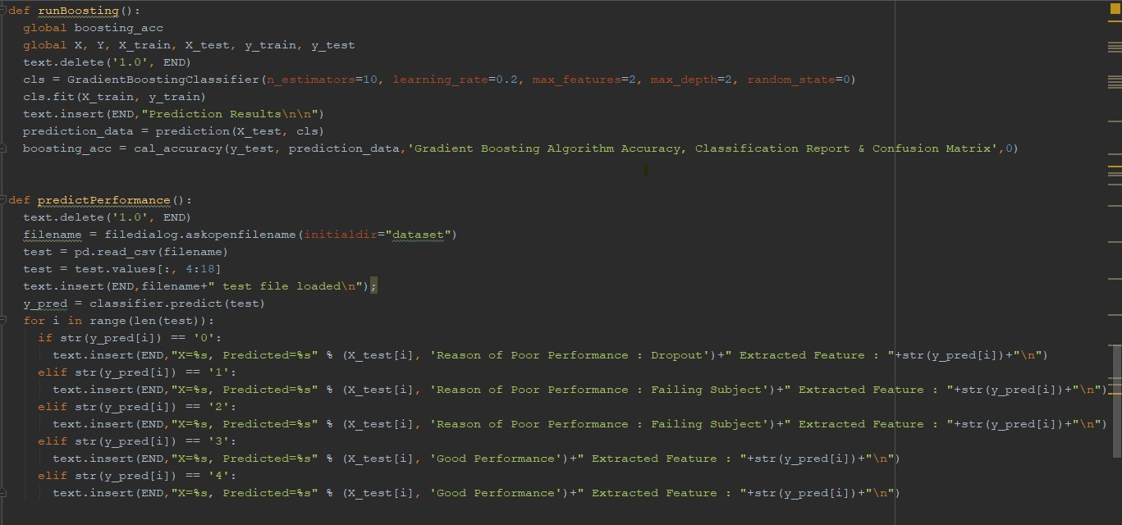

Slide 18
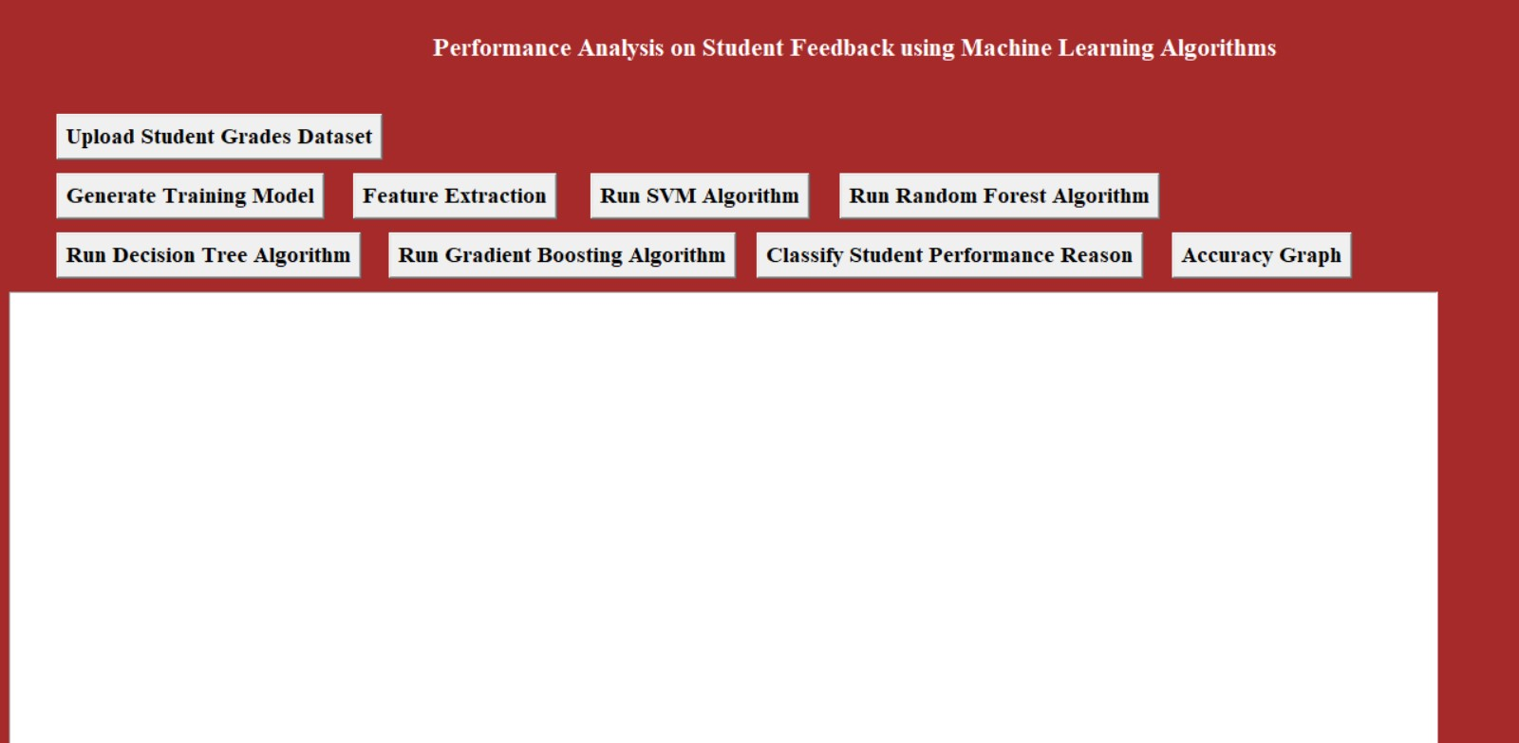
INTERFACE

Slide 19
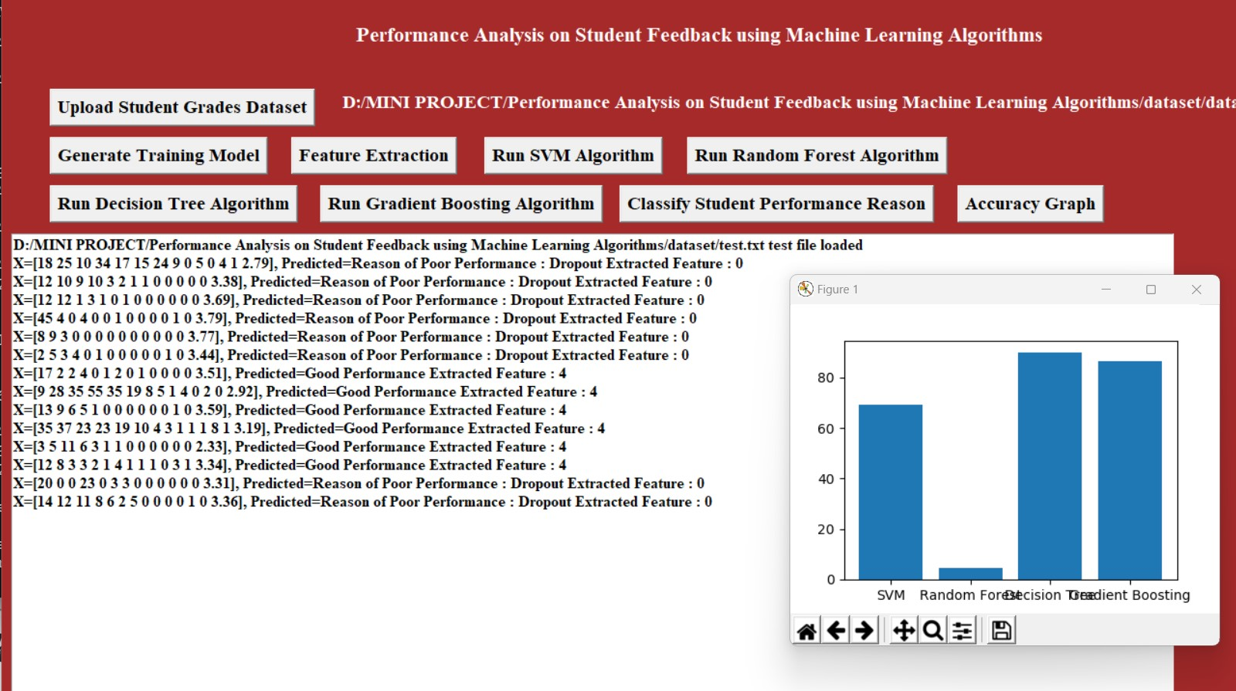

Slide 20
CONCLUSION
In conclusion, To achieve a performance analysis on students feedback using machine learning algorithms can provide valuable insights into various aspects of education and student satisfaction. By analyzing feedback data using machine learning algorithms, educational institutions can identify the factors that have the most significant impact on student satisfaction, predict satisfaction levels of future students, compare satisfaction levels across different courses and programs, and provide personalized recommendations for individual students.

Slide 21
FUTURE SCOPE
The future scope of a project analyzing student feedback using machine learning algorithms is promising and could have many potential applications. Some possible future scopes of the project could include:
Integration with other educational technologies
Real-time monitoring and feedback
Expansion to non-academic areas
Integration with other data sources

Slide 22
REFERENCES
[1]. V. Dhanalakshmi ; Dhivya Bino “Opinion mining from student feedback data using supervised
learning algorithms”, 2016 3rd MEC International Conference on Big Data and Smart City
(ICBDSC).
[2]. Sarpreet Kaur1 , Rasleen Deol,” Students Feedback for Mining Their Opinions Using
Supervised Learning Algorithm” International Journal of Engineering Science and Computing, June
2017.
[3]. Anushree Chitriv, Prof. A. Thomas Analysis of Student Feedback by Using Data Mining
Techniques , Helix 2018.

Slide 23
THANK YOU
ANY QUERIES?

