Slide 1
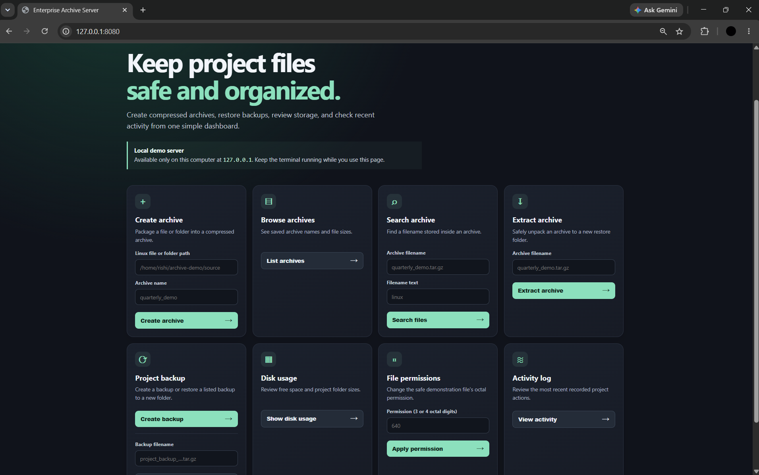
ENTERPRISE
ARCHIVE SERVER
A Linux system administration micro-project
Bash menu • archive and backup tools • local web dashboard
Local demo page at 127.0.0.1:8080
Presented by
Avinash K • V Rishith
Ragavendra Raju K S • N Nithish Kumar
Notes:
Opening: This is our Linux System Administration micro-project. It provides a Bash terminal menu for archive and backup tasks, plus an optional browser interface that runs locally on the same computer. Team members: Avinash K, V Rishith, Ragavendra Raju K S, and N Nithish Kumar.
Source: User-supplied Enterprise Archive dashboard screenshot. The supplied deck informed the visual palette and typefaces.

Slide 2
Project Purpose
One guided tool for routine Linux file administration.
Without a menu, a user must remember separate commands and paths for archiving, searching, restoring, checking storage, and changing permissions.
What the project provides
Project aim
• Create and inspect compressed archives
• Restore into a separate folder
• Review disk use, permissions, and recent actions
Make common tasks easier to run and demonstrate from Ubuntu, while keeping the project files and restore locations organized.
02 / 09
Notes:
Explain the problem in simple terms: Linux already has the commands, but beginners may find it difficult to remember them and use the correct paths. The project wraps the common tasks in a menu and gives clear results. Do not describe it as a production enterprise backup service.

Slide 3
System Architecture
The terminal and browser interfaces use the same Bash application and project folders.
INTERFACES
BASH CORE
LINUX TOOLS
PROJECT DATA
Ubuntu terminal menu
Optional browser forms
→
Feature functions
Input checks
Activity logging
→
tar / gzip
find / grep
df / du / chmod
→
archives/
backups/ and restored/
logs/ and data/
Browser route: HTML/CSS → BusyBox httpd on 127.0.0.1:8080 → Bash CGI → shared Bash functions
03 / 09
Notes:
Walk left to right. The user chooses an operation through the Ubuntu menu or optional website. The Bash application calls standard Linux commands and stores data in project folders. For the website, BusyBox serves the page locally, and a Bash CGI script passes the form request to the application.
Sources: scripts/archive_server.sh; scripts/start_web.sh; web/index.html; web/style.css; web/cgi-bin/archive.cgi.

Slide 4
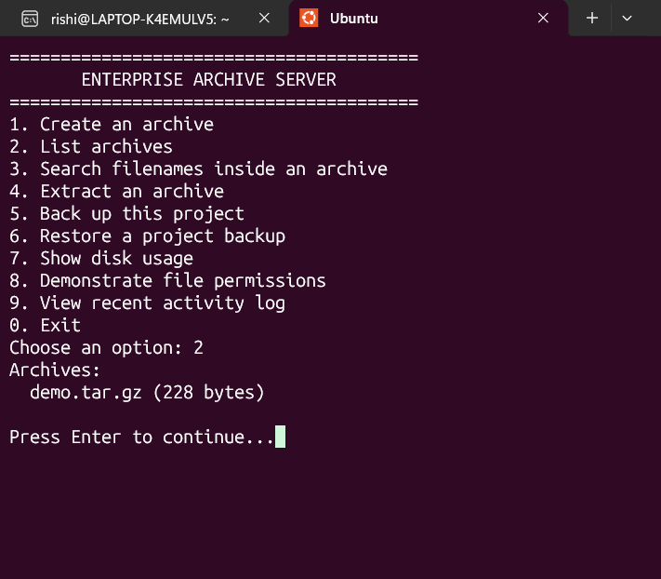
Archive Workflow
01
Choose source
Select a file or folder outside the project folder.
02
Create archive
Package it as a compressed .tar.gz file.
03
Browse or search
List archives or find a stored filename/path.
04
Extract safely
Search matches archived names and paths, not file contents.
Unpack to a new timestamped folder under restored/.
04 / 09
Notes:
Describe the normal archive path: select a source, create a .tar.gz package, list it, search the member names, and extract it. The script checks archive member paths and creates a fresh destination folder so it does not extract over the live project. Search checks names/paths only.
Sources: scripts/archive_server.sh; user-supplied terminal screenshot showing the archive list.

Slide 5
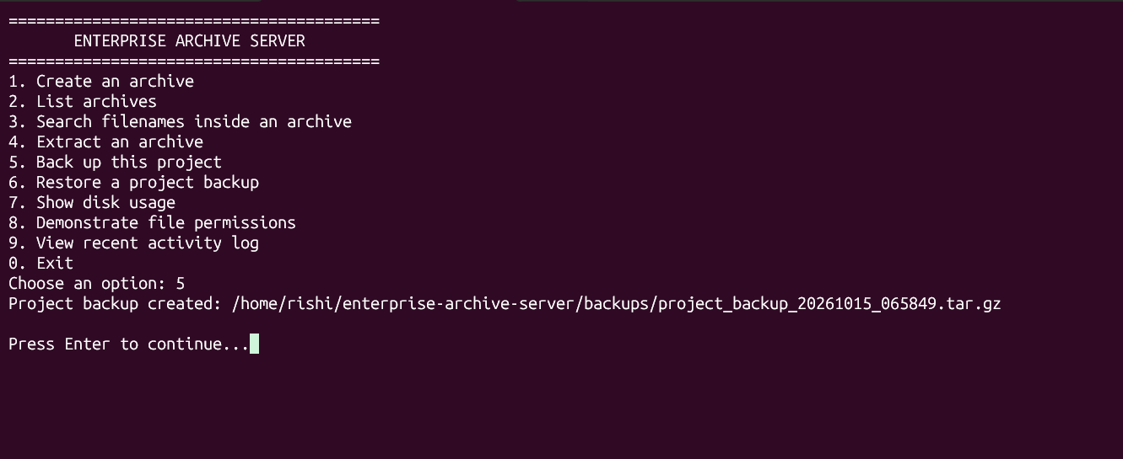
Project Backup and Restore
Backup flow
Project files
→
dated .tar.gz
backups/
Restore flow
chosen backup
→
new folder under
restored/
Included: scripts, web files, logs, and demo data.
Generated archives, backups, and restore folders are excluded.
The backup shown was created in the Ubuntu project folder.
05 / 09
Notes:
A backup is a dated compressed copy of selected project content. The script includes scripts, logs, data, web, and README/crontab example files when present. It excludes its generated archives, backups, and restored folders. Restore extracts the selected backup to a new timestamped folder under restored/.
Sources: scripts/archive_server.sh; user-supplied terminal screenshot showing backup creation.

Slide 6
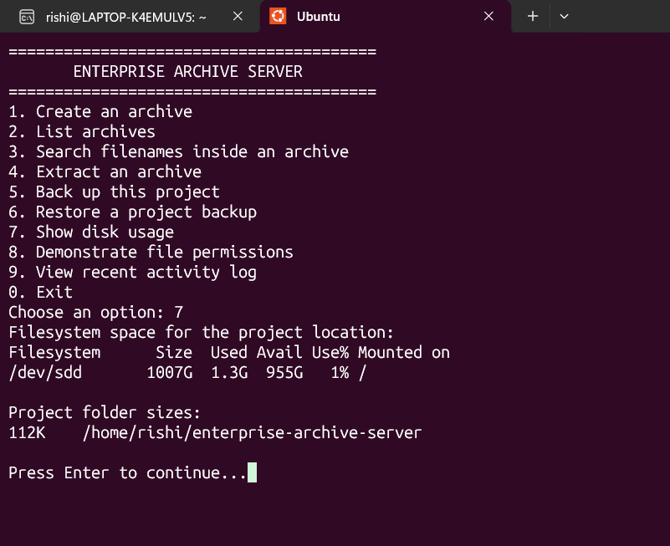
Linux Administration Features
Disk use
df -h reports filesystem capacity.
du -sh summarizes project-folder sizes.
File permissions
chmod changes only data/permission_demo.txt. Mode 640 means owner can read/write, group can read, others have no access.
Activity log
Successful actions are timestamped in logs/activity.log.
The storage figures are a snapshot from the demo VM.
06 / 09
Notes:
Explain each Linux administration function. df shows free/used space on the filesystem; du shows the project and selected folder sizes. The permissions operation creates or modifies only the sample file and uses an octal value. For mode 640, owner has read/write, group has read, and others have no permissions. The activity log appends timestamps and action descriptions. The displayed storage values are from one VM session and may change.
Sources: scripts/archive_server.sh; user-supplied disk-usage terminal screenshot.

Slide 7
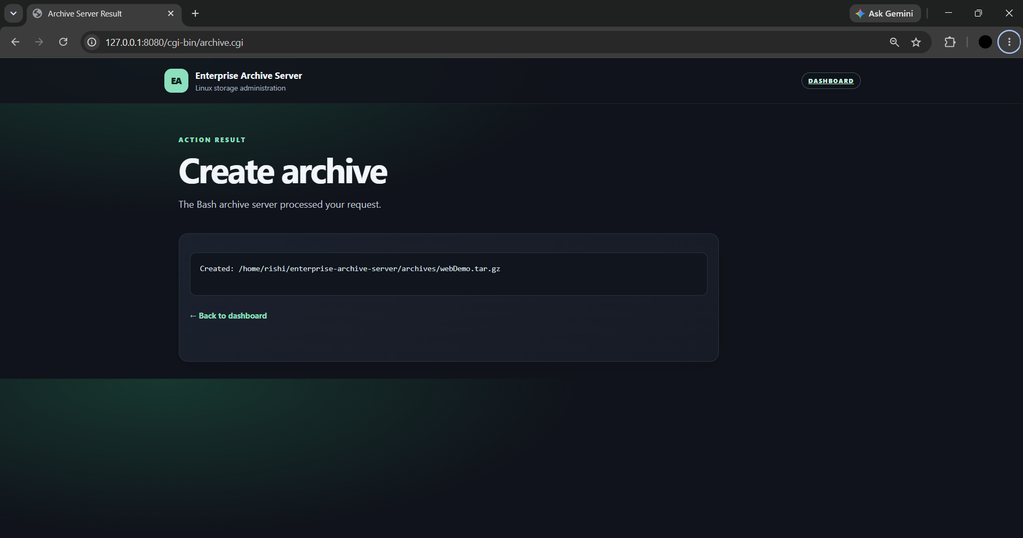
Optional Browser Interface
Frontend
HTML and CSS display forms for the archive and administration actions.
Backend bridge
A Bash CGI script receives form values and calls the project’s Bash operations.
Local deployment
BusyBox serves the demo at 127.0.0.1:8080. Keep it local; the page has no login.
Confirmed browser action: webDemo.tar.gz was created in archives/.
07 / 09
Notes:
This is an optional browser frontend to the same Bash project. HTML/CSS build the page, BusyBox httpd serves it on localhost, and the Bash CGI bridge routes the form action to the Bash application. The screenshot confirms a browser archive creation. Do not call this public deployment: it is local and has no user login.
Sources: scripts/start_web.sh; web/index.html; web/style.css; web/cgi-bin/archive.cgi; user-supplied browser result screenshot.

Slide 8
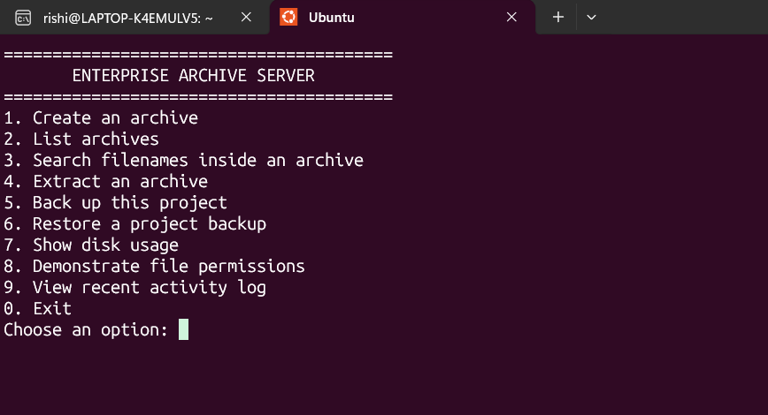
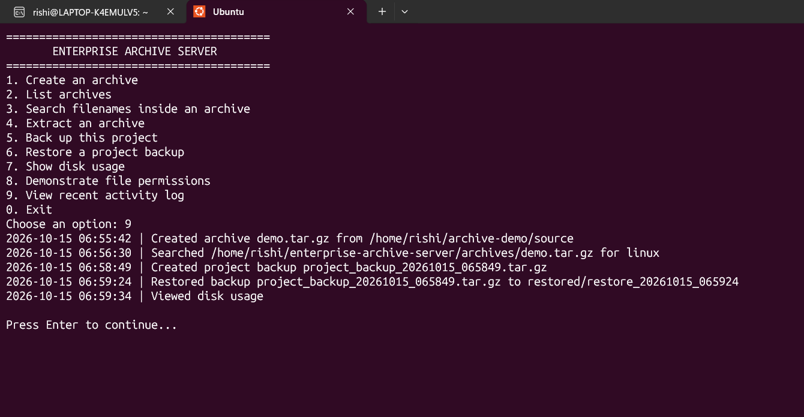
Classroom Demo
Terminal demo
Activity evidence
Run the menu and show archive, backup, restore, storage, permission, and log options.
The log records completed actions with timestamps for review.
08 / 09
Notes:
Suggested presentation sequence: open the terminal menu; create and list an archive; search a filename; extract to the new restore folder; make and restore a backup; show disk space, set permission 640 on the sample file, and review the log. Then show the browser dashboard and one successful archive creation. The supplied screenshots document the menu and recent activity.
Sources: user-supplied terminal menu and activity-log screenshots; scripts/archive_server.sh.

Slide 9
Current Result and Next Steps
A working Bash administration tool with a local browser interface.
Implemented
Next improvements
Terminal menu for archive, search, extraction, backup/restore, disk use, permissions, and logs.
Browser dashboard opened locally; archive creation was demonstrated.
Retest the browser search with the exact archive filename and verify the remaining web forms.
For wider use: add authentication, backup retention, checksum verification, and remote storage.
The cron example is optional; recurring backups were not enabled in the demo.
09 / 09
Notes:
Close by stating what is implemented and distinguishing it from future scope. The terminal operations were demonstrated. The browser dashboard opened and successfully created an archive; the first search attempt returned “archive not found,” so the user should retry with the exact filename and verify other browser forms before claiming them as tested. The server has no authentication and should remain on localhost. A cron example is supplied, but automated recurring backups were not enabled in the captured session.

