Slide 1
LEAD SCORE
CASE STUDY
Logistic regression

Slide 2
PROBLEM STATEMENT
X Education is an organization which provides online courses for industry professional. The company marks its courses on several popular websites like google.
X Education wants to select most promising leads that can be converted to paying customers.Although the company generates a lot of leads only a few are converted into paying customers, wherein the company wants a higher lead conversion. Leads come through numerous modes like email, advertisements on websites, google searches etc.
The company has had 30% conversion rate through the whole process of turning leads into customers by approaching those leads which are to be found having interest in taking the course. The implementation process of lead generating attributes are not efficient in helping conversions.

Slide 3
BUSINESS GOAL
The company requires a model to be built for selecting most promising leads.
Lead score to be given to each leads such that it indicates how promising the lead could be. The higher the lead score the more promising the lead to get converted, the lower it is the lesser the chances of conversion.
The model to be built in lead conversion rate around 80% or more.

Slide 4
STRATEGY
Import data
Clean and prepare the acquired data for further analysis
Exploratory data analysis for figuring out most helpful attributes for conversion
Scaling features
Prepare the data for model building
Build a logistic regression model
Assign a lead score for each leads
Test the model on train set
Evaluate model by different measures and metrics
Test the model on test set
Measure the accuracy of the model and other metrics for evaluation

Slide 5
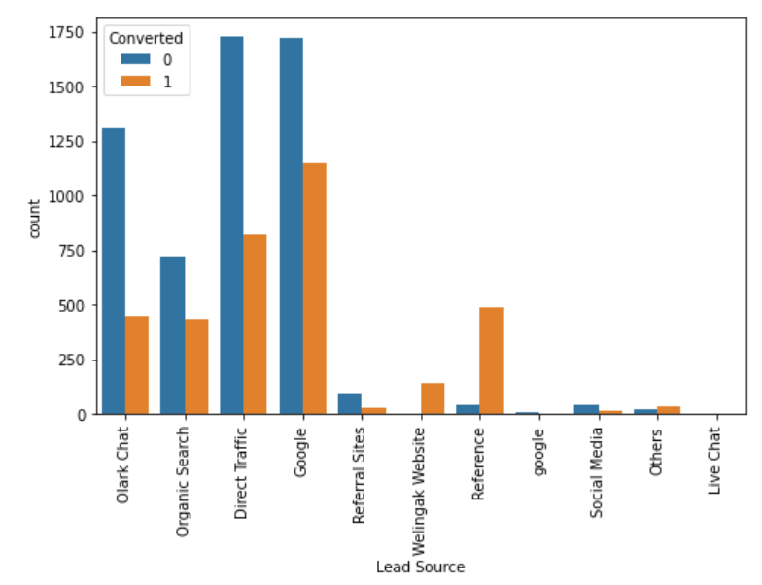
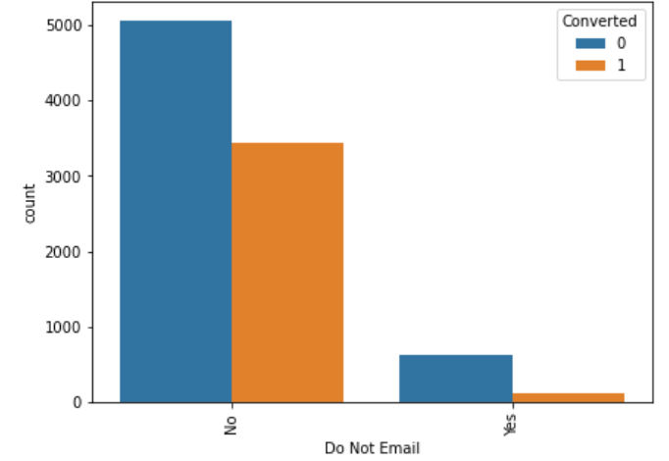
Exploratory data analysis
Lead Source VS Converted
Google searches has had high conversion compared to other modes whilst differences has had high conversion rate
Do not E-mail VS Converted
Google searches has had high conversion compared to other modes whilst differences has had high conversion rate

Slide 6
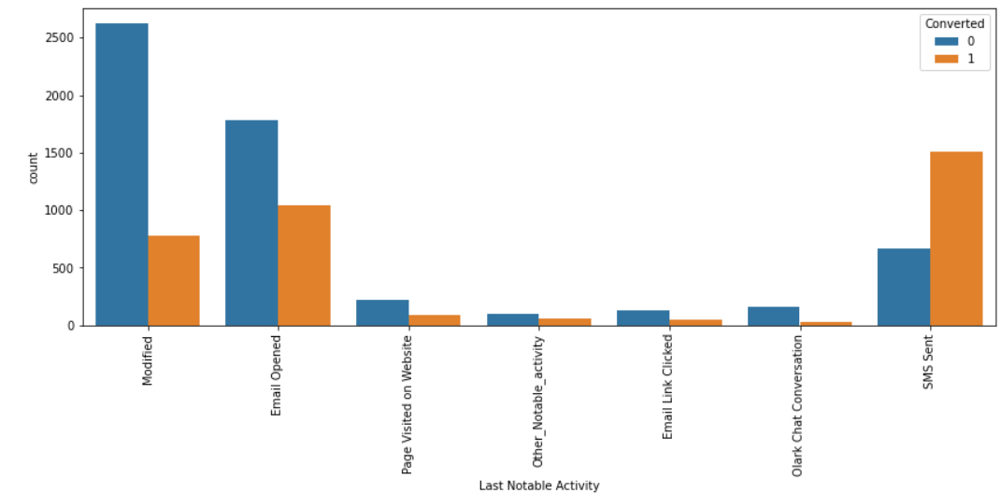
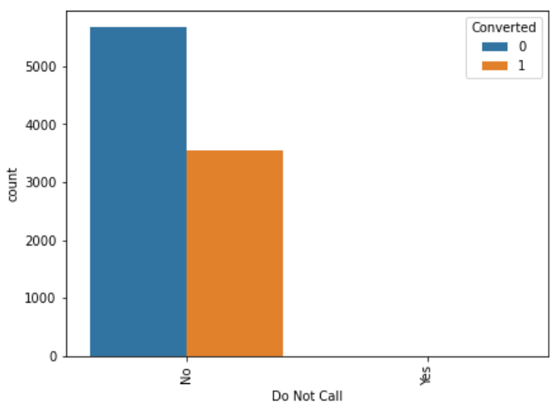
Exploratory data analysis
Last Notable Activity VS Converted
Most leads are converted with messages email also induce leads
Do Not Call VS Converted
Most leads prefer not to be informed through phone

Slide 7
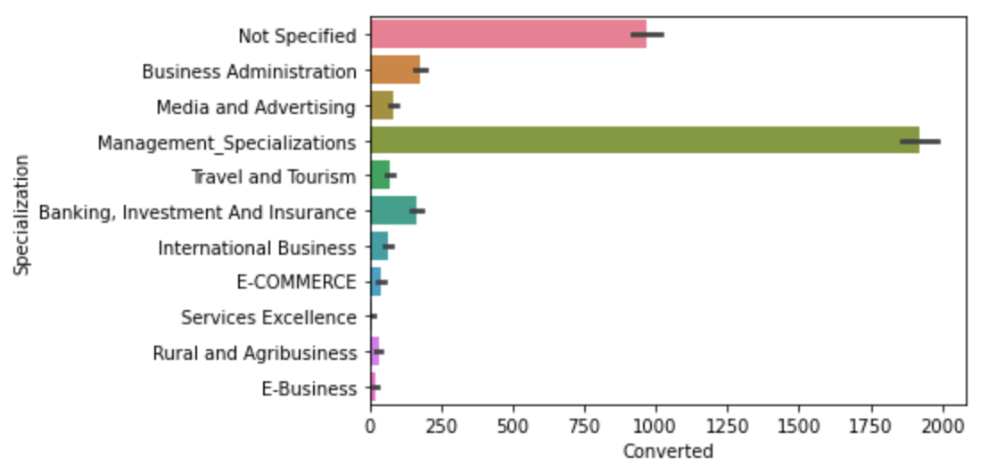
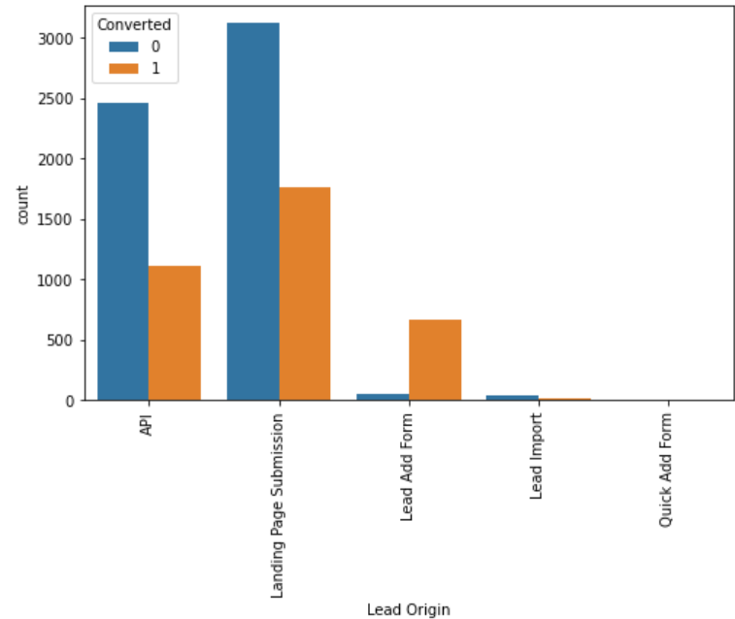
Exploratory data analysis
SpecializationVS Converted
Most of the leads have no information about specialization, on the other hand management specialization has high conversion rates people from the specialization can be promising leads
Lead Origin VS Converted
Landing page submissions has had high lead conversions

Slide 8
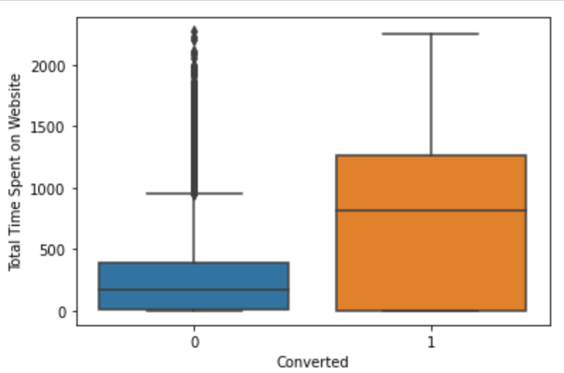
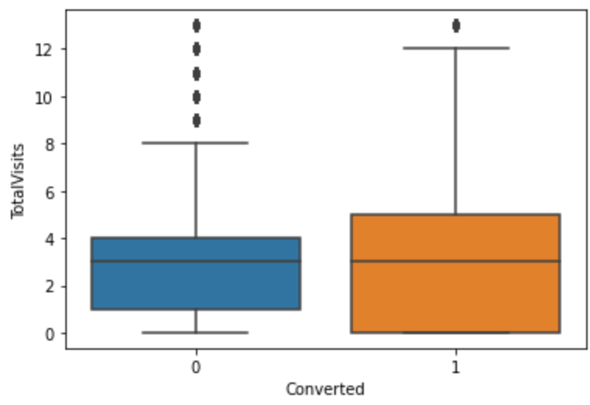
Exploratory data analysis
Total Time Spent VS Converted
People spending higher than average time are promising leads
Total Visits VS Converted
Higher total visit have a slide higher chances of being a promising lead

Slide 9
MODEL BUILDING
Splitting into train and test set.
Scale variables in train set.
Build the first model.
Use RFE to eliminate less relevant variables.
Build the next model.
Eliminate variables based on high p-values.
Check VIF value for all the existing columns.
Predict using train set.
Evaluate accuracy and other metric.
Predict using test set.
Precision and recall analysis on test predictions.

Slide 10
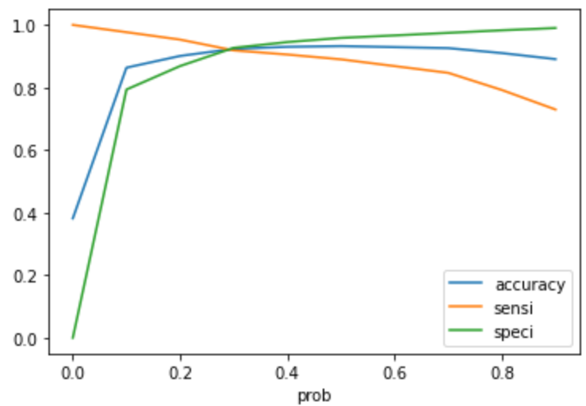
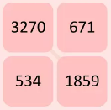
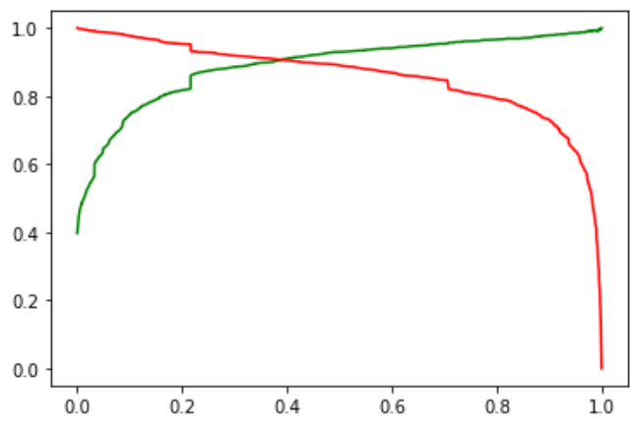
Model Evaluation (Train)
Accuracy Sensitivity And Specificity
93.1% accuracy
92.9% sensitivity
93.2% specificity
Precision And Recall
88.5% Precision
91.8% Recall

Slide 11

Model Evaluation (Test)
Accuracy Sensitivity And Specificity
90.9% accuracy
88.9% sensitivity
90.2% specificity
Test set threshold has been set as 0.35
Precision And Recall
89.6% Precision
91.9% Recall

Slide 12
Conclusion
Exploratory Data Analysis
People spending higher than average time are promising leads, so targeting them and approaching them can be helpful in conversions.
SMS messages can have a high impact on lead conversion.
Landing page submissions can help find out more leads.
Marketing management, human resources management has high conversion rates. People from these specializations can be promising leads.
References and offers for referring a lead can be good source for higher conversions. An alert messages or information has seen to have high lead conversion rate.
Precision And Recall
The model shows high close to 93% accuracy.
The threshold has been selected from Accuracy, Sensitivity, specificity measures and precision, recall curves.
The model shows 89% sensitivity and 90% specificity.
The model finds correct promising leads and leads that have less chances of getting converted.
Overall this model proves to be accurate

