Slide 1
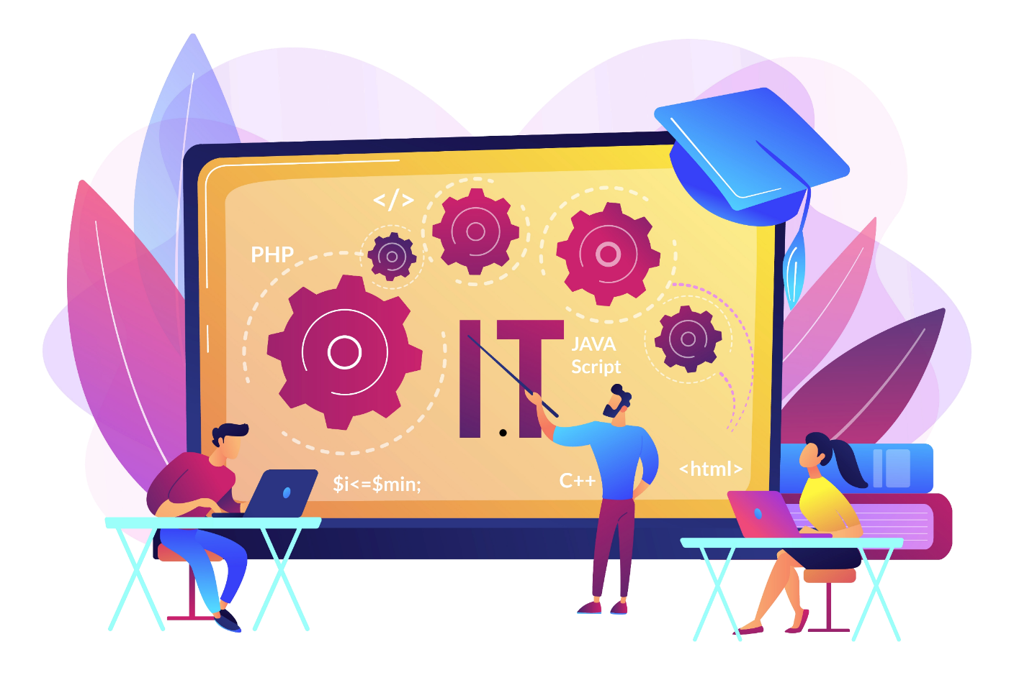
IT-What it is?
Information technology (IT) is the use of electronic devices to create, process, store, and exchange all kinds of electronic data and information . It has transformed the world into a tech village. Everything these days is connected to each other and that is just because of IT.

Slide 2
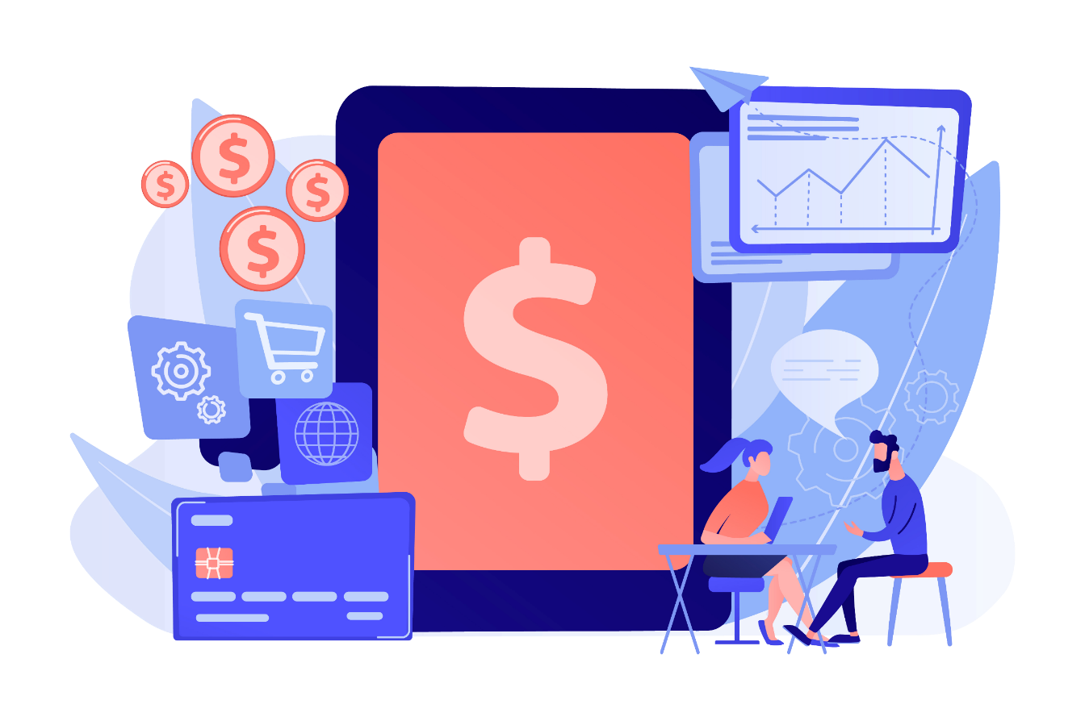
Where exactly is IT ?r
The simplest answer to this question would be ‘EVERYWHERE’. Today we can communicate with one sitting thousands of miles away with a SMARTPHONE. Today we can predict when and how the weather will be like. Today we can explore the universe. Today we can pay bills from home. Today we can study online. Today we can do almost everything we want to. This is what IT has achieved. Today IT is also the one of the largest contributors to a nations’ economy. This is what IT has achieved.

Slide 3
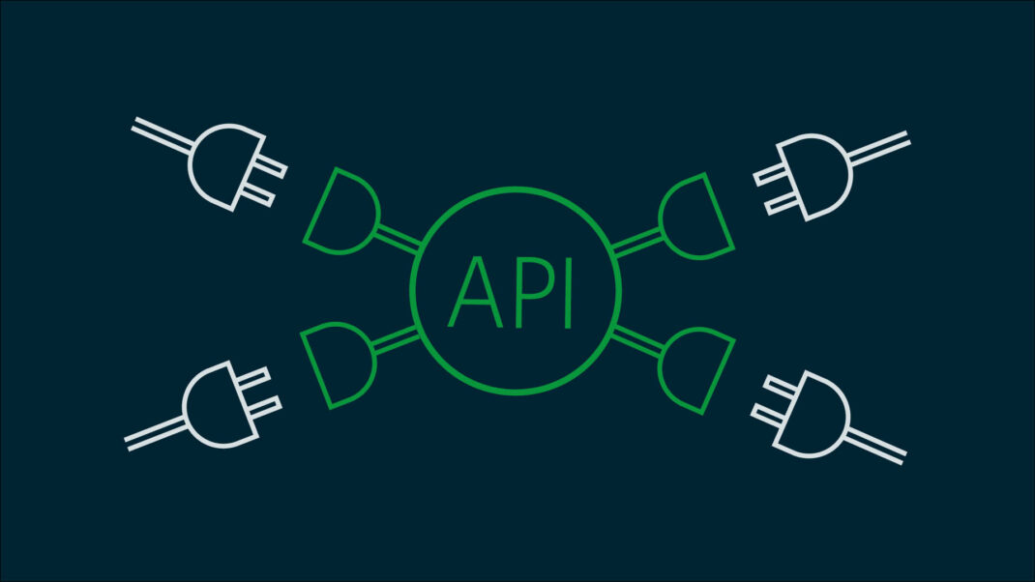
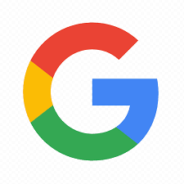


API
An application programming interface (API) is a connection between computers or between computer programs. It is a type of connection between software that offer a particular piece of service developed by one to the other . They reduce the time and money you have to invest while developing because the lesser code you have to write, the more convenient it gets. For an instance , take weather apps .Now common developers can’t afford to establish a meteorological satellite in solar system. In that case they use the weather APIs provided by the other companies who have their own satellites.
Major tech companies like Google, Amazon, and Twitter provide their own APIs to ease developers' lives.

Slide 4
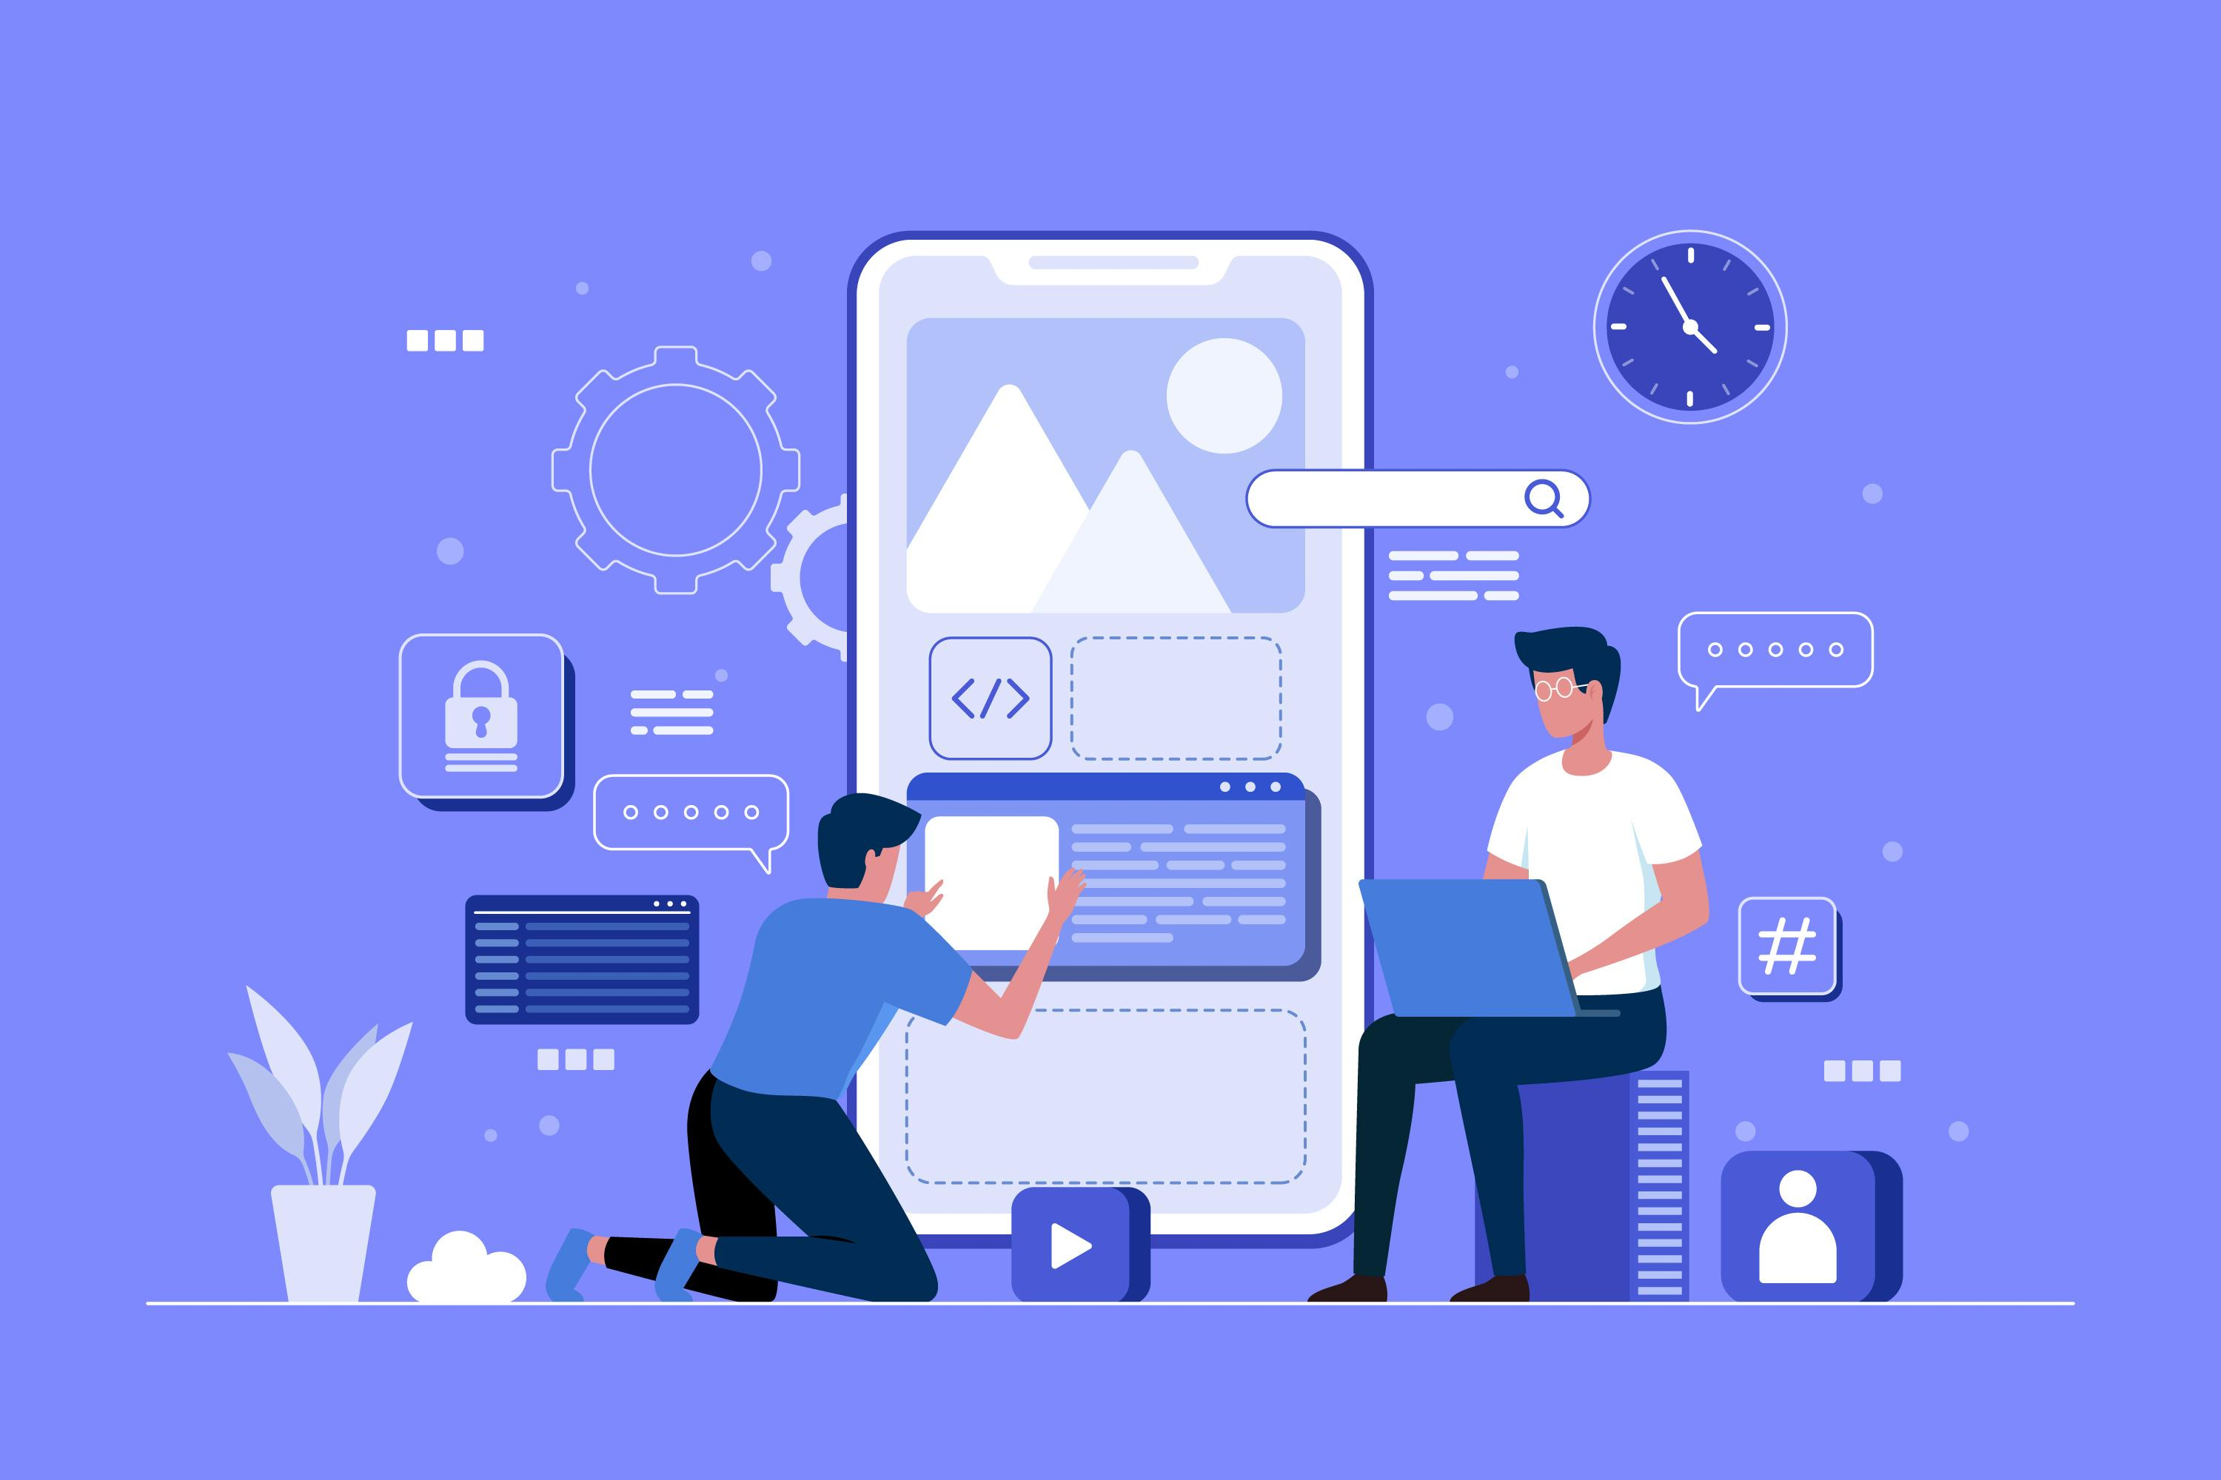
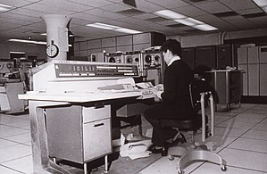
History of APIs
The term API initially described an interface only for end-user-facing programs, known as application programs. This origin can still be seen in the name "application programming interface." Today, the term is broader, including also utility software and even hardware interfaces.
The idea of the API is much older than the term itself. British computer scientists Maurice Wilkes and David Wheeler worked on a modular software library in the 1940s for EDSAC, an early computer.
Source: Wikipedia

Slide 5
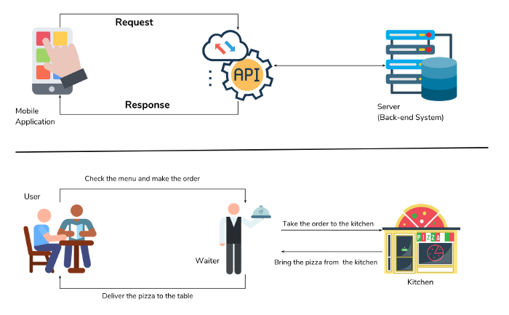
How does an API work?
APIs have increased the productivity of developers drastically. Now they don’t need to write the complex codes again that have already been written.
APIs act as a middleman between two software. Let‘s understand this through an example.
Consider you have to book an airline ticket for a flight by IndiGo Airlines. To book the ticket, you go to ixigo.com that books an airline ticket for IndiGo. Now, how is it possible that a third-party website i.e. ixigo books an airline of IndiGo for you? This is where API comes into play. Through the API, IndiGo allows ixigo to get the necessary data about seats etc. and when you book a seat ixigo books it in the IndiGo severs also through the API so that if anyone else tries to book the same seat through other third-party software like via.com, PayTM or through the IndiGo itself, they find that seat already booked. Now, in the market, no company trusts other so easily and no one would like to share their data with third party software. This is where the API Keys work.

Slide 6
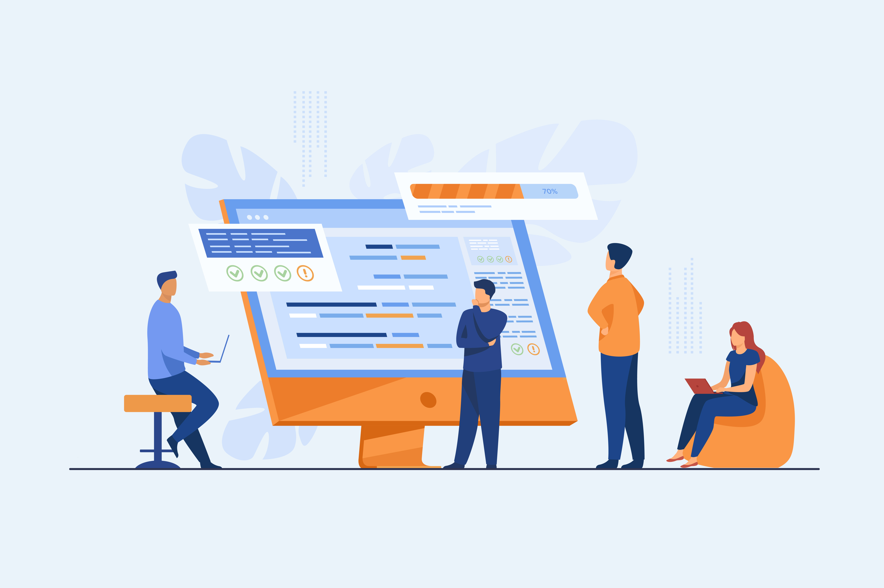
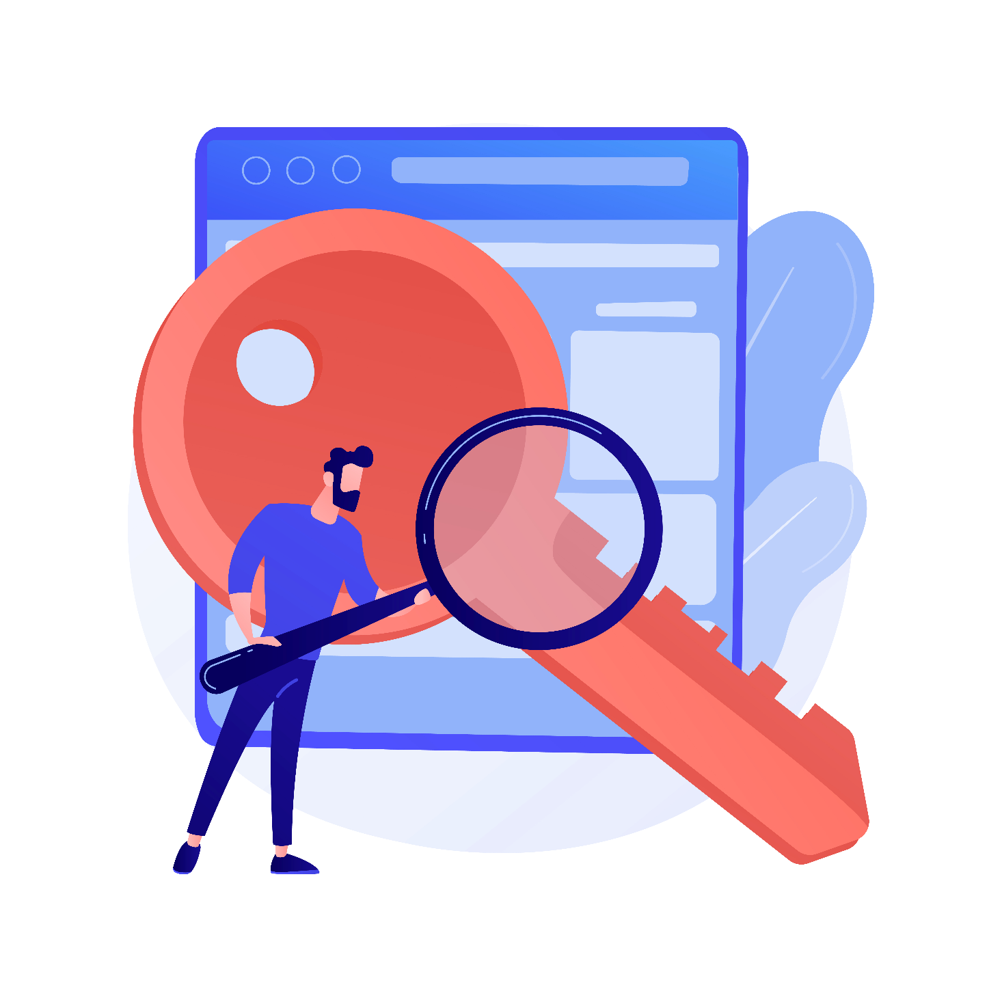
API Key
The API key is a unique identifier that authenticates requests associated with your project for usage and billing purposes. Now, in the previous example, IndiGo gives each of the third-party software a unique code i.e. API key that is required and identified by the IndiGo severs before they give their data to those. So, API keys make data transfer much more trustworthy.

Slide 7
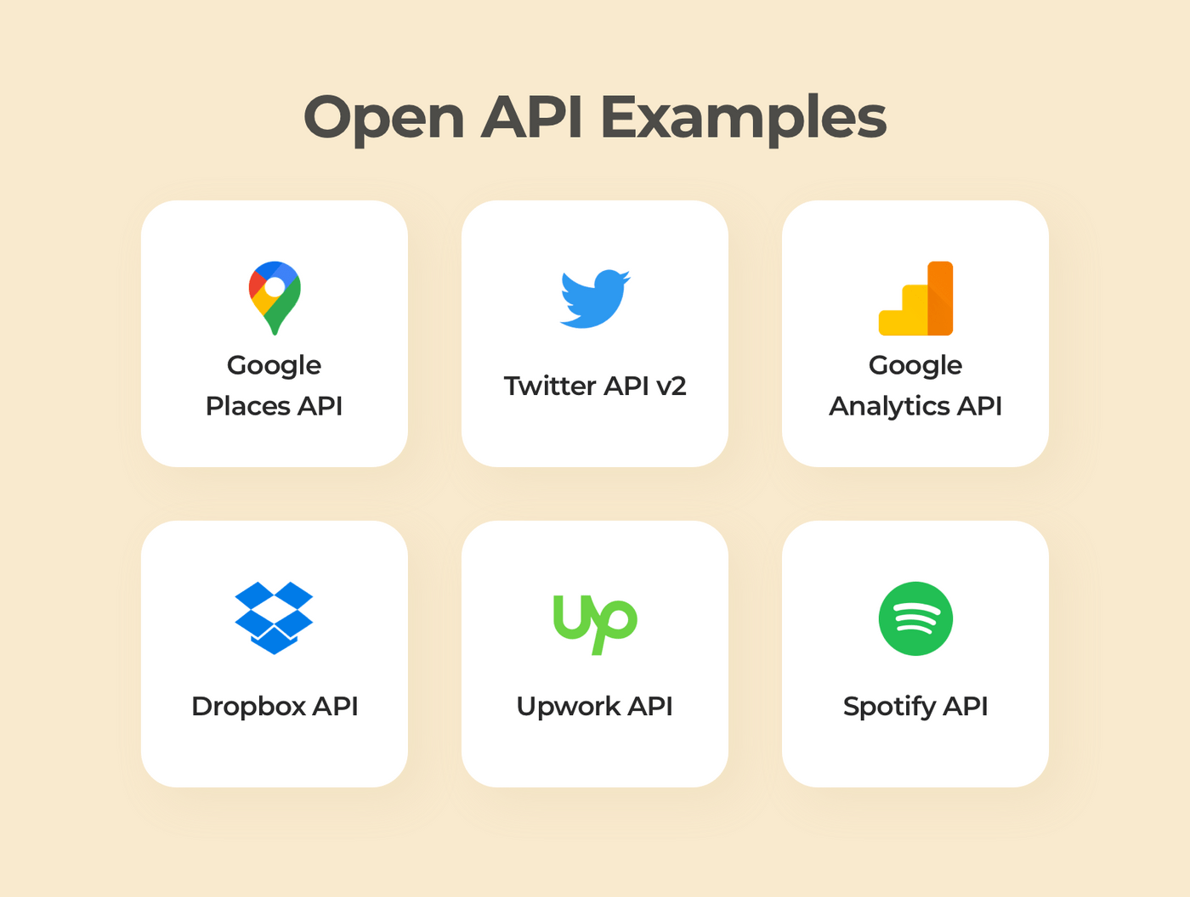
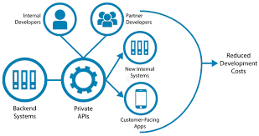
Open and Private APIs
An Open API is a public API i.e. it is publicly available to software developers. They can access these APIs and can enjoy the service anytime. For instance, the ability to create an account on an external site/app using your Google credentials is made possible using Google's open API.
A Private API is an interface that opens parts of an organization's backend data and application functionality for use by developers working within (or contractors working for) that organization. Private APIs are only exposed to internal developers therefore the API publishers have total control over what and how applications are developed.

Slide 8





Some Popular Apps that use APIs

Slide 9
Thank You
And
Have a great day !!
Japneet Singh
10th Red

