Slide 1
MTSE
By Rishi and Callum

Slide 2
Overview
Client
Client
Server
Client

Slide 3
Development Tools
GitHub
WinSCP
Notepad++
GNU Compiler (G++)

Slide 4
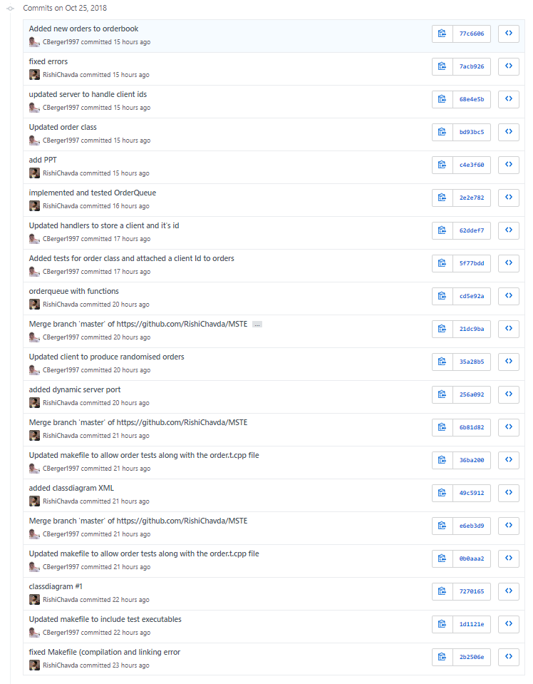
GitHub
Source/version control
Merging changes

Slide 5
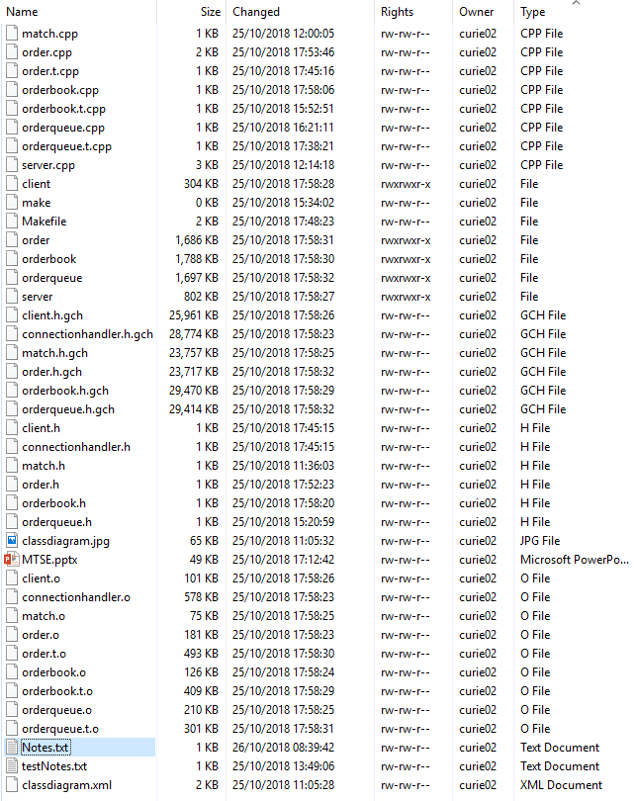
WinSCP
Connecting to Linux server
Uploading and downloading source files
Live editing of source files

Slide 6
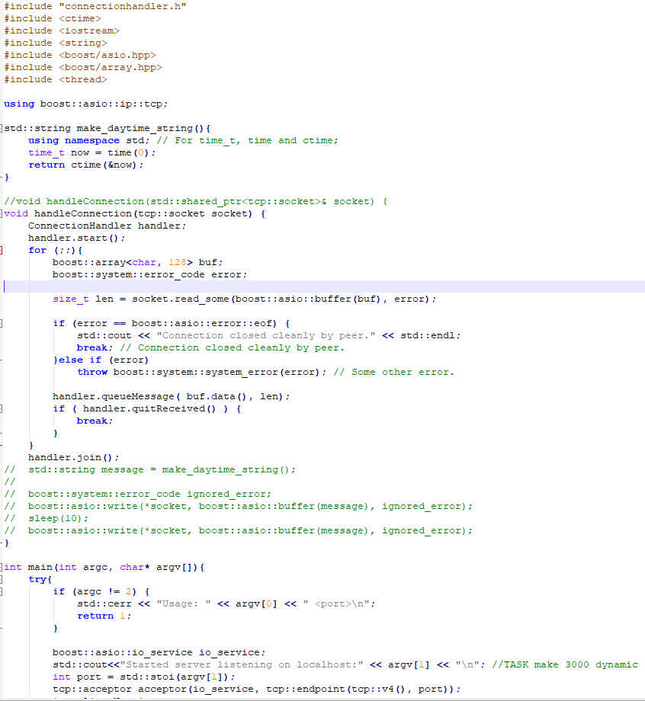
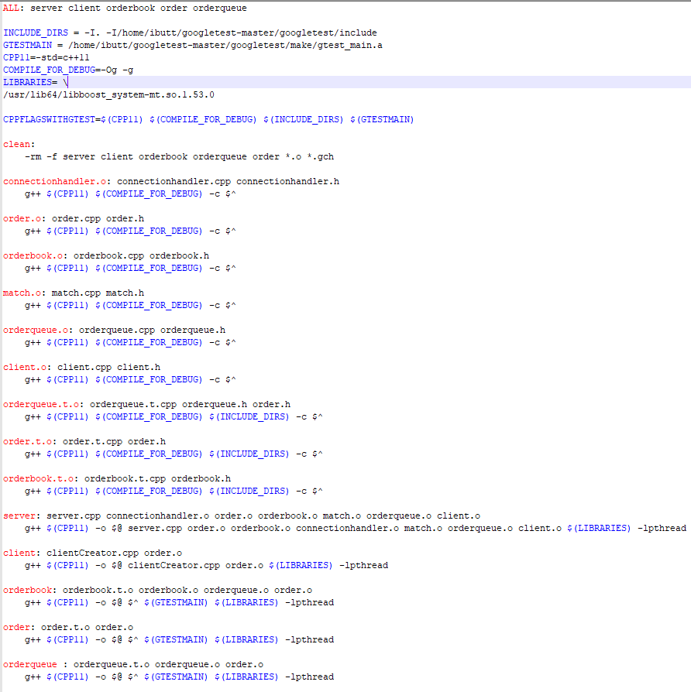
Notepad++
Editing program and makefile source code
Highlights syntax errors

Slide 7
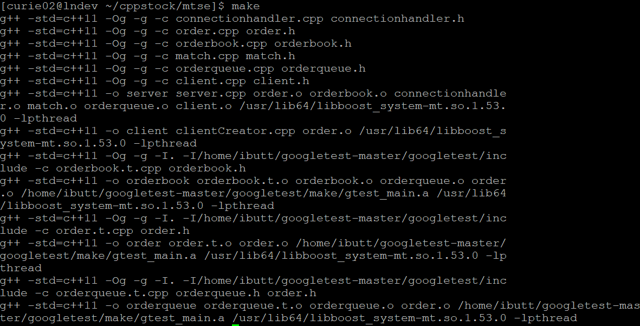
GNU Compiler (G++) and Makefile
Makefile used G++ to build the executables
Makefile was useful for clearing up previous builds’ object (.o) files and precompiled header (.gch) files

Slide 8
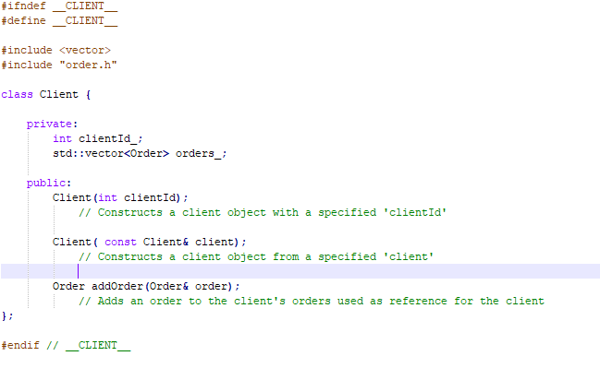
Refactoring and adding client class
Doubles to floats
Client class implementation

Slide 9
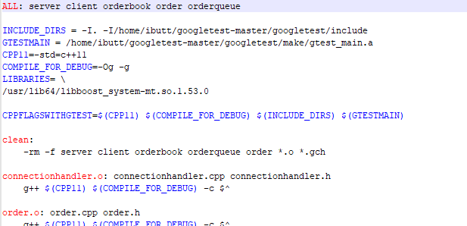
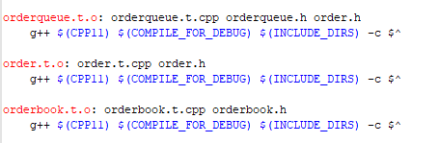
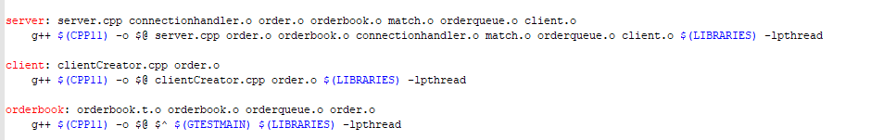
Repairing the Makefile

Slide 10
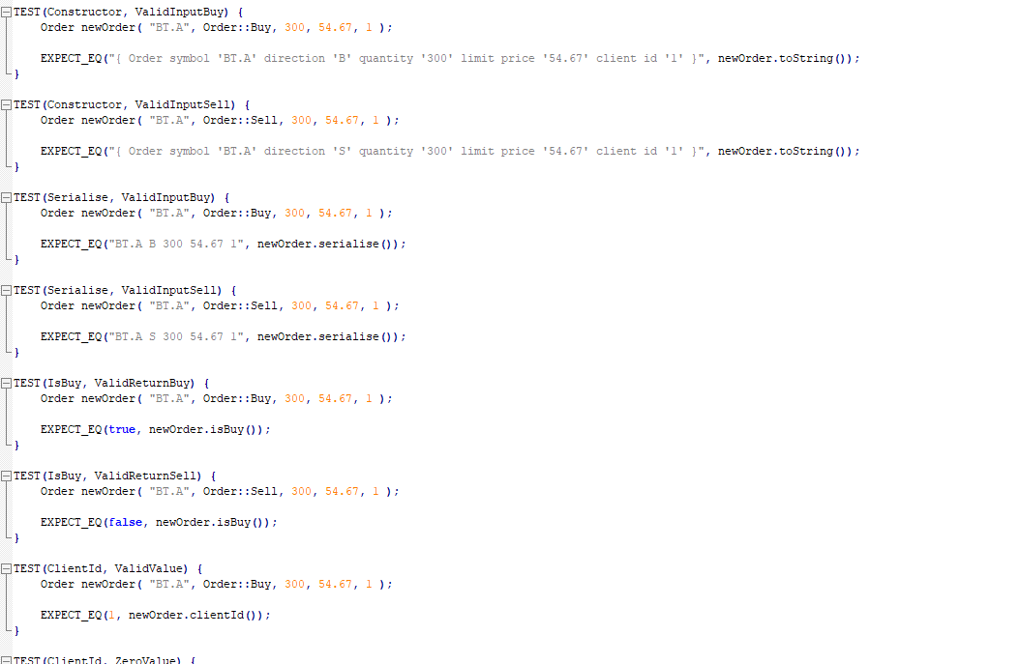
Unit Tested Order

Slide 11
Server-Client handling
New orders have a client id number
A client defines their id upon connection to the server
Client cannot attempt connection with an invalid id
Id number then connected to orders from that client

Slide 12
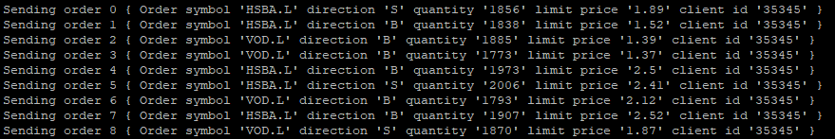
Order randomization
All values within the order are randomised except client id
Prices, volumes and instrument randomised within a range
Buy or sell randomised by 0 or 1 (true or false)

Slide 13
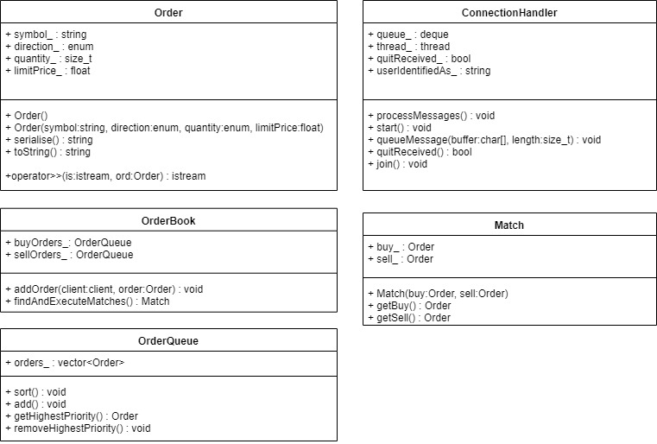
Class diagram

Slide 14
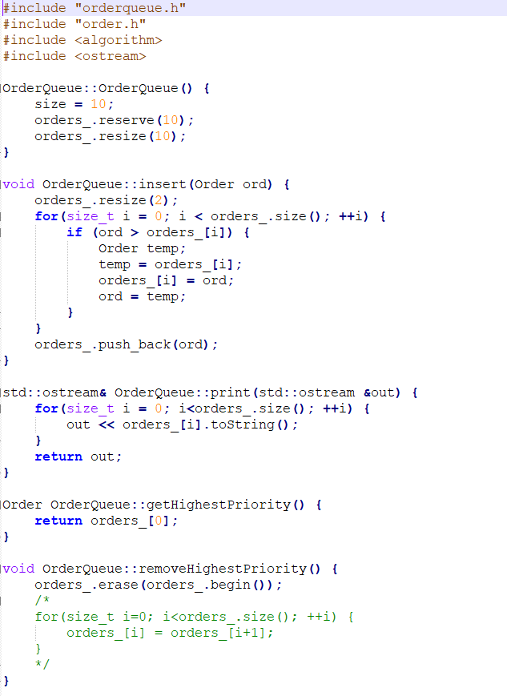
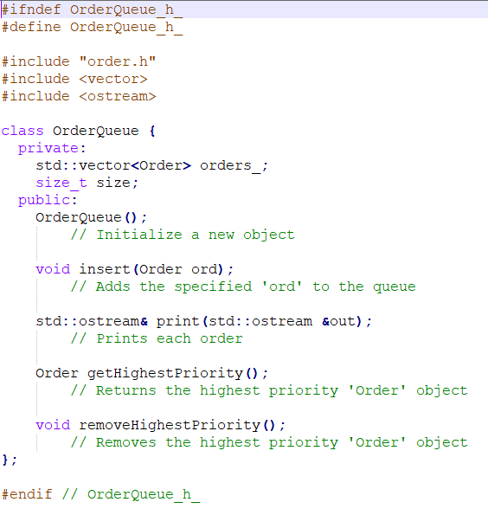
OrderQueue

Slide 15
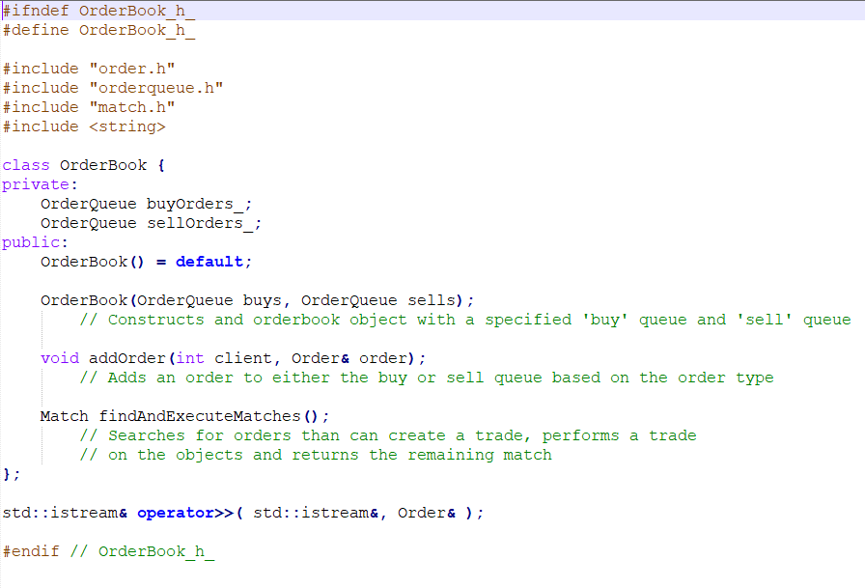
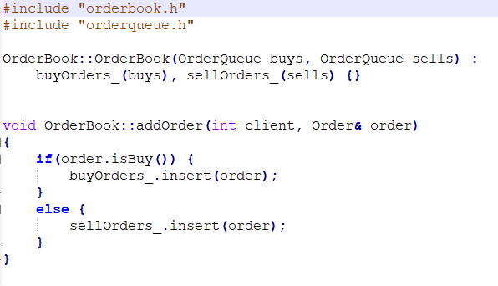
OrderBook

Slide 16
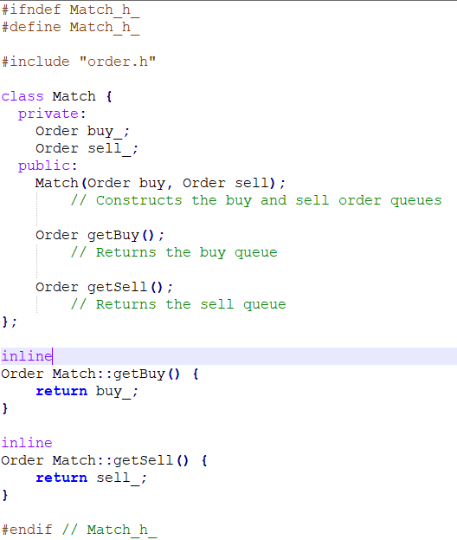
Match

Slide 17
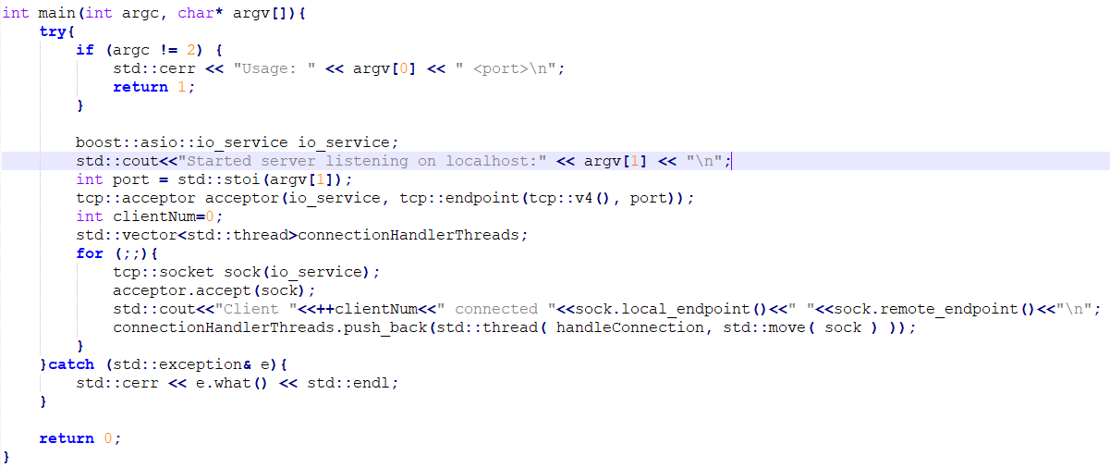
Dynamic server port

Slide 18
Demo
Client Server connection
Client sending orders
Orders randomised
Client Id with Orders
Disconnecting client shows within server
Incorrect client id

Slide 19
What Went Well
Unit Testing
Restructuring of classes
Additional functionality to classes
More dynamic client and server usage
More realistic orders

Slide 20
What To Improve Moving Forward
Matching Orders functionality
Better client server interaction
Add a GUI
Add logging of orders and matches/fills

Slide 21
Evaluation
Good teamwork and communication
Successfully implemented additional functionality and refactored existing code
Would focus on matches in the future

Slide 22
Questions

