Slide 1
MTSE
By Rishi and Callum

Slide 2
Overview
Client
Client
Server
Client

Slide 3
Development Tools
GitHub
WinSCP
Notepad++
GNU Compiler (G++)

Slide 4
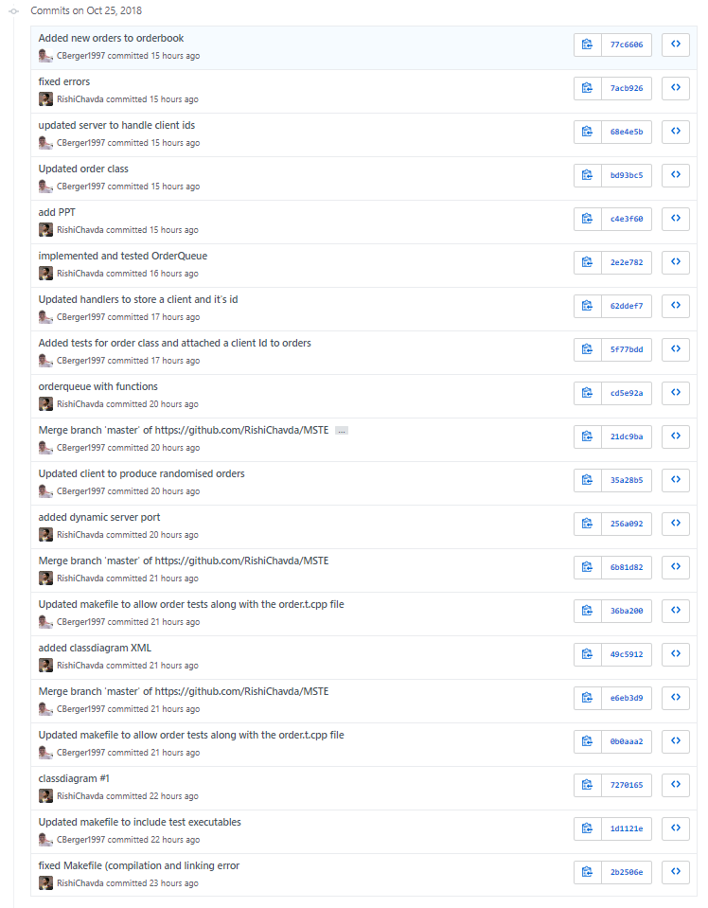
GitHub
Source/version control
Merging changes

Slide 5
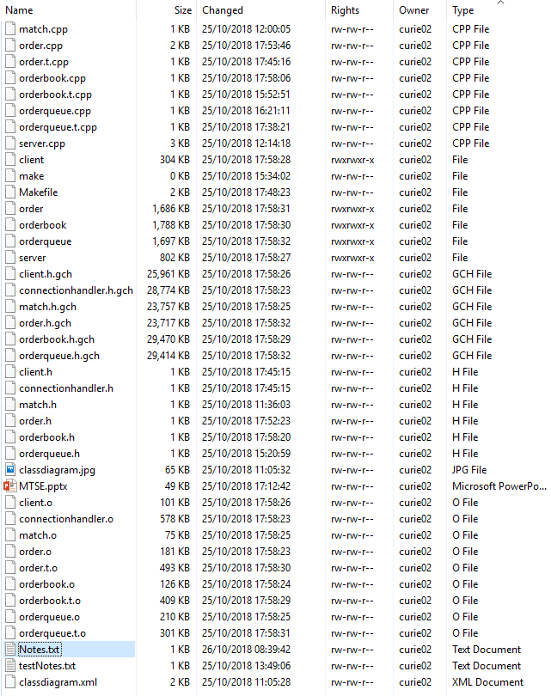
WinSCP
Connecting to Linux server
Uploading and downloading source files
Live editing of source files

Slide 6
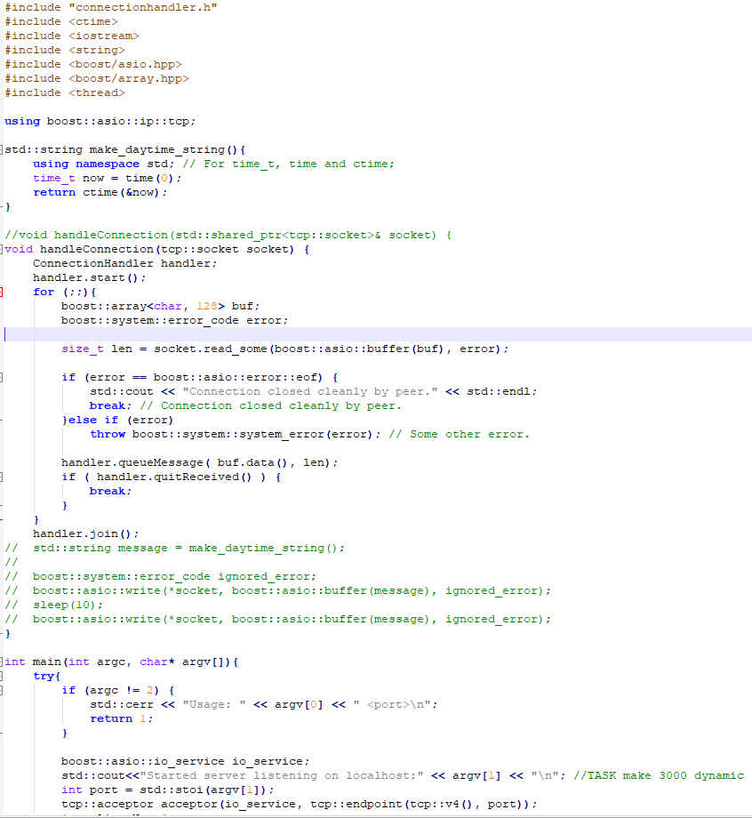
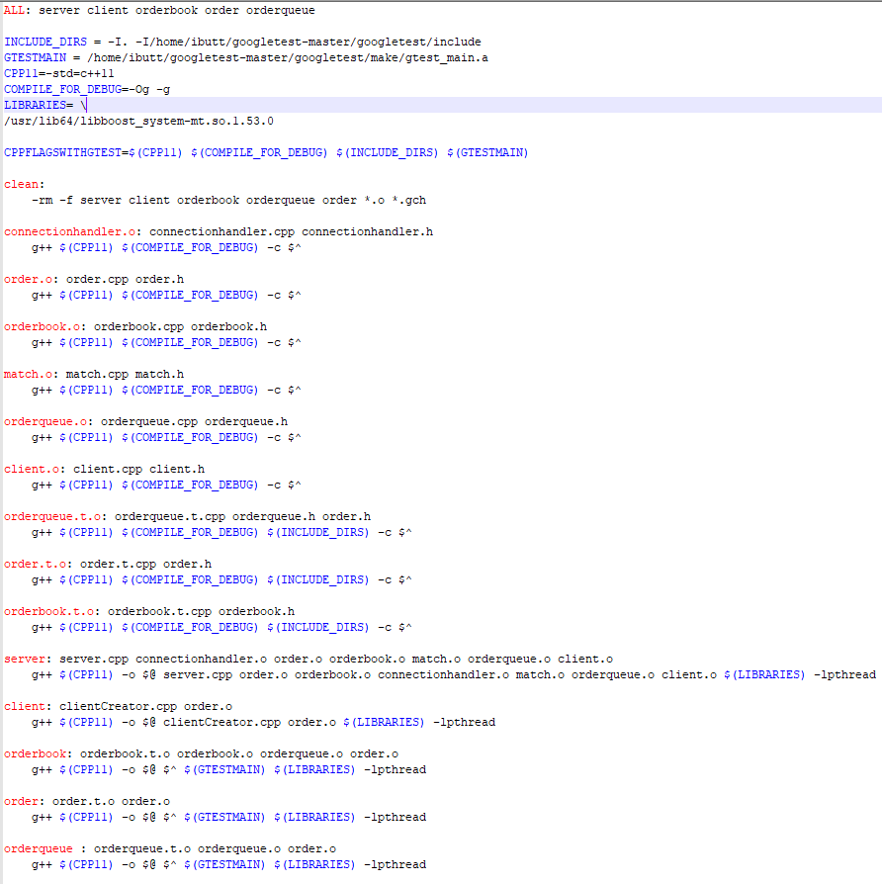
Notepad++
Editing program and makefile source code
Highlights syntax errors

Slide 7
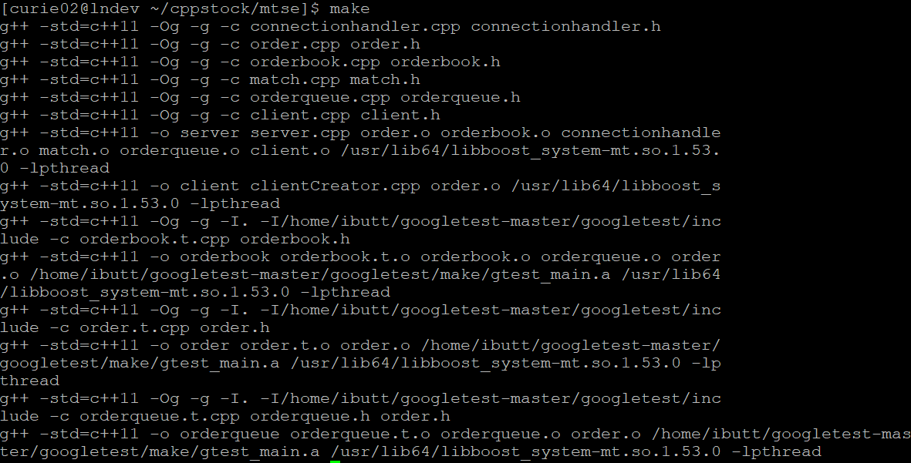
GNU Compiler (G++) and Makefile
Makefile used G++ to build the executables
Makefile was useful for clearing up previous builds’ object (.o) files and precompiled header (.gch) files

Slide 8
Repairing the Makefile

Slide 9
Tested Order

Slide 10
Server-Client handling
New orders have a client id number

Slide 11
Refactoring
Doubles to floats

Slide 12
Order randomization

Slide 13
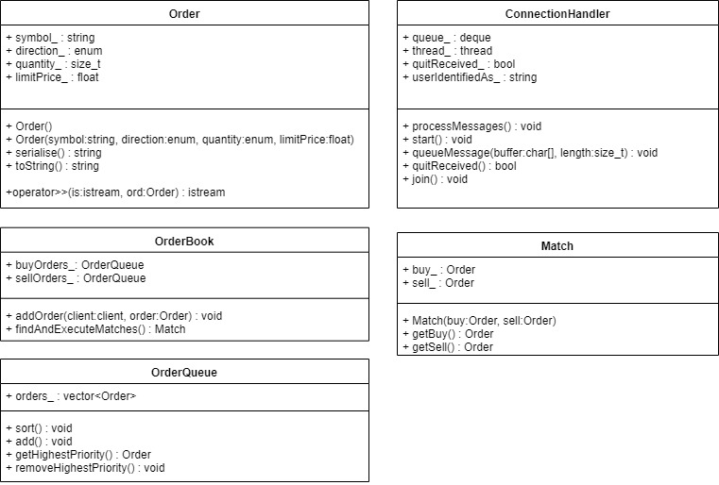
Class diagram

Slide 14
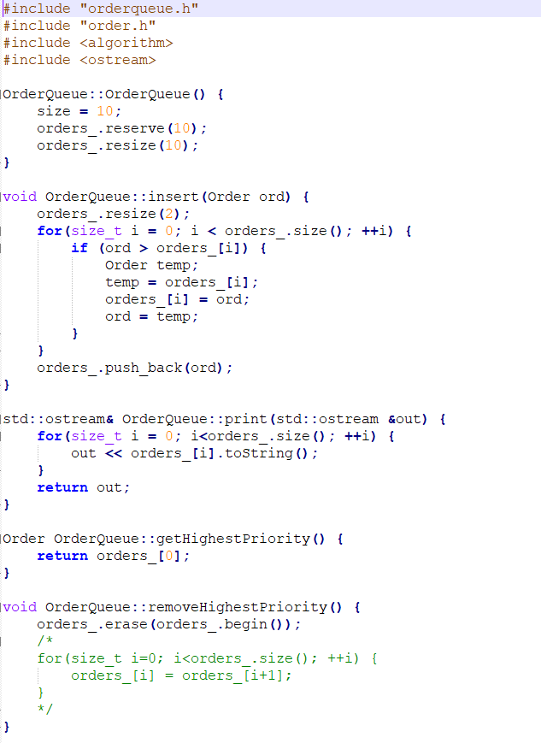
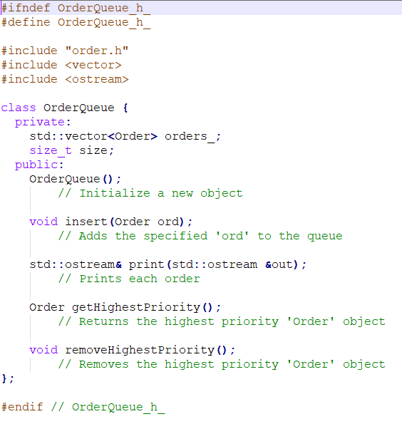
OrderQueue

Slide 15
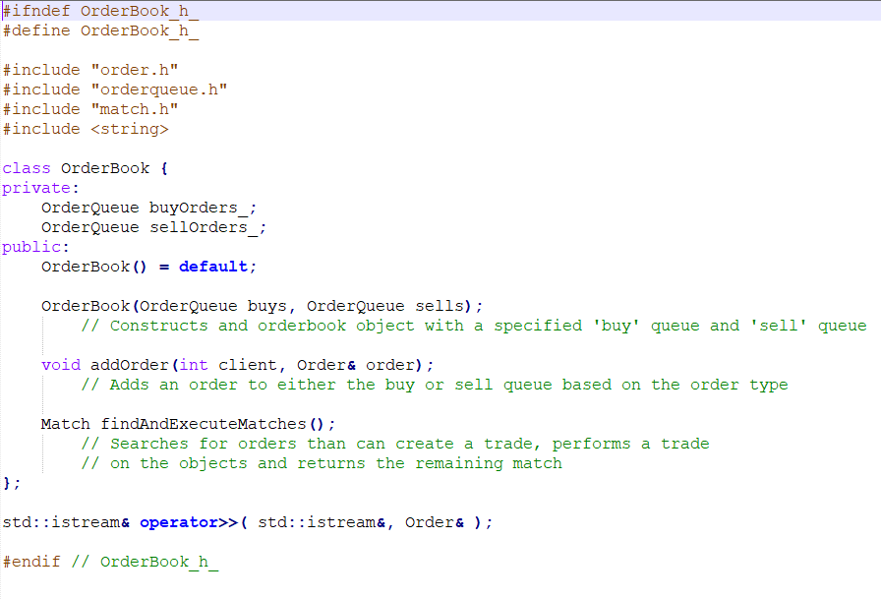
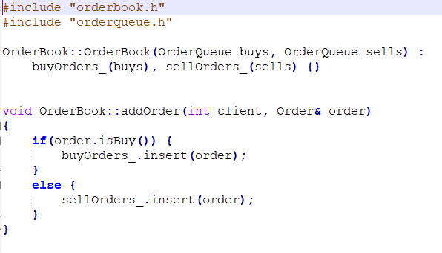
OrderBook

Slide 16
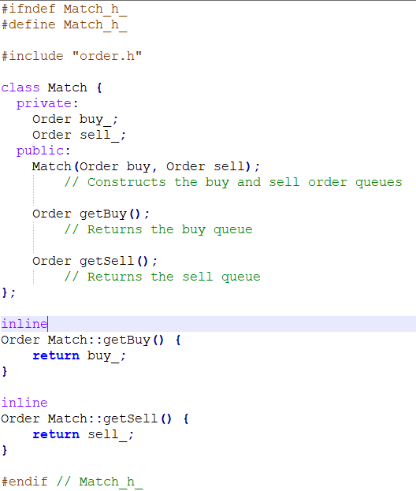
Match

Slide 17
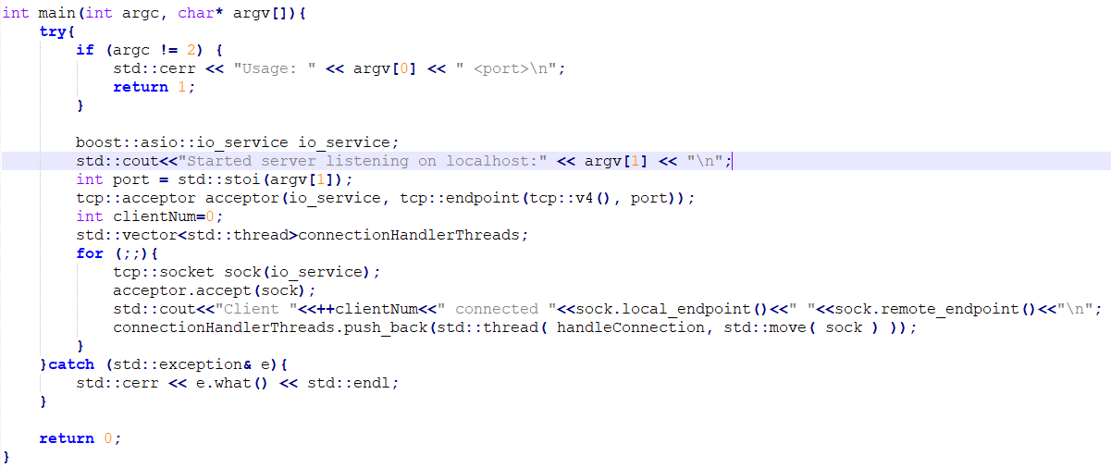
Dynamic server port

