Slide 1

PERCEPTIONS OF POVERTY
Rishi Dey Chowdhury
*Free use for Educational Purpose only. Please cite if you use this work.

Slide 2
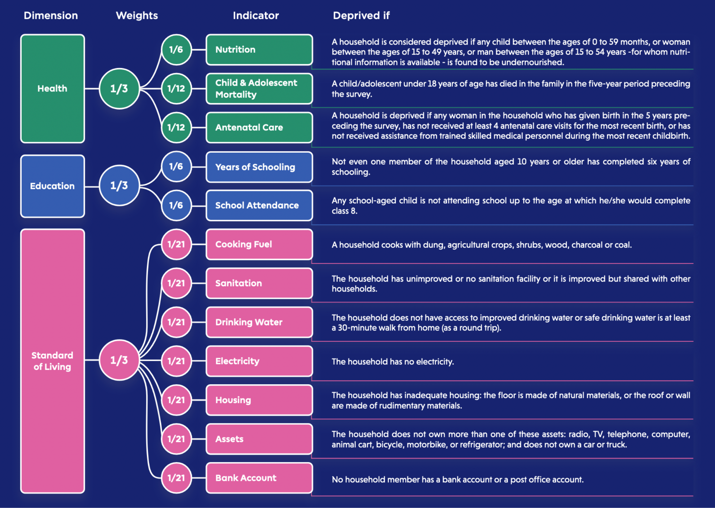
Multi-Dimensional Poverty Index
An weighted sum score calculated based on this chart is the Deprivation Score (DS) which translates to Poverty level of a person.
Here, we do not question the validity of MPI. But we want to improve on it to be apt for all class of people and across all regions across India.

Slide 3
The Problem
Regional Problems
Indian Context
Problem statement
Many of the indicators does not portray the true picture of poverty or deprivations faced by people living in a region.
Current weighting scheme doesn’t take into account this factor.
The MPI Indicators are taken directly from global MPI model. This makes it less accurate in Indian context.
Need to revisit the indicators and improve their quality.
The weighting scheme must be more robust and flexible: - Adaptable Weights - Weights ∝ Importance - MPI DS ∝ True Poverty - The Indicators truly capture what is intended

Slide 4
Challenges deep-dive
Challenge 1
Challenge 2
Challenge 3
Design Questionnaire
The questionnaire should ideally touch upon all the important aspects required to validate the weights and make them adjustable. Also the validity of the indicators.
Collect Data
We can help ease out this step of survey by following the sampling scheme of NSSO. We must collect as much bg info about a place in advance as possible and frame the qsns accord.
Inference and Benchmark
We will have to infer from whatever response we get from the survey. Translate it into meaningful decisions for policy makers and also validate our empirical results with past data.

Slide 5
CAP Framework
An effective framework which can be leveraged to design questionnaire and estimate weights for MPI
Contrastive Allocative Perturbative (CAP) Methodology

Slide 6
Design

Slide 7
The Questionnaire Structure
Collect as much background info about the place from secondary data, if possible, where survey will be conducted to calibrate the two extremes of the poverty scale and available facilities to frame targeted questions and reduce redundancy.
To identify the relative importance between two or more indicators, we design situations where the respondent have to decide who can be deemed poorer than the other
Contrast
Questionnaire
Allocation
To identify how much importance is assigned to each indicator, we design situations where the respondent has to allocate the income to different indicators under constrained scenarios
Collect information regarding socio-economic background of the respondent.
Perturb
To identify the optimum threshold of one indicator by finding the bare minimum requirement of this indicator such that a person is not deemed poor, we design such situations with different levels of this indicator

Slide 8
Sample Questions

Slide 9




Contrastive Comparison
Rank the following according to their level of poorness. The other indicators not mentioned remain the same across each person.
A
B
C
✅
✅
❌
❌
✅
✅
✅
❌
✅

Slide 10















Allocation Analysis
How will you allocate the income earned across the various indicators?
Health
💵
💵
Education
💵
Standard of Living
We may provide the average income of that region as the amount to be distributed among these classes

Slide 11


Perturbation Performance
Whom out of the following will you consider to be NOT poor? More than one person can be chosen.
A
B
C
C
Attended School Upto Class 8
Attended School Upto Class 10
Attended School Upto Class 12
Graduated

Slide 12
Sampling

Slide 13
Data Collection Strategy

Slide 14
Inference
CAP Estimate
Estimation of Weights

