Slide 1


STRESS/LOAD TESTING WITH PYTHON, PROMETHEUS & GRAFANA

Slide 2


01
02
03
04
05
VISUALIZATION BEFORE & AFTER CPU TEST
VISUALIZATION BEFORE & AFTER MEMORY TEST
VISUALIZATION BEFORE & AFTER DISK TEST
VISUALIZATION BEFORE & AFTER NETWORK TEST
VISUALIZATION BEFORE & AFTER MYSQL TEST

Slide 3
06
07
08
09
REDUCING TOIL
CONCEPT OF SIMPLICITY TO STREAMLINE APPLICATION
FUTURE SCOPE
INSIGHTS VIA WHATSAPP AND EMAIL

Slide 4

CPU LOAD TESTING VISUALIZATION

Slide 5
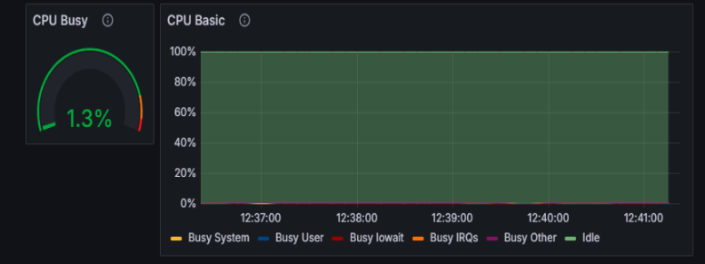
VISUALIZATION BEFORE CPU TEST

Slide 6
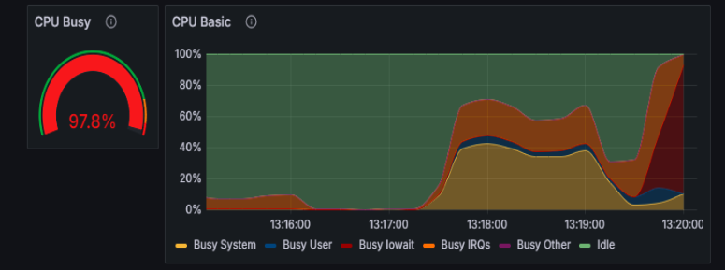
VISUALIZATION AFTER CPU TEST

Slide 7
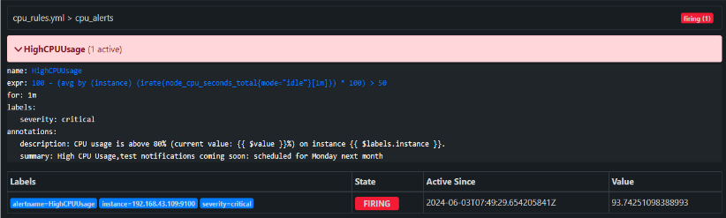
ALERT SUCCESSFULLY FIRED

Slide 8
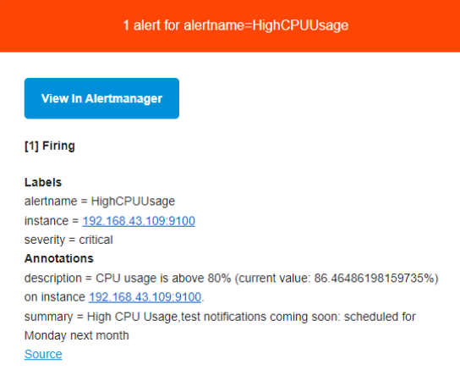
EMAIL ALERT

Slide 9
MEMORY LOAD TESTING VISUALIZATION

Slide 10
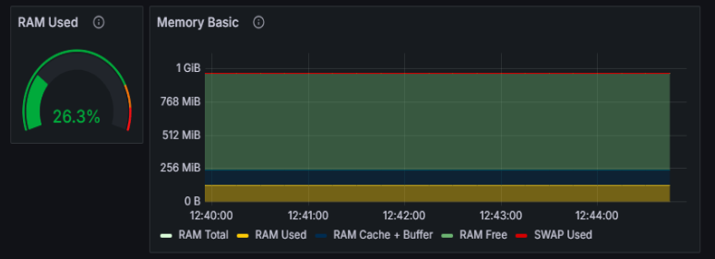
VISUALIZATION BEFORE MEMORY TEST

Slide 11
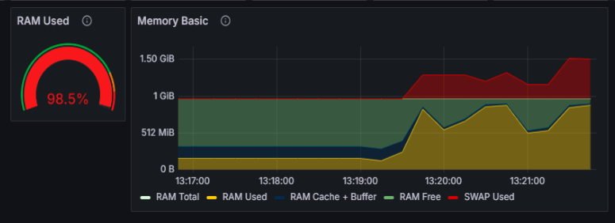
VISUALIZATION AFTER MEMORY TEST

Slide 12
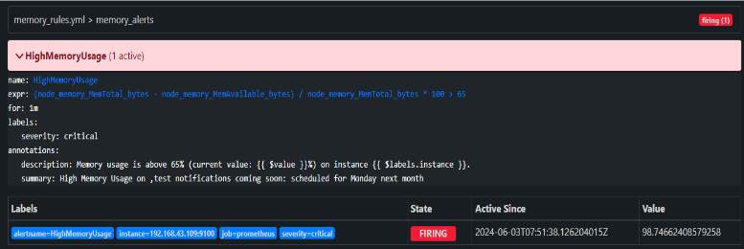
ALERT FIRED SUCCESSFULLY

Slide 13
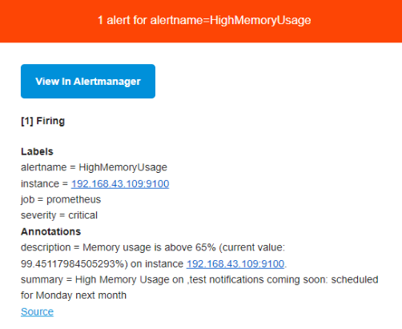
EMAIL ALERT

Slide 14
DISK LOAD TESTING VISUALIZATION

Slide 15
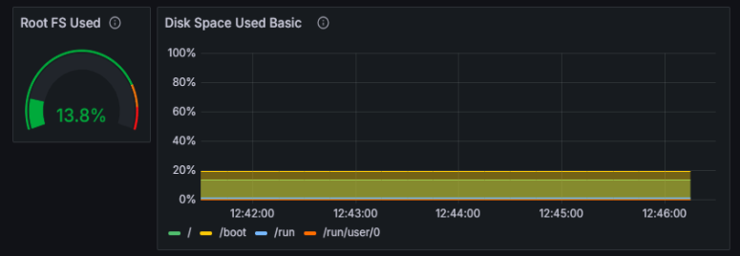
VISUALIZATION BEFORE DISK TEST

Slide 16
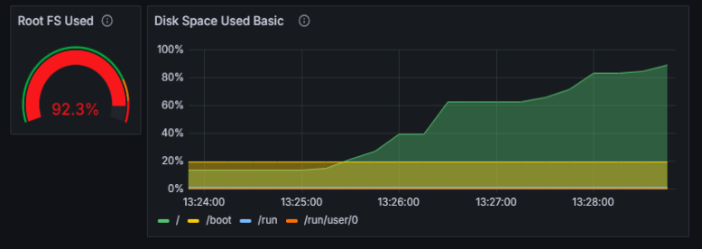
VISUALIZATION AFTER DISK TEST

Slide 17
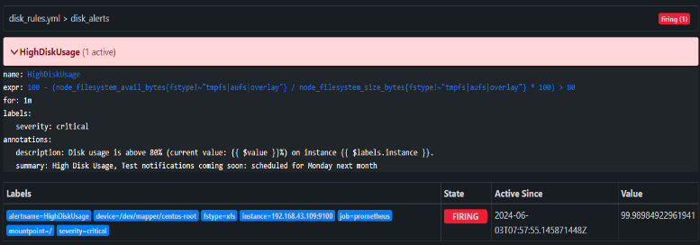
ALERT FIRED SUCCESSFULLY

Slide 18
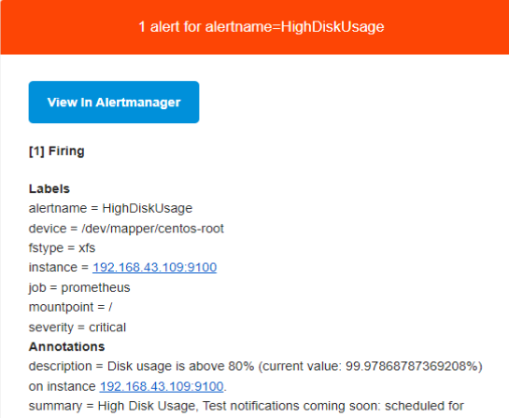
EMAIL ALERT

Slide 19
NETWORK LOAD TESTING VISUALIZATION

Slide 20
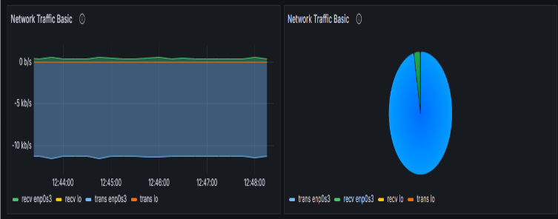
VISUALIZATION BEFORE NETWORK TEST

Slide 21
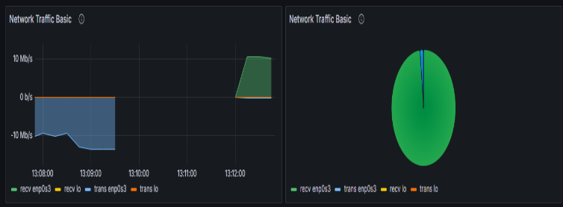
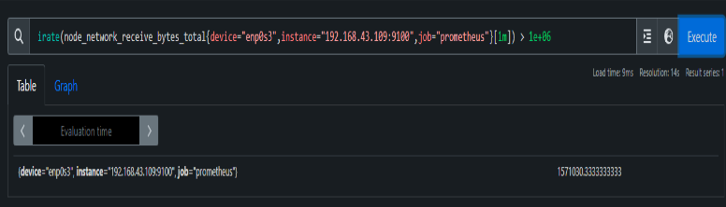
VISUALIZATION AFTER NETWORK TEST

Slide 22
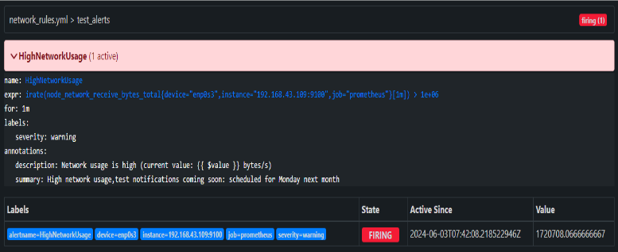
ALERT FIRED SUCCESSFULLY

Slide 23
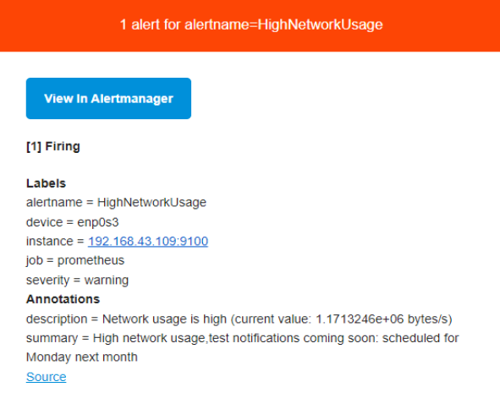
EMAIL ALERT

Slide 24
MYSQL LOAD TESTING VISUALIZATION

Slide 25
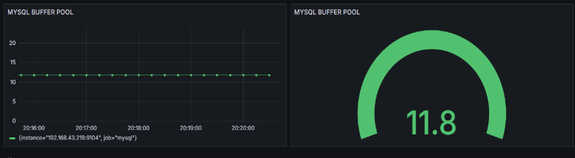
VISUALIZATION BEFORE MYSQL TEST

Slide 26
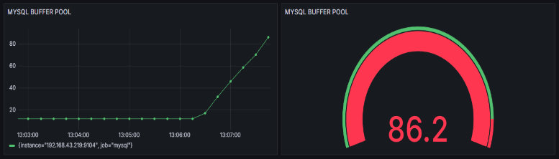
VISUALIZATION AFTER MYSQL TEST

Slide 27
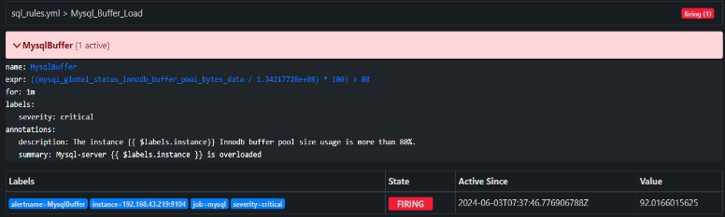
ALERT FIRED SUCCESSFULLY

Slide 28
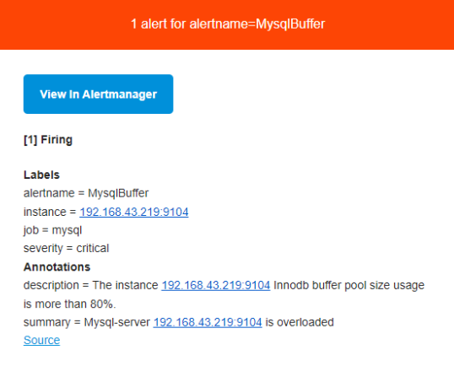
EMAIL ALERT

Slide 29

NEXT PHASE
Create a Flask API that triggers when a metric exceeds 80%. It sends Gemini API insights and suggestions to an SRE via email and WhatsApp.
Create a Python script to load CPU, memory, disk, network, and MySQL beyond 80%. Monitor with Prometheus, visualize in Grafana, and set up email alerts for threshold breaches.
Add a Python script to collect all metrics from Prometheus once any metric exceeds 80% usage and send them to the Gemini API for insights and suggestions.
PHASE 3
PHASE 1
PHASE 2

Slide 30





STRATEGIES
Utilize advanced prompting techniques to effectively extract comprehensive metrics and actionable insights from the Gemini AI.
Integrate Twilio to automatically send WhatsApp messages and email alerts to the SRE team, ensuring prompt communication when thresholds are breached.
Utilize Prometheus, Grafana, and a Flask API for real-time monitoring and triggered actions upon metrics exceeding 80% usage.
REAL-TIME MONITORING AND TRIGGERS
PROMPTING TECHNIQUES
AUTOMATED NOTIFICATIONS

Slide 31
REDUCING TOIL

Slide 32
MONITORING AND STRESS TESTING
Monitoring and Data Collection
Stress Testing
Tools Used: Prometheus
Metrics Monitored:
CPU usage
Memory usage
Disk usage
Network traffic
MySQL Stress
Key Steps:
Prometheus Queries: Regular intervals
Impact:
Real-time Monitoring: Continuous performance monitoring
First Python Script Functions:
CPU Load Tests
Memory Load Tests
Disk Read/Write Load Tests
Network traffic Tests
MySQL Stress Tests

Slide 33
INSIGHTS GENERATION AND AUTOMATION OF NOTIFICATIONS
Tools Used:
Google Generative AI
Notification Methods:
Email and WhatsApp
Key Steps:
Metrics Collection: From Prometheus
Generative AI Insights: Analysis and recommendations
Notification System: Alerts sent to stakeholders
Impact:
Actionable Insights: Clear recommendations for improvement
Proactive Alerts: Immediate notifications for potential issues

Slide 34
QUANTIFIABLE IMPACTS
Improved Response Time:
Before: Delayed issue identification
After: Faster identification and resolution
Reduced Manual Monitoring:
Before: Manual checks required
After: Automated monitoring and alerting
Enhanced System Understanding:
Before: Limited performance understanding
After: Clear understanding from stress tests
Actionable Recommendations:
Before: Manual data analysis needed
After: Automated, immediate insights
Time Saved on Routine Tasks:
Before: Significant time spent on monitoring
After: Automation allowed focus on critical tasks

Slide 35
CONCEPT OF SIMPLICITY TO STREAMLINE APPLICATION

Slide 36
STREAMLINING THROUGH SIMPLICITY
UNIFIED LOGGING SYSTEM
Before: Separate logging mechanisms.
After: Unified logging with Python’s logging module.
Impact: Simplified troubleshooting and consistent log management.
CONFIGURATION MANAGEMENT
Before: Scattered hardcoded values.
After: Centralized configurable parameters.
Impact: Easier updates and increased flexibility.

Slide 37
ENHANCED MONITORING AND EFFICIENCY
Automated Notification System
Before: Manual or complex, bespoke scripts for notifications.
After: Integrated automated notifications via WhatsApp and email.
Impact: Timely alerts reduce manual checks and Improved response times and coordination.
USER-FRIENDLY INTERFACE FOR LOAD TESTS
Before: Manually invoking scripts with various parameters.
After: Menu-driven interface for selecting and running tests.
Impact: Easier for team members with varying skill levels and Standardized test execution reduces user error.

Slide 38
CENTRALIZATION AND CLARITY
Efficient Use of Threading
Before: Complex multi-threading.
After: Simplified with Python’s ThreadPoolExecutor.
Impact: Reduced complexity and improved performance.
Clear Documentation and Comments
Before: Lack of documentation.
After: Added clear documentation and comments.
Impact: Easier knowledge transfer and maintenance.

Slide 39
FUTURE SCOPE

Slide 40
ADVANCED TESTING & SECURITY
Automate Stress Tests with CI/CD Integration:
Integrate stress tests into the CI/CD pipeline using tools like Jenkins or GitLab CI to automatically run performance tests on each build. This approach helps catch performance regressions early and ensures consistent performance monitoring.
Secure Communications:
Enhance security by using SSH keys and encrypting communications between components like Prometheus, Grafana, and MySQL. This protects data in transit and prevents breaches.

Slide 41
ADVANCED AI AND MACHINE LEARNING INTEGRATION
Predictive Analytics:
Leverage machine learning models to predict future performance trends based on historical data, aiding proactive capacity planning and early detection of performance issues.
Anomaly Detection:
Implement anomaly detection algorithms to identify unusual patterns in metrics data, improving the ability to detect and respond to issues before they impact the system.

Slide 42
SCRIPTING & DOCUMENTATION
Scripting Improvements:
Optimize existing scripts for better performance and maintainability, enhancing the efficiency of automated tasks and reducing error risks.
Automated Cleanup and Maintenance:
Implement automated scripts for routine cleanup and maintenance tasks, such as removing old log files and optimizing databases, to keep the system efficient
Detailed Documentation:
Develop comprehensive documentation for all components and processes, covering setup, usage, and troubleshooting to ensure new team members can quickly understand and work with the system.

Slide 43
INSIGHTS VIA WHATSAPP AND EMAIL

Slide 44
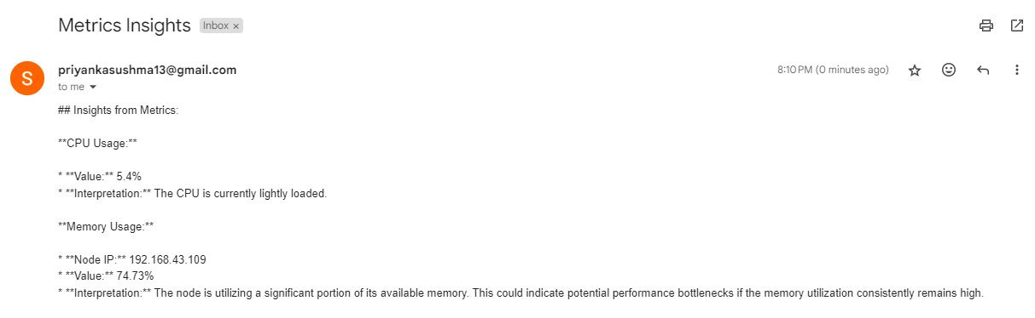
INSIGHTS & SUGGESTIONS IN EMAIL
Conti...

Slide 45
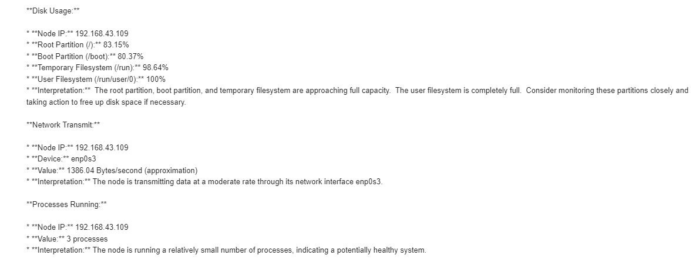
INSIGHTS & SUGGESTIONS IN EMAIL

Slide 46
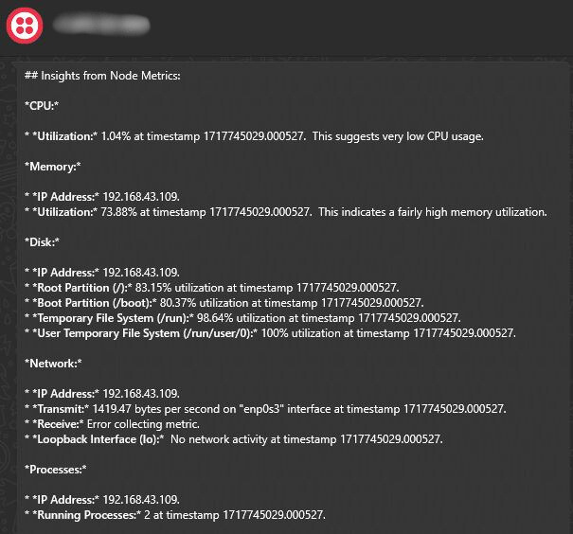
WHATSAPP

Slide 47
OUR TEAM
Vyshnavi Tallam
Rishi Devanpalli
Sushma Priyanka
Everest Cantu
Prasanna Kumar
Remy Marsh
Ceo Of Ingoude Company
Vaishnavi Uttarkar
Ceo Of Ingoude Company

Slide 48

THANK YOU

