Slide 1
ANALYTICS PLATFORM
Consumer360 Dashboard
Unified customer intelligence — revenue, retention, and segmentation in one view.

Slide 2
DASHBOARD
Dashboard Overview
$2.8M
15,847
Total Revenue
New Customers
68.4%
$179.60
Retention Rate
Avg Revenue Per User
Key Alerts
AI Risk segment up 6.5% — re-engagement recommended
Champions revenue up 15.2% — loyalty program performing
Churn segment increased 8.1% — win-back needed
2,188 customers inactive 90+ days

Slide 3
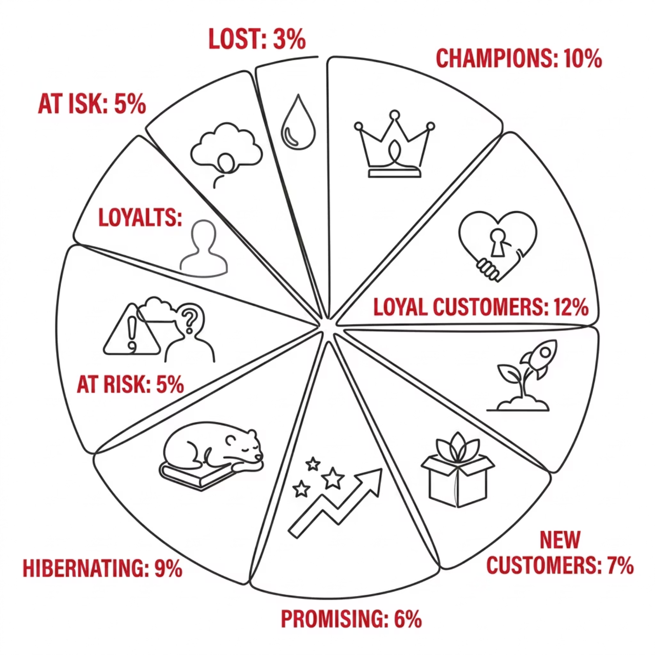

RFM ANALYSIS
RFM Segmentation
What is RFM?
Recency — How recently a customer purchased. Frequency — How often they buy. Monetary — Total spend. Each scored 1–5 to rank customers.

Slide 4
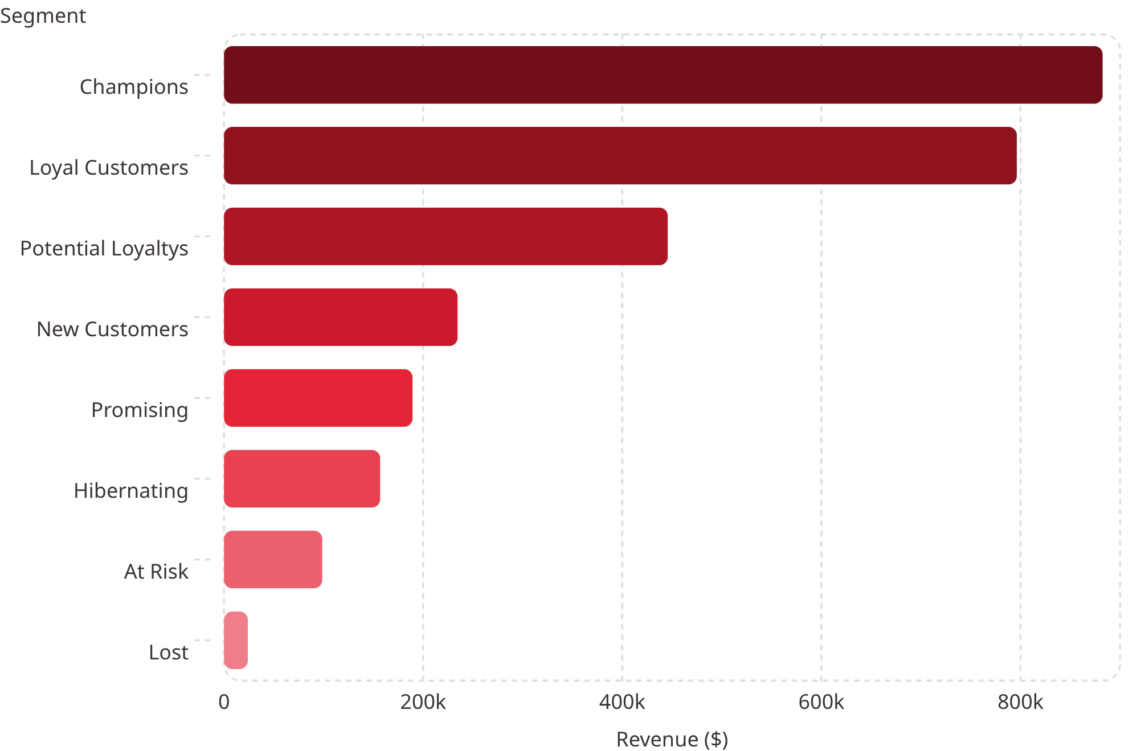
RFM ANALYSIS
Segment Performance
Segment Highlights
Champions — 2,847 customers, $882K revenue, 4.8 avg RFM
Loyal Customers — 3,156 customers, $796K revenue, 4.2 avg RFM
At Risk — 1,456 customers, $98K revenue, 1.8 avg RFM
Lost — 537 customers, $23K revenue, 1.2 avg RFM

Slide 5
CUSTOMER ANALYTICS
Customer Profiles
Profile Metrics
Sample Customer Data
15,847
Customer
Segment
RFM Score
Status
Total Customers
Nathan Anderson
New Customer
1.8
Active
9,234
Karen Thompson
Loyal
1.2
Inactive
Active
Susanne Garcia
New Customer
3.1
Active
$179.80
Angela Robinson
Promising
2.8
Active
Avg Order Value
William White
Reactivating
1.1
Inactive
$1,247
Avg LTV

Slide 6
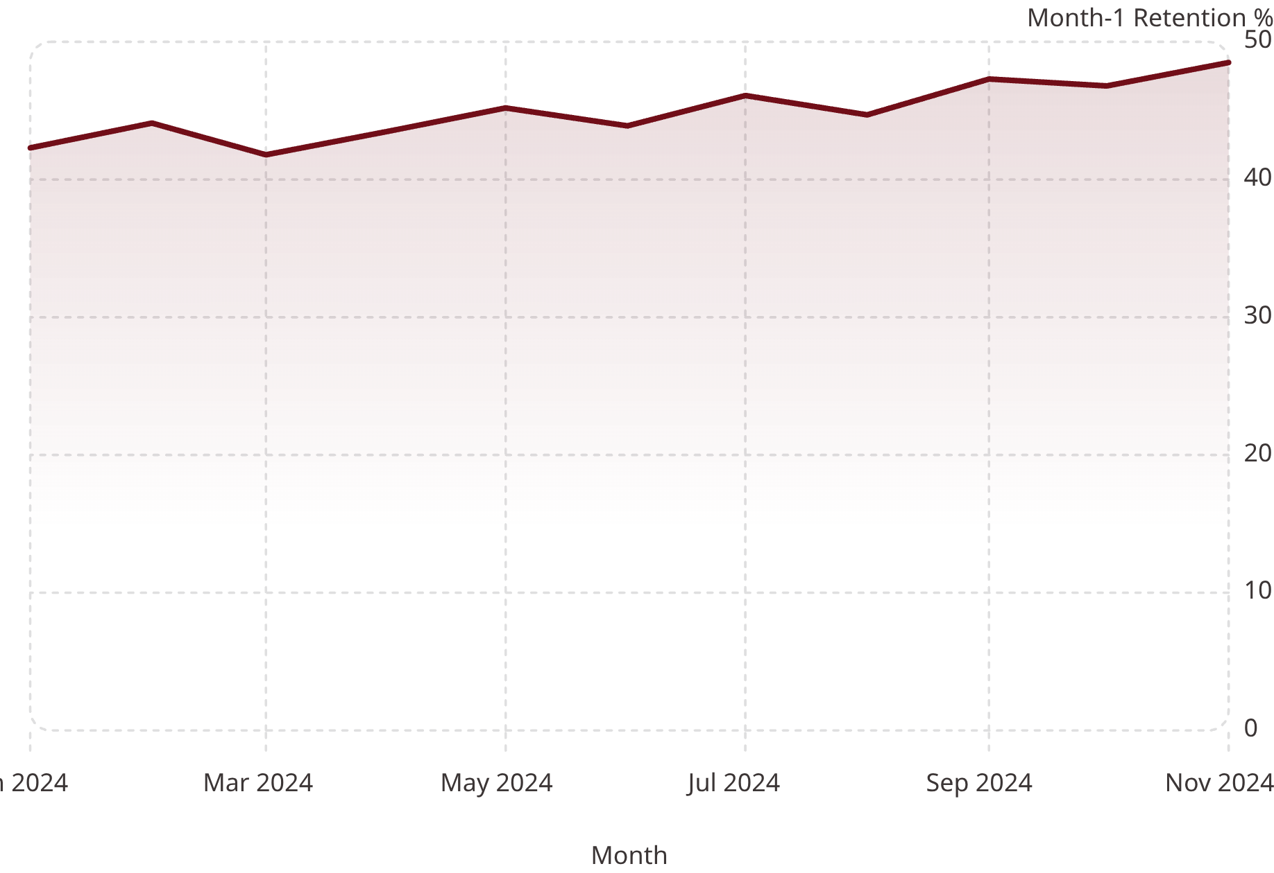
COHORT ANALYSIS
Retention Trends
Retention Benchmarks
42.3%
Avg Month-1 Retention
28.7%
Avg Month-3 Retention
18.2%
Avg Month-6 Retention

Slide 7
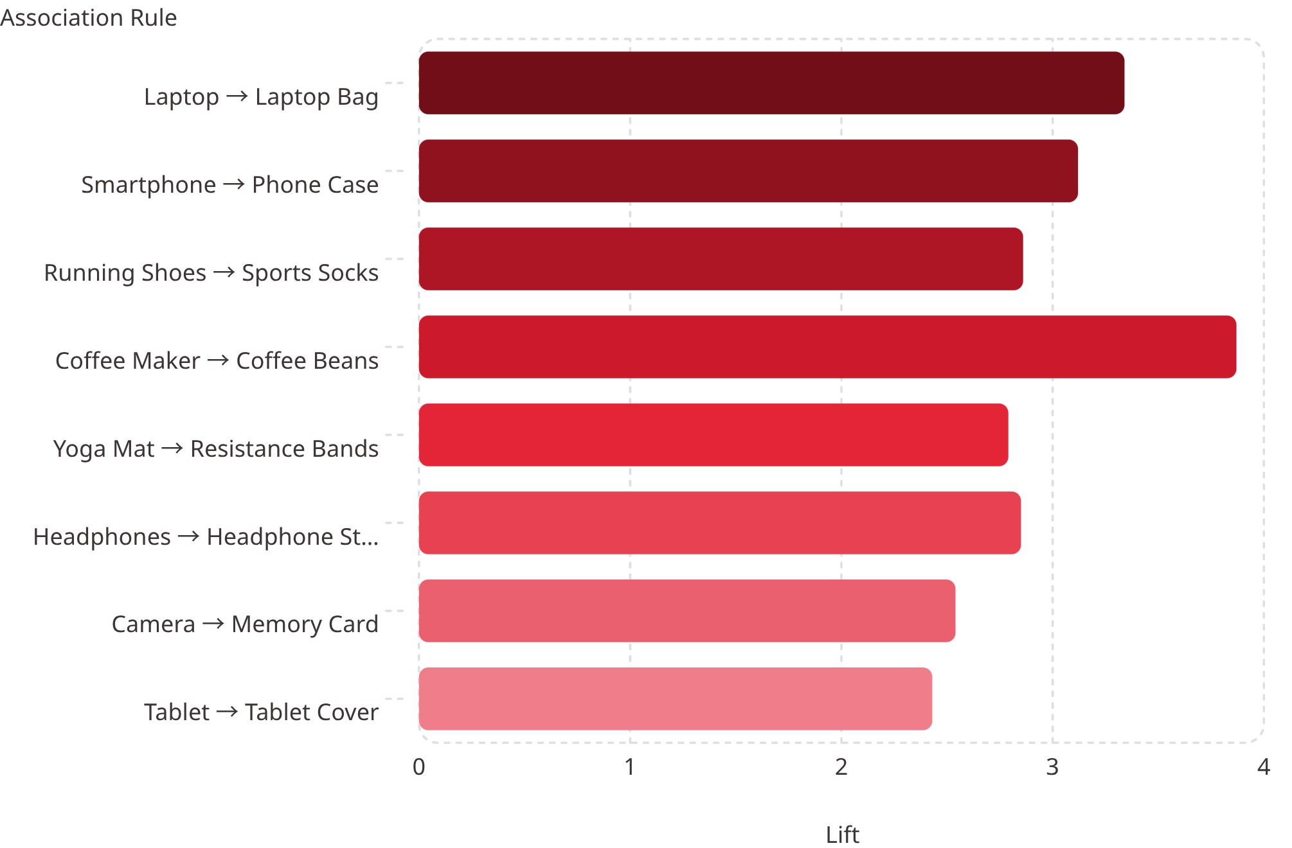
MARKET BASKET ANALYSIS
Product Association Rules
Key Insights
Coffee Maker → Coffee Beans has the highest lift at 3.87x
Smartphone → Phone Case leads in support at 19.8%
Camera → Memory Card leads in confidence at 88%

Slide 8
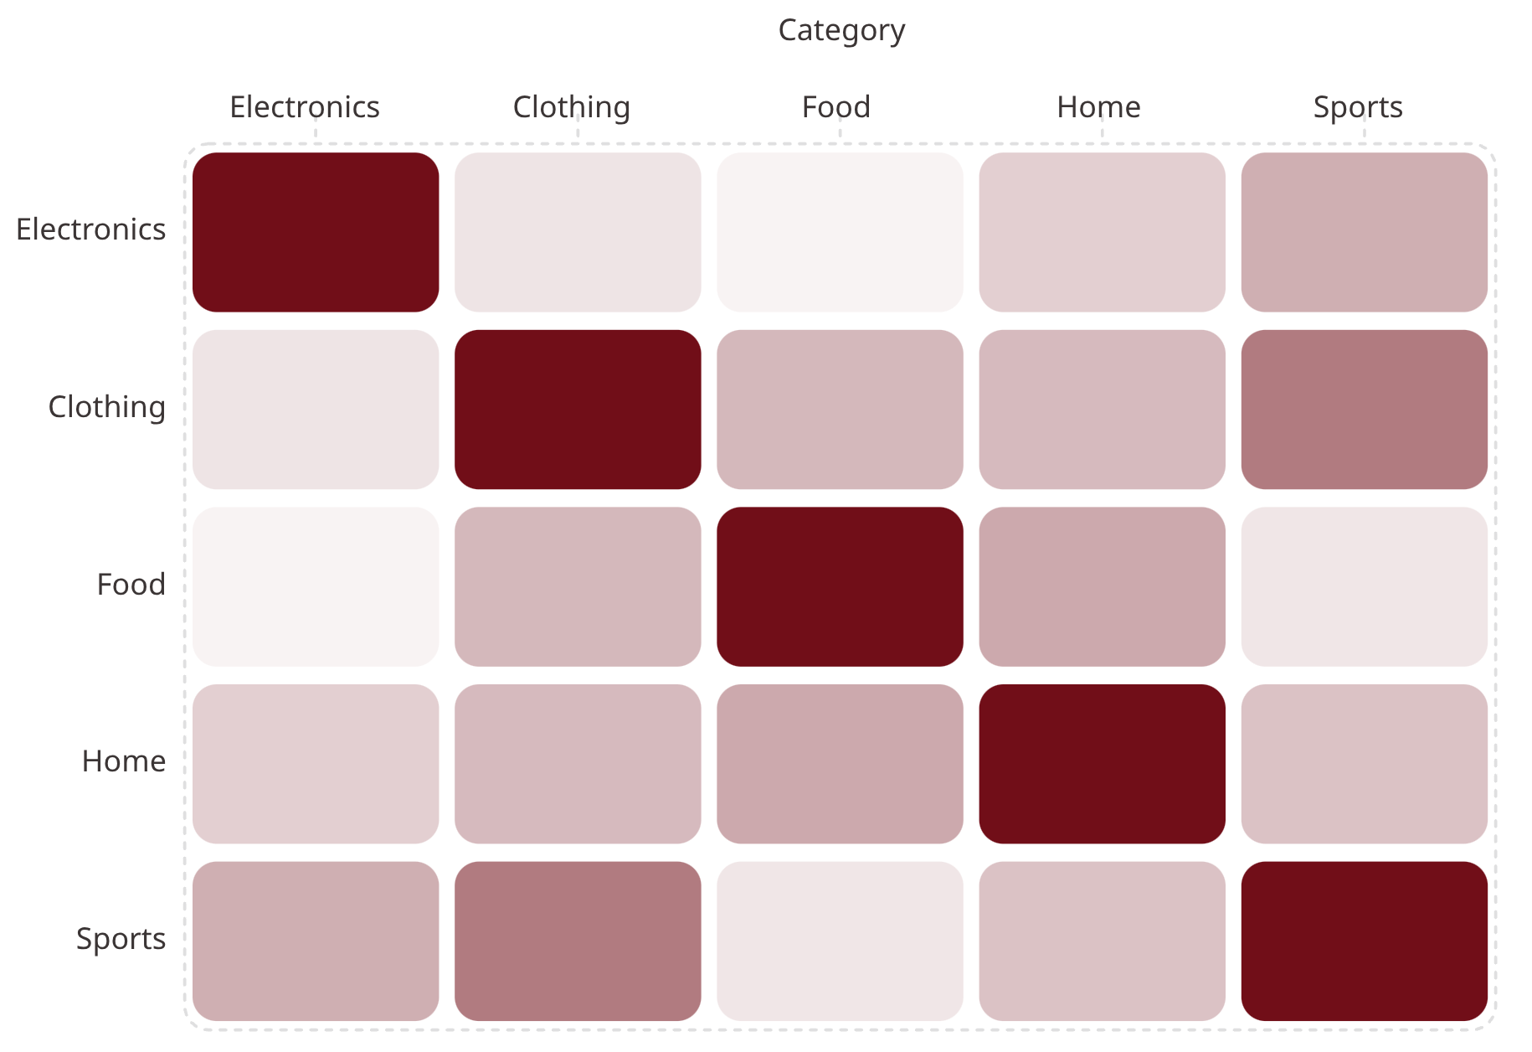

MARKET BASKET ANALYSIS
Category Affinity Matrix
What It Shows
Correlation strength between product categories — reveals which categories are frequently purchased together to guide bundling and cross-sell strategies.
Top Affinity: Clothing ↔ Sports (0.61) and Electronics ↔ Sports (0.42) show the strongest cross-category purchase patterns.

Slide 9
REPORTS
Reports & Exports
Active Reports
Scheduled Reports
Executive Summary
Report
Frequency
Status
1
Executive Summary
Weekly
Active
KPIs, revenue trends, customer metrics — Last: Dec 15
RFM Segmentation
Monthly
Active
RFM Segmentation
Revenue Analysis
Quarterly
Pending
2
All 8 segments with RFM scoring and actions — Last: Dec 15
Customer Retention
3
Cohort-based month-over-month return rates — Last: Dec 10
Revenue Analysis
4
Revenue by category, segment, product with YoY — Last: Dec 12
5
Market Basket
Association rates and cross-sell matrix — Last: Dec 11

Slide 10
SETTINGS
Platform Settings
Profile & Notifications
Display & Data
Email notifications, segment alerts, revenue alerts
Weekly digest and system update alerts
Recent: At Risk segment up 8.3%, Champions revenue up 15.2%
Dark mode, compact sidebar, animated charts
AI insights toggle
Auto-refresh every 30 minutes with cache

